Slide 1
Are Your Epochs Too Epic? Batch Free Can Be Harmful
Daewoo Kim, Trevor Brown and Ajay Singh
University of Waterloo

Slide 2
This work
Identifies a performance problem that affects safe memory reclamation (SMR) algorithms in highly concurrent environment
Figures out a subtle interaction between popular allocators and SMR algorithms that free large batches of objects at a time
Leverages this understanding to build a fast & simple SMR algorithm
More importantly, focuses on building a deep understanding of why existing algorithms degrade in performance

Slide 3
Epoch based reclamation (EBR)
One of the most widely used SMR algorithms
Easy to use and high performance
Divides an execution into epochs
If a thread wants to reclaim an object in epoch e
Instead of freeing right away, it places the object in a batch for epoch e
Entire batch is freed in a later epoch
Epoch e
Epoch e + n
Allocator
Batch e
Batch e
Free
…
…
Thread A

Slide 4
Experimental setup
Data structures
OCCtree^{[1]}
Binary search tree
Optimistic concurrency control
ABtree^{[2]}
Variant of B-tree
Lock free data structure
Store key-value pairs
[0, 2 * 10⁷) key range
Search, insert and delete
50% insert, 50% delete
Allocator & EBR algorithm
JEmalloc
DEBRA^{[2]}
System
4 socket Intel Xeon Platinum 8160
24 cores (48 logical processors) per socket
Thread counts 1-48 run on a single socket
Thread counts 49-192 run on multiple sockets
384GB DRAM
Nathan G Bronson, Jared Casper, Hassan Chafi, and Kunle Olukotun. A practical concurrent binary search tree. ACM Sigplan Notices, 45(5):257–268, 2010.
Trevor Brown. Techniques for Constructing Efficient Lock-free Data Structures. PhD thesis, University of Toronto, 2017.

Slide 5
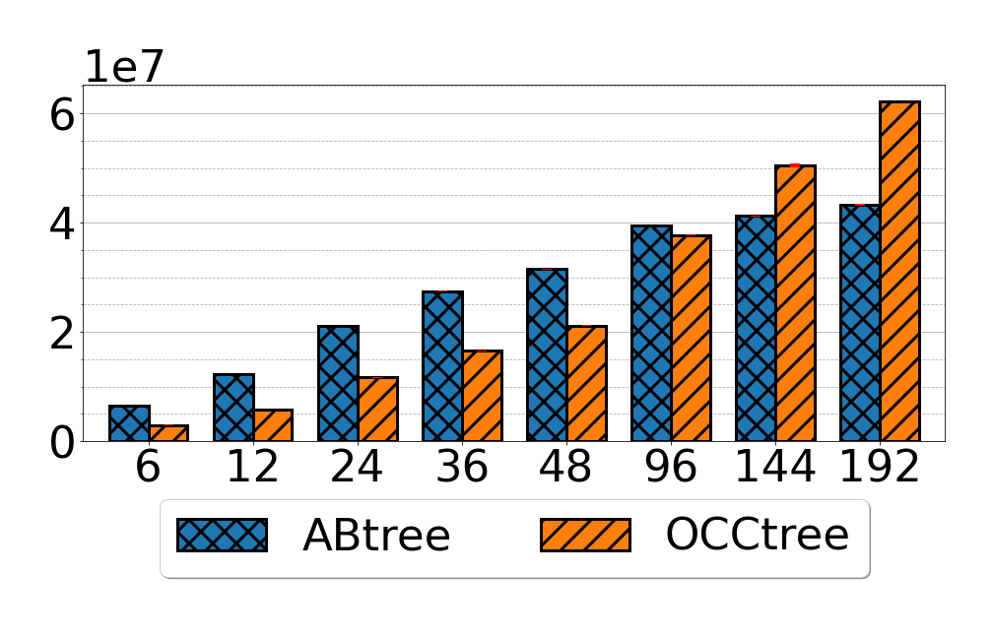
Symptom: poor scaling on NUMA
Performance (operations/sec)
Single socket (6,12,24,36,48 threads) : Both data structures perform and scale up well
Multiple sockets (96,144,190 threads): ABtree suffers scaling up while OCCtree continues to scale
better
Number of threads

Slide 6
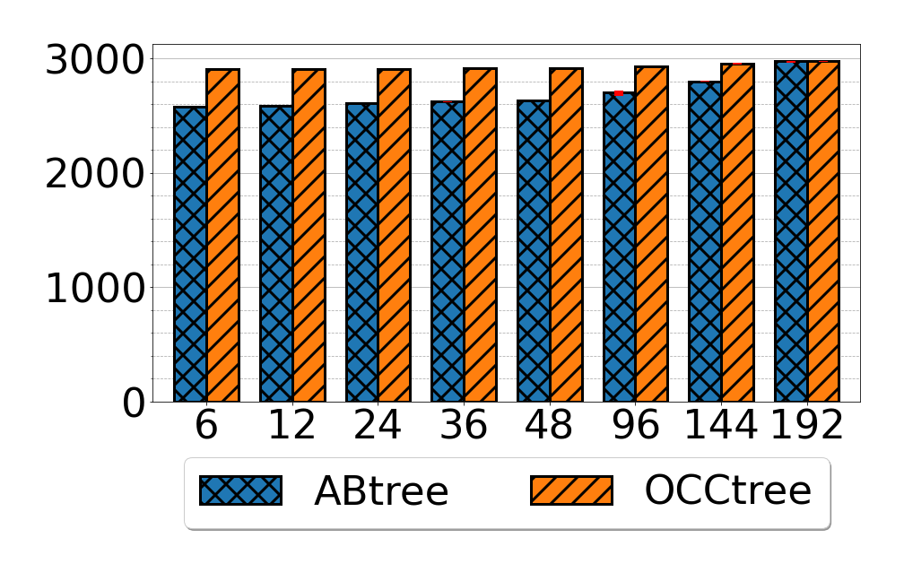
Symptom: poor scaling on NUMA
Peak memory usage (MiB)
ABtree allocates one or two large nodes (240 bytes each) per insert or delete
OCCtree only allocates one small node (64 bytes) per insert
Abtree expected to have substantially higher peak memory usage, but it does not
better
Number of threads

Slide 7
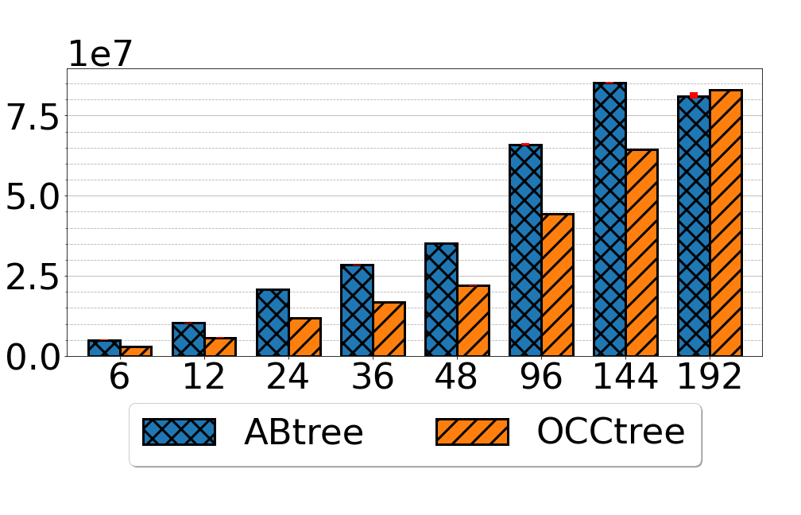
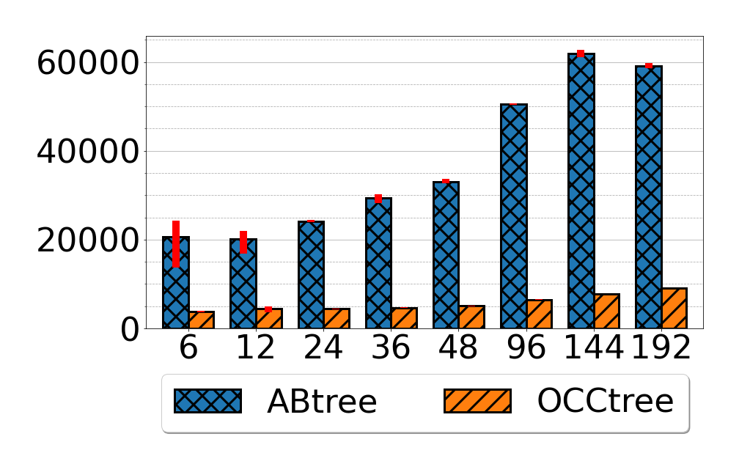
Hypothesis
(1) Compared to OCCtree, ABtree spends a larger fraction of the execution time allocating and reclaiming memory
(2) Limit other useful work in the data structure (traversing and/or modifying it)
(3) Low performance
Leaking memory (both DS)
Peak memory usage (MiB)
Performance (operations/sec)
better
better
Leaking memory closes the performance gap between Abtree and OCCtree
It is clear that Abtree allocates much more memory
Means that allocator and EBR algorithm must do much more work to maintain a small memory footprint

Slide 8
DEBRA vs leaky
DEBRA: Performance (operations/sec)
Leaky: Performance (operations/sec)
better
better
Low thread count (~48 threads): there is no difference
High thread count (96 threads ~): leaking memory significantly improves performance
There is contention related to thread count
Cost of managing memory is high at high thread count

Slide 9
Timeline graph
EBR algorithms are very sensitive to thread delays
A single delayed thread can prevent all threads from reclaiming garbage
Visualized behavior of threads, specifically the time spent freeing objects
Timeline graphs shows how much time threads spend freeing batches of nodes as epochs change
Y-axis = thread ID
Blue dot = epoch change
Each box = a reclamation event
Space between boxes = time spent accessing the data structure

Slide 10
Reclamation cost vs thread count
48 threads
96 threads
192 threads

Slide 11
Remote free
Freeing an object that the same thread allocated is usually cheap
Places the object in the thread local memory chunk (arena bin in JEmalloc)
Freeing an object that was allocated on a different thread is expensive
Involves taking locks, preventing other threads from freeing memory allocated on that thread
Arena bin - thread A
Arena bin - thread B
Arena bin - thread C
Thread A
cheap
expensive
expensive
free

Slide 12
JEmalloc
JEmalloc tries to avoid remote frees by placing objects in a local freelist
If a thread needs to allocate an object, it can reuse one from its local freelist, and no longer need to free it remotely
Arena bin - thread A
Arena bin - thread B
Arena bin - thread C
allocate
Freelist - thread A
Freelist - thread B
Freelist - thread C
Thread A
free
cheap
cheap
cheap

Slide 13
Root cause of long reclamation events
If thread local freelist is filled beyond a given threshold
Thread locks the remote bins and iterates over all objects in its freelist (while holding the lock)
It prevents other threads to free and causes long reclamation events
Threads | % this function
48 | 9.9
96 | 38.3
192 | 58.8
Arena bin - thread A
Arena bin - thread B
Arena bin - thread C
Freelist - thread A
Freelist - thread B
Freelist - thread C
Thread A
free

Slide 14
Simple solution: amortized free (AF)
When a batch is safe to free, instead of freeing it all at once, we push its objects into a thread local buffer
Free these objects one by one in subsequent data structure operations
Original DEBRA
DEBRA AF

Slide 15
Number of garbage nodes
Graph shows the number of garbage nodes over all threads in each epoch for batch free (upper) and amortized free (lower)
Amortized free have less spikes and smoother graph

Slide 16
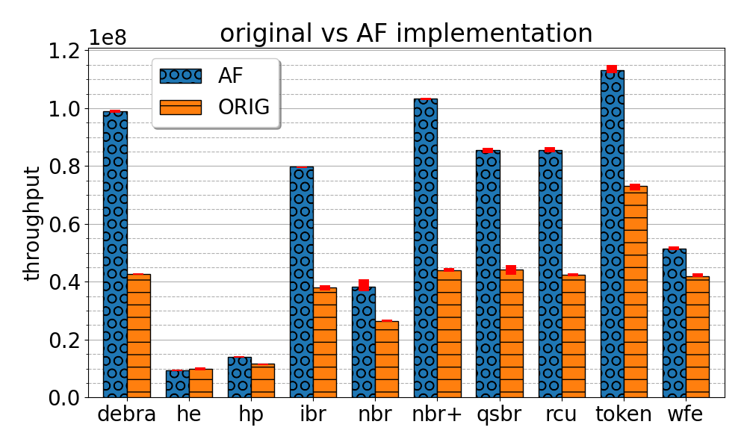
Evaluation
Applied amortized freeing technique to other SMR algorithms freeing batches of objects
Experiment on 192 threads for all algorithms
AF significantly improves many of these algorithms
better

Slide 17
Token-EBR
Investigated if extremely simple EBR algorithm, paired with amortized freeing, can match or exceed the performance of the state of the art
Revisited an old idea: token rings
Only a thread that has token can free
Please check our paper for detailed explanation and experiments

Slide 18
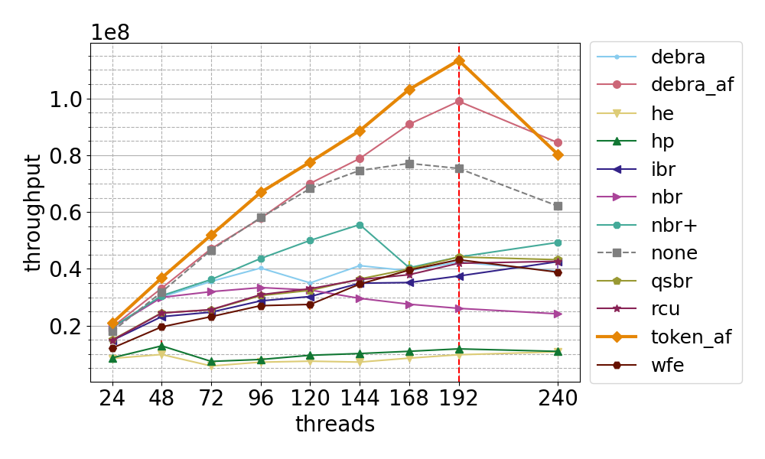
Evaluation
DEBRA_af and Token_af outperforms other state of the art reclamation algorithms
Scales up well until 192 threads
Performance degradation at 240 threads due to over subscription

Slide 19
Conclusion
Freeing large batches bypasses allocator’s optimization techniques
With 192 threads, amortized freeing doubles the performance of the six fastest existing reclamation algorithms
New token EBR outperforms the state of the art by up to 2.6x
MUCH more in the paper

