Slide 1
B-slack trees: Space efficient B-trees
Trevor Brown – University of Toronto

Slide 2
Problem
Design an embedded device that implements a dictionary
Element = key & value
Operations
Search
Insert
Delete
Notes:
[say this later, or not at all] Ideally, searches can run concurrently with updates

Slide 3
Goals:
Predictable running time for searches
Minimize amount of memory needed
Model:
Memory is allocated in blocks of one fixed size (e.g., 32 words)
In one cycle, can load and analyze a block
Pointers, keys and values each fit in one word

Slide 4
Naïve solutions
Sorted array
2n space (optimal)
search takes log₂ n loads
updates take ϴ(n) loads/stores
Hash table with linear probing
only expected running time
usually wastes 25-50% of space to avoid collisions
k₁
k₂
k₃
k₄
k₅
k₆
k₇
k₈
v₁
v₂
v₃
v₄
v₅
v₆
v₇
v₈

Slide 5
Naïve solutions
Balanced BST
searches take log₂ n loads
updates take ϴ(log₂ n) loads/stores
but 50% of space is used for pointers
d, v_{d}
b, v_{b}
f, v_{f}
a, v_{a}
c, v_{c}
e, v_{e}
g, v_{g}
Notes:
Reduce number of pointers per element by packing more elements in a node, which has higher degree: b pointers for b-1 keys

Slide 6
B-trees
All leaves have same depth, ϴ(log_{b} n)
Root is a leaf or has between 2 and b children
Every non-root leaf contains between b/2 and b keys
Every non-root internal node has between b/2 and b children
b = 8
i
q
y
-
-
-
-
a
b
c
e
f
g
h
j
k
l
m
n
o
p
r
s
t
u
v
w
x
z
A
B
C
D
F
-
Notes:
ϴ(log_{b} n) loads/stores per operation

Slide 7
B-trees
Worst case:
Root has degree 2
Other internal nodes have b/2 children
Each leaf contains b/2 keys
~50% of space is unused
b = 8
i
q
w
-
-
-
-
b
d
f
-
-
-
-
k
m
o
-
-
-
-
s
u
v
-
-
-
-
w
x
z
-
-
-
-
Notes:
b pointers for b-1 elements in full nodes, instead of 2 pointers for each element in BST

Slide 8
Leaf-oriented trees
All elements (keys & values) are stored in leaves
Internal nodes store pointers and routing keys, which direct searches to the correct leaf
Leaves store no pointers
Internal nodes store no values
Notes:
Routing keys are keys of current or old elements

Slide 9
Nodes in a leaf oriented B-tree
Leaf node
k_{i} is a key, v_{i} is its associated value
Internal node
p_{i} is a child pointer
k₁
k₂
k₃
k₄
k₅
k₆
k₇
k₈
b=8
16 words
v₁
v₂
v₃
v₄
v₅
v₆
v₇
v₈
k₁
k₂
k₃
k₄
k₅
k₆
k₇
b=8
16 words (1 wasted)
p₁
p₂
p₃
p₄
p₅
p₆
p₇
p₈
Notes:
Extra pointers in internal nodes are offset by eliminating pointers in leaves.
Only a small fraction of the nodes are internal : between 1/b and 2/(b-2) of the nodes are internal

Slide 10
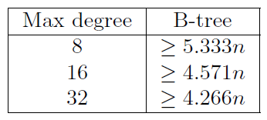
Analysis of space complexity
Number of words of memory needed to store a dictionary containing n elements
These results are from the analysis

Slide 11
Analysis of space complexity
Number of words of memory needed to store a dictionary containing n elements
These results are from the analysis
Root has degree 2
Every other internal node has degree b/2 Every leaf has b/2 keys

Slide 12
Space efficient B-tree variants
Paper discusses many variants
B*-trees, Generalized B*-trees, B+trees with partial expansions, strongly dense multiway trees, compact B-trees, overflow trees, H-trees
Big problems:

Slide 13
Space efficient B-tree variants
Paper discusses many variants
B*-trees, Generalized B*-trees, B+trees with partial expansions, strongly dense multiway trees, compact B-trees, overflow trees, H-trees
Big problems: no deletion

Slide 14
Space efficient B-tree variants
Paper discusses many variants
B*-trees, Generalized B*-trees, B+trees with partial expansions, strongly dense multiway trees, compact B-trees, overflow trees, H-trees
Big problems: no deletion, multiple node sizes
Notes:
We now describe Overflow trees, H-trees and the new B-slack tree

Slide 15
Overflow trees
Satisfies B-tree properties
The leaves under each parent are partitioned into one or more groups
Each group gets one overflow leaf that contains between 0 and b keys/pointers
Every non-overflow leaf contains at least b-3 keys
Family with poor space complexity:
Root has degree 2, every other internal node has degree b/2, and every leaf contains b-3 keys, with one empty overflow node per group of b/2 leaves

Slide 16
Overflow trees
Satisfies B-tree properties
The leaves under each parent are partitioned into one or more groups
Each group gets one overflow leaf that contains between 0 and b keys/pointers
Every non-overflow leaf contains at least b-3 keys
Family with poor space complexity:
Root has degree 2, every other internal node has degree b/2, and every leaf contains b-3 keys, with one empty overflow node per group of b/2 leaves

Slide 17
H-trees
Satisfies B-tree properties
Each leaf contains at least b-3 keys
Each internal node has 0 grandchildren or at least b²/2 grandchildren
Family with poor space complexity:
Root has degree 2, every non-root internal node has degree b/√2, and every leaf contains b-3 keys

Slide 18
H-trees
Satisfies B-tree properties
Each leaf contains at least b-3 keys
Each internal node has 0 grandchildren or at least b²/2 grandchildren
Family with poor space complexity:
Root has degree 2, every non-root internal node has degree b/√2, and every leaf contains b-3 keys

Slide 19
B-slack trees (where b > 4)
P1: All leaves have the same depth
P2: Internal nodes have between 2 and b children
P3: Leaves contain between 0 and b keys
P4: a constraint on slack

Slide 20
Slack in a node
Leaf node
Slack is the number of unused spaces for keys
Internal node
Slack is the number of unused pointers
k₁
k₂
k₃
5 slack
v₁
v₂
v₃
k₁
k₂
k₃
k₄
k₅
2 slack
p₁
p₂
p₃
p₄
p₅
p₆

Slide 21
B-slack trees (where b > 4)
P1: All leaves have the same depth
P2: Internal nodes have between 2 and b children
P3: Leaves contain between 0 and b keys
P4: For each internal node u, the total slack contained in the children of u is at most b – 1
P4 distinguishes B-slack trees from other B-tree variants
It limits aggregate space wasted by a number of nodes, instead limiting each node’s wasted space

Slide 22
Understanding P4
Example: b = 8, each node contains 4 slack
Children of the root contain a total of 16 slack
P4 says they can have at most b - 1 = 7 slack
i
q
w
b
d
f
g
k
m
o
p
s
t
u
v
w
x
y
z

Slide 23
Understanding P4
Example: b = 8, each node contains 4 slack
Children of the root contain a total of 16 slack
P4 says they can have at most b - 1 = 7 slack
So, this is not a B-slack tree
i
q
w
b
d
f
g
k
m
o
p
s
t
u
v
w
x
y
z

Slide 24
Understanding P4
Example: b = 8
Children of the root contain a total of 5 slack
P4 says they can have at most b - 1 = 7 slack
This is a B-slack tree
i
q
b
d
f
g
h
i
j
k
l
m
n
o
p
q
r
s
t
u
v

Slide 25
Understanding P4
Example: b = 8
Children of the root contain a total of 5 slack
P4 says they can have at most b - 1 = 7 slack
This is a B-slack tree
i
q
b
d
f
g
h
i
j
k
l
m
n
o
p
q
r
s
t
u
v

Slide 26
Understanding P4
Example: b = 8
Children of the root contain a total of 7 slack
P4 says they can have at most b - 1 = 7 slack
This is a B-slack tree
i
q
a
i
j
k
l
m
n
o
p
q
r
s
t
u
v
x
z

Slide 27
Understanding P4
Example: b = 8
Children of the root contain a total of 7 slack
P4 says they can have at most b - 1 = 7 slack
This is a B-slack tree
i
q
a
i
j
k
l
m
n
o
p
q
r
s
t
u
v
x
z

Slide 28
P4 implies large average degree
Example: b = 8, height = 2
What is the smallest possible number of pointers/keys at each level?
o
2 pointers per node
a
f
i
m
q
s
u
3.5 pointers per node
7 total slack (so 2*8-7 = 9 pointers)
6.4 keys per node
7 total slack (so 5*8-7 = 33 keys)
7 total slack (so 4*8 - 7 = 25 keys)

Slide 29
B-slack trees (where b > 4)
P1: All leaves have the same depth
P2: Internal nodes have between 2 and b children
P3: Leaves contain between 0 and b keys
P4: For each internal node u, the total slack contained in the children of u is at most b – 1
Family with worst case space complexity:
Root has degree 2, the total slack contained in the children of each internal node is exactly b - 1
Worse than possible: total slack contained in the children of each internal node is exactly b

Slide 30
B-slack trees (where b > 4)
P1: All leaves have the same depth
P2: Internal nodes have between 2 and b children
P3: Leaves contain between 0 and b keys
P4: For each internal node u, the total slack contained in the children of u is at most b – 1
Family with worst case space complexity:
Root has degree 2, the total slack contained in the children of each internal node is exactly b - 1
Worse than possible: total slack contained in the children of each internal node is exactly b
Notes:
GOAL: WANT TO BE ABLE TO DO SMALL UPDATES TO THE TREE AND SATISFY P1-P4.

Slide 31
Relaxed B-slack trees
Idea: decouple rebalancing from insertion/deletion
Insertion and deletion are simple
All updates make small, localized changes
Any relaxed B-slack tree can be transformed into a B-slack tree by rebalancing
Rebalancing can be deferred

Slide 32
Relaxed B-slack trees
Goal:
Insertion and deletion routines that maintain a relaxed B-slack tree
Rebalancing steps that can turn any relaxed B-slack tree into a B-slack tree
Obtaining a B-slack tree:
After inserting or deleting, perform rebalancing steps until no rebalancing step is applicable

Slide 33
Nodes in a relaxed B-slack tree
Each node is given a weight of 0 or 1
Serves a similar purpose to the colours red & black in a red-black tree
Relaxed depth is one less than the sum of weights on a root-to-leaf path

Slide 34
Properties of relaxed B-slack trees
P0': Every node with weight 0 has 2 children
P1': All leaves have the same relaxed depth
P2': Internal nodes have between 1 and b children
P3: Leaves contain between 0 and b keys
P4: For each internal node u, the total slack contained in the children of u is at most b – 1

Slide 35
Properties of relaxed B-slack trees
Three types of violations in a relaxed B-slack tree can be removed by rebalancing steps to produce a B-slack tree
A weight violation occurs at a node with weight zero (violating P1)
A degree violation occurs at an internal node that has only one child (violating P2)
A slack violation occurs at an internal node whose children contain a total of b or more slack (violating P4)
P1': All leaves have the same relaxed depth
P2': Internal nodes have between 1 and b children

Slide 36
Updates to relaxed B-slack trees
Insertion and deletion routines that preserve P0', P1', P2' and P3

Slide 37
Rebalancing: fix a weight violation
Root-Zero
Absorb
Split

Slide 38
Rebalancing: fix a degree violation
Root-Replace
One-Child
k ≥ 2 children with total slack s < b, and some child has ONE pointer
Evenly distribute the keys & pointers

Slide 39
Rebalancing: fix a slack violation
Compress
k ≥ 2 children with total slack s ≥ b
remove children until s < b and evenly distribute keys & pointers

Slide 40
Amortized complexity of rebalancing
Starting from a B-slack tree containing n keys, do i insertions and d deletions
The resulting relaxed B-slack tree will be transformed into a B-slack tree after at most rebalancing steps
O(log(n+i)) rebalancing steps per insertion
O(1/b) rebalancing steps per deletion

Slide 41
Space complexity
Number of words needed to store n > b³ elements is less than 2n b/(b-3)
Close to the optimal 2n
More complicated bounds are known; they are much better when b is small

Slide 42
Experiments
B-slack tree implemented in Java
Experiments performed random operations (50% insertion and 50% deletion) on keys drawn uniformly from a fixed range
Notes:
precise control over memory was impossible, so the implementation is somewhat inefficient

Slide 43
Experiments
Prefilling phase
Perform updates until the tree is approximately half full (i.e., contains approximately half of the keys in the key range)
Measurement phrase
Perform one million updates, and record:
Number of rebalancing steps performed
Number of nodes in the tree at the end
Number of keys in the dictionary at the end

Slide 44
Experiment 1: small tree
B-slack tree with b = 16
Key range [0,2¹²) = [0,4096)
Measurements:
0.6 rebalancing steps per update
Average degree of nodes was 15.4 (lower bound = 12.7, optimal = 16)
Space complexity 2.226n (upper bound = 2.727n, optimal = 2n)

Slide 45
Experiment 2: big tree
B-slack tree with b = 32
Key range [0,2²⁰) = [0,1048576)
Measurements:
1.1 rebalancing steps per update
Average degree of nodes was 31.5 (lower bound = 30.8, optimal = 32)
Space complexity 2.097n (upper bound = 2.144n, optimal = 2n)

Slide 46
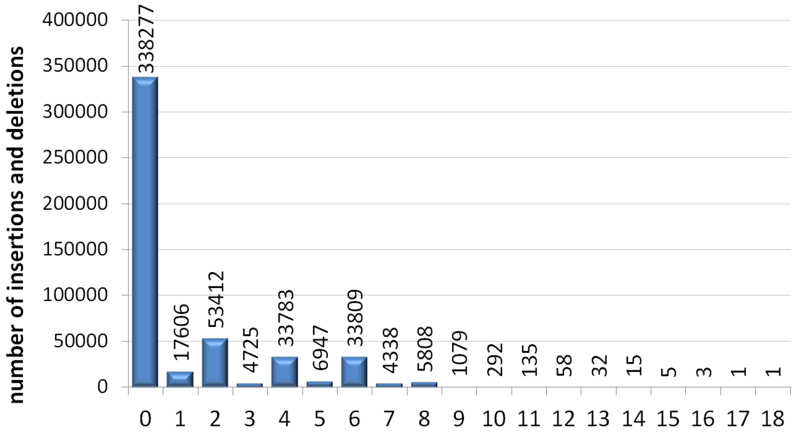
Rebalancing histogram
number of rebalancing steps per insertion or deletion

Slide 47
Other experiments
Performed experiments for
b = 8, 16, 32
key range sizes 2⁵, 2⁶, 2⁷, …, 2²⁰
workloads:
50% ins 50% del
90% ins 10% del
10% ins 90% del
Results
Average degrees always approximately b - 0.5
At most 1.2 rebalancing steps per update

Slide 48
Improving rebalancing complexity
Can greatly improve amortized complexity of rebalancing at a small space cost by changing P4: For each internal node u, the total slack contained in the children of u is at most b – 1 + degree(u)
O(1) amortized rebalancing complexity
B-slack tree containing n elements requires less than 2n b/(b-4) words

Slide 49
Conclusion
B-slack trees have
Excellent worst-case space complexity
Even better space complexity in practice
Amortized logarithmic insertion and deletion
Only one node size
Well suited for hardware implementation
Rebalancing can be improved to amortized constant per update with a small increase in space
Easy to obtain good concurrent implementation of relaxed B-slack tree

