Slide 1
Brief Announcement: Performance Anomalies in Concurrent Data Structure Microbenchmarks
Authors: Rosina Kharal, Trevor Brown

Slide 2
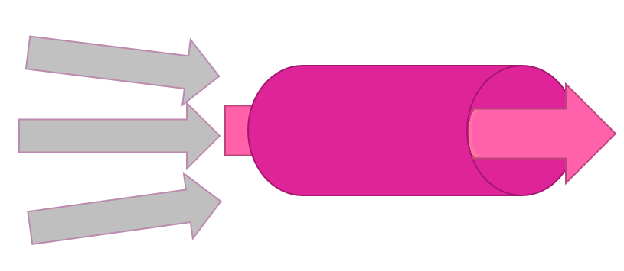
Overview:
(Our work) focuses on optimizing performance of concurrent data structures
Performance efficiency of concurrent data structures plays a pivotal role in modern day data access:
Fast update and retrieval of information
Allow multiple users/threads to access and update data in a parallel manner
Uninterrupted, smooth transitions while limiting delays and managing concurrency

Slide 3
Overview:
Benchmarks commonly used to evaluate the performance of concurrent data structures
Microbenchmarks: Assessing limited range of performance metrics across varying implementations of concurrent data structures.
We are primarily interested in throughput results for comparative analysis
How many operations (update/retrieval) can be performed on the concurrent data structure by n threads in a limited amount of time.
Other performance measures are possible (memory usage, total cycles per operation, total instructions per operation).

Slide 4
Overview:
Benchmarks commonly used to evaluate the performance of concurrent data structures
Microbenchmarks: Assessing limited range of performance metrics across varying implementations of concurrent data structures.
We are primarily interested in throughput results for comparative analysis
How many operations (update/retrieval) can be performed on the concurrent data structure by n threads in a limited amount of time.
Other performance measures are possible (memory usage, total cycles per operation, total instructions per operation).

Slide 5
Overview:
Focus on concurrent set data structures (CSet).
Allow search, insertion, deletion of keys in a data structure by multiple threads.
Many implementations of Concurrent Sets (concurrent trees, skip-lists, linked lists, hash tables …)
2
10
15
21
22
27
50
61

Slide 6
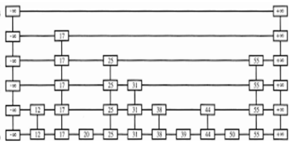
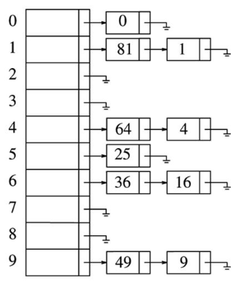
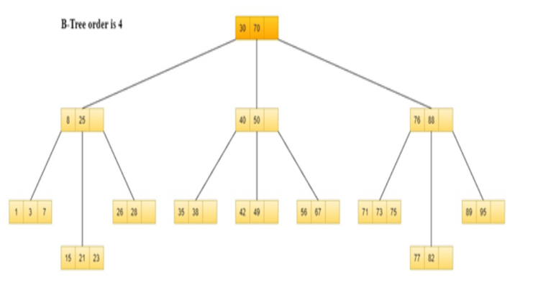
Overview:
Focus on concurrent set data structures (CSet).
Allow search, insertion, deletion of keys in a data structure by multiple threads.
Many implementations of Concurrent Sets (concurrent trees, skip-lists, linked lists, hash tables …)
2
10
15
21
22
27
50
61

Slide 7
Role of Microbenchmarks:
Microbenchmark performs a stress test on a CSet
An experiment loop where n threads bombard the concurrent set data structure with randomized operations on randomly generated keys from a specified key range.
Potentially hundreds of threads on shared memory system trying to access the data structure, possibly the same location, at the same time.

Slide 8
Role of Microbenchmarks:
User Specified Parameters:
Number of threads: n, duration of experiment: d, key range in CSet: r
Update rate: u (ratio of insert/delete operations to search operations), prefill size: i

Slide 9
Motivation:
Take various microbenchmarks
Test the same common concurrent data structure with identical input parameters across each
We would expect to observe relatively similar performance results
Observed strikingly large performance differences

Slide 10
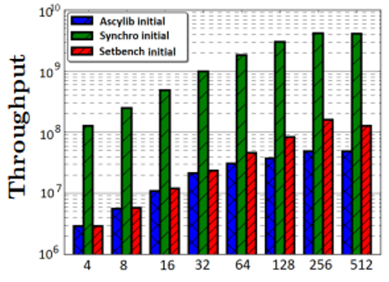
Motivation:
The same concurrent data structure (Natarajan-Mittal Tree)
Logarithmic y-axis
10-100x performance differences
Ascylib Initial
Synchro Initial
Setbench Initial
Throughput
4 8 16 32 64 128 256 512
Threads

Slide 11
Motivation:
The same concurrent data structure (Natarajan-Mittal Tree)
Equalized the specific data structure implementations across the microbenchmarks, yet large performance gaps remained.
Ascylib Initial
Synchro Initial
Setbench Initial
Throughput
4 8 16 32 64 128 256 512
Threads

Slide 12
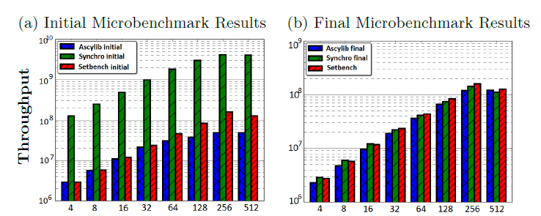
Goals:
Once we understand causes for performance variance and account for microbenchmark design discrepancies,
Can we reach a point where performance results are more equalized across the microbenchmarks
Initial Results
Threads

Slide 13
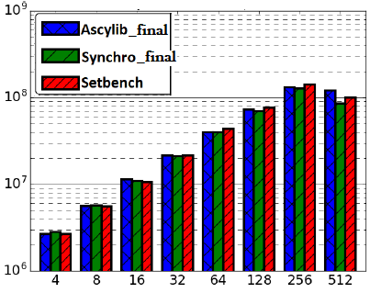
Goals:
Once we understand causes for performance variance and account for microbenchmark design discrepancies,
Can we reach a point where performance results are more equalized across the microbenchmarks
Initial Results
Final Results
Threads
Threads

Slide 14
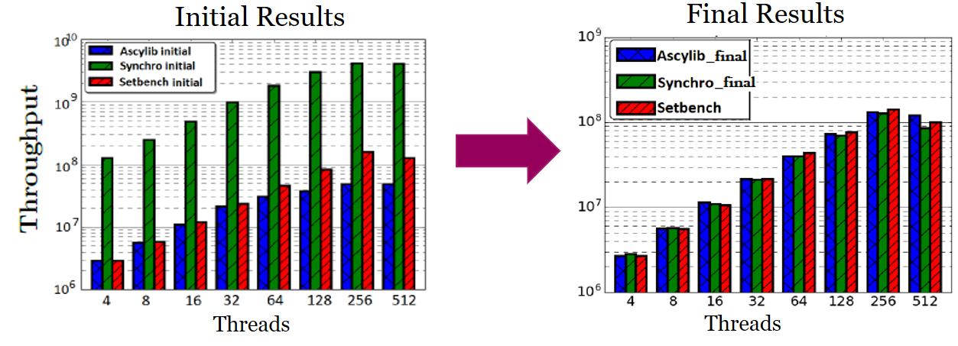
Investigation:
Performed a systematic review of the design intricacies within each microbenchmark
Derive a prescriptive approach for best practice in microbenchmark design for concurrent set data structures.

Slide 15
Microbenchmark Design
Effective Updates:
Splitting the update rate across insert and delete operations.
Effective updates ensure one type of update is successful before another type of update is attempted /thread.
A thread is not allowed to perform deletions until a successful insert operation occurs.

Slide 16
Microbenchmark Design
Effective Updates:
Key range[1,10]: 50% effective inserts, 50% effective deletes
Insert(5) → false
Insert(1) → false
Insert(8) → false
6
3 8
1 5

Slide 17
Microbenchmark Design
Effective Updates:
Key range[1,10]: 50% effective inserts, 50% effective deletes
Insert(5) → false
Insert(1) → false
Insert(8) → false
6
k
3 8
Insert(9) →
1 5
.
.
.

Slide 18
Microbenchmark Design
Effective Updates:
Key range[1,10]: 50% effective inserts, 50% effective deletes
Insert(5) → false
Insert(1) → false
Insert(8) → false
6
k
3 8
Insert(9) → true
1 5 9
.
.
.

Slide 19
Microbenchmark Design
Effective Updates:
Key range[1,10]: 50% effective inserts, 50% effective deletes
Insert(5) → false
Insert(1) → false
Insert(8) → false
6
Inflates throughput
k
3 8
Insert(9) → true
1 5 9
.
.
.

Slide 20
Microbenchmark Design
Effective Updates:
Key range[1,10]: 50% effective inserts, 50% effective deletes
Insert(5) → false
Insert(1) → false
Insert(8) → false
6
Inflates throughput
k
3 8
Insert(9) → true
1 5 9
Use Effective Updates with Caution
.
.
.

Slide 21
Microbenchmark Design
Effective Updates:
Key range[1,10]: 50% effective inserts, 50% effective deletes
Insert(5) → false
Insert(1) → false
Insert(8) → false
6
Inflates throughput
k
3 8
Insert(9) → true
1 5 9
Recommendation:
Randomly select between insert/delete operations
.
.
.
Notes:
.

Slide 22
Microbenchmark Design
PRNG Usage
PRNG are necessary in order to generate random keys and decide the operation choice at random
Choice of PRNG can have a non-trivial impact on performance results
Observed performance inversion based on the PRNG of choice

Slide 23
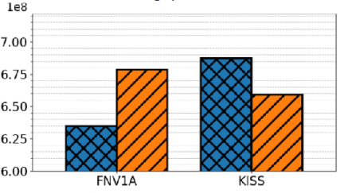
Microbenchmark Design
PRNG Usage
PRNG are necessary in order to generate random keys and decide the operation choice at random
Choice of PRNG can have a non-trivial impact on performance results
Observed performance inversion based on the PRNG of choice
Throughput Concurrent Trees
1e8
BST-TK
Lock-Free BST
FNV1A KISS

Slide 24
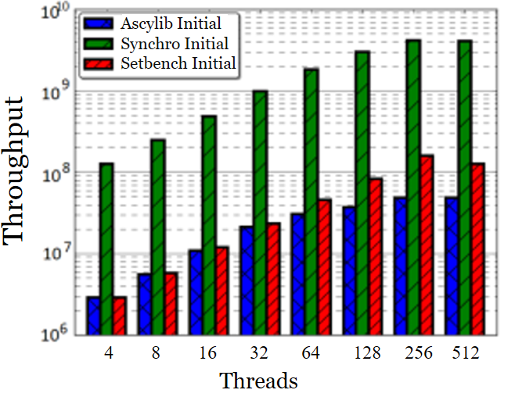
Microbenchmark Design
Decentralized Microbenchmark Experimental Loop
Error prone
One microbenchmark was performing delete only update operations in the experimental loop
Leads to quickly empty data structure, all operations reduce to fast search operations

Slide 25
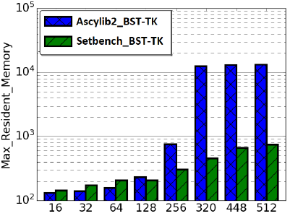
Microbenchmark Design
Memory Reclamation:
Microbenchmarks may incorporate memory reclamation for some concurrent data structures
Poor vs more efficient memory reclamation will impact performance

Slide 26
Full Paper
Summary: We perform experiments relevant to design strategies for optimal microbenchmark design
In order to get an accurate depiction of performance across various concurrent data structures

Slide 27
Full Paper
Describe additional properties leading to inaccurate performance results
A set of recommended best practice for microbenchmark design
Impact of poor vs efficient memory reclamation on throughput results
Assess various strategies for PRNG utilization within microbenchmark experiments
Examining bitwise randomness of numbers generated by PRNG
Practical use of hardware RNG is microbenchmark experiments
Recommendations for efficient, high quality random number generation while limiting the added cost during the measured portion of experiments
Thank you ☺

