Slide 1
Brief Announcement: Performance Anomalies in Concurrent Data Structure Microbenchmarks
Authors: Rosina Kharal, Trevor Brown

Slide 2
Performance Anomalies in Concurrent Data Structure Microbenchmarks
Authors: Rosina Kharal, Trevor Brown
Notes:
Hello My name is Rosina Kharal
Thank you for having me today in this beautiful warm city Of Augusta
I will be speaking about our work on “ Performance anomalies in concurrent data structure microbenachmrks”
This is work under the supervision of Trevor Brown at the University of Waterloo.
I will provide a brief overview of our work discussing our motivaitons and some of the take aways from our findings.

Slide 3
Overview
Background
Microbenchmark Investigation
PRNG Usage
Overview
Motivation
Experiments
Part 1
Experiments
Part 2
Notes:
1)Overview of the research area and the role of microbenchmarks
4)Recommended best practice in Microbenchmark design
I will not be able to speak about every experiments in a great amount of detail, but I will be sure to try to touch upon many key results.

Slide 4
Overview
Background
Microbenchmark Investigation
PRNG Usage
Overview
Motivation
Experiments
Part 1
Experiments
Part 2
Full Paper
Full Set: Recommended Best Practices
Advances in the Setbench Microbenchmark
Notes:
1)Overview of the research area and the role of microbenchmarks
4)Recommended best practice in Microbenchmark design
I will not be able to speak about every experiments in a great amount of detail, but I will be sure to try to touch upon many key results.

Slide 5
Motivation / Background

Slide 6
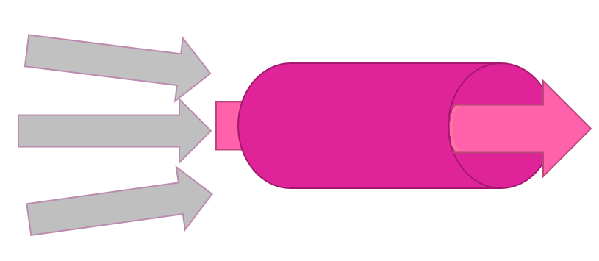
Overview:
Our work focusses on optimizing performance of concurrent data structures
Performance efficiency of concurrent data structures plays a pivotal role in modern day data access:
Fast update and retrieval of information
Allow multiple users/threads to access and update data in a parallel manner
Uninterrupted, smooth transitions while limiting delays and managing concurrency
Notes:
To begin with,
Our work focusses on the optimization of performance of concurrent data structures
As we know,
Performance efficiency of concurrent data structures plays a pivotal role in modern day data access:
Fast update and retrieval of information
Allow multiple users/threads to access and update data in a parallel manner
Uninterrupted, smooth transitions while limiting delays and managing concurrency

Slide 7
Overview:
Benchmarks commonly used to evaluate the performance of concurrent data structures
Microbenchmarks: Assessing limited range of performance metrics across varying implementations of concurrent data structures.
We are primarily interested in throughput results for comparative analysis
How many operations (update/retrieval) can be performed on the concurrent data structure by n threads in a limited amount of time.
Other performance measures are possible (memory usage, total cycles per operation, total instructions per operation).
Notes:
Benchmarks commonly used to evaluate the performance of concurrent data structures
Microbenchmarks: Assessing limited range of performance metrics across varying implementations of concurrent data structures.
We are primarily interested in throughput results for comparative analysis
How many operations (update/retrieval) can be performed on the concurrent data structure by n threads in a limited amount of time.

Slide 8
Overview:
Focus on concurrent set data structures (CSet).
Allow search, insertion, deletion of numeric keys in a data structure by multiple threads.
Many implementations of Concurrent Sets (concurrent trees, skip-lists, linked lists, hash tables …)
2
10
15
21
22
27
50
61

Slide 9
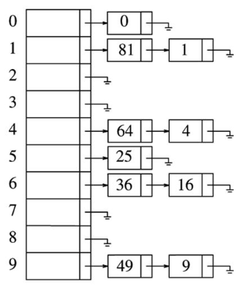
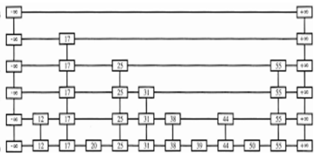
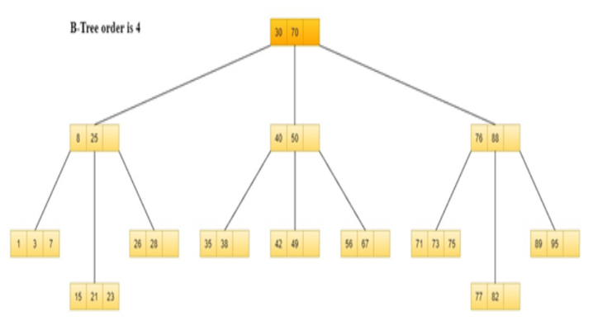
Overview:
Focus on concurrent set data structures (CSet).
Allow search, insertion, deletion of keys in a data structure by multiple threads.
Many implementations of Concurrent Sets (concurrent trees, skip-lists, linked lists, hash tables …)
2
10
15
21
22
27
50
61

Slide 10
Overview:
Focus on concurrent set data structures (CSet).
Allow search, insertion, deletion of keys in a data structure by multiple threads.
Many implementations of Concurrent Sets (concurrent trees, skip-lists, linked lists, hash tables …)
2
10
15
21
22
27
50
61

Slide 11
Role of Microbenchmarks:
Microbenchmark performs a stress test on a CSet
An experiment loop where n threads bombard the concurrent set data structure with randomized operations on randomly generated keys from a specified key range.
Notes:
benchmarks… allow users to customize input parameters…
It is possible to install various different Microbenchmarks,
Set parameters exactly the same such that we can test a common workload
Across all of them.

Slide 12
Role of Microbenchmarks:
Microbenchmark performs a stress test on a CSet
An experiment loop where n threads bombard the concurrent set data structure with randomized operations on randomly generated keys from a specified key range.
t1
t2
10
3
t3
8
t4: delete
3
t5
2
Notes:
benchmarks… allow users to customize input parameters…
It is possible to install various different Microbenchmarks,
Set parameters exactly the same such that we can test a common workload
Across all of them.

Slide 13
Role of Microbenchmarks:
Microbenchmark performs a stress test on a CSet
An experiment loop where n threads bombard the concurrent set data structure with randomized operations on randomly generated keys from a specified key range.
t6: delete
2
t1: insert
t2: insert
10
3
t3: insert
8
t4: delete
3
t5: insert
2
Notes:
benchmarks… allow users to customize input parameters…
It is possible to install various different Microbenchmarks,
Set parameters exactly the same such that we can test a common workload
Across all of them.

Slide 14
Role of Microbenchmarks:
Microbenchmark performs a stress test on a CSet
Example: Insert/Delete workload (update only)
t6: delete 2
t1: insert
t2: insert
10
3
t3: insert
8
t4: delete 3
t5: insert
2
Notes:
In addition to Insert/Delete operations ( known as UPDATE Operations)
We would have threads performing search only operations, simply checking for the presense or absence of a key

Slide 15
Role of Microbenchmarks:
High contention
Potentially hundreds of threads bombarding the CSet
Notes:
Potentially hundreds of threads on shared memory system trying to access the data structure, possibly the same location, at the same time.

Slide 16
Role of Microbenchmarks:
High contention
Potentially hundreds of threads bombarding the CSet
t16: delete 20
t1: insert 8
t6: delete 2
t1: search 10
t3: search 1
t3: search 1
t2: insert 3
t5: insert 2
t12: insert 4
t2: search 19
t15: search 10
t9: search 8
t8: insert 7
t10: search 6
t5: delete 10
t3: search 1
t11: search 25
t3: insert 8
t8: insert 7
t3: search 7
t15: search 11
t6: search 1
t4: delete 3
t4: search 8
t7: search 7
t5: delete 9
t5: insert 2
t14: delete 24
t2: search 2
t17: insert 5
t9: search 5
t7: insert 21
Notes:
Potentially hundreds of threads on shared memory system trying to access the data structure, possibly the same location, at the same time.

Slide 17
Role of Microbenchmarks:
Microbenchmark performs a stress test on a CSet
Potentially hundreds of threads on shared memory system trying to access the data structure, possibly the same location, at the same time.
t6: delete
2
t1: insert
t2: insert
10
3
t3: insert
8
3
t5: insert
2
Notes:
benchmarks… allow users to customize input parameters…
It is possible to install various different Microbenchmarks,
Set parameters exactly the same such that we can test a common workload
Across all of them.

Slide 18
Role of Microbenchmarks:
Accuracy of results is paramount
Total throughput results- which concurrent data structure implementation outperforms
Test various methods of managing concurrency.
Notes:
benchmarks… allow users to customize input parameters…
It is possible to install various different Microbenchmarks,
Set parameters exactly the same such that we can test a common workload
Across all of them.

Slide 19
Role of Microbenchmarks:
User Specified Parameters:
Number of threads: n, duration of experiment: d, key range in CSet: r
Update rate: u (ratio of insert/delete operations to search operations), prefill size: i
Notes:
benchmarks… allow users to customize input parameters…
It is possible to install various different Microbenchmarks,
Set parameters exactly the same such that we can test a common workload
Across all of them.

Slide 20
Motivation:
Take various microbenchmarks
Test the same common concurrent data structure with identical input parameters across each
We would expect to observe relatively similar performance results
Observed strikingly large performance differences
Notes:
Download two microbenchmarks.. Each contain an implementation of the same data structure…
If you ran the same workload in each microbenchmark, you would expect similira
Suppose you download two
Offer data structure X for you to run experiments…
Take both benchmarks…
Run a 90% search, …
Same workload on the same data structure…
You would expect to see similar performance…. Well…
We actually found large performance gaps…

Slide 21
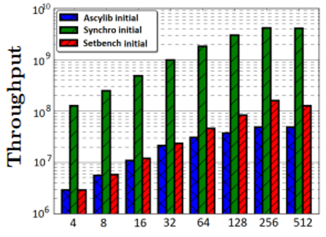
Motivation:
The same concurrent data structure (Natarajan-Mittal Tree) [7]
Logarithmic y-axis
10-100x performance differences
Ascylib Initial
Synchro Initial
Setbench Initial
Throughput
4 8 16 32 64 128 256 512
Threads
Notes:
These are initial performance results for 3 commonly employed microbenchmarks
256 logical processors
At 512 we are oversubscribing

Slide 22
Motivation:
The same concurrent data structure (Natarajan-Mittal Tree) [7]
Equalized the specific data structure implementations across the microbenchmarks, yet large performance gaps remained.
Ascylib Initial
Synchro Initial
Setbench Initial
Throughput
4 8 16 32 64 128 256 512
Threads
Notes:
sdfsdfsdfsdfsdfsdfsdfssdfsdfhhhhhhhhhhh

Slide 23
Experiments Part 1:
Microbenchmark Investigation

Slide 24
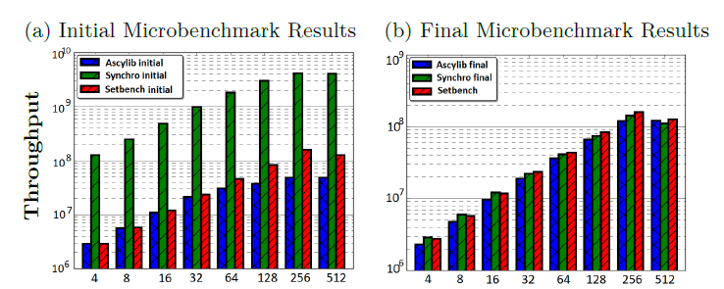
Goals:
Once we understand causes for performance variance and account for microbenchmark design discrepancies,
Can we reach a point where performance results are more equalized across the microbenchmarks
Initial Results
Threads

Slide 25
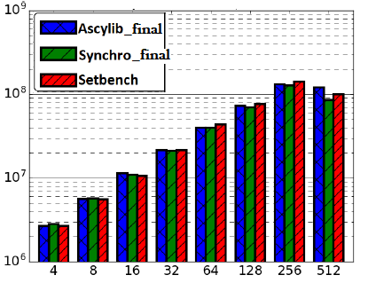
Goals:
Once we understand causes for performance variance and account for microbenchmark design discrepancies,
Can we reach a point where performance results are more equalized across the microbenchmarks
Initial Results
Final Results
Threads
Threads
Notes:
This was the Basis of our work

Slide 26
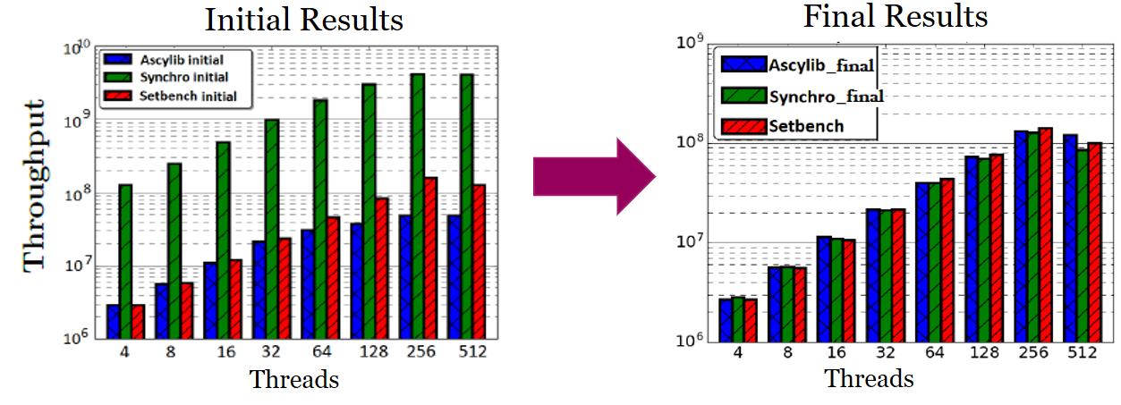
Investigation:
Performed a systematic review of the design intricacies within each microbenchmark
Derive a prescriptive approach for best practice in microbenchmark design for concurrent set data structures.
Notes:
We investigate and formalize the root causes for large differences in performance results

Slide 27
Methodology
Examine implementation details of each microbenchmarks
Perform successive modifications to each microbenchmark where discrepancies/errors were encountered.
Attempt to equalize performance

Slide 28
Methodology
First set of experiments:
Same concurrent data structure as implemented in each microbenchmark
No memory reclamation
Prefilling is equalized in all three (insert-only prefilling to half the key range)
Testing parameters, workload is identical across all microbenchmarks
AMD EPYC 7662 processor, 256 logical cores, 256 GB RAM
Key range: unless stated otherwise 1 million keys, 20 second experiments

Slide 29
Initial Performance Results
Lock-free BST (Natarajan-Mittal Tree [7])
External BST- All keys are in leaf nodes.
Internal nodes contain keys for routing purposes.
Threads
Notes:
Certainly insert and delete operaitons are increasing the performance gaps, and the concurrent lock-free BST is certainly boosted on synchrobench compared to results in Setbench and Ascyblib
Lets try to understand why

Slide 30
Initial Performance Results
One microbenchmark consistently indicates lower performance
One microbenchmark consistently indicates higher performance
Threads
Notes:
Certainly insert and delete operaitons are increasing the performance gaps, and the concurrent lock-free BST is certainly boosted on synchrobench compared to results in Setbench and Ascyblib
Lets try to understand why

Slide 31
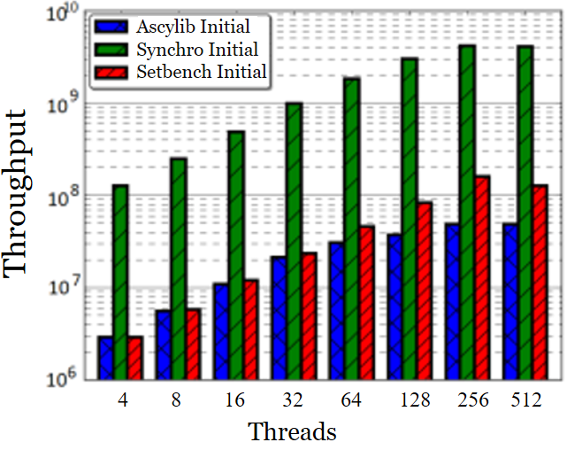
Microbenchmark Design:
Decentralized Microbenchmark Experimental Loop
Error prone
One microbenchmark was performing delete only update operations in the experimental loop
Leads to quickly empty data structure, all operations reduce to fast search operations
Notes:
Now I will run through some of the interesting differnces, design discrepancies found within some of the microbenchmarks.
There were a few modifications to synchrobench that quickly reduced performance results.
The first was related to Decentralised Experiment loop
I will just touch upon some of our findings… and certainly the full paper discusses several more interesting issues in further detail
This is one of the reasons why Synchrobench results on this particular data structure were much much higher

Slide 32
Microbenchmark Design:
Decentralized Microbenchmark Experimental Loop
Error prone
One microbenchmark was performing delete only update operations in the experimental loop
Leads to quickly empty data structure, all operations reduce to fast search operations
Microbenchmark Experimental Algorithm
Exist in one centralized location
Notes:
Now I will run through some of the interesting differnces, design discrepancies found within some of the microbenchmarks.
There were a few modifications to synchrobench that quickly reduced performance results.
The first was related to Decentralised Experiment loop
I will just touch upon some of our findings… and certainly the full paper discusses several more interesting issues in further detail
This is one of the reasons why Synchrobench results on this particular data structure were much much higher

Slide 33
Microbenchmark Design:
Effective Updates:
Splitting the update rate across insert and delete operations.
Effective updates ensure one type of update is successful before another type of update is attempted /thread.
A thread is not allowed to perform deletions until a successful insert operation occurs.
Notes:
Another important design consideration is related to Effective Updates.
What is the protocol for splitting the update rates across insert and delete operations.
Counting all these searches towards throughput.
Not saying you cannot effective…
Use with with causation…
Because you may not be measuring what you think you are measuring.

Slide 34
Microbenchmark Design:
Effective Updates:
Key range[1,10]: 50% effective inserts, 50% effective deletes
t1
Insert(5) → false
Insert(1) → false
Insert(8) → false
6
3 8
1 5
Notes:
Counting all these searches towards throughput.
Not saying you cannot effective…
Use with with causation…
Because you may not be measuring what you think you are measuring.

Slide 35
Microbenchmark Design:
Effective Updates:
Key range[1,10]: 50% effective inserts, 50% effective deletes
t1
Insert(5) → false
Insert(1) → false
Insert(8) → false
6
k
3 8
Insert(9) →
1 5
.
.
.
Notes:
Following t attempted insersions…
we have a successful insertion
Counting all these searches towards throughput.
Not saying you cannot effective…
Use with with causation…
Because you may not be measuring what you think you are measuring.

Slide 36
Microbenchmark Design:
Effective Updates:
Key range[1,10]: 50% effective inserts, 50% effective deletes
t1
Insert(5) → false
Insert(1) → false
Insert(8) → false
6
k
3 8
Insert(9) → true
1 5 9
.
.
.
Notes:
---- Stick to 50 50
Counting all these searches towards throughput.
Not saying you cannot effective…
Use with with causation…
Because you may not be measuring what you think you are measuring.

Slide 37
Microbenchmark Design:
Effective Updates:
Key range[1,10]: 50% effective inserts, 50% effective deletes
t1
Insert(5) → false
Insert(1) → false
Insert(8) → false
6
Inflates throughput
k
3 8
Insert(9) → true
1 5 9
.
.
.
Notes:
---- Stick to 50 50
Counting all these searches towards throughput.
Not saying you cannot effective…
Use with with causation…
Because you may not be measuring what you think you are measuring.

Slide 38
Microbenchmark Design:
Effective Updates:
Key range[1,10]: 50% effective inserts, 50% effective deletes
t1
Insert(5) → false
Insert(1) → false
Insert(8) → false
6
Inflates throughput
k
3 8
Insert(9) → true
1 5 9
Use Effective Updates with Caution
.
.
.
Notes:
---- Stick to 50 50
Counting all these searches towards throughput.
Not saying you cannot effective…
Use with with causation…
Because you may not be measuring what you think you are measuring.
We discuss later in the conclusions section… our recommendation is to randomly decide between insert and delete operations.

Slide 39
Microbenchmark Design:
Effective Updates:
Key range[1,10]: 50% effective inserts, 50% effective deletes
t1
Insert(5) → false
Insert(1) → false
Insert(8) → false
6
Inflates throughput
k
3 8
Insert(9) → true
1 5 9
Recommendation:
Randomly select between insert/delete operations
.
.
.
Notes:
---- Stick to 50 50
Counting all these searches towards throughput.
Not saying you cannot effective…
Use with with causation…
Because you may not be measuring what you think you are measuring.

Slide 40
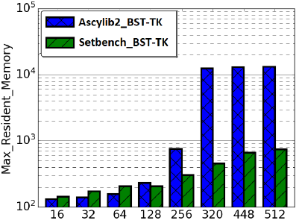
Microbenchmark Design
Memory Reclamation:
Microbenchmarks may incorporate memory reclamation for some concurrent data structures
Poor vs more efficient memory reclamation will impact performance
[4]
[4]
Notes:
Microbenchmarks may incorporate memory reclamation for some concurrent data structures.
Poor vs more efficient memory reclamation will impact performance
Microbenchmarks will reclaim memory in some concurrent data structure implementations,
Throughput results across various microbenchmarks may be similar, but one impelemnation is leaking memory at higher thread counts.
Here we see the maximum memory usage for two microbenchmakrs testing the ticket based concurrent binary search tree
One is leaking memory at higher thread counts. Particulary when the cores are oversubscribed.
One may have- Fast Memory Reclamation, vs more efficient memory reclamiation but pay a penalty

Slide 41
Microbenchmark Design
Memory Reclamation:
Microbenchmarks may incorporate memory reclamation for some concurrent data structures
Poor vs more efficient memory reclamation will impact performance
Efficiency of memory reclamation may impact performance results: Monitor total memory usage during experiments
[4]
Notes:
Microbenchmarks may incorporate memory reclamation for some concurrent data structures.
Poor vs more efficient memory reclamation will impact performance
Microbenchmarks will reclaim memory in some concurrent data structure implementations,
Throughput results across various microbenchmarks may be similar, but one impelemnation is leaking memory at higher thread counts.
Here we see the maximum memory usage for two microbenchmakrs testing the ticket based concurrent binary search tree
One is leaking memory at higher thread counts. Particulary when the cores are oversubscribed.
One may have- Fast Memory Reclamation, vs more efficient memory reclamiation but pay a penalty

Slide 42
Microbenchmark Design Principles
Recommended best practice for microbenchmark design includes strategies to detect and mitigate errors in the microbenchmark.
Checksum validation
Notes:
Testing across varying key ranges, shorter duration experiments ~ 5 seconds

Slide 43
Microbenchmark Design Principles
Data structure prefilling step that includes randomized insert and delete operations.
Converge to a data structure that is half full
Multi-threaded prefilling
Generates a prefilled CSet data structure with a more realistic configuration (as opposed to a CSet that is produced by insert-only operations)
Notes:
Testing across varying key ranges, shorter duration experiments ~ 5 seconds

Slide 44
Microbenchmark Design Principles
Note: Prefilling may have an impact on performance depending on the concurrent data structure.
A BST prefilled with insert-only operations will have a different structure than a tree prefilled with insert and delete ops
Notes:
Testing across varying key ranges, shorter duration experiments ~ 5 seconds

Slide 45
Microbenchmark Design Principles
Discussed further in full paper
Thread pinning
Key distributions
More expressive ADTs
Starvation aware experiments
Notes:
Testing across varying key ranges, shorter duration experiments ~ 5 seconds

Slide 46
Experiments Part 2:
PRNG Usage in Microbenchmark Experiments
Notes:
In the second part of our experiments, we wanted to investigate the roll of PRNGs in Microbenchmark experiments and their impact on performance

Slide 47
Methodology
Examine the role of pseudo random number generators (PRNGs) and their impact on performance
Investigate research questions related to fast and high quality randomness in Microbenchmark experiments
Derive a set or recommendations related to PRNG usage in microbenchmark experiments
Notes:
Testing across varying key ranges, shorter duration experiments ~ 5 seconds

Slide 48
PRNG Usage
PRNG are necessary in order to generate random keys and decide the operation choice at random
Choice of PRNG can have a non-trivial impact on performance results
Observed performance inversion based on the PRNG of choice
Notes:
PRNG are necessary in order to generate random keys and decide the operation choice also at random

Slide 49
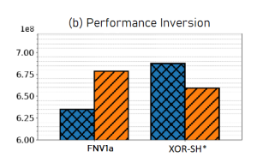
PRNG Usage
PRNG are necessary in order to generate random keys and decide the operation choice at random
Choice of PRNG can have a non-trivial impact on performance results
Observed performance inversion based on the PRNG of choice
Throughput Concurrent Trees
1e8
BST-TK
Lock-Free BST
Notes:
We conduct additional experiments related to PRNG usage in our work
In 2009 Marsaglia presented a version based on 64-bit integers (appropriate for 64-bit processors) which combines a multiply-with-carry generator, a Xorshift generator and a linear congruential generator.^{[5]}
^{Based on Marsaglia XOR}

Slide 50
Hardware Randomness
Search for high quality randomness with a source of entropy
Intel secure key instruction, RDRAND available on Ivy Bridge processors
Returns a random number from intel on-chip hardware
RDRAND intended for applications that require high-quality random numbers.
Notes:
These are too expensive to use for IN-place RN Generation
Multiple Recursive Generators (MRGs) are a family of random number generators based on higher order recursion, which provide statistically high-quality random number sequences with extremely long-recurrence lengths, and deterministic jump-ahead for effective parallelism. We reformulate the MRG8 (8th-order recursive implementation) for Intel's KNL and NVIDIA's P100 GPU - named MRG8-AVX512 and MRG8-GPU respectively. Our optimized implementation generates the same random number sequence as the original well-characterized MRG8.
(PDF) MRG8: Random Number Generation for the Exascale Era (researchgate.net)

Slide 51
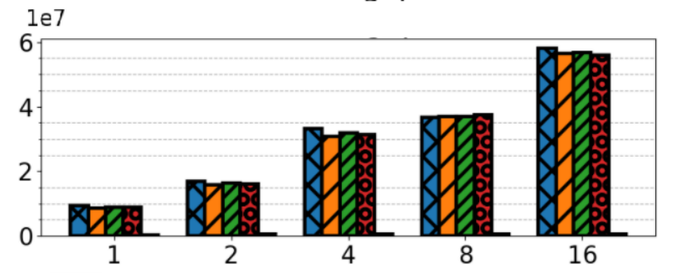
Hardware Randomness
Search for high quality randomness with a source of entropy
Performance penalty too high for practical use in high speed microbenchmark experiments
Comparison PRNG – Hardware RNG
Threads
Notes:
These are too expensive to use for IN-place RN Generation
Multiple Recursive Generators (MRGs) are a family of random number generators based on higher order recursion, which provide statistically high-quality random number sequences with extremely long-recurrence lengths, and deterministic jump-ahead for effective parallelism. We reformulate the MRG8 (8th-order recursive implementation) for Intel's KNL and NVIDIA's P100 GPU - named MRG8-AVX512 and MRG8-GPU respectively. Our optimized implementation generates the same random number sequence as the original well-characterized MRG8.
(PDF) MRG8: Random Number Generation for the Exascale Era (researchgate.net)

Slide 52
Pre-generated Array of Random Numbers
Place cost of high quality randomness outside of measured experiment
Pre-generate a large array 1Million random numbers using hardware RNG (increased entropy), or cryptographic hash function
During Microbenchmark experiment index into the array for next random number
Array size must be large enough to avoid frequent repetition of random numbers
10 Million random numbers
Notes:
These are too expensive to use for IN-place RN Generation

Slide 53
Pre-generated Array of Random Numbers
Place cost of high quality randomness outside of measured experiment
Pre-generate a large array 1Million random numbers using hardware RNG (increased entropy), or cryptographic hash function
During Microbenchmark experiment index into the array for next random number
Array size must be large enough to avoid frequent repetition of random numbers
10 Million random numbers
Decrease in performance with pre-generated array of random numbers
Penalties associated with additional cache misses, increased total cycles per operation
Notes:
These are too expensive to use for IN-place RN Generation

Slide 54
Periodic Reseeding during microbenchmark experiments
Use fast, software PRNG during microbenchmark experiments
Periodically inject entropy into the PRNG (re-seeding).
Periodically reseeding to introduce additional randomness into a PRNG is discussed by Manssen et al. [21]
Reseeding XOR_SH* PRNG every 1 million random numbers
No significant penalty
Notes:
These are too expensive to use for IN-place RN Generation

Slide 55
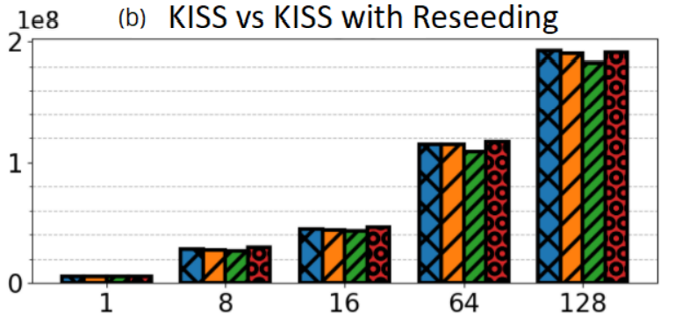
Periodic Reseeding during microbenchmark experiments
Use fast, software PRNG during microbenchmark experiments
Periodically inject entropy into the PRNG (re-seeding).
Periodically reseeding to introduce additional randomness into a PRNG is discussed by Manssen et al. [21]
Reseeding XOR_SH* PRNG every 1 million random numbers
Reseeding
Notes:
These are too expensive to use for IN-place RN Generation

Slide 56
PRNG Usage in Microbenchmark Experiments
Recommend two PRNG instances per thread
one for generating random values during the experiment
one for injecting new entropy into the first PRNG (periodic reseeding).
If periodic reseeding is used for every 1 million keys, there is a low, intangible impact on performance.
If RDSEED or RDRAND are not available, we recommend using a high quality cryptographic PRNG for the 2nd PRNG.
Notes:
Testing across varying key ranges, shorter duration experiments ~ 5 seconds

Slide 57
Full Paper
Summary: We perform experiments relevant to design strategies for optimal microbenchmark design
In order to get an accurate depiction of performance across various concurrent data structures
Notes:
--- In Summary we are looking for an accurate depiction of performance across various implemenations of concurrent data structures…
--- onsidering the Microbenchmark design is cructial in achieving that goal.
With that I will conclude…
And I would be happy to discuss more during break.
We performed additonia work that I could not discuss…

Slide 58
Full Paper
Describe additional properties leading to inaccurate performance results
A full set of recommended best practice for microbenchmark design
Impact of poor vs efficient memory reclamation on throughput results
Advanced features of the Setbench microbenchmark
Notes:
--- In Summary we are looking for an accurate depiction of performance across various implemenations of concurrent data structures…
--- onsidering the Microbenchmark design is cructial in achieving that goal.
With that I will conclude…
And I would be happy to discuss more during break.
We performed additonia work that I could not discuss…

Slide 59
Thank you ☺

Slide 60
Thank you ☺

Slide 61
References
[1] Austin Appleby. Murmurhash3, 2012, 2012. URL: https://github.com/aappleby/smhasher/ wiki/MurmurHash3.
[2] Maya Arbel-Raviv, Trevor Brown, and Adam Morrison. Getting to the root of concurrent binary search tree performance. In 2018 USENIX Annual Technical Conference (USENIX ATC 18), pages 295–306, 2018.
[3] Trevor Alexander Brown. Reclaiming memory for lock-free data structures: There has to be a better way. In Proceedings of the 2015 ACM Symposium on Principles of Distributed Computing, pages 261–270, 2015.
[4] Tudor David, Rachid Guerraoui, and Vasileios Trigonakis. Asynchronized concurrency: The secret to scaling concurrent search data structures. In Proceedings of the Twentieth International Conference on Architectural Support for Programming Languages and Operating Systems, ASPLOS ’15, page 631–644, New York, NY, USA, 2015. Association for Computing Machinery. doi:10.1145/2694344.2694359.
[5] Tudor Alexandru David, Rachid Guerraoui, Tong Che, and Vasileios Trigonakis. Designing ascy-compliant concurrent search data structures. Technical report, 2014.
[6] J. Evans. Scalable memory allocation using jemalloc, 2011. URL: https://www.facebook. com/notes/10158791475077200/.
[7] Aravind Natarajan and Neeraj Mittal. Fast concurrent lock-free binary search trees. In Proceedings of the 19th ACM SIGPLAN Symposium on Principles and Practice of Parallel Programming, PPoPP ’14, pages 317–328, 2014. URL: http://doi.acm.org/10.1145/2555243. 2555256, doi:10.1145/2555243.2555256.
[8] Vincent Gramoli. More than you ever wanted to know about synchronization: Synchrobench, measuring the impact of the synchronization on concurrent algorithms. In Proceedings of the 20th ACM SIGPLAN Symposium on Principles and Practice of Parallel Programming, pages 1–10, 2015. [4]
[9] Nikolaos D Kallimanis. Synch: A framework for concurrent data-structures and benchmarks. arXiv preprint arXiv:2103.16182, 2021
Notes:
--- In Summary we are looking for an accurate depiction of performance across various implemenations of concurrent data structures…
--- onsidering the Microbenchmark design is cructial in achieving that goal.
With that I will conclude…
And I would be happy to discuss more during break.
We performed additonia work that I could not discuss…

Slide 62
References
[10] Donald Nguyen and Keshav Pingali. What scalable programs need from transactional memory. SIGPLAN Not., 52(4):105–118, apr 2017. doi:10.1145/3093336.3037750.
[11]Frank McSherry, Michael Isard, and Derek G Murray. Scalability! but at what {COST}? In 15th Workshop on Hot Topics in Operating Systems (HotOS XV), 2015. 25
[12] Chi Cao Minh, JaeWoong Chung, Christos Kozyrakis, and Kunle Olukotun. Stamp: Stanford transactional applications for multi-processing. In 2008 IEEE International Symposium on Workload Characterization, pages 35–46. IEEE, 2008
Notes:
--- In Summary we are looking for an accurate depiction of performance across various implementations of concurrent data structures…
--- considering the Microbenchmark design is crucial in achieving that goal.
With that I will conclude…
And I would be happy to discuss more during break.
We performed additonia work that I could not discuss…

