Slide 1
Multicore programming
Linearizability: defining correctness for concurrency
Lecture 1
Trevor Brown

Slide 2
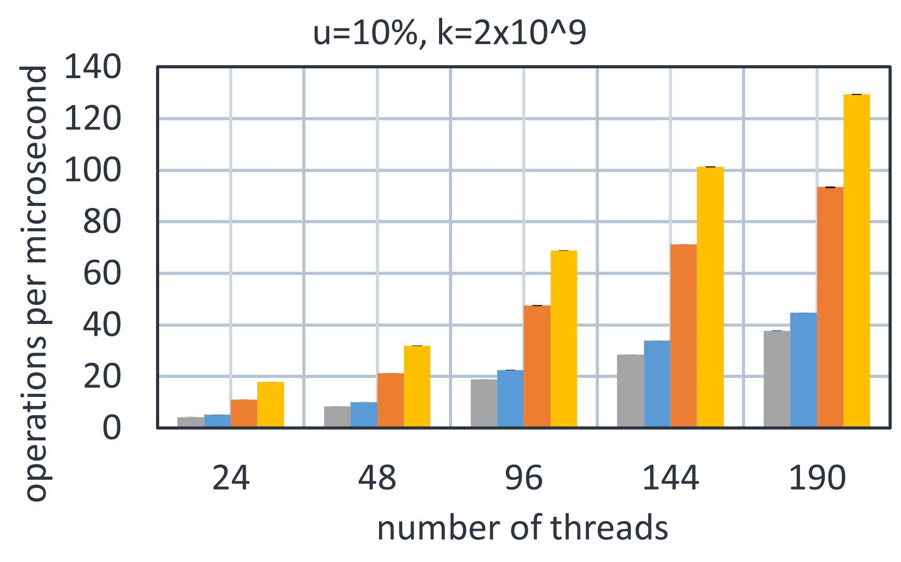
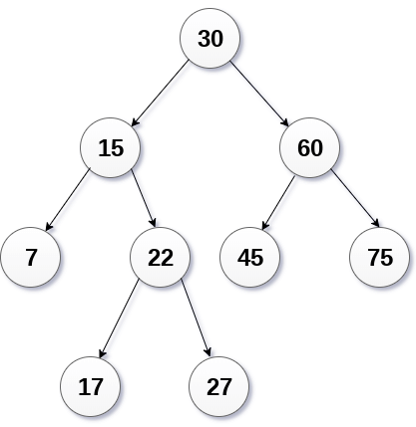
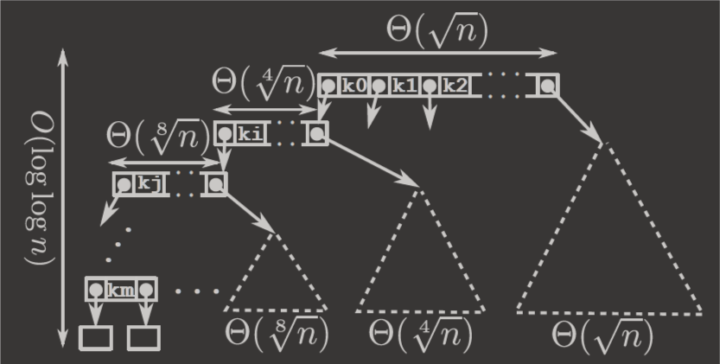
My Research: a taste
Key-value stores w/1 billion keys
Workload: 10% update, 90% search
Big multicore systems
192 thread Intel
144 thread Intel, 9x 32-thread cluster, soon 256 thread AMD…
How to harness them effectively?
Fast concurrent data structures
Lock-free balanced search trees
Synchronization primitives
Memory allocation & reclamation
Transactional memory
Non-volatile memory
lock-free
lock-based

Slide 3
This course
Emphasis on both theory and practice
Leaning towards practice
Correctness is hard
Theory is needed to make things rigorous
But, concurrency is about performance
So, practice must inform theory!
Less focus on traditionally taught concurrent programming material
Attempting to teach the unspoken/unwritten intuition of experts
Hoping to reach the bleeding edge
Covering C++ (Java is similar and often easier – but less control!)

Slide 4
Background
Introductory material

Slide 5
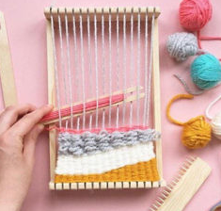
Concurrency and threads
Threads
Building block for concurrency
Relatively lightweight (overhead in ~1000s-10000s of cycles)
Threads can share the same memory space
Each thread has private memory
And access to shared memory (via reads & writes)
Read and write are atomic
Cannot see partially written values
Use to call a function asynchronously
Can synchronize with join
Knowing what these are…
Doesn’t mean you can do this :)

Slide 6
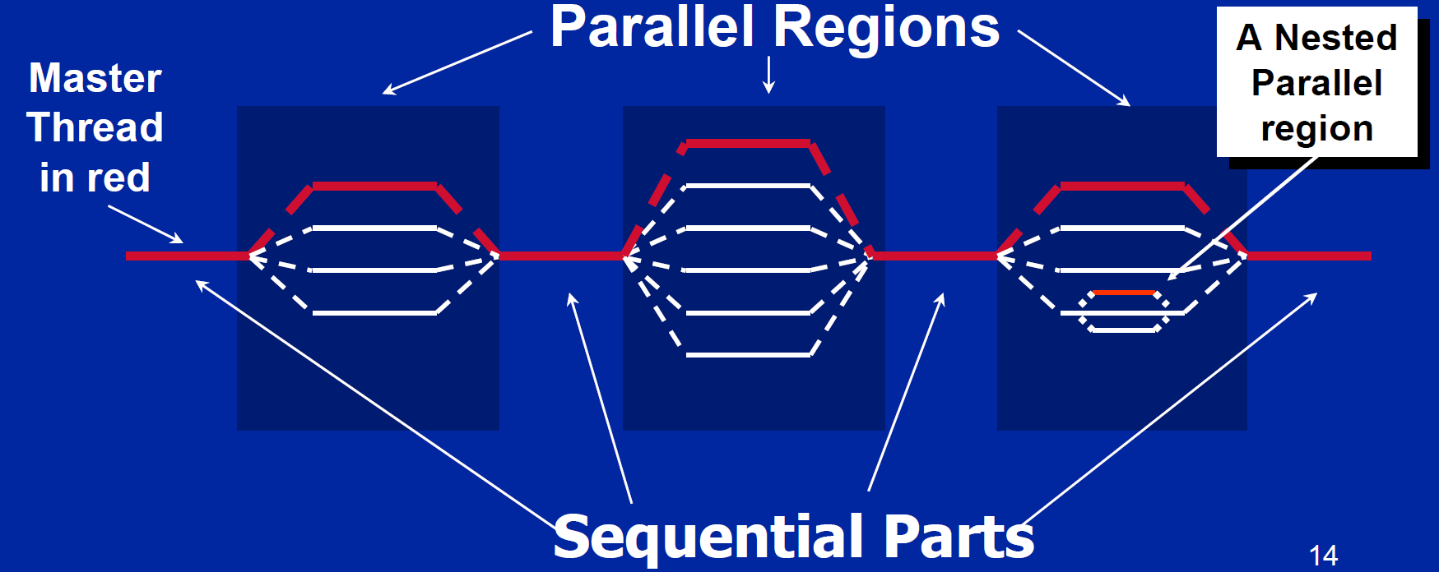
Fork/Join: Common design pattern
Identify work that can be divided between threads
Fork many threads, each doing some share of the work
Join the threads (synchronize)
Repeat if necessary
Diagram shamelessly stolen; see slide notes
Notes:
Diagram is stolen from: https://www.google.com/url?sa=t&rct=j&q=&esrc=s&source=web&cd=2&ved=2ahUKEwjJjP_1pZjeAhUKL8AKHTHdA34QFjABegQICRAC&url=https://www.openmp.org/wp-content/uploads/omp-hands-on-SC08.pdf&usg=AOvVaw2BMZ-x-dl68_2rW2LZevlD

Slide 7
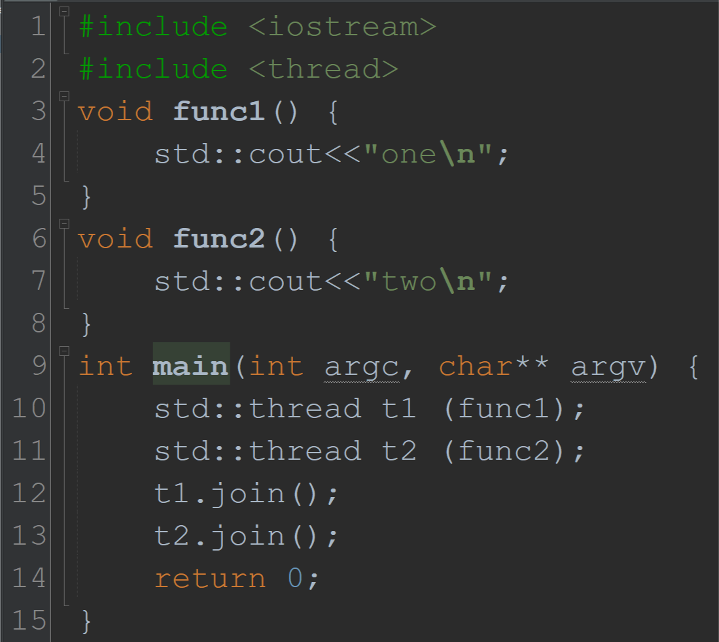
basic Threading examples: #0
Five inversions after 1000 runs
…
Thread 1 starts first… biasing the line order

Slide 8
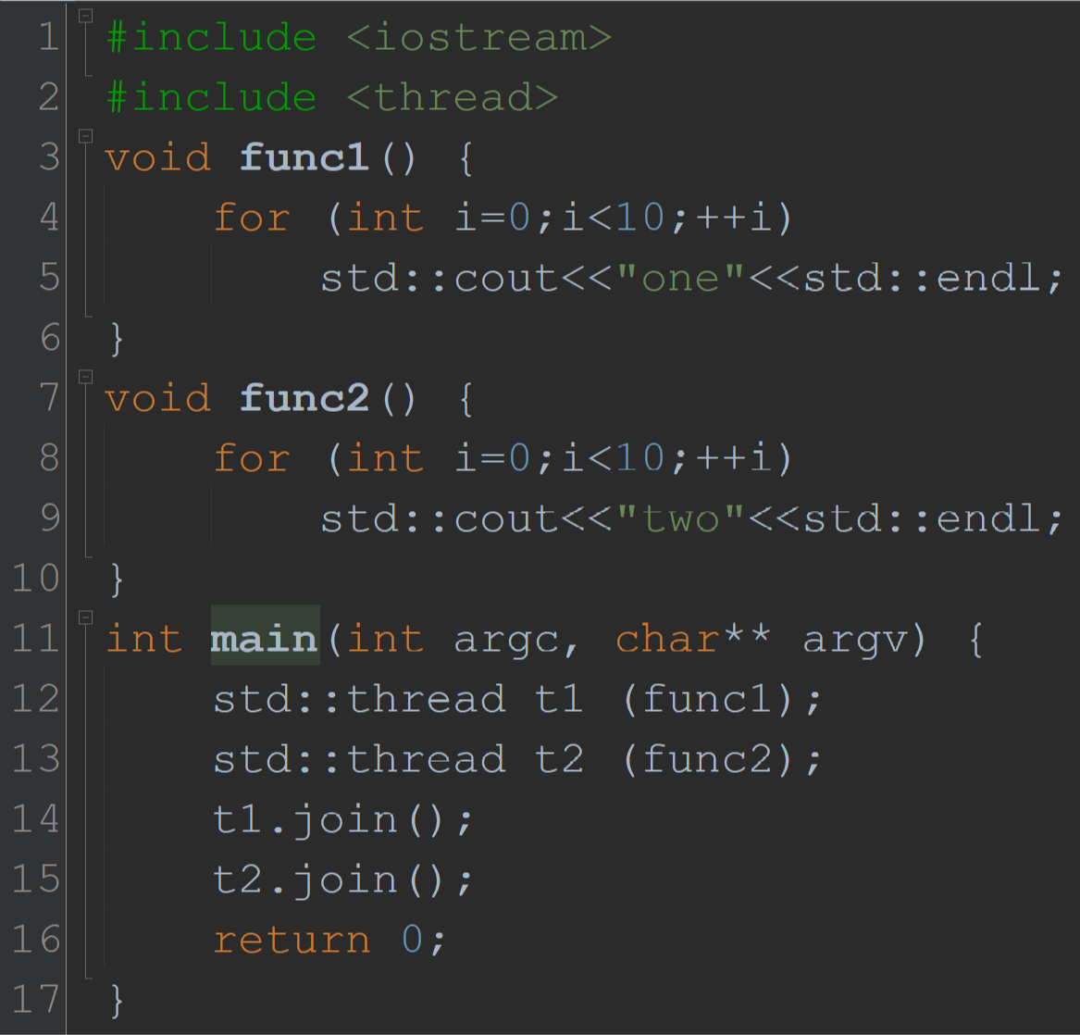
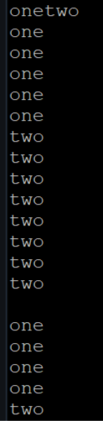
basic Threading examples: #1

Slide 9
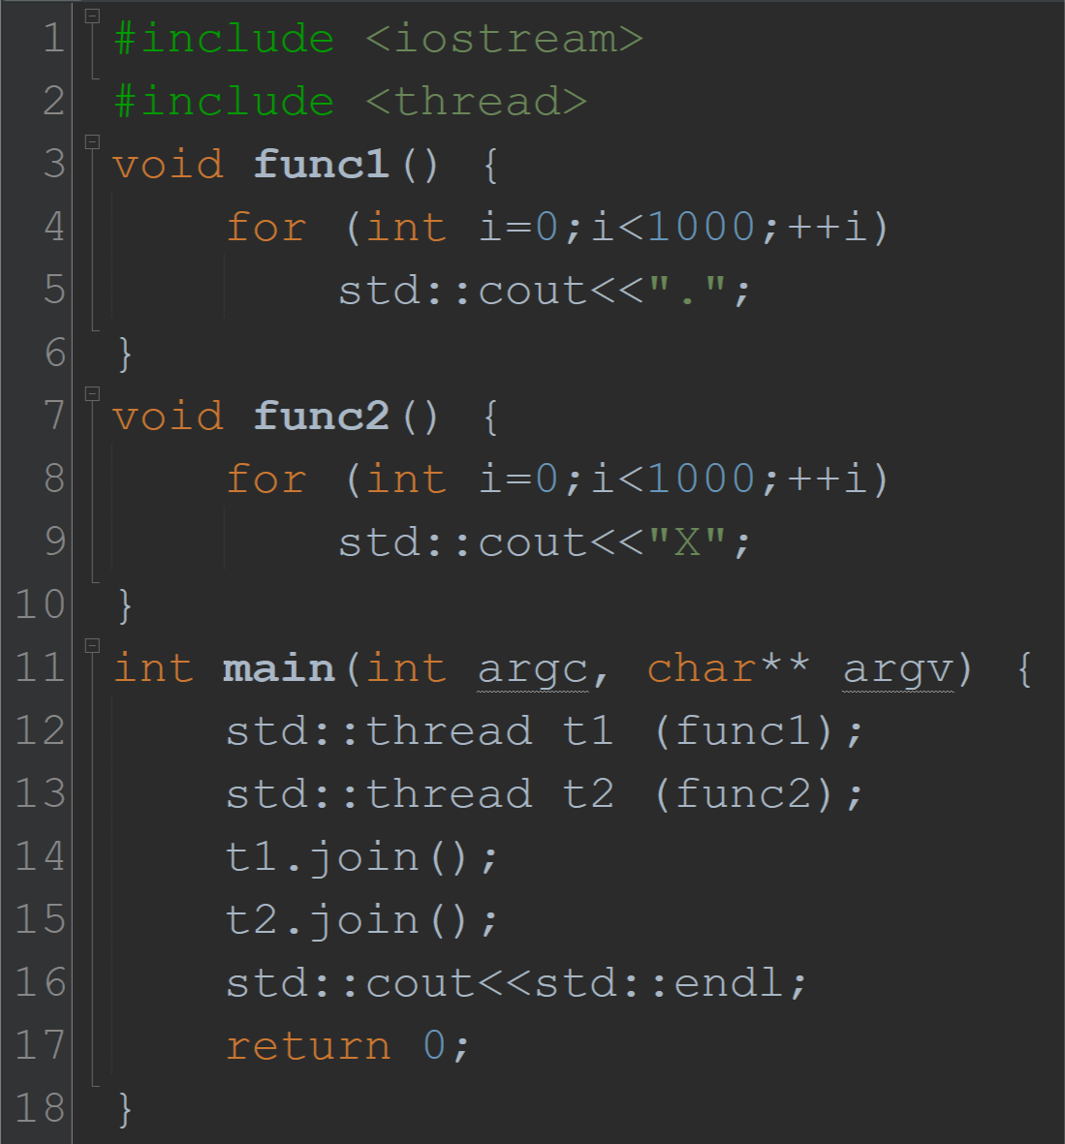
basic Threading examples: #2
....................XXXXXXXXXXXXXXXXXXXXXXXXXXXXXXXXXXXXXXXXXXXXXXXXXXXXXXXX.X........X.X...X.XXX.XXXXXX..X.XXXXXX.XXXXX.XXXXXXX.XXXXXXXX.X......X.........X.XXXXXXX.XXXXXXXXXX.X........X.XXXXXXXX.XXXXXX.X........X.XXXXXXX.XXXXXXX.X......X.......X.........X.XXXXXX.X........X.......X.XXXXXXX.X........X.XXXXXXXX.XXXXXXXX.XXXXXXXX.XXXXXXX.XXXXXXX.XXXXXXXX.X.........X.XXXXXXX.X.XXXXXXXX.X.......X.XXXXXXXX.X.....X.XXXXXXXXX...X.........X.X.......X.XXXXXXX.XXXXXXXXX.XXXXXXXXXX.X........X.......X.XXXXXX.XXXXXXX.XXXXXX.X.......X.XXXXXXX.X.XXXXXXXXX.X.......X.XXXXXXX.X......X.......XXX.XXXXXXXX.X.......X.XXXXXXX.X.XXXXXXX.XXXXXXX.XXXXXXX.X........X.XXXXXX.X.......X.XXXXXXX.X......X.XXXXXXXX.XXXXXXXXX.X.XXXXXXX.X........X.......X.X.XXXXXXX.XXXXXXX.XXXXXX.XXXXXXX.XXXXXXX.X........X..........X........X.......X.XXXXXX.XXXXXXX.XXXXXXXX.XXXXXXXX.X........X.X.XXXXXXXX.XXXXXXX.X......X........X.XXXXX.X........X.XXXX.X.XXXXXX.X........X........X.......X.XXXXXXXX.XXXXXXXX.X.........X.XXXXXXXX.XXXXXXXX.X.......X......X......X.XXXXXXX.X.X......X........X........X.X.......X.X......X.X.....X.X......X.XXXXXXXX.XXXXXXXXXXX.XXXXXXXX.XXXXXXXX.X........X.XXXXXXXX.XXXXXXXX.X.......X.XXXXXXX.X........X.XXXXXXX.XXXXXXXX.XXXXXXXXX.XXXXXXXX.XXXXXXXXX.XXXXXXXX.XXXXXXX.X.......X........X.XXXXXXX...X.........X.XXXXXXX.X.....X.XXXXXXXX.XXXXXXXX.XXXXXXXX.X.......X.XXXXXXXXXX.XXXXXXXXX.X.......X........X.XXXXXXX.X.......X.......X.........X.XXXXXXX.XXX.X.......X.........X........X.........X.XXXXXXXX.X.......X.......X.XXXXXX.X.......X.XXXXXX.X........X.X.X.X.XXXXXX.X........X.XXXXXXX.X......X........X.XXXXXXXX.XXXXXXXX.XXXXXXXX.X........X........X.XXXXXXXX..X.XXXXXXXXX.XXXXXXXX.XXXXXXXX.X........X........X........X.XXXXXXX.X........X..........X.......X........X........X.........X.XXXXXXX.X.XXXXXXX.X........X.........X......X.X........X.XXXXXXX.X.......X........X.XXXXXXX.X........X.XXXXXXXX.XXXXXX.X......X.XXXXXX.................................................................................................

Slide 10
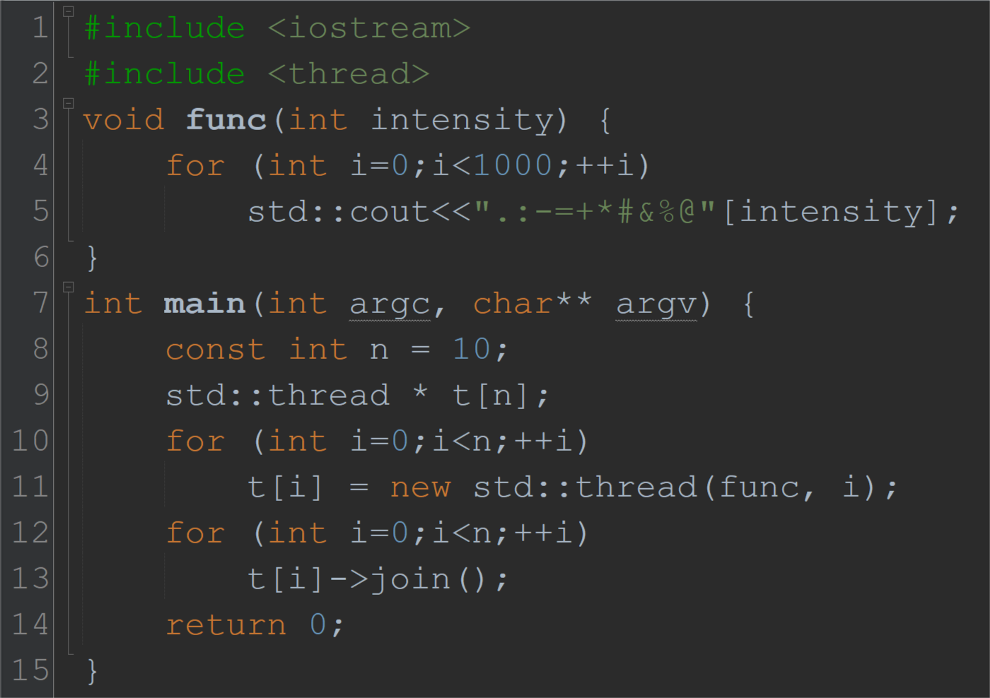
Ex3: Using this to visualize thread scheduling
.-------------.......-.........................................................-.-----.-..:-----------------------------------------------------------------------------------------------------------:-::::-:-
::::::.::::::-.........--------.....:.....................................................................................:.::::::::.::::::::-.:--.:.-::::::.-------:.......-.---.....:-------.::::::::.......:
:::::-:.---:----------------------------------------:--------.............=.=.-..............:.:::::::.:::::::::.-:.-.:---.--------.=--.----.-.--.........=-----.====-========-........----:.:::.:....-::::::::
:----.:::=-:=.=:+=:.+-+:+::::::+++::::::::-+.+=.:-++++=-----+.====:--.:::-...:+.:-+.:::-.+-----++:.+:::++-.+-=.-:.+:::*+:------------:::::::==-****-------=*::::.****:......*:::::.*+-+++-+.-+.---------:=+::+:
.#-............*-:***-=.:#=######-:=::-###*==#=*=-=*=+#=:.:::+######################*.+*+#=***.*:..#:-+:::::::######:::::::*#################+.#.#######.**+###..=#.+-............=-.:====-.:*...-*:........%.+
...............+%%%*=%+++++++++++++++++++++++++++++++-*******:=-#.&*:.&:-+=%:.=%%+..:%&*#::%&##########################=#-%%=#.+%*=:#&++++++-+**=*##---%-.&%*&+#&**=-+###############.-&-+=..............%#++++
+%=:+&-=.++*..........#:+*****%..........-#+%%-++#=..............-+-&%=%%%%%%%%:+@&&&&.:+#*@++.......=@@@@*:====+%***::#.==============+*%%%%-=========.@:**+...@@&#:@*......:@@@@@@@@@%=&:-+@%-#&:.@@@@@@@@@@@
@@@@@@@-#&::%@-*=:+#@--&@*:.+#-&&&@&:::::.%##+-=&%+++-=#%+:&##%+======#+*-+@**:###.+++++++++++++++++++:-----.*%@@#++-+.+%::::::::::::::::::::##########=@#+-.:::::::::::::::#=&@#*%&+#***-%%%%%+@##&-%%%%%%%%%%
%%%%.@@@@@@@@@@@@@@@:####&*#%+.*%=###:@...........%=#:@.%#####:*=...............#@:*=-+&*%#+:+*@.&:+=****......::+===-*&.%+++++@=-*:.%@@=&*:%%%-----=&.%%-----&&&&&&&&&&&&&&&&&&%%=:-------@&&&+====.:::::::::&
+#@@@@@:&:-..........&::::#......%&*-##..+&&*****#######:#.+%&&&&&=:#*=&=+-#&========%*.-#&&&+-#%&.........*+-#%&:---@#%=-#&%%%%%&&-.=#*@&&&&&&&&&&&&&&&#@-.&&&&&&&&&&&&&&*:@########*:::::::::::::::::::::::::
:::::::::::::::::-:---:-.@:::::::.-=@:::%+-----*=&-.******%&+#:================&.%@++:&%.@-=:&&&&&&.--=#%+*&......-.%+&-&---=#-*@&:+++@-.::%+#@+@=*&#.=%&@-#...=%=&@+######...=-&++++*......%=-&&:%.-----@::::=
%..*:=%@:***+%=-*:++++++++++++++++++#=%%%%%%#.:&%#==.:&%@####=......:%@#=::::::::::::::::::-+%%%%%%%%&*++++++++++++:&#+**.&:+++++%##########::+....%=*+:@=====+:%%%%%%%%%%%%%%%%%%%%%%%%%%-::::&%#%=&&&&&--%.==
==@#-&@#--%%%=&&&&&+-.*@+++=#&@%*##&==============+%.@@@@@@@@@@@@@@@@@@@@@@=-%&+=#-%%%%%%%%%%%%%%%%%%%%%%%%%+*&&&&&&&&&&&&#.-*%*&.+*@&&&&&&&&&&&&#%-+..@#######-++++++*&@@.###################+*--@=:.*@@@=::::
:.#&%***************#-+%=:%&@+:+:&&&&&&&*#::-=**::###############*&.:::=:+...-.....=:::::::+++-#&:@+++++-&&&&&&&&&&&&&&&:@*=#&::@*-#%@@@@*-#-#%@&--###+*********@-#-=%+&@@@@@@@@@@@@@:--.+####=-..*++++++++++++
+++++=%&:+++++++@&&&&&&&&&-.*:&-------@*:&#-*%@@@@@.--*&&#.+&@#=......+@@@@@@@@@@@#-*==%-+-%%%%%%%%.+*&#@:+-&@@@@-----#+&&&&.*-%+&%*#--@+=%%%%%*#:-@+++++++++++++++%%*::::::.++++++++++++++++++++++++++++++++++
++++++#+####+#&+%#*++++&%*-=:#&.*.====+@:#.%+++++++++++++++++++++:-@*.&@=:::::::.&@-:+&*@@=.+&*=:...++++#+****=%..#&+++=:.######&&+++::%.......##*&&&+:-#*&+.:-@&+%:*@&+%*-.&&&&&&#:@.%##:+.#::*%.........-&+**
*-&&&&&=+#***----==++:**-%=#+:&**.####+&*@=...-+++++++++++++++++++++++@#:&-+@@@@@@@@##:&-+++=@@@#.:+==@#--------------*=====.:-%****==+::::::%.#==+#@.....*:&#@@%:&.**%#-.*::::::::#-***:&+#%**&+##############
###=&%%%%%%#*@=&.+@=%&%++==============#%.*-=&%%@+-=&&&&&&&&&&:%%%%%%%%%%%%%%%%%%--=.@+*---=-+++++++++++++#&=====:-*%##-&&&&&-:::+*****.=@:*+-=@#&+%=:%&*=:#-=======*##&+@:::::=:*=-#::.&*%=====@##....*%====@@
:#######.....*%%%%-=@@@@@:*--&#%*:::#-=**&::::#--=+&#:-*+&.##:#-=:@*.%+&::**-....%.&&&&&#*%:..&--#-%@*#%%@*###=+:*******@-%&+:------=&&&&&&&&&&&&&&&&&&+%:::@++*:-=-#.@=@-#......%:@&.%:#&&&&&......*@##&@+....
.....=%&-+=.....@#:=----------*####+:::::::::::::-@++++++++++++++=#*%:+*#=%%%%%%%%%-@.*:%%%%%%%%%%%%%%%+%@----#-.:&@#+-:%&*.++=&&*++@%==.******-++++++++++++++++++%@@@@@@@@@@@@@@@@@@@@@@@@@@@@@@@@@=@@@@@@@@@@
@@@@@@@=*@@@@@@@@@@@@@@@@@@@@@=-.#*=======-&=.*=:@*%#+*-=::::::::::::::::::::@+-------:@*+&:*--------+#:.&&&&&&&&&&=---#:%====*.+:&%##=*++++++++++++:&&&&&&&&&&&&&&&&#-::&=*#.=%-@-+#*%@--#.+%@@@@@@@@@@@@@@@&*
++=%&****:=%=.*+:%#====@&%%%#=&%%-@@@@@@@@@@@@@@@@@@@@&&+%=.=@@+*#%%%%%%.-===============+*%.--------------#***&..+#####*&=.++++++*@-=++.*@#=====&.***-###===+&&&&.###===-&&&&&&&&:#########*=.&%-:#+=&%*###=@%
*+-@%%*.-:&=.+--:&#...+=*&#&++++++++=%:&#*-:::&&#%*@&######-=&&&&:@@@@&&&%+---------------------------&@@@@@@@@@@@@@@@@@@@@&%.++++++++++=&&&&*+%=**=#:.%%%%%%%%*+@#.#.*+@-*&#+#%&=++++++-%%%%%&*###############
#######%&=------------.+&&&&&@*-.%+@=*..++&:#@=**...+#@-%=*:#@#=%%%%%%%%-##@**********:*&-------#@:@+%-#=&&&&&&&&&&&&&&#@@@@@@@*=###+@*============%++-**####=.@:************=@+#################:%@+@:%&####+-
%:&++*-------------:+*%::::::&-%%%%%%%%%%@&&&&&+---=:@&+++++++#-*@%#+&&&&&&&&&&&&&*&.@%+&*#%%%-=&:.***@+===========%:@@@&#=::::::::-@%.=========&@-=&&&&&&&&&&&&&&&&&&&&&&&&&&&&&&&&&&&&&+&&&&&&&&&&&&&&*+.&&&&
&&*&&-:=***.#-.:#&.=#%-.=========================:=-#.-&#...-%&%#&-----+&%#&:-+=%:#%.+=&@&.=@%&+-.........%&++@....%:+=#.&:+#&-%####-+################:&.=:&&&&&&&&&&&&&&&&&&+#%=#####%=+#&=+%%%%-&.+#%-=:%&===
==#####+%:.#+==:=%+@:#&+=##:&&*=%&&.::::::::::#......=%*-:.=%&******:#&&@%%%%%%%*.-=###@-+**&%.---@@@@@&&%=+++++++++++++++++++++.++-:+=.%+:::::::::@:%=@@@@@@@@@@@@.:#%%%%%%%%-&::::::::=.&###=#:@.-%:&@.#*:&%%
%%%%%%%%%-.*.=&%-------.....:=*&&&&+%%%%%%%%%%%%%:#===&+++++++++++++++++:#-%%%%%%%%%%:.---+*#######&.@++&&-.........=&#------+%&*#:=@%&*+::::.#######*+::..#%++++@&-:*##%++@@.**#&++:@.#&&&&&&&&&&&&&&+:-%##+=@
--%.:+=@&#....==@&&*=@-+&&&&&&&&&&&&%.-&&&&&&&&&%#:---&%@####.-----+*@@@=#-%*&=#=-%:*+#-&:+++++++++++++++++@--------&.#+=::#+*@-%&@@@-%:.#=-:&.==%=*#...........:=*#-+=%::::&**-+=.@#+&&&&&&&&&&.@@@@@@@:+%.=*+
+++-%#%.@=*##%.#:.+@#%**************.@+++++++&-%#:=@@@@@@@@&===#&-&%+:=&@*:#+@*:++++++-=&*#::::::::-=*.%&+***@.........%+#*****-@%++++++=####-----------------------------------------*---------------*.@**@@@@
@@%=#*****************@%%*=:%.==#=%.@-##*+&..-%=+++@*******%*************.@=:%%%%**......&====:%%%%%%%-.&@*****=#-&@@:.-+:....#*%+&*:.#+&&&&&&&&&&&&&&&&&&&&&&::.:**%=&&+@***-&&&+%***:-&+++++++.%%%%%%*:---&%#
.......&&%:::::::::.=#%::&-%%@::&+.@:&+=+@-#%.*===+*@%.+-+***@=:-+******===-@@+*&%-----#*&@:###########&@@@@@@@@=::%.&+=-:::%.+#=&&&&&&&&&&.@-%=%@:@########+.-%#::::::::::::*-----------@+.#&%+=#@-&:+@%*:.&%#
:@.&-%%%%@+=*----------:&+&*%%%.+&-#:.....-#=+*-#-=+:************@--------------.%*:@..%%=@#..:::::::::::@-%=#@@===#%+:@=&%-*+:=====&------------------@+::::::&*.@@+@#*-.+:@@@@@@=.+++&#-*@.%:#-#@.....%+-&.:+
-.#@=+*&%..@-*****:%..-+&#%.-+&&&&-*.=%#-+.=&=#-@...........=*:-.%.&%%#*+=@.%%-%*&==.%%%%%%%%%%%%%%%%-:.@==============#:--------=+*:#=.@***#-###=@%..@+%&...@@#+++++++++++++++*...........%%%%%%+-############
####=%%%%%%%%%:...#=+:@--%*&--@=%.&&&&&&&&:=...&-@#.....&%@*.&&&&&&&&&&+#:=-***&%..#:-+..:@*+.....%-@*+=&%-%***************+.&-:=========================================*=*****=+*===========================#
+*+-#########*=+:&.+-===========&.:+----@*&&&#.........=@#-======*############%.+:@-#@%.:..@&%*+-.:@*....#-&+.@#*=-*&+=:-&*&::::::-+***&#.+=&-#.@&-####=.:&-###############*....:&=-#####.+&=-.:.&&&=-:%+@#&-%:
===============#-=+@@@@@@&#*+++%##:.******=&&&&&&&#:.-&%@:=&.%%@%:=:*@-%#+.........*---------------:+=#@%++=.###########%@@@@@@@@@@@@@@@@@@@@@*====#%%%%%%%%%%%%%:@@**%:::+#-*%%%%:@------%=::::::*.%@:*#.&*=-.
..&*-&:#+@-%:#*-&##%::::::::::::::::::::@&%-@&#=-+%#&------%=@@@@*%:=%@*:::@+%=@@@@@@@@@@@@@@@@@@*=+======#*=:#@=+++++++++++++#@=*+:@=*#::%@=*=***********************&=====*#@=*:&&#+:&##%***:&&&&&&&&&&&&&+=&
&&&&%+@%*@@@@@#+++++*@#%++++++*@#@#@:=****************:#=:::::*%*======#=*+@%%%%%%%%%%%%%%%%%%%&+@&*&#+*@&+%######*%+#*@:&##*@:%=+&#::::*+&+&@%++=&&@++++++&%#@=:&+#*@@=@=:*******#*+%&=#:#@=&+:==&=@#%*:##::&%
+*:#&@%+#=%:#@%%=:#&=@#:*&&+::::::::::::*+++++#&@***+:::::::::++=###########++++++++@=:+%@@#:@&#%*&::::::::::::%+&&&&*:@@@@@@@@@@@@@@@@@@@@@@@@@@@@@@@@@=@@@@@@@@@@@@@@@@@@@@@@@=@&+=@@@@@@@=+&#======%*=+&#*:=
@###&:=:=**=%*=&#@=%%%%%%%%%%%=====&@:#=========%=:#&&&&&&&&&&&%+===@##@+:=%#@+:#%+=@:@&:::::#@@===============:=&&&&&+*@@@@@@@@@@%#=+@%%%#&=*%##&@*%%%%%%%%%%%%%%#=*@%##&*@%&*=:*@&#======:#=#*===::::::::::::
::@*********##@&+*@&%+@#=@%#@@@=%+#*%%+@@@@@@@@@#+=+&*===========*@=&@@@@@%=*#@:#%***:+@&***=+:&#@==#@:&+=@@@@@@@@@@@@@@@@@@@@@&=*+=@#:&@+=:&*@%#**&@@+&%=:#&++#:&@+#####+@@:#*&+:&#####*+=::::++#@*%@+*%%%%%%%
%%%%%%%%=+++++++@@@@%=*+++:@%=*::#%%%%%+*:=&#=%&+%%&*=%@+++++++++++*%=++%:*********************+:%*&=%@+&*%#=@:&&&#&############*+=#@&+*=#%*+++++++++++#*%+:************************+++&@#*****************#+@&
&&&&&&&&&&&&&&&+++++++++%&#+:###%&*#=&:%&*@&&@::+#&&&+@@@@@@#%*=@++++=@=:++++&@+@:=&#@=&&&&&&&&#*=======+:&&&@&#*+++:###=***%@=*&:@===+&&&&&&&&&&&&&&&&&&#@@@@@@@=:####@=%*#@@@+#%+++++++@&==%=:*:********#*@=:
#@*&:@&@#&#:%&&&&&&#*%@&:*******&:@*&&#*&@&&*=:&:::=***@:%#:=:====@&:::::::#:@&=::@*::=====&:%=#*=#&&=######################################*#*******#&@#*&#@*####:=&**************&:=======::::::::%#:&*:@=&@=
&&%#*@====&%%%%%%%%%%%%%%%%%%*=&&&&&&@%==&:#=&&%=======%&===@%%:=@@=:@=@*&%&%%%@*****%****=%&%%%*&*****@%&*&&&&&&&&&&@&&&&*=%=%%%%%&==%&&&&*&***********@=***===%***@%%%%%%%%%@%%%%%%%********@%%%%@*@@@@@@@*@*
%@=%****%**=%*@*************@*%%%%%******=*%=*%=========@=@@@@@@@=@%@@@%%%%%=%*@=*@=====*%@%%%%%%%%**%%%%%%******@*@@%@%%%%%%%%%@*****@@@@@@********%@@@@@@%%%%%%*%**@@%@*%%%%=@*%@%%%%%%%=@@@*@*****%@%%%%%%%%
%%@%*@@@@@@@@@@@@@@*@*%@*=****=*=======@*=@%****%*@*@%*=@**%@*%%*%*%%%%%=***@*%=@*@%@@@@@@@@%*%%%%@=%==%=@%====*@=@==@=@@@*@**=@@@@@=====@*==========*=*@====@@%@%@*%%%%%%%%%%%%%%%%%%%%%%%%%%%%%%%%%%%%%*%*@%@
%*@%******@%%%%%%%%%%%%%%%%%%%%%%%%%%%@@@@@@@@@@@@@@************

Slide 11
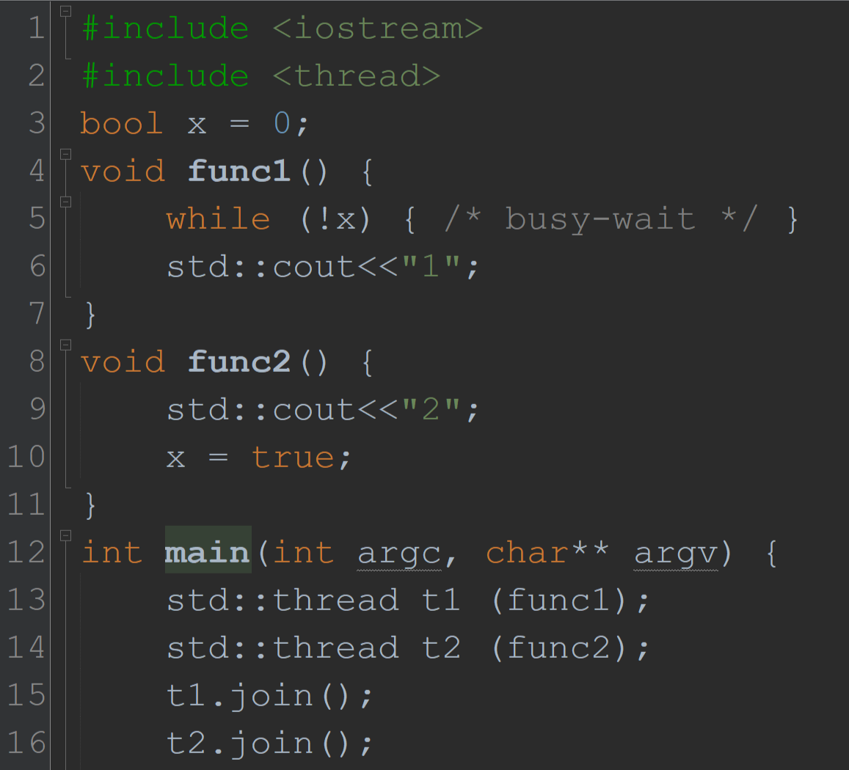
basic examples…
… can lead to hard questions!
What happens in this code?
At –O0 (no optimization), print “21”
At –O3 it runs forever!
What’s happening here?
Compiler optimizations often break multithreaded code!

Slide 12
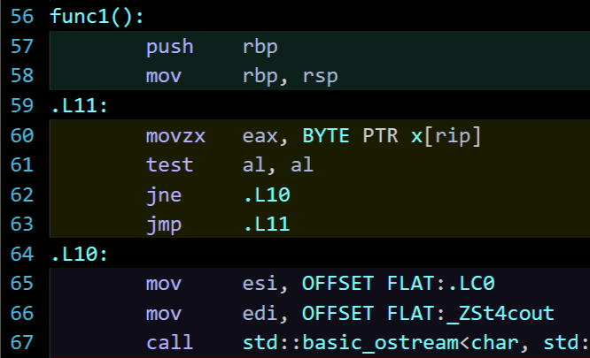
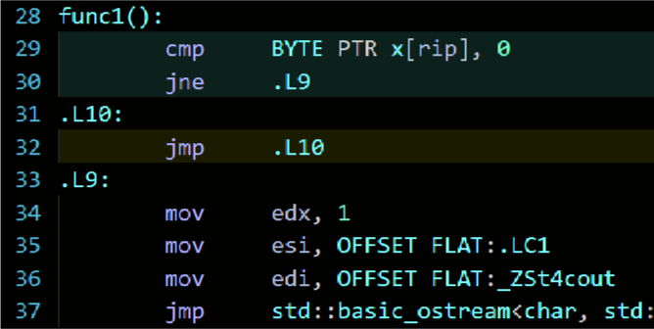
–O0 vs –O3
-O0
Repeatedly read and test x inside the loop
Read and test x once before an empty loop
-O3
ASM generated using GCC 9.1 via https://godbolt.org/

Slide 13
The Issue
Important principle!
Compiler doesn’t know x may be changed by other threads
In a single-threaded execution it wouldn’t
Solution
Use C++ Atomics for x
Informs the compiler that x may change
(Before C++ atomics, we used volatile for this)
Principle: any variable written by at least one thread, and read by at least one other thread, should be an atomic<T> type

Slide 14
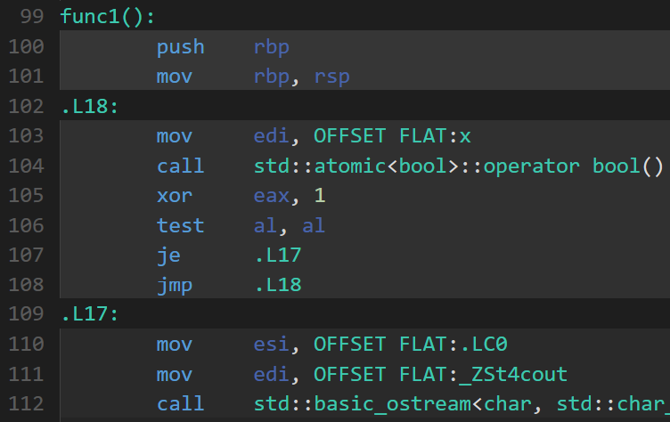
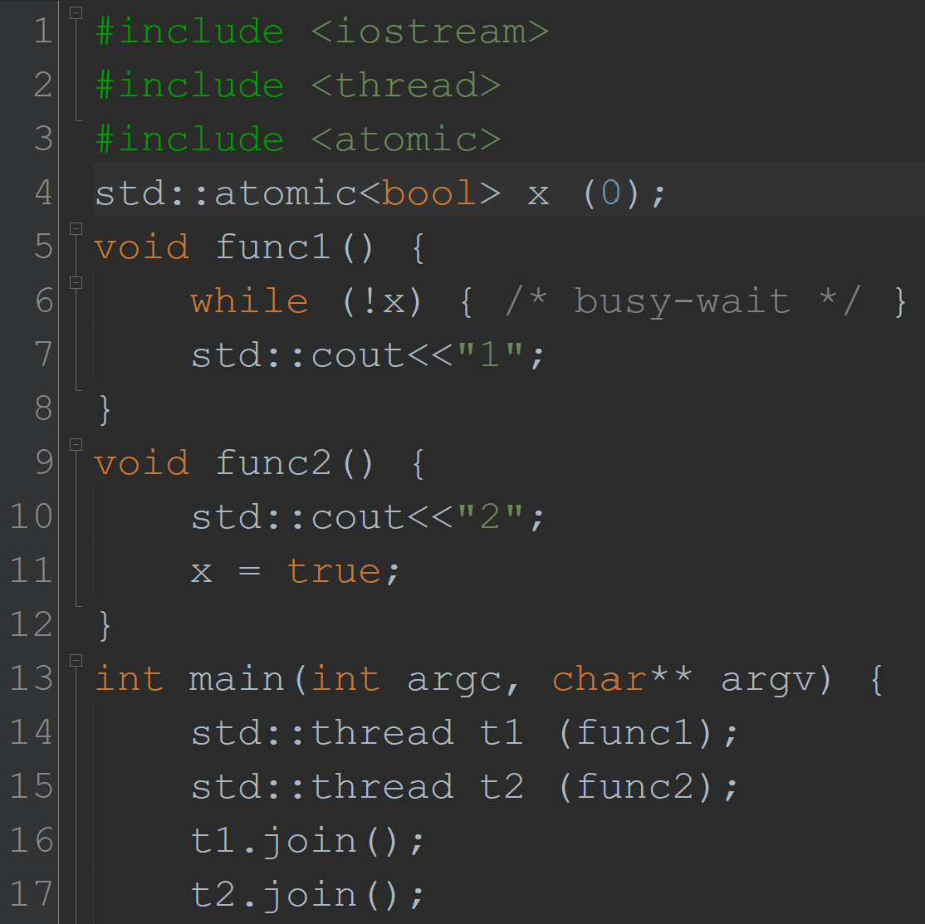
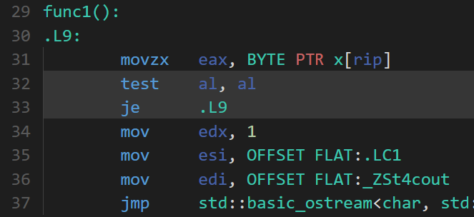
Using atomic<bool>
-O0
Repeatedly read and test x inside the loop
Repeatedly read and test x inside the loop… correct!
-O3

Slide 15
Definition: (Shared) object
Important definition!
An object has some abstract state and offers one or more operations
An operation has an invocation (possibly taking some arguments) and a response (possibly returning a value)
An object can be accessed simultaneously by many threads

Slide 16
Example: Counter object
Abstract state! We are not saying anything about the implementation.
Stores an integer value, initially zero
Operations…
Increment
Increase the value by one and return the old value
Read
Return the current value
How to define semantics? Want to avoid implementation details…
Again, we are talking about the abstract state
Not any particular representation in memory…

Slide 17
Motivation
Why might you want a counter?
To keep track of the size of a concurrent hash table
Counter is incremented whenever an element is inserted
Counter is read to decide whether the table should be expanded
Suppose accesses to the hash table are spread out and highly concurrent
Then the hash table is not a concurrency bottleneck
Counter should not be a concurrency bottleneck either!
Why are we studying counters?
As a vehicle to understand concurrency, correctness, performance and systems

Slide 18
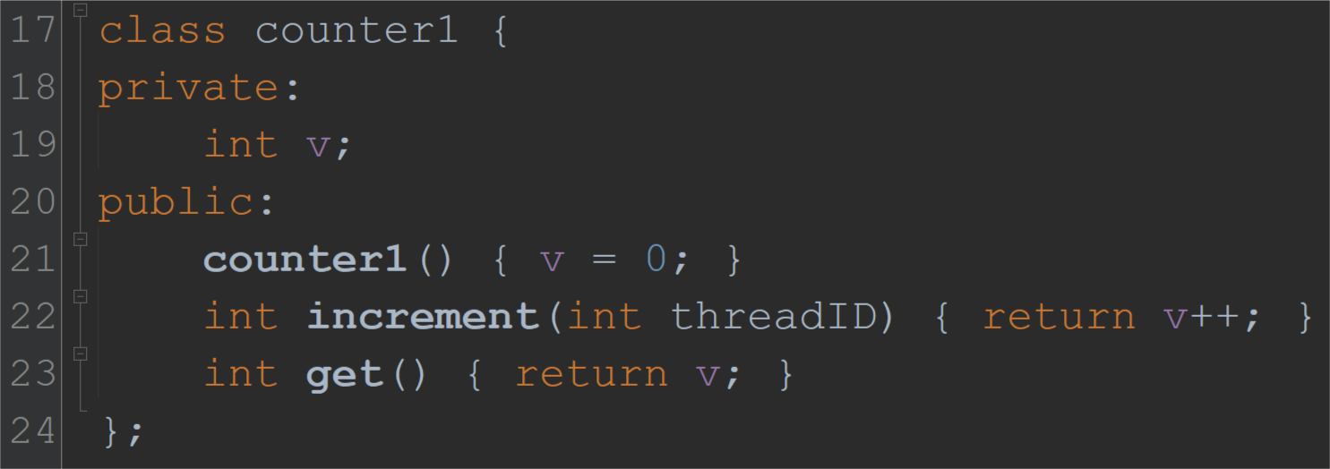
Naïve implementation of a counter
Using reads and writes
Increment(c)
x = Read(c)
Write(c, x + 1)
Return x
Get(c)
x = Read(c)
Return x
This is really a read followed by a write…

Slide 19
Execution of an algorithm
Important definition!
Execution E is a sequence of alternating configurations and steps
C₁ s₁ C₂ s₂ C₃ s₃ …
Configurations and steps capture how the system changes over time
A configuration describes the state of the system
Contents of memory
Program counters of all threads
A step is a read or write to shared memory
(Or an atomic synchronization primitive --- more on that later)

Slide 20
Example execution 1: our naïve counter implementation
Suppose two threads p and q both access the same counter c
thread p
thread q
Read(c) → 0
Write(c, 1)
Return 0
Read(c) → 1
Write(c, 2)
Return 1
After 2 increments
Final counter value = 2
Time

Slide 21
Example execution 2
thread p
thread q
Read(c) → 0
Read(c) → 0
After 2 increments
Final counter value = 1?
Incorrect!
Write(c, 1)
Return 0
Write(c, 1)
Return 0
Same return values?
Incorrect!
Time

Slide 22
Example execution 3
thread p
thread q
thread r
Read(c) → 0
Read(c) → 0
Write(c, 1)
Return 0
Read(c) → 1
Write(c, 2)
Return 1
Read(c) → 2
After 4 increments
Final counter value = 1?
Any changes between this Read and Write are overwritten!
Write(c, 3)
Return 2
Write(c, 1)
Time

Slide 23
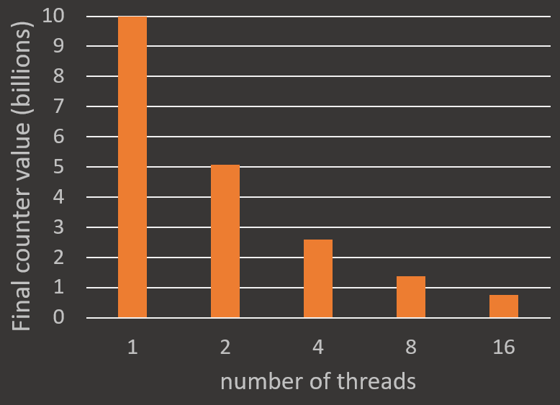
How bad is this naïve counter’s accuracy in practice?
Simple experiment
n threads share one counter
Each thread performs (10 billion / n) increments
What should the final counter value be at the end of the execution?
93% of all increments are lost!

Slide 24
What does it mean to be correct?
In the counter accuracy experiment
Obvious: at the end, counter should = 10 billion
Not obvious: during the experiment, what should each Increment() return?
???
Inc.→0
thread p
Inc.
Inc.
?
?
<
Inc.→1
Inc.
thread q
Inc.
Inc.
?
<
?
Inc.→2
thread r
Inc.
Inc.
Time
What to do when operations overlap?

Slide 25
What does it mean to be correct?
Correctness condition: Linearizability
High level idea
Every concurrent execution E has an equivalent sequential execution
I.e., E represents a sequential execution that could happen!
Implies: E cannot do anything that is impossible in a sequential execution
Lifts an object’s sequential definition into the concurrent setting
Concurrent behaviour is defined by valid sequential behaviour

Slide 26
Defining Linearizability
CRITICAL definition!
A concurrent execution is linearizable if
each operation has a linearization point during the operation, such that
if all operations appear to occur instantly at their linearization points, then they behave exactly as defined in the sequential abstract data type
An object is linearizable if all possible executions are linearizable

Slide 27
Is this linearizable?
Execution 1
I.e., can we choose linearization points during each operation such that all operations respect the sequential ADT?
Yes
thread p
Inc.→0
Inc.→3
thread q
Inc.→1
Inc.→4
Inc.→5
thread r
Inc.→2
Inc.→6
Time

Slide 28
Is this linearizable?
Execution 2
I.e., can we choose linearization points during each operation such that all operations respect the sequential ADT?
Yes
thread p
Inc.→0
Inc.→6
thread q
Inc.→1
Inc.→3
Inc.→5
thread r
Inc.→2
Inc.→4
Time

Slide 29
Is this linearizable?
Execution 3
I.e., can we choose linearization points during each operation such that all operations respect the sequential ADT?
Cannot pick same linearization point for both, or sequential ADT does not make sense
Cannot pick same linearization point for both, or sequential ADT does not make sense
???
Inc.→0
NO
thread p
Inc.→3
thread q
Inc.→1
Inc.→3
Inc.→5
thread r
Inc.→2
Inc.→4
Time

Slide 30
Is this linearizable?
Execution 4
I.e., can we choose linearization points during each operation such that all operations respect the sequential ADT?
thread p
Inc.→0
Inc.→6
thread q
Inc.→2
Inc.→3
Inc.→5
thread r
Inc.→1
Inc.→4
Time
LATEST that “Inc.→2” can linearize
EARLIEST that “Inc.→1” can linearize
So “Inc.→1” must be linearized after ”Inc.→2” (violating the sequential ADT)
NO

Slide 31
Assignment 1
Released now
Due in one week
Goals:
Get your development environment set up
Connect to remote servers that you can use for development (for this class)
Learn Linux tools
Practice turning human-readable text output into experimental graphs
Learn how to submit your programs to Marmoset
Learn how to submit written parts to Crowdmark
I hope you can login… but if you can’t, we’ll figure it out.

Slide 32
Course resources
No official textbook (just slides and some supplementary papers)
That said, The Art of Multiprocessor Programming by Herlihy and Shavit may be helpful
See Piazza for slides, assignments, announcements, questions
See Crowdmark for submitting written parts of assignments
See Marmoset for submitting code

Slide 33
Summary
Important definitions
Threading model (shared memory)
(Shared) object
Execution (of an algorithm)
Linearizability (of executions and objects)
Important system concepts
Threading via std::thread
C++ atomics (principle: when to use atomics)
Assignment 1 due in a week

