Slide 1
Multicore programming
Implementing KCAS and reclaiming descriptors
Lecture 12
Trevor Brown

Slide 2
Last time
Implementing double-compare-single-swap
Using descriptors and helping to guarantee lock-free progress
Started implementing k-word compare-and-swap

Slide 3
This time
Finishing the implementation of KCAS
Reclaiming memory for DCSS and KCAS
How to use epoch-based memory reclamation
On the slides (but not in the lecture):
Quick intro to some debugging/perf tools

Slide 4
Intuition: how a Successful KCAS works: Doubly-linked list as an example
pred
succ
after
Delete(17)
15
17
20
X
KCAS descriptor
status = Undecided
n = 5
&pred.next | succ | after
&after.prev | succ | pred
&pred.mark | false | false
&succ.mark | false | true
&after.mark | false | false
Succeeded

Slide 5
Intuition: How a FAILED KCAS works: Doubly-linked list as an example
pred
succ
after
Delete(17)
15
17
20
X
KCAS descriptor d
status = Undecided
n = 5
&pred.next | succ | after
&after.prev | succ | pred
&pred.mark | false | false
&succ.mark | false | true
&after.mark | false | false
Failed to change succ.mark from false to point to d!
Failed
CAS from d back to expected values

Slide 6
Keeping helper threads in sync
Key ideas:
In phase 1 (lock-free “locking”), helpers compete to CAS the status from Undecided to Succeeded or Failed
Only one helper can “win” and change status
Once the status is Succeeded or Failed, no more lock-free “locking” should happen
I.e., helpers should no longer change addresses to point to the KCAS descriptor
Accomplish this with DCSS!
In phase 2 (completion), all helpers agree (based on the status) to change all addresses to new values, or back to their old values (exp₁…exp_{k})

Slide 7
Using dcss in the “locking” phase
Threads use DCSS to “lock” addresses (storing a pointer to a KCAS descriptor)
DCSS addr1 = status field of the KCAS descriptor
DCSS exp1 = Undecided
DCSS addr2 = address to be “locked” for the KCAS (from KCAS arguments)
DCSS exp2 = expected value for that address (from KCAS arguments)
DCSS new2 = pointer to the KCAS descriptor
Semantics of DCSS guarantee:
KCAS will successfully “lock” an address only if the KCAS status is still Undecided
Without this guarantee, something called an ABA problem can occur. (discussion…)

Slide 8
Distinguishing between descriptors
Now that we have DCSS descriptors and KCAS descriptors, we must be able to distinguish between them
Steal another bit from each word (DCSS uses the least significant bit, KCAS uses 2nd-least significant)
The two least significant bits tell us whether an address contains a value, DCSS descriptor, or KCAS descriptor
pack(d): return d | 1 [making it “look like” a DCSS descriptor pointer]
packKCAS(d): return d | 2 [making it “look like” a KCAS descriptor pointer]
unpack(d): return d & ~3 [zeroing out the bottom two bits]

Slide 9
Implementation
Data structures
Code
struct KCAS_desc {
bool KCAS(addr1, ..., exp1, ..., new1, ...)
atomic<word_t> status;
word_t n;
KCAS_row row[K];
char padding[24];
} __attribute__ ((aligned(64)));
1 KCAS_desc * d = new KCAS_desc(addr1, ...);
2 d->status = Undecided;
3 SortRowsByAddress(d); // to avoid livelock
4 return KCASHelp(d);
word_t KCASRead(atomic<word_t> * addr)
struct KCAS_row {
5 word_t v;
6 do {
7 v = DCSSRead(addr);
8 if (isKCAS(v)) KCASHelp(unpack(v));
9 } while (isKCAS(v));
10 return v;
atomic<word_t> * addr;
word_t exp;
word_t new;
};
Linearize at last DCSSRead(addr)

Slide 10
bool KCASHelp(KCAS_desc * d)
Use DCSS to change addresses to point to the KCAS descriptor
11 int newStatus = Succeeded;
12 if (d->status == Undecided)
13 | for (int i = 0; i < d->n; i++)
14 | | word_t val2 = DCSS(&d->status, d->row[i].addr,
| | Undecided, d->row[i].exp,
| | packKCAS(d));
15 | | if (val2 != d->row[i].exp) // if DCSS failed
16 | | | if (isKCAS(val2)) // because of a KCAS
17 | | | if (unpack(val2) != d) // a DIFFERENT KCAS
18 | | | KCASHelp(unpack(val2));
19 | | | --i; continue; // retry "locking" this addr
20 | | | // else another helper "locked" for us
21 | | | else // addr does not contain its exp value
22 | | | newStatus = Failed; break;
23 | CAS(&d->status, Undecided, newStatus);
24 bool succ = (d->status == Succeeded);
25 for (int i = 0; i < d->n; i++)
26 | val = (succ) ? d->row[i].new : d->row[i].exp;
27 | CAS(d->row[i].addr, packKCAS(d), val);
28 return succ;
Phase 1: lock-free “locking”
Status CAS
Phase 2: completion

Slide 11
bool KCASHelp(KCAS_desc * d)
11 int newStatus = Undecided;
12 if (d->status == Undecided)
13 | for (int i = 0; i < d->n; i++)
14 | | word_t val2 = DCSS(&d->status, d->row[i].addr,
| | Undecided, d->row[i].exp,
| | packKCAS(d));
15 | | if (val2 != d->row[i].exp) // if DCSS failed
16 | | | if (isKCAS(val2)) // because of a KCAS
17 | | | if (unpack(val2) != d) // a DIFFERENT KCAS
18 | | | KCASHelp(unpack(val2));
19 | | | --i; continue; // retry "locking" this addr
20 | | | // else another helper "locked" for us
21 | | | else // addr does not contain its exp value
22 | | | newStatus = Failed; break;
23 | CAS(&d->status, Undecided, newStatus);
24 bool succ = (d->status == Succeeded);
25 for (int i = 0; i < d->n; i++)
26 | val = (succ) ? d->row[i].new : d->row[i].exp;
27 | CAS(d->row[i].addr, packKCAS(d), val);
28 return succ;
Recall: KCAS just returns KCASHelp(d)
Where should we linearize a successful KCAS?
At the status CAS! The behaviour of all helper threads, and hence, the outcome of the KCAS, is decided there. (Crucial points: (1) everything is “locked” at that time, and (2) no thread can see the “old” values after that time.)
Why does this work?
Complicated argument! Model checking + proof sketch in paper.
Deeper than we need to go.

Slide 12
Reclaiming descriptors

Slide 13
Lifecycle of a Node
Can’t reach from shared memory + can’t reach from private memory = safe to free
Unallocated
Uninitialized
Retired
In the data structure
Safe to free
Free
Allocate
Safe memory reclamation problem:
Determine that no thread can reach the record by following pointers from private/stack memory
Make node accessible
to other threads
???
Remove (all incoming pointers)

Slide 14
Epoch Based Reclamation (EBR)
EBR is a relatively low-overhead blocking solution to the safe memory reclamation problem
Consider a data structure composed of records (e.g., descriptors) that should be reclaimed
Suppose threads do not remember pointers to records found in one operation, and then use them in another subsequent operation
Instead, when starting a new operation, a thread “forgets” all pointers to records, and can only access a record by starting at some address in shared memory that is not part of a record, and following pointers from there.)
EBR interface:
startOp()
Must be invoked at the beginning of each operation before accessing any shared records (i.e., records that have previously been made accessible to other threads)
retire(rec)
Should be invoked once rec is no longer reachable from shared memory
Can still be reachable from threads’ local memories, however… this is fine!
Unlike free(), retire will delay reclamation until no thread has a pointer to node
How is EBR implemented? Will see later... Let’s see how to use it.

Slide 15
Using EBR in DCSS
startOp() here
word_t DCSS(addr1, addr2, exp1, exp2, new2)
1 DCSS_desc * d = new DCSS_desc(addr1, ...);
2 word_t val2;
3 while (true) {
4 val2 = VAL_CAS(d->addr2, d->exp2, pack(d));
5 if (isDCSS(val2)) DCSSHelp(unpack(val2));
6 else break;
7 }
8 if (val2 == d->exp2) {
9 DCSSHelp(d); // finish our operation
10 }
11 return val2;
DCSS_desc is our “record” type
Do we always access a DCSS_desc by following pointers starting from an address that is not part of a DCSS_desc?
Yes! Any DCSS_desc that we access is found by reading an address passed to DCSS/DCSSRead (and this address cannot be part of a DCSS_desc)
retire(d)
else free(d)
word_t DCSSRead(atomic<word_t> * addr)
17 word_t v;
18 while (true) {
19 v = *addr;
20 if (isDCSS(v)) DCSSHelp(unpack(v));
21 else break;
22 }
23 return v;
startOp() here

Slide 16
Using EBR in KCAS
startOp() here
bool KCAS(addr1, ..., exp1, ..., new1, ...)
KCAS_desc is our “record” type
1 KCAS_desc * d = new KCAS_desc(addr1, ...);
2 d->status = Undecided;
3 SortRowsByAddress(d); // can skip sometimes
4 bool ret = KCASHelp(d);
5 return ret;
Do we always access a KCAS_desc by following pointers starting from an address that is not part of a KCAS_desc?
retire(d)
Yes! Any KCAS_desc that we access is found by reading an address passed to KCAS/KCASRead (and this address cannot be part of a KCAS_desc)
word_t KCASRead(atomic<word_t> * addr)
5 word_t v;
6 do {
7 v = DCSSRead(addr);
8 if (isKCAS(v)) KCASHelp(unpack(v));
9 } while (isKCAS(v));
10 return v;
startOp() here
No need to worry about DCSS_desc records, as those are completely encapsulated in DCSS (black box)
Note: from the perspective of the KCAS algorithm, the DCSS object is a black box. Reclamation of DCSS descriptors is hidden in the implementation of DCSS.
(Conceptually, there are two instances of the EBR algorithm: one for DCSS, one for KCAS)

Slide 17
Tools for debugging and performance
Debugging and optimizing concurrent programs is very hard. Tools can help!
Debugging
GNU Debugger (GDB)
Segfaults, infinite loops
Address Sanitizer (ASan)
Segfaults, memory leaks
1~2x slowdown
Valgrind
Segfaults, memory leaks, memory access errors
many-x slowdown
Graphviz
Visualizing pointer based data structures
Performance
Linux Perftools (perf)
Studying cycles, cache misses, instructions, stalled cycles
At the whole-application level
C/C++ Performance API (PAPI)
Precise information from perf, but recorded within your program
VTune Amplifier
Powerful (and now free!) profiler
A lot of errors in concurrent programs manifest as memory access errors! For example, a thread may write a bad value into a pointer because of a concurrency bug, and another thread may then read it.

Slide 18
Debugging Tools

Slide 19
Using valgrind to find memory access errors
$ valgrind --fair-sched=yes ./a1code_segfault/workload_timed.out 4 1000 naive
==107893== Command: ./a1code_segfault/workload_timed.out 4 1000 naive
==107893==
==107893== Use of uninitialised value of size 8
==107893== at 0x510F0D4: std::thread::join() (in /.../x86_64-linux-gnu/libstdc++.so.6.0.22)
==107893== by 0x1092DC: void runExperiment<CounterNaive>(...) (workload_timed.cpp:46)
==107893== by 0x108E3B: main (workload_timed.cpp:70)
==107893==
==107893== Invalid read of size 8
==107893== at 0x510F0D4: std::thread::join() (in /.../x86_64-linux-gnu/libstdc++.so.6.0.22)
==107893== by 0x1092DC: void runExperiment<CounterNaive>(...) (workload_timed.cpp:46)
==107893== by 0x108E3B: main (workload_timed.cpp:70)
==107893== Address 0x190 is not stack'd, malloc'd or (recently) free’d
...

Slide 20
Using Address Sanitizer to check for memory leaks
$ g++ -pthread –g -fsanitize=address -static-libasan -fopenmp -O3 ex2_mmult_threads.cpp
$ ./a.out 24
matrix created: 0.02s
randomize call finished: 0.10s
... multiply call finished: 2.82s
=================================================================
==76549==ERROR: LeakSanitizer: detected memory leaks
Direct leak of 192 byte(s) in 24 object(s) allocated from:
#0 0x555b294992d8 in operator new(unsigned long) (/home/.../a.out+0xc82d8)
#1 0x555b294dab9e in matrix::multiply(matrix*, int) (/home/.../ex2_mmult_threads.cpp:12)
SUMMARY: AddressSanitizer: 192 byte(s) leaked in 24 allocation(s).

Slide 21
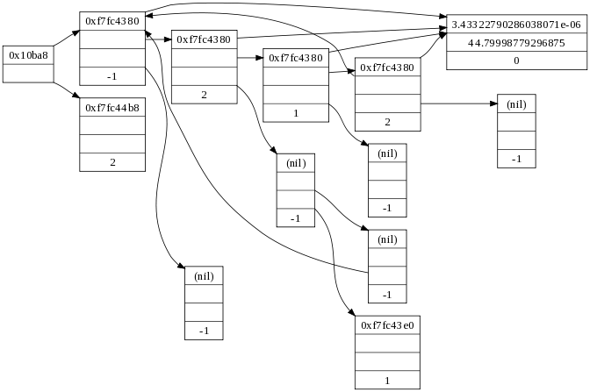
Graphviz: when you just need to SEE it
digraph g {
node [
fontsize = "16"
shape = “record"
];
edge [];
"node0" [
label = "<f0> 0x10ba8| <f1>“ ];
"node1" [
label = "<f0> 0xf7fc4380|<f1>|<f2>|-1"
];
[...]
"node0":f0 -> "node1":f0 [
id = 0
];
[...]
}
$ dot -Tpng input.dot > output.png
Tip: try to get your toughest bugs to happen in SMALL data structures, so you can graphviz them

Slide 22
Sanity checking: experiment checksums
Important to perform sanity checks wherever you can!
Helps to catch obvious (and non-obvious) mistakes
One good sanity check: checksum based validation
Reduce the data structure to a number (a data structure checksum)
Reduce each threads’ completed operations to a number (a thread checksum)
verify that thread checksums “match” the data structure checksum
(I.e., the work the threads think they’ve done is reflected in the data structure!)
Creativity needed to come up with good checksum functions

Slide 23
Performance Tools

Slide 24
Investigating cache misses with Linux Perftools: perf record
$ perf record -e cache-misses ./ex4_counting_events_counter4.out 24
matrix created: 0.00s
randomize call finished: 0.03s
...
number of additions = 1000000000
[ perf record: Woken up 1 times to write data ]
[ perf record: Captured and wrote 0.802 MB perf.data (20591 samples) ]
$ perf report

Slide 25
Investigating performance with Linux Perftools: perf report
Samples: 20K of event 'cache-misses', Event count (approx.): 543388
Overhead Command Shared Object Symbol
22.51% ex4_counting_ev ex4_counting_[…].out [.] _ZN6matrix8multiplyE...
5.64% ex4_counting_ev [kernel.kallsyms] [k] decay_load
5.07% ex4_counting_ev [kernel.kallsyms] [k] native_sched_clock
5.02% ex4_counting_ev [kernel.kallsyms] [k] __update_load_avg_se...
4.21% ex4_counting_ev [kernel.kallsyms] [k] perf_event_alloc.par...
3.75% ex4_counting_ev [kernel.kallsyms] [k] _raw_spin_lock
3.73% ex4_counting_ev [kernel.kallsyms] [k] cgroup_rstat_updated
3.34% ex4_counting_ev [kernel.kallsyms] [k] task_tick_fair
[...]
Interactive console… select this line and press [ENTER] twice…

Slide 26
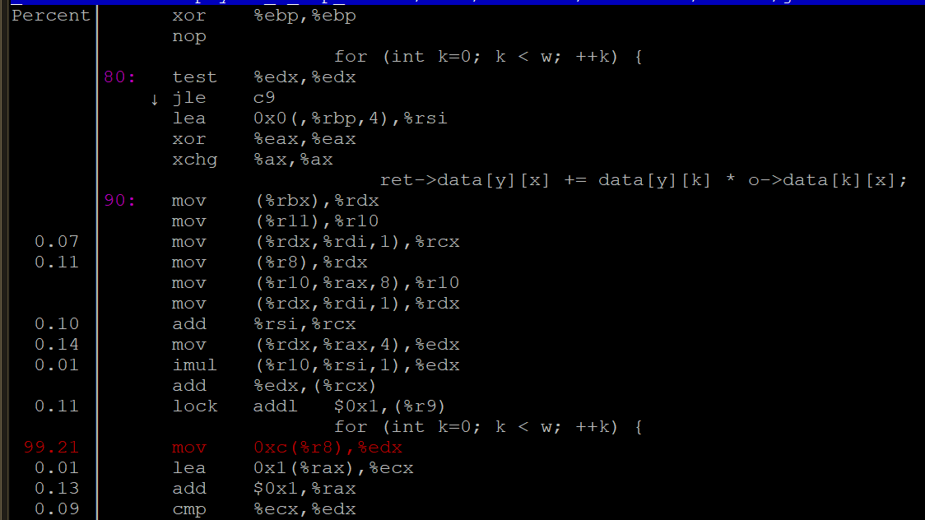
In reality it’s this line, where we fetch & add a subcounter in a sharded counter that suffers from false sharing
Perf claims cache misses are at this line, but the real culprit can be off by a few lines

Slide 27
C/C++ library: PAPI
https://icl.utk.edu/papi/
Gives access to most of the same stuff as perf stat/record/report, but programmatically inside your own code
Can always include some measurements in your runs
Fast --- no real overhead on Intel for ~2-4 performance monitoring counters
Can easily measure only part of your execution (skip measuring setup/teardown)
Can present results in a nice format (e.g., L3 cache misses PER data structure operation)
total throughput : 94906203
PAPI_L1_DCM=36.4196
PAPI_L2_TCM=24.8331
PAPI_L3_TCM=11.8196
PAPI_TOT_CYC=5515.5
These are all “per data structure operation”

Slide 28
When you need a real profiler: VTune
Surprisingly, Intel’s VTune is free. Even for commercial use!
Great profiler for seeing what threads are doing throughout your execution
Surprisingly easy to learn and use, even in complex scenarios…
Profiling code that runs locally is trivial
Profiling code that runs remotely:
~6 hours invested to learn the idiosyncrasies of VTune + remote execution

Slide 29
