Slide 1
Multicore programming
Hardware transactional memory, and TLE
Lecture 13
Trevor Brown

Slide 2
Announcements
Memory reclamation: last time was hopefully enough detail for A5, but maybe not enough to fully understand the limitations of EBR in complex scenarios
Would like to talk more about memory reclamation, but a bit later…

Slide 3
Usefulness of KCAS
KCAS is an awesome tool, but it doesn’t solve everything
It makes it easy to change multiple addresses atomically (and with lock-free progress)
Locks do this too (but without lock-freedom)
Implement KCAS with locks, if you like (can also be fast). surprisingly tricky to get right, though… more later…
It does not make it trivial to argue searches work
And searches are part of updates!
So, we still need some ad-hoc correctness arguments for both searches and updates!
Question: how to get fast data structures with easy/trivial proofs for searches (as well as the search/traversal part of updates)?
Lock-based algorithms that do not lock while searching also have this same challenge: proving correctness for searches is hard.
This is why I think lock-free algorithms and fast lock-based ones are somewhat similar…

Slide 4
This time
A technology that can help with correctness arguments for searches
Implemented in some modern hardware
Many recent Intel CPUs
IBM POWER8+ (IMO, not as good as Intel’s implementation)
ARMv8 (haven’t used it yet…)
Can also be used to greatly accelerate some algorithms such as KCAS
And can even accelerate lock-based algorithms

Slide 5
transactional memory (TM)
Allows a programmer to perform arbitrary blocks of code atomically
Note: locks also do this (just not always efficiently or easily)
bool transfer(int *src, int *dst, int amt)
bool result = false;
atomic {
if (*src > amt) {
*src -= amt;
*dst += amt;
result = true;
}
}
return result;

Slide 6
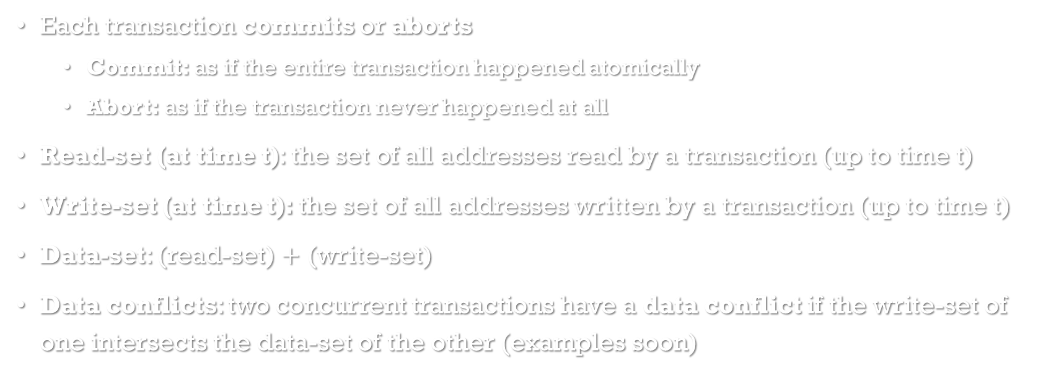
Definitions
Each transaction commits or aborts
Commit: as if the entire transaction happened atomically
Abort: as if the transaction never happened at all
Read-set (at time t): the set of all addresses read by a transaction (up to time t)
Write-set (at time t): the set of all addresses written by a transaction (up to time t)
Data-set: (read-set) $+$ (write-set)
Data conflicts: two concurrent transactions have a data conflict if the write-set of one intersects the data-set of the other (examples soon)

Slide 7
Transactional operations
Studying Intel’s hardware implementation of TM
xbegin: start a new transaction and return XSTARTED
xend: try to commit the transaction (might abort instead)
xabort: abort the transaction
read *addr: Read & add addr to the transaction’s read-set (in L3 cache)
write *addr = val: Write & add addr to the transaction’s write-set (in L1 cache)
Note: xbegin, xend, xabort are actual x86/64 assembly instructions
Instruction set: TSX-NI / RTM (provided in several modern Intel chips)

Slide 8
High level idea
Transaction works sort of like a lock, but can abort
Suppose thread p reads *src at line 3, then thread q subsequently modifies *src
This causes a data conflict, which will cause p’s transaction to abort (since its view of memory is no longer atomic)
bool transfer(int *src, int *dst, int amt)
1 bool result = false;
2 xbegin();
3 if (*src > amt) {
4 *src -= amt;
5 *dst += amt;
6 result = true;
7 }
8 xend();
9 return result;
Work might not be done because of an abort
Must handle aborts somehow

Slide 9
A bit more detail on Intel’s Hardware TM (HTM)
Threads can execute transactions that read/write/CAS/F&A any addresses
They can also read/write/CAS/F&A addresses non-transactionally (as usual)
Transactions abort as soon as there is a data conflict
Data conflicts can be between two transactions, or between a transaction and a thread that performs non-transactional accesses
Suppose a transaction T accesses (read/write/CAS/F&A) an address, and then before T commits, a different thread p modifies (write/CAS/F&A) that address. Whether p’s modification is inside a transaction or not, T will abort immediately.
Suppose a transaction T modifies an address, and then before T commits, a different thread p reads that address. If p’s read is not performed inside a transaction, then T will abort immediately.
Moreover, transactions can abort at any time, for any reason!

Slide 10
What happens when a transaction Aborts
p: jumps back to xbegin, which returns XABORTED
p: execute xbegin, which returns XBEGIN_STARTED
When a transaction aborts, the thread jumps to its last xbegin, and this xbegin returns XABORTED
bool transfer(int *src, int *dst, int amt)
1 bool result = false;
2 xbegin();
3 if (*src > amt) {
4 *src -= amt;
5 *dst += amt;
6 result = true;
7 }
8 xend();
9 return result;
p: read *src
p: write to *src
p: write to *dst
q: write to *src
Note: in practice, p will even abort if q writes to the same cache line (or even sometimes the adjacent cache line, i.e., the other member of a 128b aligned pair of cache lines); very careful padding is advised!

Slide 11
Handling aborts
Branch based on the return value of xbegin
Handle abort in else case
Useful to record # of aborts, debug, change code behaviour, etc.
Usually desirable to retry aborted transactions
Often want to wait a bit before retrying…
bool transfer(int *src, int *dst, int amt)
1 bool result = false;
2 retry:
3 if (xbegin() == XSTARTED) {
4 if (*src > amt) {
5 *src -= amt;
6 *dst += amt;
7 result = true;
8 }
9 xend();
10 } else { // we aborted
11 handleTheAbort();
12 goto retry;
13 }
14 return result;

Slide 12
First attempt: transactional hash table
int sequentialInsert(int key)
int insert(int key)
1 int h = hash(key);
2 for (int i=0;i<capacity;++i) {
3 | int index = (h+i) % capacity;
4 | int found = data[index];
5 | if (found == key) {
6 | return false;
7 | } else if (found == NULL) {
8 | data[index] = key;
9 | return true;
10 | }
11 }
12 return FULL;
1 retry:
2 if (xbegin() == XSTARTED) {
3 int result = sequentialInsert(key);
4 xend();
5 return result;
6 } else {
7 // transaction aborted
8 goto retry;
9 }
But there’s a problem with this implementation…

Slide 13
The problem with HTM
Transactions can abort for any reason
No progress guarantee!
Not hard to write code in which all transactions abort forever
Example: if a transaction causes a page fault, it will execute the page fault handler inside a transaction, and this tends to abort, reverting any progress towards loading the page!
So, the transaction retries, and aborts again! And again! …
Need to provide a fallback code path (for example, using locks) to run when a transaction aborts too many times
Two code paths: fast path (using HTM), fallback path

Slide 14
Transactional lock elision (TLE)
TLE uses the simplest and most common choice of fallback code path:
Acquire a global lock then execute the transaction’s code (without xbegin/xend)
Transactions on the fast path should not run while the global lock is held
This prevents transactions from changing data that the global lock is supposed to protect
So, on the fast path, each transaction reads the lock state
If it is locked, the transaction aborts, and the thread waits until the lock is free to try again
If it is not locked, the transaction proceeds
If the lock is acquired at any time during the transaction, this will be a data conflict, and the transaction will abort!
Crucial point: transactions only need to read the lock to ensure that the operation succeeds only if no one else holds the lock.
Without HTM, you would need to acquire the lock to guarantee no one else holds it when you change the data structure.

Slide 15
Example: TLE-based hash table
Why does TLE work?
int insert(int key)
1 int retriesLeft = 5;
2 retry:
3 if (xbegin() == XSTARTED) {
4 if (locked) xabort();
5 int result = sequentialInsert(key);
6 xend();
7 return result;
8 } else {
9 // transaction aborted
10 while (locked) { /* wait */ }
11 if (--retriesLeft > 0) goto retry;
12 acquire(&locked);
13 int result = sequentialInsert(key);
14 release(&locked);
15 return result;
16 }
What do we know about a (fast path) transaction that commits?
If it read an address, and then that address was later changed, the txn would have aborted.
Fast path
(transactions)
So, the transaction’s behaviour is the same as it would be if it had actually acquired the global lock (since it observed no changes during its execution)!
Fallback path
(global lock)
What about the fallback path?
We hold the global lock, so no one else can access anything. Equivalent to running in a single threaded system.

