Slide 1
Multicore programming
Versioned locks, snapshots, version-lock-based KCAS
Lecture 15
Trevor Brown

Slide 2
Last time
When does TLE perform well? Poorly?
More sophisticated uses of hardware transactional memory (HTM)
Concept: algorithms that allow fast-path transactions to run concurrently with fallback-path operations
Accelerating lock-free KCAS

Slide 3
This time
Try-locks
Implementing try-locks
Try-lock set (a simple engineering trick for easily acquiring/releasing multiple locks)
Naïve (incorrect) KCAS using try-locks
Versioned (try-)locks
Implementing versioned locks
KCAS using versioned locks

Slide 4
Try-locks
Traditional lock operations
lock(): blocks until lock is acquired – may take a LONG time
unlock(): release the lock (usually a small number of instructions w/o blocking)
Try-lock
tryLock(): either acquires the lock and returns true, or does not and returns false
unlock(): release the lock
tryLock and unlock should both be wait-free (but algorithms that use them are not; those algorithms are lock-based)

Slide 5
Why do we care about try-locks?
Two-phased locking with try-locks
Try to lock all data
If a tryLock returns false, release all locks and try again
Make changes
Release all locks
Deadlock is impossible in this algorithm, even if you do not lock addresses in any consistent order
Livelock is possible, but can be extremely unlikely

Slide 6
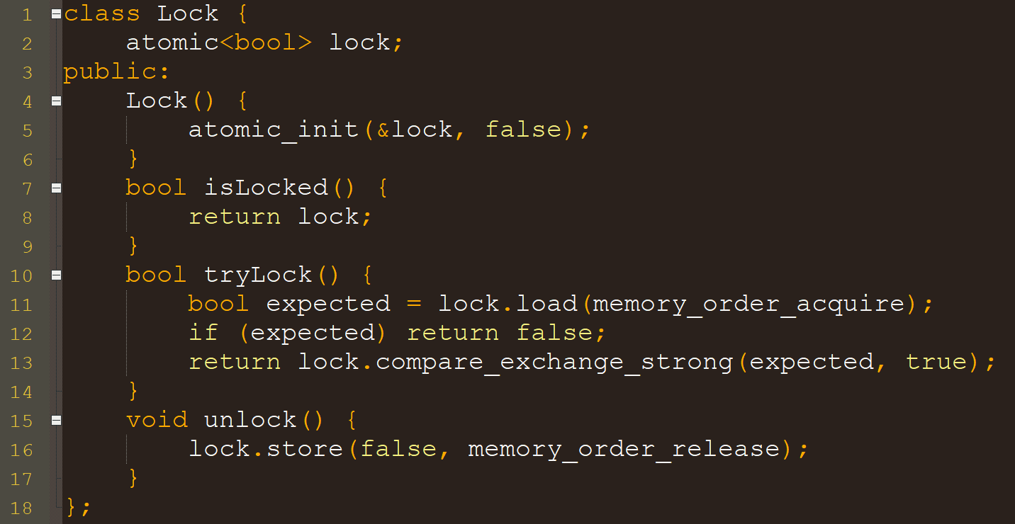
Implementing a try-lock
Fail fast (try to avoid CAS when contended) Why?
A write is enough. No CAS needed. Why?

Slide 7
Try lock set: a simple abstraction for taking multiple try locks
Supply an upper bound on k via a template parameter
Just some simple software engineering
1 template <int MAX_K>
2 class TryLockSet { // contains info on locks we have locked
3 Lock * locks[MAX_K];
4 int k; // number of locks acquired
5 public:
6 TryLockSet() { k = 0; }
7 ~TryLockSet() {
8 for (int i=0;i<k;++i) locks[i]->unlock();
9 }
10 bool tryLock(Lock * lock) {
11 if (lock->tryLock()) {
12 locks[k++] = lock;
13 return true;
14 }
15 return false;
16 }
17 }
Locks we currently hold
Unlock all of our locks
Destructor: code executed when this object goes out of scope
Try to acquire lock, and add it to locks if successful

Slide 8
Try-lock based KCAS: Where are the locks stored?
Option 1: alongside program data
For each program value, place a lock next to it in memory
Upsides: simple, good locality (locks usually in same cache lines as data)
Downsides:
Requires program memory layout changes
Can double memory requirements
1 class addr_t {
2 private:
3 Lock lock;
4 public:
5 word_t value;
6 Lock * addrOfLock() { return &lock; }
7 };
data
lock
data
lock
data
lock
data
lock
data
lock
data
lock
Each variable that can be modified by KCAS becomes an instance of addr_t

Slide 9
Try-lock based KCAS: Where are the locks stored?
Option 2: in a dedicated lock table
Don’t give each address a unique lock
Have each lock protect a set of addresses
How to map an address to “its” lock?
Hash addresses to obtain a lock ID
lockID = hash(addr) % numLocks
400
408
416
424
432
440
data
data
data
data
data
data
Hash(408)%3 = 1
Hash(432)%3 = 1
lock₀
lock₁
lock₂
What if I want to lock both 432 and 408?
Careful about acquiring the same lock twice!
Lock() should be re-entrant. (For example, the lock can store the ID of the thread currently holding it, and you can check if you’ve already locked it, so you don’t try to lock again.)

Slide 10
Why would you want to use a lock table?
If you can’t (or don’t want to) change the program’s memory layout
If you want to save space in data structure nodes (and the cache) by using fewer locks
Maybe you can even use the same lock table across many data structures? (if the table is large enough)
Practical consideration: false sharing on locks in the table? (they are next to each other, after all…)
Padding is probably a bad idea (can try and see…)
If number of locks is huge, relative to # of threads, expected contention should be low…

Slide 11
Implementing a lock table
How many locks do we need to get good scalability?
e.g., 1 million
Should be much larger than (max # threads) * (max # addresses written by KCAS)
1 // put padding before
2 Lock lockTable[LOCKTAB_SZ];
3 // put padding after
4
5 class addr_t {
6 public:
7 word_t value;
8 Lock * addrOfLock() {
9 int idx = hash(&value) % LOCKTAB_SZ; // hash the address of value
10 return &lockTable[idx];
11 }
12 };
Small optimization: if the lock table size is a power of 2, then h & (LOCKTAB_SZ-1) is exactly the same as h % LOCKTAB_SZ, but bitwise-& can be cheaper than modulo
Can use either option for our try-lock based KCAS… Option 2 is cleaner, IMO…

Slide 12
Naïve Try-lock based KCAS
Array of addr_t *, each having a lock and a value
Supply K via a template parameter
1 template <int K>
2 bool KCAS_locks(addr_t ** addr, val_t * expv, val_t * newv) {
3 retry:
4 TryLockSet<K> tls; // auto-unlock when this goes out of scope
5 for (int i=0;i<K;++i) { // try to acquire locks
6 if (!tls.tryLock(addr[i]->addrOfLock()))
7 goto retry; // (release locks and) retry
8 if (addr[i]->value != expv[i])
9 return false; // (release locks and) fail
10 }
11 for (int i=0;i<K;++i) *addr[i] = newv[i];
12 return true; // (release locks and) succeed
13 }
Try to
acquire
all locks
Write, unlock, return
18 val_t KCASRead(addr_t * addr) {
19 return addr->value;
20 }
Is it OK if KCASRead ignores locks?
Only one step to linearize at!
Where is KCASRead linearized?

Slide 13
KCASRead cannot ignore locks!
If KCAS is really atomic, then once you’ve seen X=1, a subsequent read of Y should not see 0!
Lock X
Lock Y
Write X = 1
KCAS(&X, &Y, 0, 0, 1, 1)
So, because this can happen, our KCAS is not atomic!
Thread p
(In contrast, if you see X=0, then read Y and see 1, that’s actually possible with an atomic KCAS between reads)
Thread q
time
Implies KCAS has already been linearized
Implies KCAS has already been linearized
Implies KCAS has not been linearized yet
KCASRead(&X)
KCASRead(&Y)
Implies KCAS has not been linearized yet
Return value?
Return value?
Sees X = 1
Sees Y = 0

Slide 14
How can we Fix this problem? First attempt:
Lock X
Lock Y
Write X = 1
Write Y = 1
Unlock X
Unlock Y
Thread p
KCAS(&X, &Y, 0, 0, 1, 1)
Thread q
read(X)
time
KCASRead(&X) should read only after X is unlocked
KCASRead(&Y)
This KCAS can be linearized at any time when X and Y are both locked!
Return value?
Return value?
Sees X = 1
Sees Y = 1

Slide 15
Another attempt at KCASRead
Wait until addr is unlocked
1 val_t KCASRead(addr_t * addr) {
2 while (true) {
3 if (addr->addrOfLock()->isLocked()) continue;
4 return addr->value;
5 }
6 }
Correct but slow! (Why slow?)
Consider an invocation of KCASRead that returns V
Want to linearize at a time t during the KCASRead when:
addr contained V, and
addr is not locked
Can we find such a time to linearize KCASRead?
Then read
How about locking addr, reading, and unlocking?
Need a tool to help us find a single time when addr contained V and was unlocked
No, addr might be locked again by the time we read addr->value!

Slide 16
Versioned try-locks
Like a try-lock, but also has a version number associated with it
Version number = # of times lock was acquired
Represented as an integer
Least significant bit = lock-bit (is it currently locked)
Other bits = version number
“Unlocked, after being acquired 4819 times” <4819, 0> = (4819 << 1) | 0
“Locked, after being acquired 17 times” <17, 1> = (17 << 1) | 1
Checking if a lock is held: if (lock & 1) { … }
Getting the version number from a lock: ver = (lock >> 1);
Offers operations: unlock(), tryLock() and read()

Slide 17
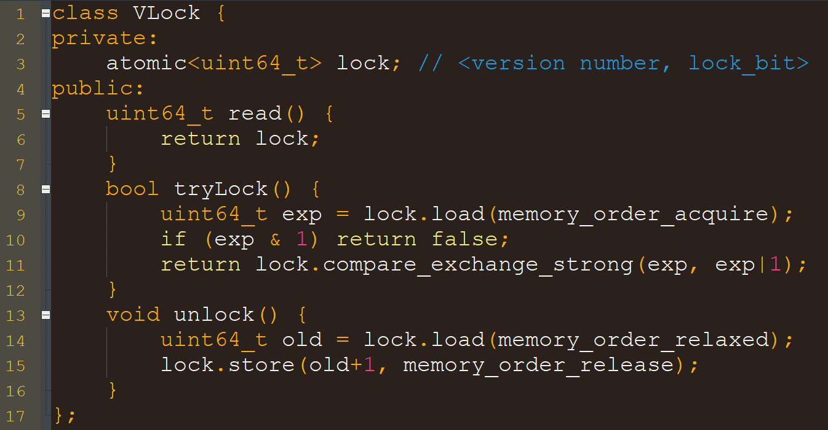
Implementing versioned try-locks
If lock is held
Try to acquire
Note: “relaxed” is strong enough here because of the CAS before and data dependency after…
Since the lock bit (LSB) is 1, incrementing lock changes the LSB to 0 (unlocked), and increments the version #

Slide 18
Correct KCASRead
1 val_t KCASRead(addr_t * addr) {
2 Lock * l = addr->addrOfLock();
3 while (true) {
4 uint64_t s1 = l->read();
5 if ((s1 & 1) == 0) {
6 casword_t v = addr->value;
7 uint64_t s2 = l->read();
8 if (s2 == s1) return v;
9 }
10 }
11 }
Read lock state (i.e., <version_number, lock_bit>
If it is unlocked
Read value
Read lock state again
If still unlocked, and same version number as before
Then addr was not locked at any time between the two read() operations.
So when we read addr->value, addr is not locked!
The rest of the code is the same as the naïve try-lock based KCAS, but with versioned try-locks instead of try-locks.

Slide 19
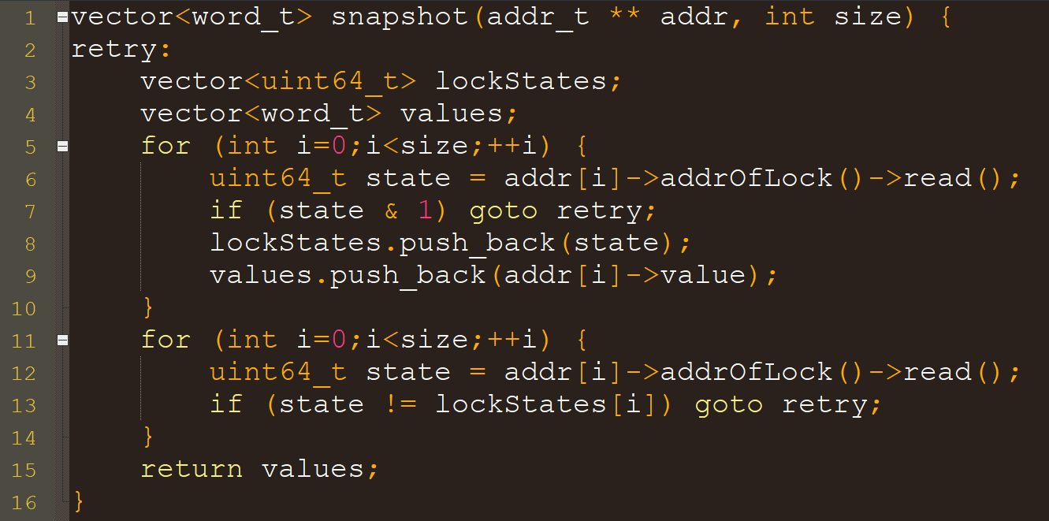
What else can we do with these version numbers?
E.g., can implement a snapshot operation, which atomically performs many reads (all at once)
For each addr, read the lock state (incl. version number)
Locally save the lock state we saw
Retry if we see a lock is held
Then read the value guarded by the lock (crucially, after the lock state)
If we get past this loop, then no value has changed since we read it!
Reread all lock states and check that all locks are still released, and version numbers are the same as we saw above (else retry)
Example of the famous “double collect” paradigm
This is called version/sequence-based validation
Can linearize the entire snapshot between loops

