Slide 1
Multicore programming
Optimizing lock-based KCAS with HTM, OpenMP, debugging/perf
Lecture 16
Trevor Brown

Slide 2
Last time
Try-locks
Naïve (incorrect) KCAS using these
Versioned (try-)locks
KCAS using these

Slide 3
This time
Accelerating version-lock-based KCAS with HTM
Purpose: to demonstrate accelerating a lock-based algorithm using HTM!
OpenMP
Debugging and performance
Checksums/validation

Slide 4
Using HTM to accelerate try-lock based KCAS
Similar to accelerating the lock-free algorithm (but a bit simpler)
Goal
HTM-based KCAS that uses try-lock based KCAS as the fallback path
Approach
Fast path algorithm:
Wrap try-lock based KCAS in a transaction: xstart ; KCAS ; xend
Now each KCAS on the fast path is atomic, just because it is in a transaction
Get rid of parts of the algorithm that are unnecessary

Slide 5
Adding transactions
template <int K>
bool KCAS(addr_t ** addr, val_t * expv, val_t * newv) {
int retries = 5;
int status;
retry:
if ((status = _xbegin()) == _XBEGIN_STARTED) {
bool result = KCAS_txn<K>(addr, expv, newv);
_xend();
return result;
} else { // transaction aborted
if (--retries >= 0) goto retry;
bool result = KCAS_locks<K>(addr, expv, newv);
return result;
}
}
Fast path: try-lock based KCAS code inside a transaction
(We use the same version-lock-based KCASRead for both code paths)
KCAS_txn is initially the same as KCAS_locks. We will optimize it.
Fallback path: try-lock based KCAS code
Before retrying, should wait a bit…
Maybe we could sneak it out using an explicit _xabort() status code?
Idea: if we aborted because a lock was held, could we wait until that lock is released?
But that information was lost when we aborted…
Could pass an index < 127 into addr[] to _xabort!

Slide 6
Turning lock acquisition into reading
1 template <int K>
2 bool KCAS_txn(addr_t ** addr, val_t * expv, val_t * newv) {
3 retry:
4 TryLockSet<K> tls; // auto-unlock when this goes out of scope
5 for (int i=0;i<K;++i) { // try to acquire locks
6 if (!tls.tryLock(addr[i]->addrOfLock()))
7 goto retry; // (release locks and) retry
8 if (addr[i]->value != expv[i])
9 return false; // (release locks and) fail
10 }
11 for (int i=0;i<K;++i) {
12 *addr[i] = newv[i];
13 }
14 return true; // (release locks and) succeed
15 }
No need to lock! HTM ensures atomicity. However, we must respect others’ locks.
This becomes a read.
But, be careful! Still need to increment version numbers so fallback path can tell we changed addresses!
With no locking, we don’t need TryLockSet
We modify the versioned try-lock implementation to expose the “lock” word…

Slide 7
Turning retries into aborts
1 template <int K>
2 bool KCAS_txn(addr_t ** addr, val_t * expv, val_t * newv) {
3 retry:
4
5 for (int i=0;i<K;++i) {
6 if (addr[i]->addrOfLock()->lock & 1)
7 goto retry;
8 if (addr[i]->value != expv[i])
9 return false;
10 }
11 for (int i=0;i<K;++i) {
12 *addr[i] = newv[i];
13 addr[i]->addrOfLock()->lock += 2; // update version numbers
14 }
15 return true;
16 }
No point retrying here, since we can only make progress if the lock is released, which will abort us. So, just xabort.
So, no need for the “retry:” label anymore.

Slide 8
Optimized code
1 template <int K>
2 bool KCAS_txn(addr_t ** addr, val_t * expv, val_t * newv) {
3
4
5 for (int i=0;i<K;++i) {
6 if (addr[i]->addrOfLock()->lock & 1)
7 _xabort(i);
8 if (addr[i]->value != expv[i])
9 return false;
10 }
11 for (int i=0;i<K;++i) {
12 *addr[i] = newv[i];
13 addr[i]->addrOfLock()->lock += 2; // update version numbers
14 }
15 return true;
16 }
User defined _xabort status code (assuming i < 127)

Slide 9
Cleaned up the spacing/comments
1 template <int K>
2 bool KCAS_txn(addr_t ** addr, val_t * expv, val_t * newv) {
3 for (int i=0;i<K;++i) {
4 if (addr[i]->addrOfLock()->lock & 1) _xabort(i); // read locks
5 if (addr[i]->value != expv[i]) return false; // read values
6 }
7 for (int i=0;i<K;++i) {
8 *addr[i] = newv[i]; // update values
9 addr[i]->addrOfLock()->lock += 2; // update version numbers
10 }
11 return true;
12 }

Slide 10
Using our new _xabort status code
1 template <int K>
2 bool KCAS(addr_t ** addr, val_t * expv, val_t * newv) {
3 int retries = 5;
4 int status;
5 retry:
6 if ((status = _xbegin()) == _XBEGIN_STARTED) {
7 bool result = KCAS_txn(addr, expv, newv);
8 _xend();
9 return result;
10 } else { // transaction aborted
11 if (status & _XABORT_EXPLICIT) {
12 int idx = _XABORT_CODE(status);
13 while (addr[idx]->addrOfLock()->read() & 1) { /* wait */ }
14 }
15 if (--retries >= 0) goto retry;
16 bool result = KCAS_locks<K>(addr, expv, newv);
17 return result;
18 }
19 }
If the abort was caused by a user _xabort call
Get the user-provided abort code
Wait until the returned index is no longer locked

Slide 11
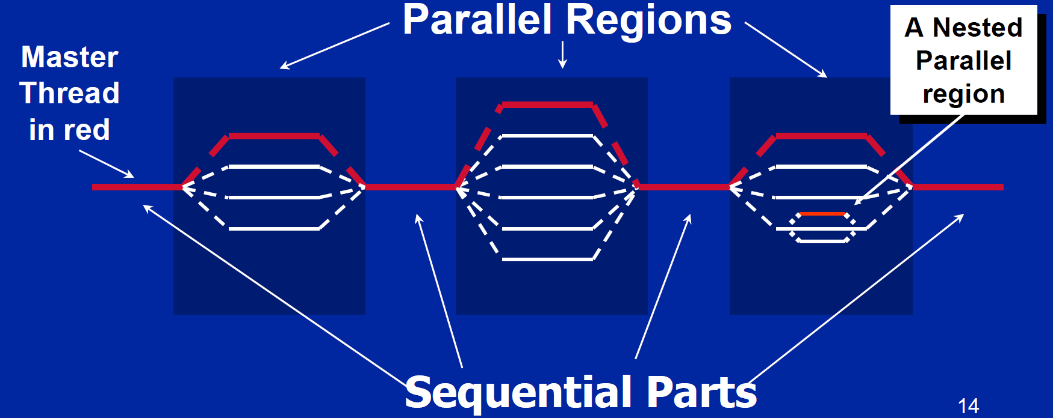
OpenMP (Open Multi processing)
A library for fork-join parallelism

Slide 12
Overview
Easy to use in your own C/C++ projects
Tons of features; we just look at a couple of simple tools
Parallel sections
Parallel for loops
Reductions
OMP Single, OMP Tasks
Usage:
#include <omp.h>
GCC: compile with -fopenmp
Warning: Windows Subsystem for Linux v1 appears to use a global lock in its implementation of OpenMP. It offered no speedup in my testing. (Try running on a real Linux box or a virtual machine!)

Slide 13
1. Parallel section
Shortcut for: spawning n threads, where n = # of logical processors in the system, having them all execute the same code block, and then joining them
Spawn n threads
Sequential code
Concurrent/parallel code
#include <cstdio>
void main() {
int id = 0;
printf(" hello(%d)", id);
printf(" world(%d)\n", id);
}
#include <omp.h>
void main() {
#pragma omp parallel
{
int id = omp_get_thread_num();
printf(" hello(%d)", id);
printf(" world(%d)\n", id);
}
}
What is my thread ID (in 0..n-1)?
n threads execute this
Output: “ hello(0) world(0)”
Stop n threads
Output?

Slide 14
Parallel output

Slide 15
Why is this useful?
Using OpenMP
Equivalent code using pthreads
#pragma omp parallel
doSomething();
const int n = SomehowGetNumLogicalProcessors();
pthread_t *threads = new pthread_t[n];
for (int i=0;i<n;++i) {
if (pthread_create(&threads[i], NULL, doSomething)) {
std::cerr<<"ERROR: could not create thread"<<std::endl;
exit(-1);
}
}
for (int i=0;i<n;++i) {
if (pthread_join(threads[i], NULL)) {
std::cerr<<"ERROR: could not join thread"<<std::endl;
exit(-1);
}
}
delete[] threads;
Equivalent code using std::thread

Slide 16
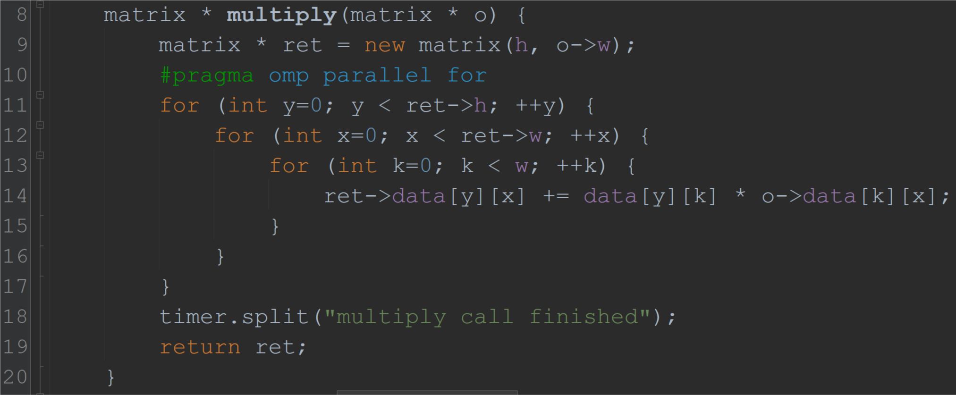
2. Parallel For
OpenMP automatically decides how many threads (n) to spawn
It splits work evenly between the n threads (each does approx. $\frac{ret→h}{n}$ iterations of this loop)
Implicit fork (thread spawning)
Implicit join

Slide 17
Why is this useful?
Using OpenMP
Without using OpenMP: starting threads to run loop_body
#pragma omp parallel for
for (long i=0;i<n;++i)
loop_body(i);
Without using OpenMP: loop_body
int id = getMyThreadID();
int istart = id * n / numThreads;
int iend = (id+1) * n / numThreads;
if (id == numThreads-1) iend = n;
for (int i=istart; i<iend; i++)
original_loop_body(i);

Slide 18
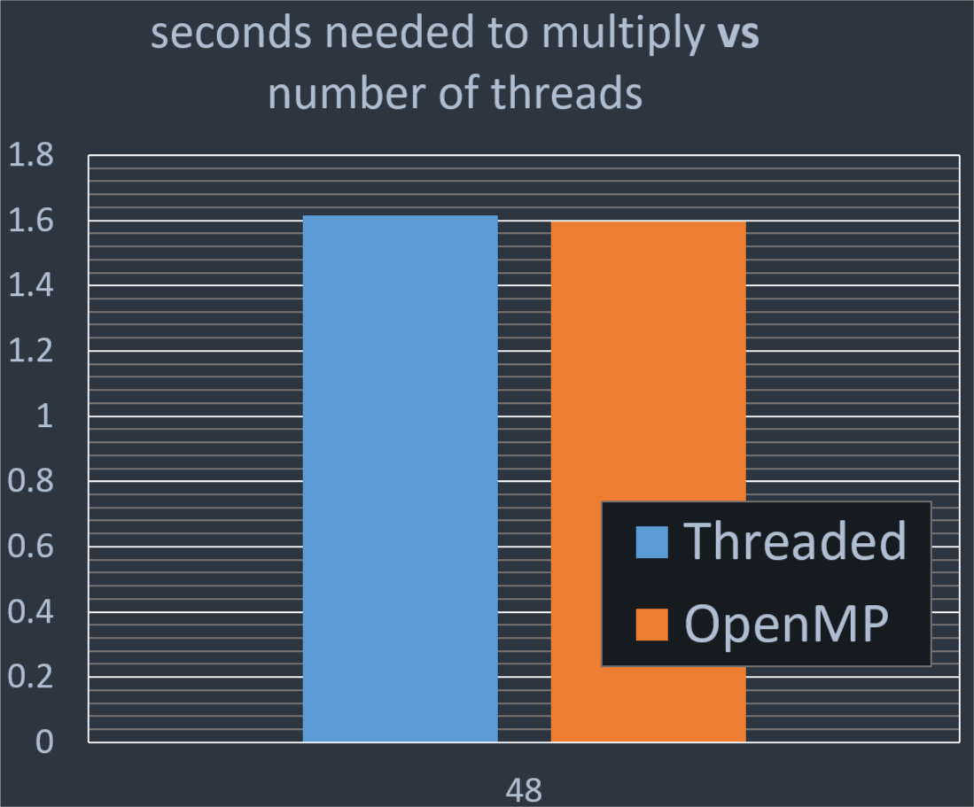
Performance of OpenMP vs manual threading

Slide 19
3. Reductions
A reduction takes a vector (array) and turns it into a scalar (single number)
Example: summing an array
Naïve use of OpenMP
Problem: many threads do this, and this increment is not atomic!
long sum = 0;
for (long i=0;i<n;++i) {
sum += array[i];
}
long sum = 0;
#pragma omp parallel for
for (long i=0;i<n;++i) {
sum += array[i];
}
Problem: correct, but not very scalable!
How about using fetch&add?
long sum = 0;
#pragma omp parallel for
for (long i=0;i<n;++i) {
__sync_fetch_and_add(&sum, array[i]);
}
Ideally: want a thread to maintain a local sum while processing a batch, and fetch&add its local sum into the global sum at the end of the batch

Slide 20
OpenMP reductions
OpenMP natively supports reductions over numerous operators (+, *, &, |, …)
Must tell OpenMP which variable will be used to store the reduction
Example: summing an array
Correct OpenMP reduction
long sum = 0;
for (long i=0;i<n;++i) {
sum += array[i];
}
long sum = 0;
#pragma omp parallel for reduction (+:sum)
for (long i=0;i<n;++i) {
sum += array[i];
}
1 thread, time to complete: 4330 ms
48 threads, time to complete: 185ms

Slide 21
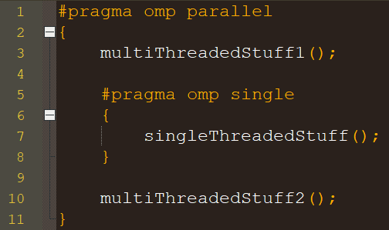
4(a). OpenMP Single
Sometimes you want a single threaded computation in the middle of your parallel computation

Slide 22
4(B). OpenMP Task
Define a task that should be completed by any available thread in a parallel section
Common design pattern: one thread generates & launches tasks, tasks run in parallel
Spin up n threads to run tasks
Single thread generates tasks
This function call, with this argument, becomes a task, and is run in the background (by one of the n-1 other threads)
This closing brace waits for all tasks to complete
Can also manually wait for all tasks, whenever you like, with #pragma omp taskwait
OMP task tutorial: https://openmp.org/wp-content/uploads/sc13.tasking.ruud.pdf

Slide 23
Tools for debugging and performance
Debugging and optimizing concurrent programs is very hard. Tools can help!
Debugging
GNU Debugger (GDB)
Segfaults, infinite loops
Address Sanitizer (ASan)
Segfaults, memory leaks
1~2x slowdown
Valgrind
Segfaults, memory leaks, memory access errors
many-x slowdown
Graphviz
Visualizing pointer based data structures
Performance
Linux Perftools (perf)
Studying cycles, cache misses, instructions, stalled cycles
At the whole-application level
C/C++ Performance API (PAPI)
Precise information from perf, but recorded within your program
VTune Amplifier
Powerful (and now free!) profiler
A lot of errors in concurrent programs manifest as memory access errors! For example, a thread may write a bad value into a pointer because of a concurrency bug, and another thread may then read it.

Slide 24
Debugging Tools

Slide 25
Using valgrind to find memory access errors
$ valgrind --fair-sched=yes ./a1code_segfault/workload_timed.out 4 1000 naive
==107893== Command: ./a1code_segfault/workload_timed.out 4 1000 naive
==107893==
==107893== Use of uninitialised value of size 8
==107893== at 0x510F0D4: std::thread::join() (in /.../x86_64-linux-gnu/libstdc++.so.6.0.22)
==107893== by 0x1092DC: void runExperiment<CounterNaive>(...) (workload_timed.cpp:46)
==107893== by 0x108E3B: main (workload_timed.cpp:70)
==107893==
==107893== Invalid read of size 8
==107893== at 0x510F0D4: std::thread::join() (in /.../x86_64-linux-gnu/libstdc++.so.6.0.22)
==107893== by 0x1092DC: void runExperiment<CounterNaive>(...) (workload_timed.cpp:46)
==107893== by 0x108E3B: main (workload_timed.cpp:70)
==107893== Address 0x190 is not stack'd, malloc'd or (recently) free’d
...
Typical first step in debugging any error that isn’t obvious:
Ensure that valgrind runs without any such errors.
If there are such errors, fix those first!

Slide 26
Using Address Sanitizer to check for memory leaks
$ g++ -pthread –g -fsanitize=address -static-libasan -fopenmp -O3 ex2_mmult_threads.cpp
$ ./a.out 24
matrix created: 0.02s
randomize call finished: 0.10s
... multiply call finished: 2.82s
=================================================================
==76549==ERROR: LeakSanitizer: detected memory leaks
Direct leak of 192 byte(s) in 24 object(s) allocated from:
#0 0x555b294992d8 in operator new(unsigned long) (/home/.../a.out+0xc82d8)
#1 0x555b294dab9e in matrix::multiply(matrix*, int) (/home/.../ex2_mmult_threads.cpp:12)
SUMMARY: AddressSanitizer: 192 byte(s) leaked in 24 allocation(s).

Slide 27
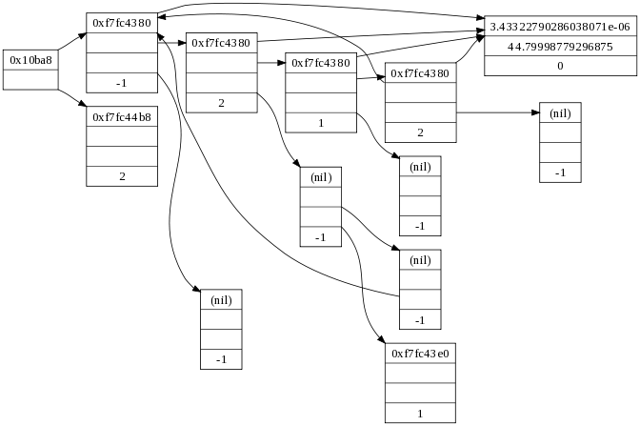
Graphviz: when you just need to SEE it
digraph g {
node [
fontsize = "16"
shape = “record"
];
edge [];
"node0" [
label = "<f0> 0x10ba8| <f1>“ ];
"node1" [
label = "<f0> 0xf7fc4380|<f1>|<f2>|-1"
];
[...]
"node0":f0 -> "node1":f0 [
id = 0
];
[...]
}
$ dot -Tpng input.dot > output.png
Tip: try to get your toughest bugs to happen in SMALL data structures, so you can graphviz them

Slide 28
Sanity checking: experiment checksums
Important to perform sanity checks wherever you can!
Helps to catch obvious (and non-obvious) mistakes
One good sanity check: checksum based validation
Reduce the data structure to a number (a data structure checksum)
Reduce each threads’ completed operations to a number (a thread checksum)
verify that thread checksums “match” the data structure checksum
(I.e., the work the threads think they’ve done is reflected in the data structure!)
Creativity needed to come up with good checksum functions

Slide 29
Example: Synthetic KCAS benchmark
n threads repeatedly do the following for 3 seconds
Pick K uniform random slots in an array
Read integers stored in those slots
Do a KCAS to change each of the K slots from the value exp that we read, to a new value of exp + 1
Report average throughput (KCAS operations/sec) over all trials
7
11
5
3
4
9
10
11
14
15
8
9
10
5
9
10
4
11
13
14
6
12

Slide 30
Example: checksum validation for such a benchmark
Data structure checksum
Sum of all array entries
Each successful KCAS increments k array slots by 1
Should add k to the data structure checksum
Thread checksum
kX where X = # of successful KCAS operations performed by the thread
Each successful KCAS should add k to the thread checksum
Validation
sum(thread checksums) == data structure checksum ?
(If a KCAS operation is lost, or screws up the array, validation [hopefully] fails)

