Slide 1
Multicore programming
Epoch-based memory reclamation and experimental methodology
Lecture 17
Trevor Brown

Slide 2
This time
Epoch-based memory reclamation
(The algorithm itself, as well as a bit more on usage)
Time permitting:
A discussion on experimental methodology

Slide 3
Lifecycle of a record (object)
Unallocated
Uninitialized
Retired
In the data structure
Safe to free
Free
Allocate
Reuse
Safe memory
Reclamation
(such as EBR!)
Insert
Remove
Notes:
Let’s talk about the safe memory reclamation problem.
Consider a system where memory is initially unallocated, and processes allocate records, …

Slide 4
Reclamation with and without locks
Easy with locks: correct locking ensures that no process can access an unlinked record
Hard without locks: processes must carefully coordinate to avoid accessing freed nodes
Challenge: any record you are about to free could be pointed to by another process
a
b
c
f
process p

Slide 5
Quiescence and grace periods
Definition: a process is quiescent iff its private memory does not contain any pointers to records in the data structure
Definition: a grace period is an interval during which each thread has some time when it is quiescent (different threads can be quiescent at different times---that is fine)
Fact: a retired record can be freed after a subsequent grace period
Grace period
But how to detect when there has been a grace period since b was retired?
q quiescent
p quiescent
Process p
Insert(b)
Insert(d)
Insert(a)
Find(b)
If we can detect this, we can know it is safe to free b
Safe to free b
Process q
Delete(b)
Insert(c)
Record b retired
time

Slide 6
Using epochs to detect grace periods
Key assumption: threads are quiescent when not executing data structure operations
The execution is divided into epochs, and the current epoch number is stored (as a global) in shared memory
At the start of each data structure operation:
read current epoch and announce it (in a global array with one slot per thread)
check whether all other threads have announced it
if so, increment the current epoch
(And each thread is quiescent just before it starts this data structure operation…)
Before this time, no thread has announced epoch e-1
This is a grace period!
Each thread must have announced e-1 by this time
time
Current epoch incremented from e-2 to e-1
Current epoch incremented from e-1 to e
Therefore, each thread starts a new data structure operation and announces e-1 at some point between these two times!
How to figure out which objects were retired before this grace period?
Recall: anything retired before a grace period can be freed after it!

Slide 7
Determining which records are safe to free
Maintain a shared limbo bag for each of the last 3 epochs
Records retired by thread p are added to the bag for the last epoch announced by p
So, if p reads epoch 7, then retires a node u, it will place u in the limbo bag for epoch 7
Note: by the time p retires u, the current epoch might be 8 (but it cannot be 9 or larger… why?)
When the current epoch changes from e to e+1, we free all records in the limbo bag for e-2 (lets see why…)
No record is added to the limbo bag for e-2
Can free all records in the limbo bag for e-2
Every record added to the limbo bag for e-2 is retired before this!
Retired records are added to limbo bags for e-1 and e only.
And, this is a grace period!
time
Current epoch incremented from e-1 to e
Current epoch incremented from e to e+1
Notes:
And, it turns out you can do this with only 3 limbo bags.

Slide 8
Example execution of the EBR algorithm
Implicit current bag pointer: epoch%3
Free everything in this bag, clear it out, and reuse it…
Steps in a 2-thread execution
Bags represent
these epochs:
thread p
thread q
0
Insert(a)
Insert(g)
0
Current epoch
Limbo bag[0]
b (0)
g (3)
0
3
Insert(b)
Insert(e)
1
4
0
1
2
3
Delete(b)
Insert(c)
1
Insert(f)
Delete(a)
Limbo bag[1]
a (1)
1
4
2
Delete(f)
Insert(b)
Announced epochs
0
1
0
1
2
2
3
3
3
Insert(g)
Insert(d)
2
-1
-1
Limbo bag[2]
Insert(k)
Delete(g)
3
f (2)
2
process q
process p
Free/clear/ reuse bag…

Slide 9
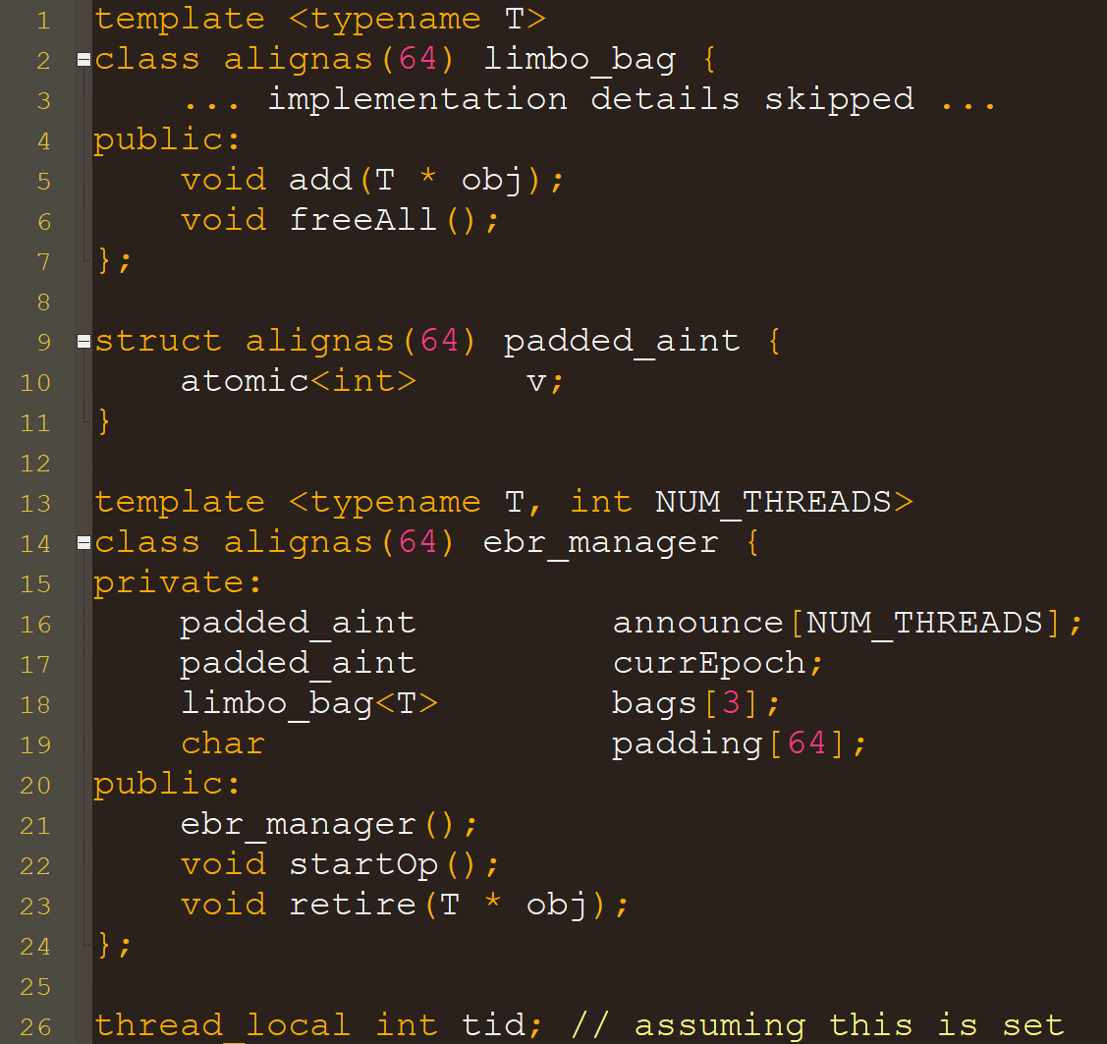
Implementation: Data types
alignas to serve as padding
Sequential implementation
Sequential implementation
Note: freeAll should cause object destructors to be called just before the objects are freed
Type T of objects to manage/reclaim is templated
Threads’ epoch announcements represent the epoch they are conceptually running in
Limbo bags for the current epoch and the previous two epochs
API: let’s see how these are implemented
Another option instead of passing tid to every function

Slide 10
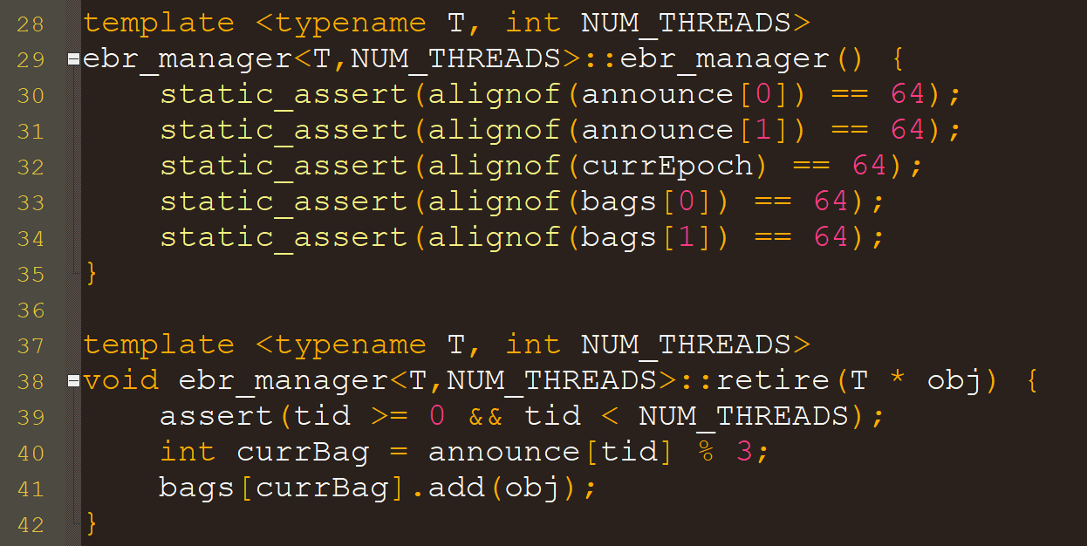
Implementation: Easy parts
Paranoia: double check that alignment really implies data is padded the way we think it is
Paranoia: check that our tid is a valid one
announce[tid] is the epoch we are conceptually running in, and this modulo 3 is the limbo bag for that epoch. We put obj in that bag.

Slide 11
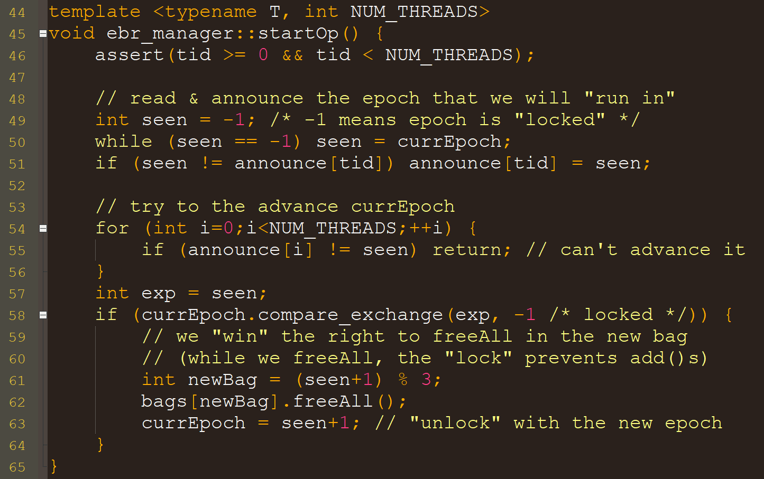
The hard part (Not optimized)
Paranoia: check that our tid is a valid one
currEpoch can conceptually be “locked” by a thread, who temporarily sets it to -1. So, we repeatedly read until we see an “unlocked” value.
If we see a new epoch, we update our announcement
Check if all threads have announced seen
If so, we will try to increment currEpoch and reclaim memory
This involves “locking” currEpoch, freeing contents of the new current bag, and “unlocking” currEpoch to the new epoch value

Slide 12
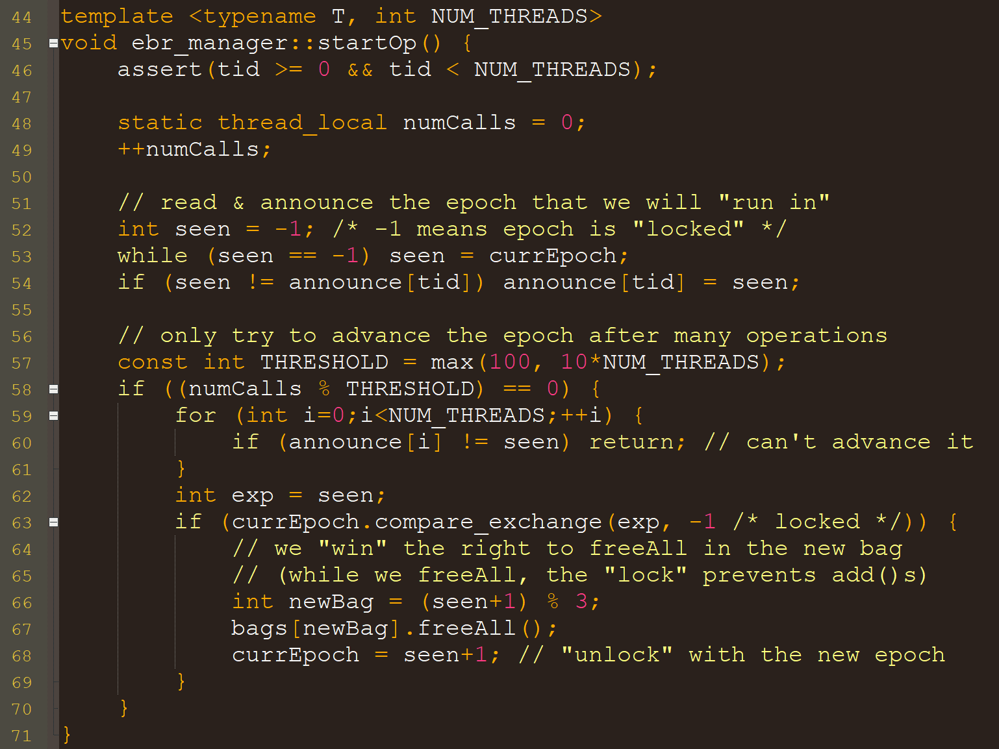
Optimizing
Each thread keeps track of how many calls it has ever made to startOp()
static: accessible only within the function, but preserves its value across function calls (“= 0” happens once)
We try to advance the epoch only after performing THRESHOLD operations
Tradeoff: it takes longer to reclaim garbage, but we amortize the overhead of scanning announcements over many operations
Caveat: I have not run this code, and have not spent time tuning THRESHOLD

Slide 13
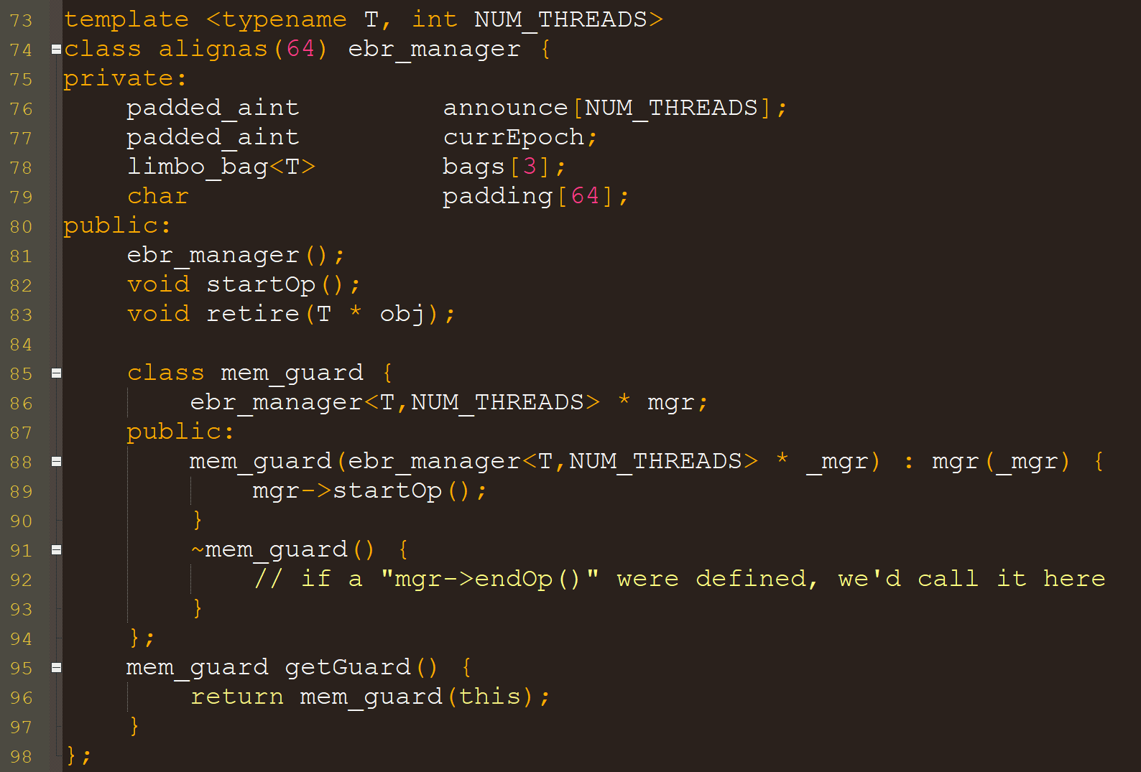
Adding an RAII GetGuard() operation
Note: getGuard() has somewhat limited usefulness when there is no endOp() operation…
Just showing you how to do this RAII design pattern…

Slide 14
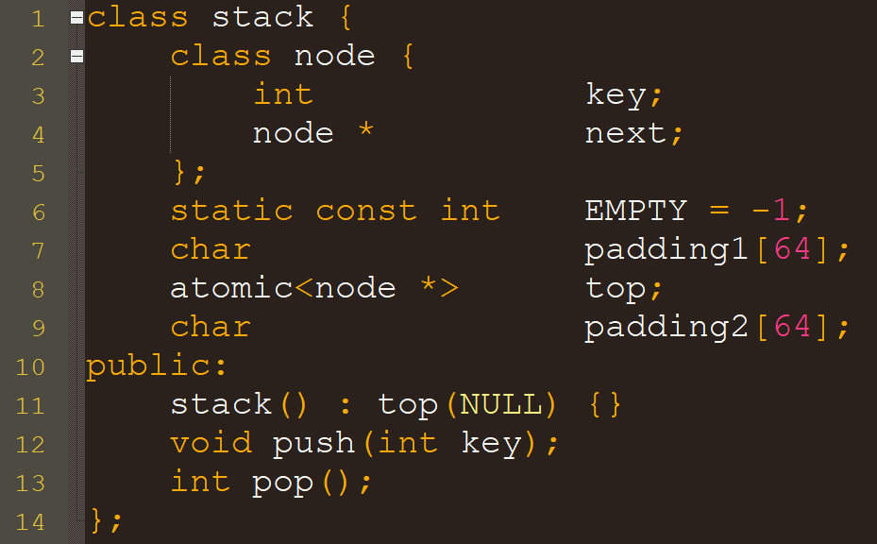
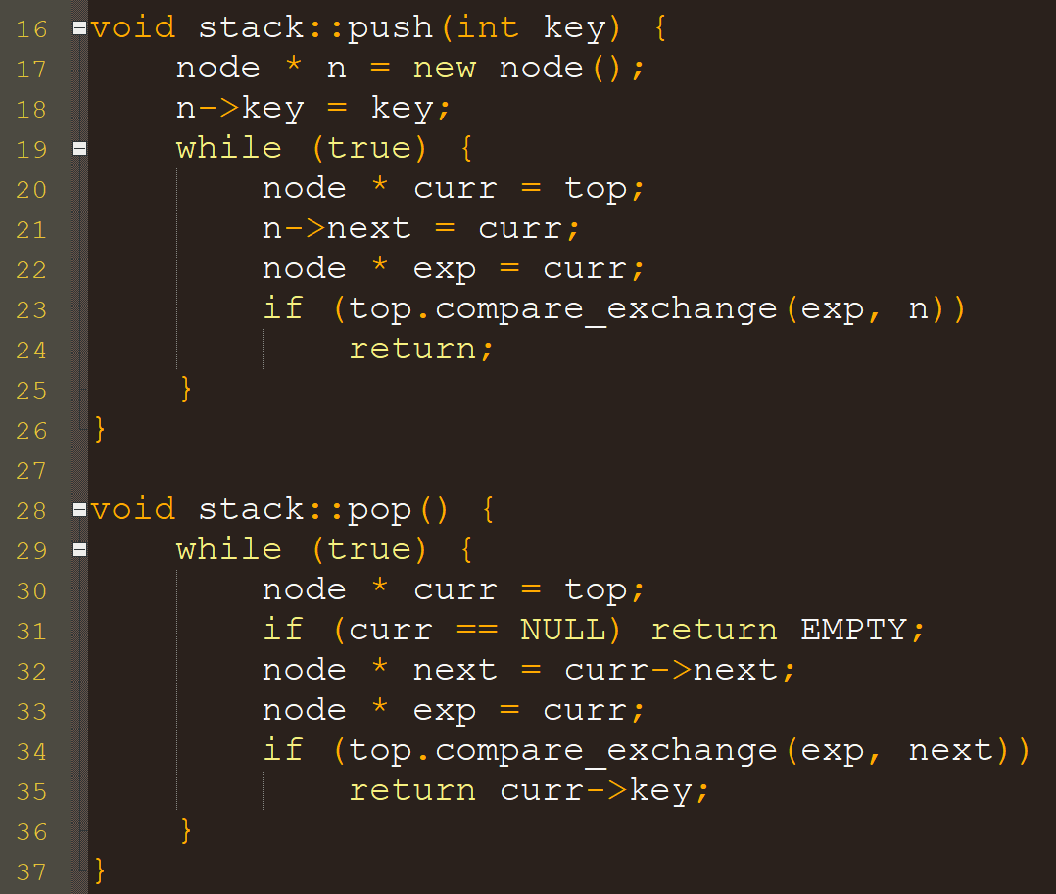
Usage example 1: recall the Treiber Stack

Slide 15
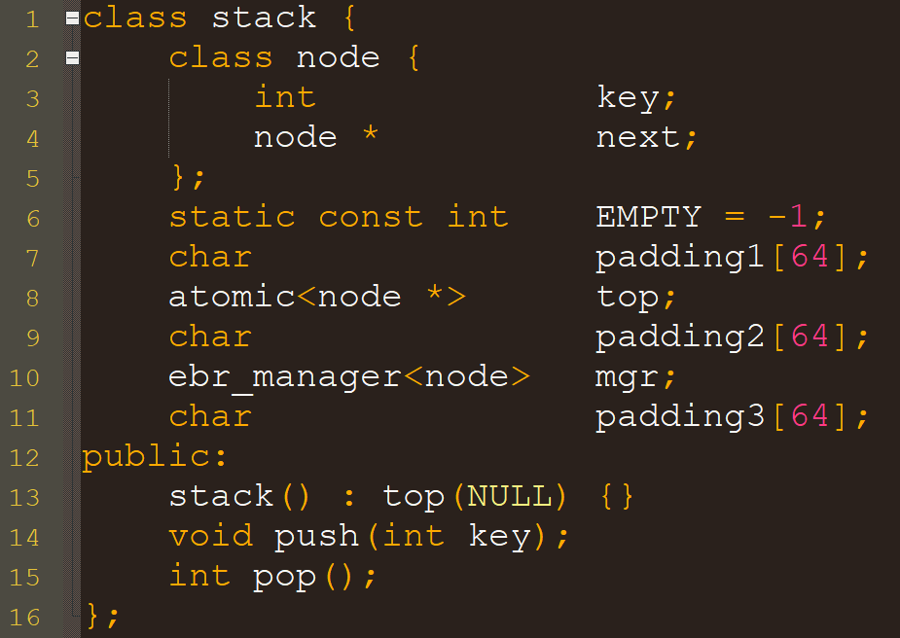
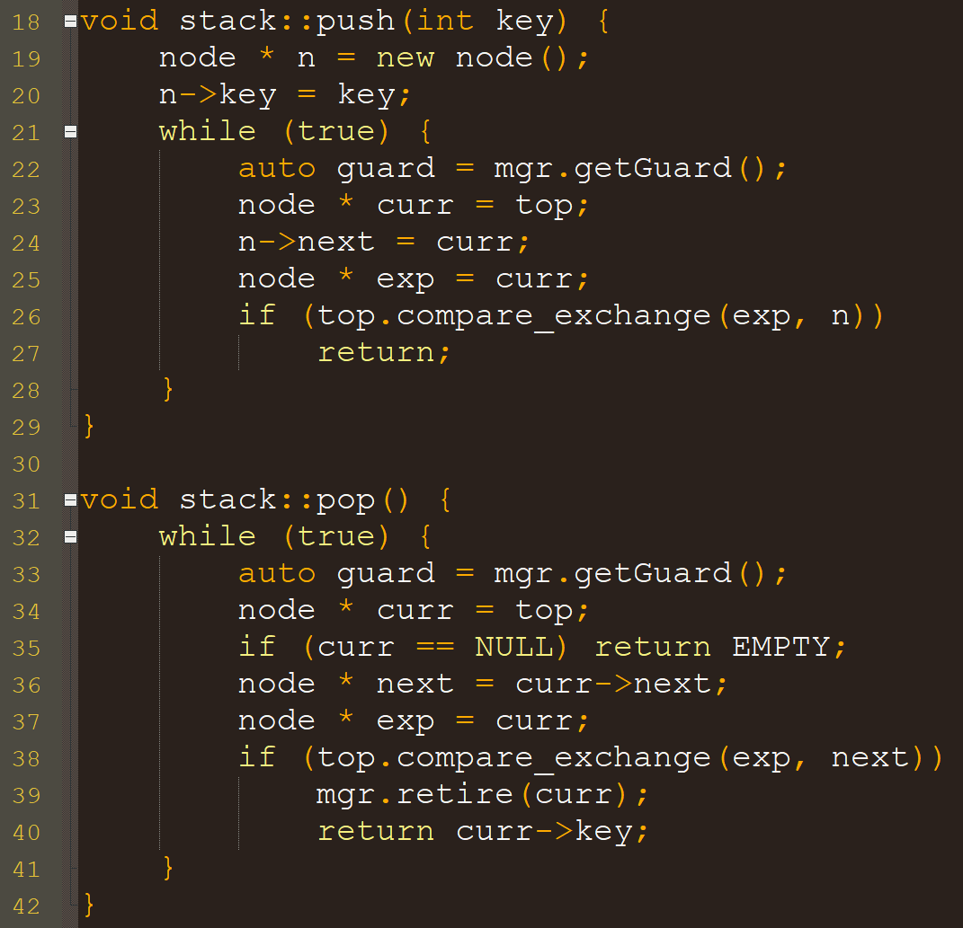
Treiber Stack with memory reclamation

Slide 16
example 2: Expandable Hash table
struct hashmap
struct table
1 char padding1[64];
2 atomic<table *> currentTable;
3 char padding2[64];
1 char padding1[64];
2 atomic<int> * data;
3 atomic<int> * old;
4 int capacity;
5 int oldCapacity;
6 counter * approxIns;
7 counter * approxDel;
8 char padding2[64];
9 atomic<int> chunksClaimed;
10 char padding3[64];
11 atomic<int> chunksDone;
12 char padding4[64];
Suppose we allocate new counter objects for each table object
Want to reclaim object types: hashmap, table, counter, atomic<int> array

Slide 17
Expandable Hash table with memory reclamation
If CAS succeeds, then we unlinked t, so we have the right to call mgr->retire(t)
struct hashmap
struct table
1 char padding1[64];
2 atomic<table *> currentTable;
3 char padding2[64];
4 ebr_manager<table> mgr;
5 char padding3[64];
1 char padding1[64];
2 atomic<int> * data;
3 atomic<int> * old;
4 int capacity;
5 int oldCapacity;
6 counter * approxIns;
7 counter * approxDel;
8 char padding2[64];
9 atomic<int> chunksClaimed;
10 char padding3[64];
11 atomic<int> chunksDone;
12 char padding4[64];
Observation: if a table object t is safe to free, then no thread will ever access t->old or t->approxIns or t->approxDel
So those objects can be directly passed to free() whenever a table object is freed (carefully do this in ~table(), which is invoked by EBR)

Slide 18
Optimizing into a “real” algorithm (one worth implementing)

Slide 19
Refers not to distributed systems, but to distributing the limbo bags across threads…
Distributed
Epoch
Based
Reclamation
Algorithm
Note: the memory reclamation algorithm you were given in A5 is based on DEBRA…
Notes:
In the rest of this talk, I’m going to describe a more efficient, fault-tolerant memory reclamation technique for a data structure designer to use.
I’ll start by describing DEBRA, a distributed version of EBR, then I’ll introduce DEBRA+, which adds fault tolerance.

Slide 20
Significant change from EBR
Per-thread quiescent bit to allow reclamation to continue while a process is quiescent
Useful if some threads finish their work and stop, or work on something else
Partial fault tolerance
Crashing while quiescent does not block reclamation
Notes:
The most significant change I made going from EBR to DEBRA was adding a per-process quiescent bit. This allows reclamation to continue while a process is quiescent, which is useful for several reasons. Most notable, it adds a sort of partial fault tolerance, since reclamation can continue if a process crashes while its quiescent. And, this is not as easy as it initially seems; one consequence is that processes can have significantly different views of what the current epoch is.
adds a sort of partial fault tolerance, since reclamation can continue if a process crashes while quiescent state.
building block for true fault tolerance in DEBRA+
not as easy as it initially seems; one consequence is that processes can have significantly different views of what the current epoch is.
Several other optimizations are described in the paper.
Entire blocks are shuttled to, or from, the shared free bag when per-thread free bags become too large, or too small, respectively

Slide 21
Easy change: scanning epoch announcements
Amortize cost over several operations
Each operation checks one epoch announcement (or you could check one announcement per K operations)
After checking n announcements, where n is the number of threads, and seeing the announcements are up to date, the epoch can be advanced
Notes:
I also made an easy change to the way that a process scans epoch announcements. The idea is to amortize the cost of scanning over several operations…
In EBR, scanning added Θ(n) RMRs to each operation. Since the announcements are constantly changing, these reads were very likely to cause cache misses.

Slide 22
Efficient bags
Per-process limbo bags
Each process rotates its limbo bags whenever its announcement changes
Per-process free bags and one shared free bag
When rotating its limbo bags, a process appends its oldest limbo bag to its own free bag
Entire blocks moved to/from shared free bag
More details (and optimizations) in the paper Brown, T. Reclaiming memory for lock-free data structures. PODC 2015.
Conference paper
Extended paper
Slides for that talk
Notes:
I also eliminated the contention and sync overhead of EBR’s shared limbo bags by making them per-process in DEBRA. It’s not immediately obvious that this works, so some care must be taken when proving correctness.
And, more details, and several more optimizations, appear in the paper.

Slide 23
Complexity of DEBRA
leaveQstate: O(1) steps ← called at start of operation
enterQstate: O(1) steps ← called at end of operation
retire: O(1) steps ← called after unlinking a record
Reclamation operations are wait-free!
However, this does not mean reclamation is fault tolerant!
A thread that crashes while non-quiescent can still block reclamation!
This is addressed in the DEBRA+ algorithm (same paper as DEBRA)
… and more recently with Ajay Singh and Ali Mashtizadeh in Neutralization Based Reclamation, PPoPP 2021. [paper] [talk]

