Slide 1
Multicore programming
Implementing a counter: what could go wrong?
Lecture 2
Trevor Brown

Slide 2
Recall: what it means for an execution to be linearizable
Must be possible to choose linearization points during each operation such that all operations return the same values that they would if they were executed instantly at their linearization points
Non-linearizable if it is not possible to pick such linearization points
thread p
Inc.→0
Inc.→6
thread q
Inc.→1
Inc.→3
Inc.→5
thread r
Inc.→2
Inc.→4
Time

Slide 3
Recall: what it means for an Object to be linearizable
For every possible execution E of the object
E must be a linearizable execution
An object is non-linearizable
if any execution of the object is non-linearizable
(i.e., the object can possibly behave “badly”)

Slide 4
Recall: this execution of the naïve counter
thread p
thread q
thread r
Read(c) → 0
Read(c) → 0
Write(c, 1)
Return 0
Read(c) → 1
Write(c, 2)
Return 1
Any changes between this Read and Write are overwritten!
Read(c) → 2
Write(c, 3)
Return 2
Write(c, 1)
Time

Slide 5
Implementing a linearizable counter
Intuition: increment must atomically Read and Write (“at the same time”)
Otherwise a thread can always Write a “stale” value (overwriting “fresh” values)
Need stronger tools!
How about using a lock?

Slide 6
A Lock / mutex
Guards an object: allows only one thread at a time to access it
Operations
Acquire / lock
Blocks until the calling thread has acquired the lock (then returns)
(Thread is then allowed to access the object)
Release / unlock
Releases the lock so other threads can acquire it
(Thread is no longer allowed to access the object)
Java: synchronized
C: pthread_spin_lock
C++: std::mutex

Slide 7
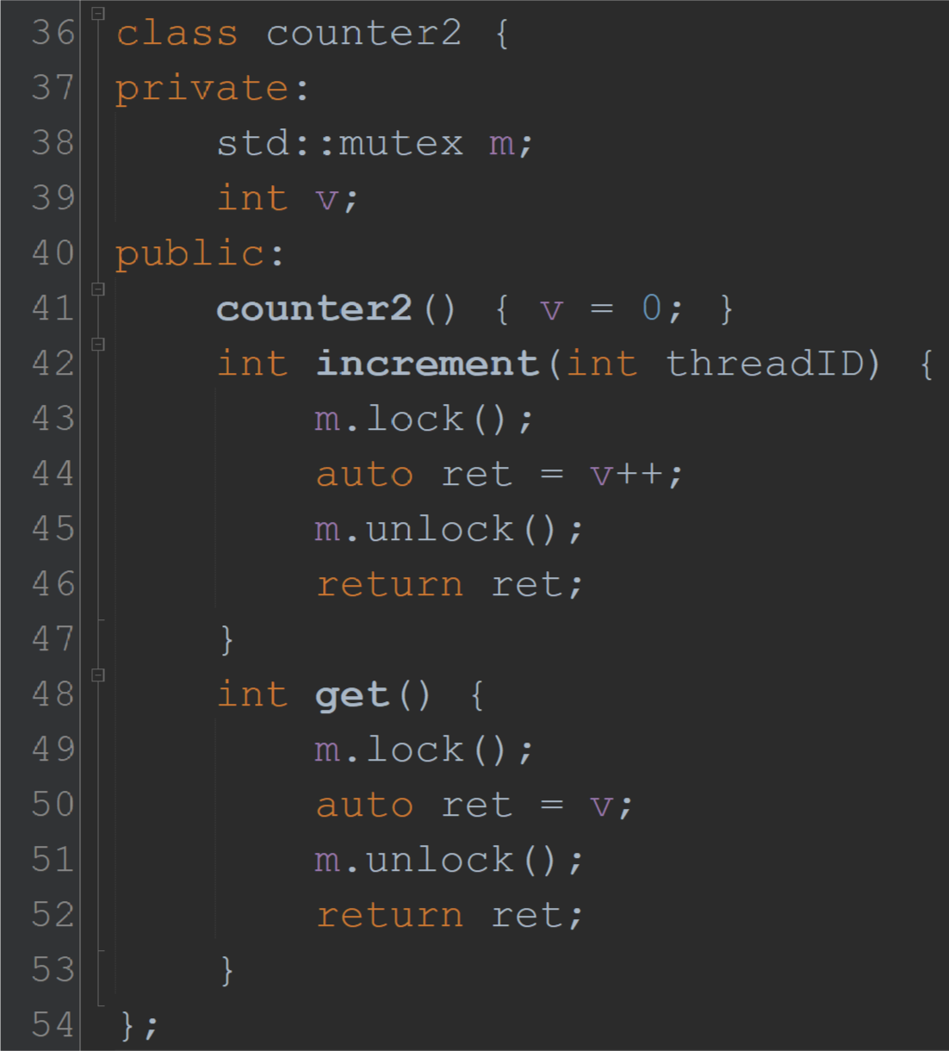
Lock-based counter
This is really a read followed by a write…
How does this help?
Both read and write are done while holding the lock

Slide 8
Can this problem happen now?
thread p
thread q
Read(c) → 0
m.lock()
Read(c) → 0
q: do m.lock()
Write(c, 1)
Return 0
Blocks until p’s m.unlock()
m.unlock()
Write(c, 1)
Return 0
Will now Read & Return 1!
Time

Slide 9
Where do we linearize each operation?
Intuition behind why these linearization points work: to all threads, operations appear to happen instantly at these lines
(So, anything that happens while the counter is locked is effectively atomic)
Linearize increment at the WRITE (really, any time when the lock is held would work)
(… because, from the perspective of other threads, the counter cannot be accessed while it is locked)
Linearize get at the READ of v

Slide 10
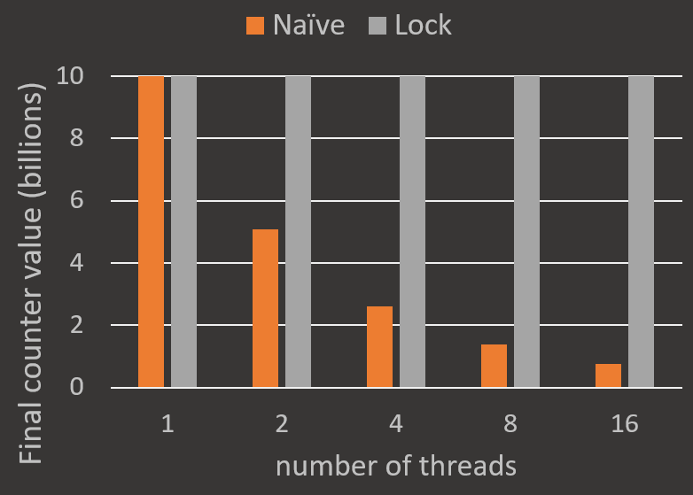
Output after adding a lock
Same as the previous “accuracy experiment”
Comparing final counter value of naïve and lock-based
Output is now correct!
(Of course, this experiment is not a correctness proof)
What about performance?

Slide 11
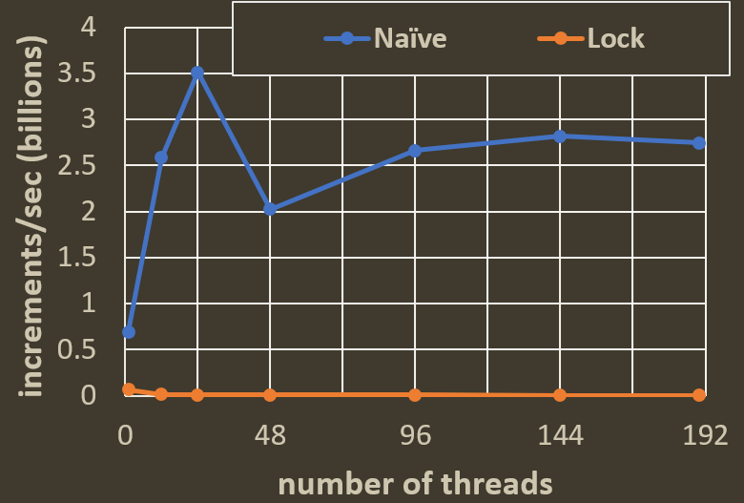
Performance comparison
Simple timed experiment
Each data point = average of 5 trials
In each trial, for 3 seconds,
threads repeatedly perform Increment,
and we measure increments/second
What is the overhead of locking?
10x slower with 1 thread
450x slower with 190 threads
Is there a better tool than locking?
Machine with 4 physical processors (each with 24 cores + hyperthreading)
Hyperthreading happens here
Second physical processor added

Slide 12
Fetch and add (FAA)
Instruction implemented modern Intel and AMD systems:
lock xadd
FAA(addr, val) does the following atomically (all at once)
old = Read(addr)
temp = old + val
Write(addr, temp)
Return old

Slide 13
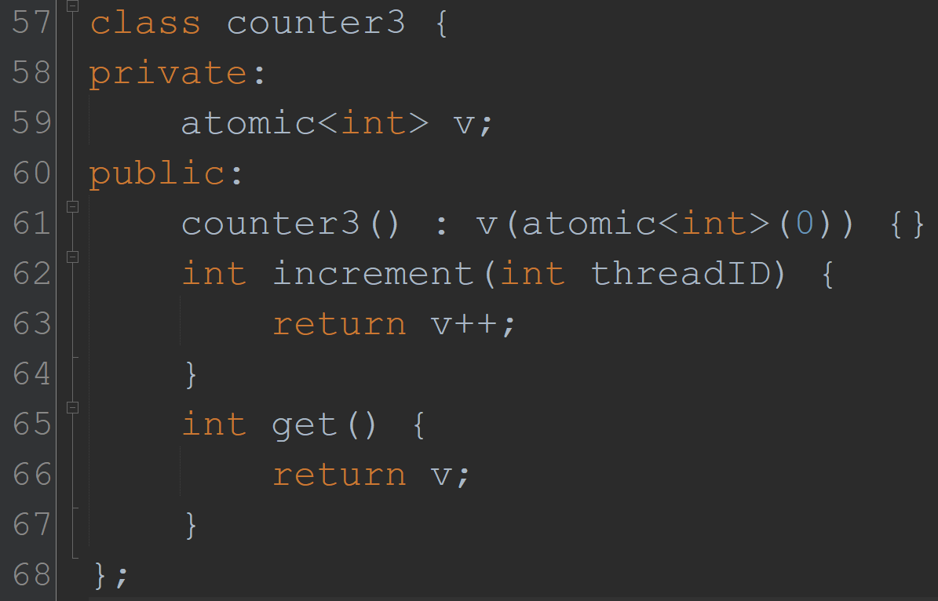
Easy FAA-based counter
Because v is atomic<int>, this is really a FAA!
Notes:
“Atomically increments or decrements the current value. The operation is a read-modify-write operation. […] Performs atomic post-increment. Equivalent to fetch_add(1).”

Slide 14
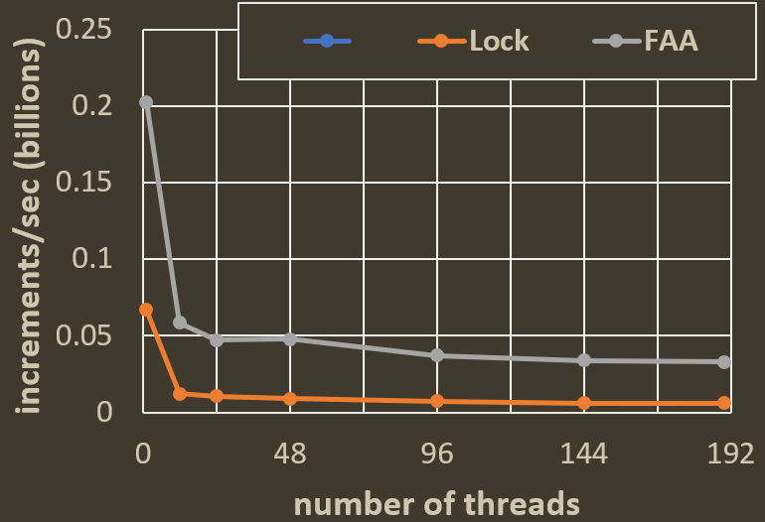
How does this perform in practice?
Same timed experiment
Excluding Naïve from the graph (to zoom in on Lock and FAA)
Compared to Lock
FAA is up to 5.4x faster
Compared to Naïve (incorrect)
FAA is up to 83x slower
(much better than Lock’s 450x)

Slide 15
Problem: too much contention
Accessing a single counter creates a contention bottleneck
What if we shard (partition) the counter into multiple sub counters
Increment: pick one sub counter and increment it
What about Get?
Counter value is distributed over the sub counters
Trade-off
Single counter → slow Increment, fast Get
Sharded counter → fast Increment, slower/more complex Get?
We are going to ignore these complications and only think about increment…

Slide 16
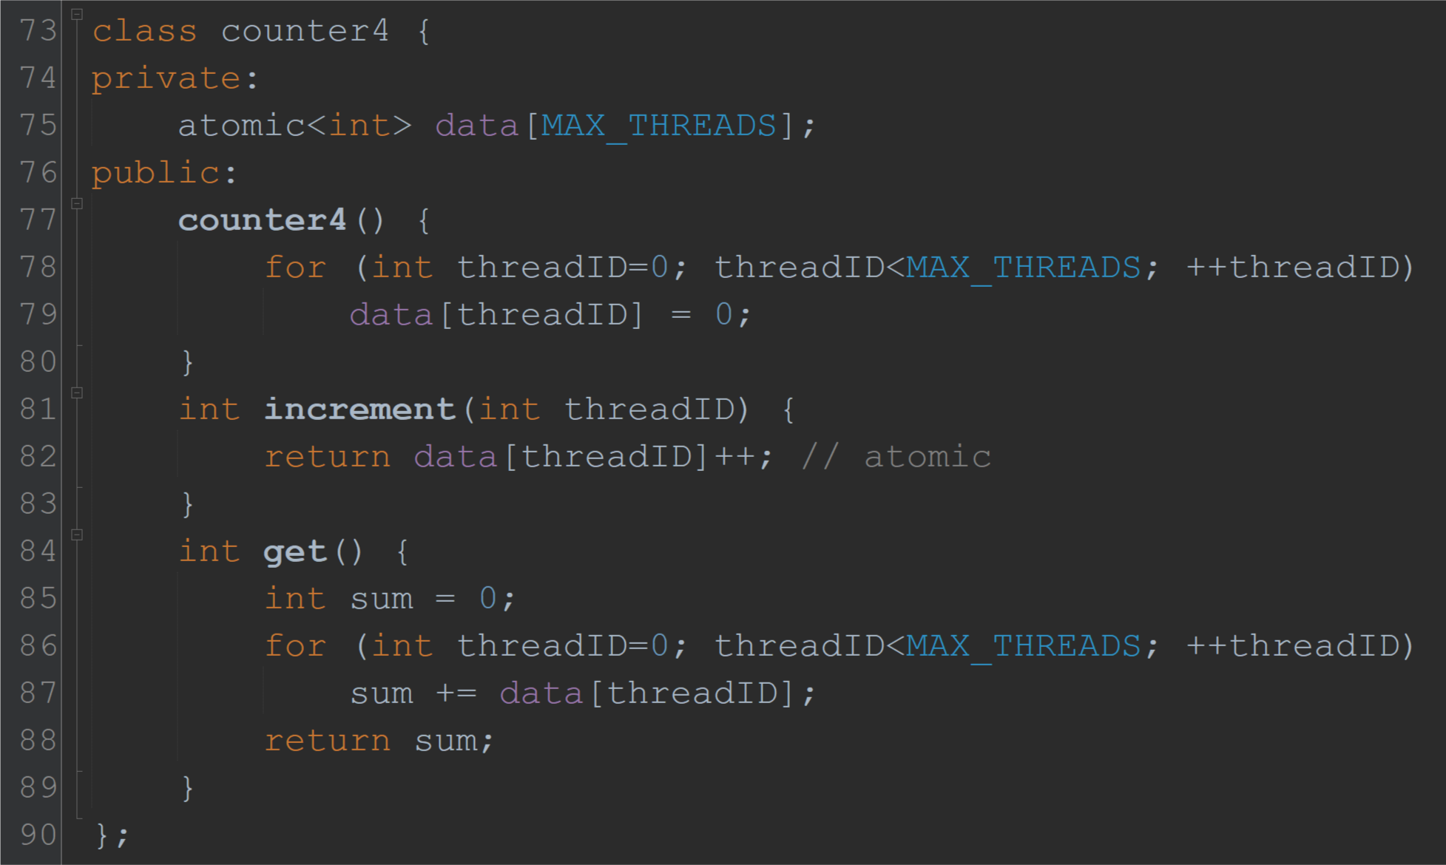
Naïve Sharded counter
Each thread uses its own sub counter
No data sharing, should scale perfectly

Slide 17
How does this perform?
Same timed experiment
Why is the scaling so poor?
No shared data, right?
Answer: cache coherence

Slide 18
How cache coherence works
Thread 1’s cache
Thread 2’s cache
w₁
w₂
w₃
w₄
w₅
w₆
w₇
w₈
S
w₁
w₂
w₃
w₄
w₅
w₆
w₇
w₈
S
X
Thread 1 reads w₂
Thread 2 reads w₇
Cache line invalidated and evicted!
Thread 2 writes w₇
w₁
w₂
w₃
w₄
w₅
w₆
w₇
w₈
64 byte (8 word) cache line

Slide 19
Memory layout of sub counters
c[0]
c[1]
c[2]
c[3]
c[4]
c[5]
c[6]
c[7]
c[8]
c[9]
c[10]
c[11]
c[12]
c[13]
c[14]
c[15]
…
one cache line
one cache line
Incrementing one of these will invalidate all of them
(causing huge contention)
This is called
false sharing

Slide 20
Solution: padding
Add empty space to each sub counter
To make it cache line sized
c[0]
c[1]
…
one cache line
one cache line

Slide 21
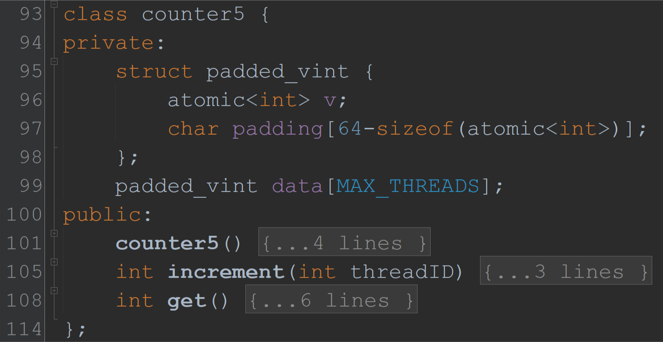
Padded Sharded counter
This is where the magic happens
Identical to naïve sharded counter
data[0].v
data[0].padding
data[1].v
data[1].padding
data
v
padding
v
padding
…
padded_vint data[0] ~= cache line
padded_vint data[1] ~= cache line

Slide 22
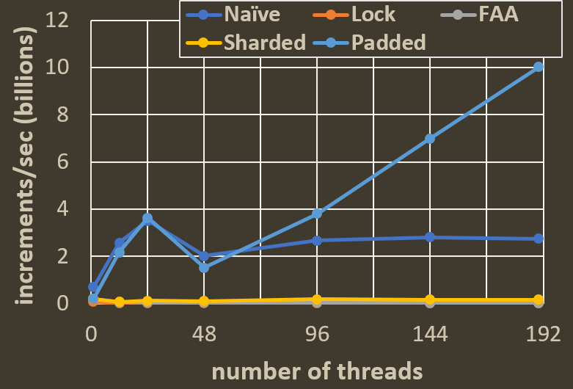
How does this perform?
Same experiment, but comparing naïve sharding with a padded counter
Pretty good scaling
18x vs optimal 24x
49x vs optimal 190x
18x single-threaded
49x single-threaded

Slide 23
Speed vs simplicity
But… reading is hard!
Solving this will add complexity
Simplicity is valuable!
Do we need a complex solution?
Sometimes… but not always…

Slide 24
Considering use cases: a FAA-counter might be good enough
FAA-based counter does not truly scale
But, its absolute throughput might be high enough for your application
Real applications do more than just increment a single counter
Avoid unnecessary optimization
Figure out if it’s a bottleneck first
33 million increments/sec!

Slide 25
A word of warning: padding can hurt
Union-find data structure
Each 8b node was padded to 64b
Removing padding → 5x faster!
Why?
Many nodes, uniformly accessed → contention is rare → false sharing is rare → padding can’t help much
Padding wastes space → 1/8th as many nodes in cache!
operations per microsecond

Slide 26
When to pad?
Important principle!
When the number of objects being padded is O(# threads) for a small constant
AND threads frequently write to these objects
Try and see if it helps…

Slide 27
Summary
Cache coherence, shared and exclusive modes, cache invalidations, contention
Sharding (partitioning data to reduce contention)
False sharing and padding (principle: when to pad)
Locks, fetch-and-add
Implementing linearizable counters
Lock-based counter
Fetch-and-add counter
Sharded counter
Padded sharded counter

