Slide 1
Multicore programming
(Dis)ordered data structures
Lecture 3
Trevor Brown

Slide 2
Announcements
Reminder: A1 due soon
A2 to be released soon!

Slide 3
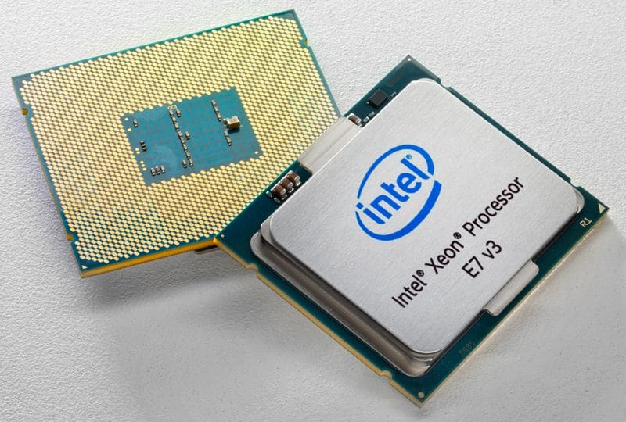
modeling performance on a real system
Processor caches largely determine performance
Last-level cache is most important
(Memory is 10-100x slower)
Cache lines accessed by only one thread
Cheap to access (even exclusive mode creates no contention)
Read-only cache lines accessed by many threads
Cheap to access (shared mode allows concurrency)
Cache lines accessed by many threads and often modified
Expensive to access (exclusive mode blocks other threads)
Possibly susceptible to false sharing

Slide 4
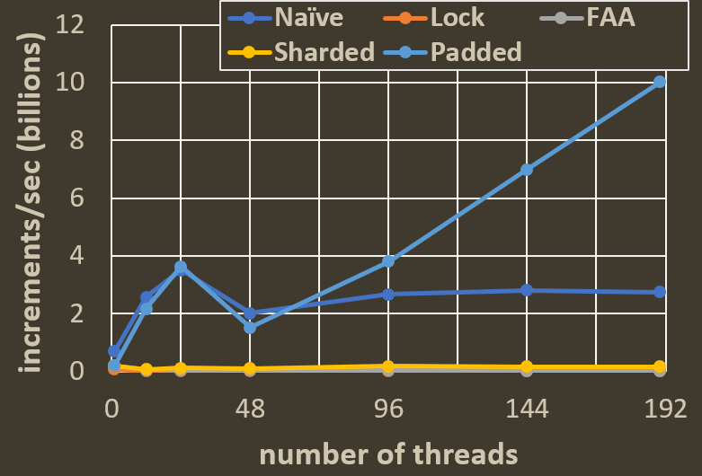
Recall: Padded sharded counter performance
Timed experiment comparing naïve sharding with a padded counter
Pretty good scaling
Can we make this even faster?

Slide 5
Entering the Danger Zone
To learn about instruction reordering and weak memory models…

Slide 6
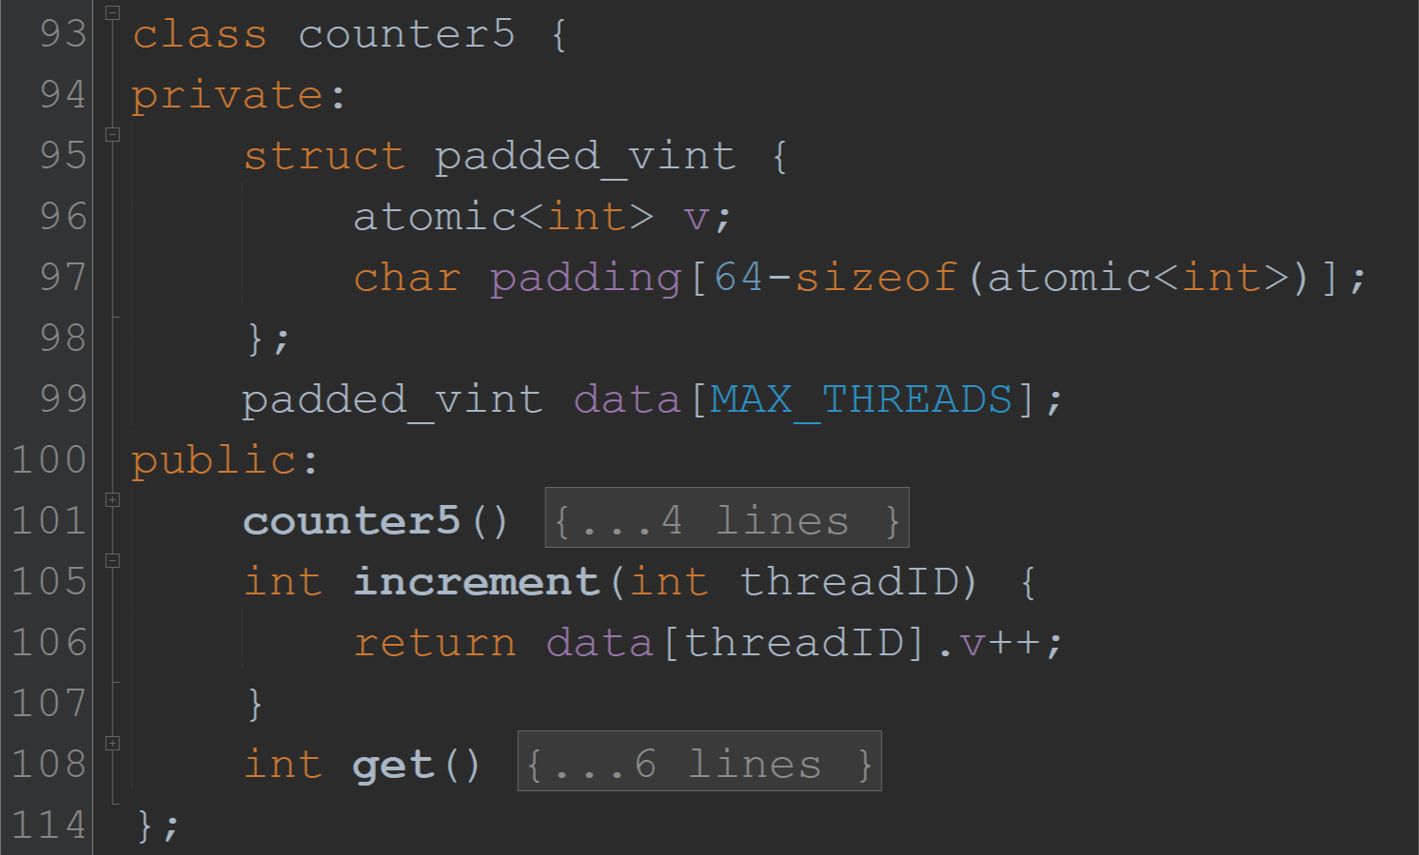
Because this is atomic<int>…
This is a FAA instruction!
But each thread only modifies its own sub counter!
So, FAA is not needed for increments to be atomic relative to other increments!
(We aren’t worrying about get operations for now…)

Slide 7
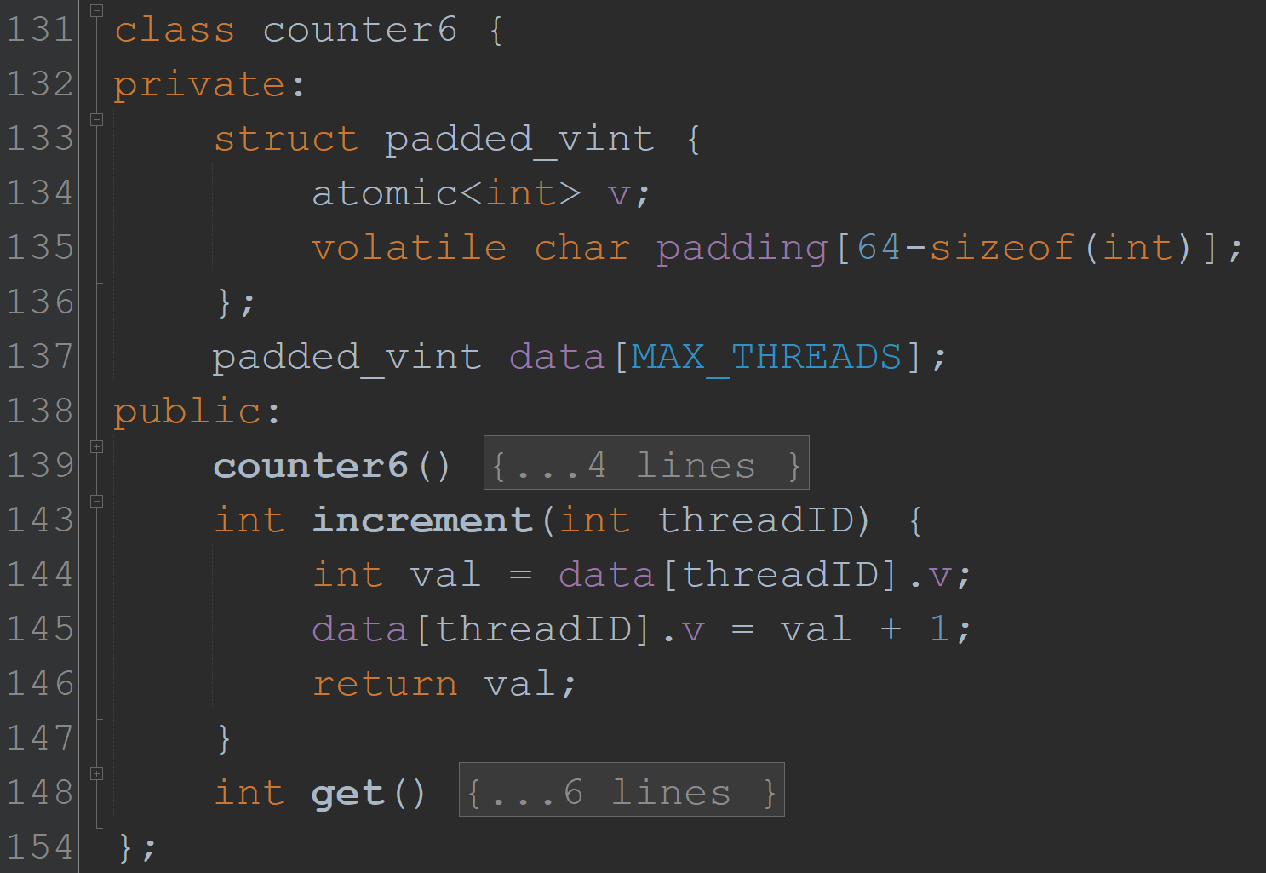
Attempt 1: Break ++ into load & store
Guesses re: change in performance?
Result: 10x slowdown! Why?
No FAA (“lock xadd”), but there is an mfence added by the compiler… What is this?

Slide 8
Instruction reordering
When you write code, are the lines of code executed in the order you write them?
Compiler can reorder your code! (as long as doing so wouldn’t break sequential code)
Processor can also reorder your code
On modern Intel and AMD, the only permitted reordering is taking a read that is after a write, and moving it so it is now before the write
This is called “read before write” reordering (and it helps hide cache miss latency)
Both compiler and processor reordering are prevented by using C++ atomics as shown
Before atomics, we used explicit mfence instructions to prevent this (__sync_synchronize in GCC)
Not a concern if you always lock objects before accessing them – locks are specifically designed prevent reordering!
(In this case, no need to use atomic types for fields protected by locks!)

Slide 9
Attempt 1: Break ++ into load & store
Result: 10x slowdown! Why?
mfence is added by the compiler to guarantee sequential consistency
This prevents the CPU from reordering instructions, but is very costly
Note: FAA also functions like an mfence on x86/64
(Conjecture: CPU “combines” FAAs, unlike mfences)
Can we remove the mfence? Is it correct to do so?

Slide 10
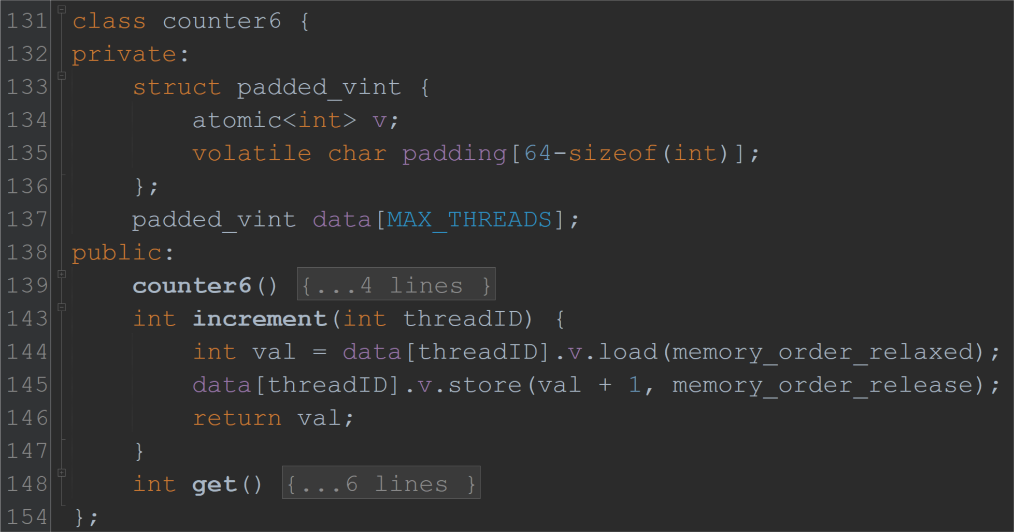
Attempt 2: Explicitly allow reordering
Unreasonably deep insight: we don’t actually care about instructions being reordered here
Use atomic::load() and atomic::store() with argument memory_order_relaxed
This tells the compiler we don’t need or want an mfence there

Slide 11
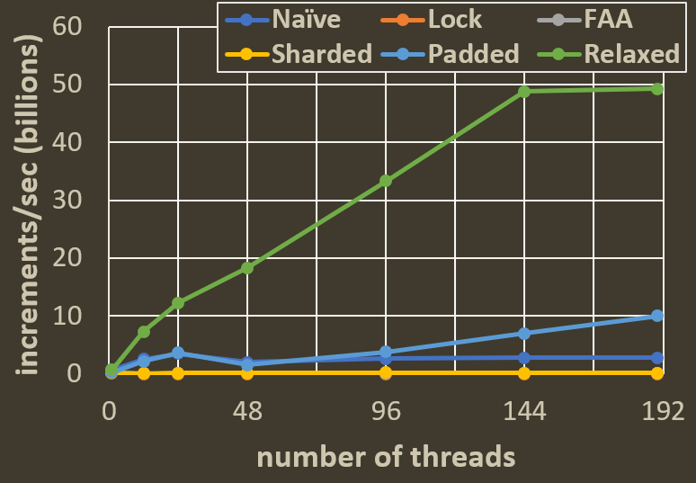
Going
Takeaways: (1) fetch&add is much faster than a write followed by an mfence. (2) mfence is so slow that it’s almost certainly faster to use an atomic exchange instruction (also called XCHG or SWAP) on x86/64 instead of a write+mfence.

Slide 12
How *could* you use C++ Atomics
atomic<int> x offers functions:
int r = x.load(memory_order)
x.store(new_value, memory_order)
memory_order has default value of memory_order_seq_cst
If all accesses to shared variables use this, you get sequential consistency (as if there is no reordering)
Other possible arguments:
memory_order_acquire and memory_order_release (used together)
If a thread p “acquires” data that another thread q “released”, then p also sees the effects of anything else q did before releasing the data (difficult…)
memory_order_consume (poorly defined, probably deprecated, ignore!)
memory_order_relaxed (all reordering allowed!)

Slide 13
How *should* you use C++ atomics?
Prevent all reordering by using the default memory_order_seq_cst
C++14 specification 29.3, note 8:
“memory_order_seq_cst ensures sequential consistency only for a program that is free of data races and uses exclusively memory_order_seq_cst operations. Any use of weaker ordering will invalidate this guarantee unless extreme care is used.”
When the spec. says “extreme care,” you should be terrified

Slide 14
memory_order_relaxed, and others

Slide 15
Another approach: approximate objects
Sometimes approximate results are enough for some applications!
Example: if a counter is used to decide when to expand a hash table (just to improve performance --- no impact on hash table’s correctness)
Could imagine an approximate counter ADT
Parameterized by an error constant c
Abstract state is an integer, initially zero
Operations
Increment: increases the abstract state by 1
ExactGet: returns the abstract state
Get: returns a value that is within ±cn of the abstract state, where n is the number of threads that access the counter
Just in case you want an exact answer
For typical use

Slide 16
An approximate counter implementation
Global data: atomic<int64_t> globalCount
Per-thread data: int64_t localCount
Increment:
increments the thread’s own private localCount
after the thread has done $c⋅n$ increments, it does Fetch&Add(&globalCount, localCount) then sets its private localCount to 0
How far off can globalCount be from the true value?
$Error=c⋅n^{2}$
Insignificant once counter value is large
(For c=10, 100 threads, error is 100k. After just 10M increments, this is 1% error)
Reduces contention on size vs F&A every time
How fast is this approach? You’ll see in A2!

Slide 17
Next topic
(Dis)ordered data structures

Slide 18
Stack object
Operations
Push(key)
Pushes a key onto the stack
Pop()
Returns the last key pushed onto the stack, if the stack is not empty
Otherwise, returns null

Slide 19
Naïve stack in C++
Data types
Operations
struct node {
const int key;
atomic<node *> next;
node(int _key, node * _next)
: key(_key), next(_next) {}
};
struct stack {
atomic<node *> top;
stack() : top(NULL) {}
void push(int key);
int pop();
};
void stack::push(int key) {
node * n = new node(key, top);
top = n;
}
int stack::pop() {
node * n = top;
if (n == NULL) return EMPTY;
top = n->next;
return n->key;
}
Pop() leaks memory… more on this later…

Slide 20
Example execution
Push(17)
Read top
Create node
Change top
Push(52)
Push(24)
Pop()
Read top and see node(24)
Change top to node(52) and return 24
24
next
top
52
next
17
next

Slide 21
What can go wrong?
Read top,
see node(17)
Create node
Change top
This item is lost!
top
thread p
Push(17)
Push(24)
24
52
next
thread q
Push(52)
next
Time
17
next
Read top,
see node(17)
Create node
Change top

Slide 22
Another example
Read top,
see node(52)
Read top->next,
see node(17)
Change top to node(17)
Return 52
top
thread p
Push(17)
Push(52)
Pop()
52
thread q
Pop()
next
Time
17
Read top,
see node(52)
Read top->next,
see node(17)
Change top to node(17)
Return 52
next

Slide 23
What’s the problem here?
Algorithmic step 1: read the value(s) that determine what we will write
Algorithmic step 2: perform the Write
Anything that happens in between is ignored / overwritten!
Reads and writes are not enough

Slide 24
A more powerful primitive
Compare-and-swap (CAS)
Atomic instruction implemented in most modern architectures (even mobile/embedded)
Idea: a write that succeeds only if a location contains an “expected” value exp
Semantics
CAS(addr, exp, new)
if (*addr == exp) {
*addr = new;
return true;
}
return false;
Implemented atomically in hardware

Slide 25
CAS-based stack [Treiber86]
void stack::push(int key)
int stack::pop()
node * n = new node(key);
while (true) {
node * curr = top;
n->next = curr;
if (CAS(&top, curr, n)) return;
}
while (true) {
node * curr = top;
if (curr == NULL) return EMPTY;
node * next = curr->next;
if (CAS(&top, curr, next)) {
return curr->key;
}
}
Change top from curr to n
Change top from curr to curr->next

Slide 26
How does this avoid errors?
curr_{p} = Read(top)
n_{p} = new node(24)
CAS(&top, curr_{p}, n_{p}) - fails
Thread p will reread top and try again
n_{p}
top
n_{q}
24
thread p
Push(17)
Push(24)
52
next
next
thread q
Push(52)
17
Time
next
curr_{q}
curr_{q} = Read(top)
n_{q} = new node(52)
CAS(&top, curr_{q}, n_{q})
curr_{p}

Slide 27
What about freeing memory?
int stack::pop()
while (true) {
node * curr = top;
if (curr == NULL) return EMPTY;
node * next = curr->next;
if (CAS(&top, curr, next)) {
free(curr);
auto retval = curr->key;
return retval;
}
}
We disconnected a node from the stack!
Why not call free() on it?
We are not locking before accessing nodes…
Multiple threads might be accessing curr!

Slide 28
Problems freeing memory
curr_{p} = Read(top)
next_{p} = Read(curr_{p}->next),
Accessing freed memory!
top
curr_{p}
thread p
Push(17)
Push(52)
Pop()
curr_{q}
52
next
thread q
Pop()
next
Time
17
curr_{q} = Read(top)
next_{q} =
Read(curr_{q}->next)
CAS(&top, curr_{q}, next_{q})
free(curr_{q})
next
next_{q}

Slide 29
Using free correctly
Must delay free(curr) until it is safe!
When is it safe?
When no other thread has a pointer to curr
There are memory reclamation algorithms designed to solve this
Hazard pointers, epoch-based reclamation, garbage collection (Java, C#)
Usually provide a delayedFree operation (plus some other operations)
We won’t worry about memory reclamation for now…
Will see how to use such an algorithm in an assignment

Slide 30
What does the stack guarantee?
Correctness (safety): Linearizable
Every concurrent execution is equivalent to some valid execution of a sequential stack
(as long as we don’t screw up memory reclamation)

Slide 31
What does the stack guarantee?
Progress (liveness): Lock-free
Some thread will always make progress, even if some threads can crash
A crashed thread stops taking steps forever
Crashed threads are indistinguishable from very slow threads (because threads can be unboundedly slow)
Allows some threads to starve
But not all threads will starve
Algorithms are usually designed so starvation is rare in practice

Slide 32
Reasoning about progress
void stack::push(int key)
node * n = new node(key);
while (true) {
node * curr = top;
n->next = curr;
if (CAS(&top, curr, n)) return;
}
What can prevent progress in the stack?
Unbounded while loops
When do we break out of a loop?
When we do a successful CAS
What can prevent a successful CAS?
A concurrent successful CAS by another thread p
int stack::pop()
while (true) {
node * curr = top;
if (curr == NULL) return EMPTY;
node * next = curr->next;
if (CAS(&top, curr, next)) {
return curr->key;
}
}

Slide 33
Mechanics of proving progress
Proof by contradiction
Assume threads keep taking steps forever, but progress stops
After some time t, no operation terminates, so everyone is stuck in a while loop
To continue in their while loops, threads must continue to perform failed CASs forever after t
Every failed CAS is concurrent with a successful CAS, which is performed by an operation that will not perform any more loop iterations
Eventually, no running operation will perform loop iterations → contradiction!

Slide 34
Recap
Finishing up last class
Predicting performance on multicore machines revolves largely around the caches
Instruction reordering
C++ atomics: relaxed memory orders --- fast but dangerous
Memory fences
Important definition: lock-freedom
Lock-free stack (implementation and progress proof sketch)

