Slide 1
Multicore programming
Proving Linearizability
Lecture 4
Trevor Brown

Slide 2
Announcements
A2 should be released shortly, with a fairly short deadline
  If a non-trivial fraction of the class needs more time, we can extend this
  (But, we can only do this a couple of times, and A4 will likely need this)

Slide 3
Last time
We described a stack
We argued that it offers lock-free progress
We did not prove linearizability…
  Let’s do that now!
  This is the main proof in this course (AC/HS crosslisting)
  Hopefully explanation is helpful for A2!

Slide 4
Typical strategy for Lin. Proofs
Choose linearization points (LPs) for all operations
  A linearization point is usually a read, write or CAS (a step)
  Note: can pick different linearization points for,
  e.g., different push()es, or different pop()s
Prove: for each concurrent execution E,
the chosen LPs induce an equivalent linearized (sequential) execution L
  Recall: equivalent means
  all operations in L return the same values as their corresponding operations in E

Slide 5
Other (important) proof possibilities
In some algorithms, it is not possible to choose an explicit step
where an operation should be linearized
In such algorithms, we prove:
  for each concurrent execution E,
  there exist LPs that induce an equivalent linearized execution L
  These LPs are usually configurations (i.e., points in time) rather than steps
In practice, even if we cannot explicitly choose a line of code (step) as an LP,
we can often argue there exists some time during O
when the value O returned would have been the correct thing to return
  (And we can thus linearize at that time)
Advice: try explicit LPs first, and fall back to this if you can’t find LPs that “work out”

Slide 6
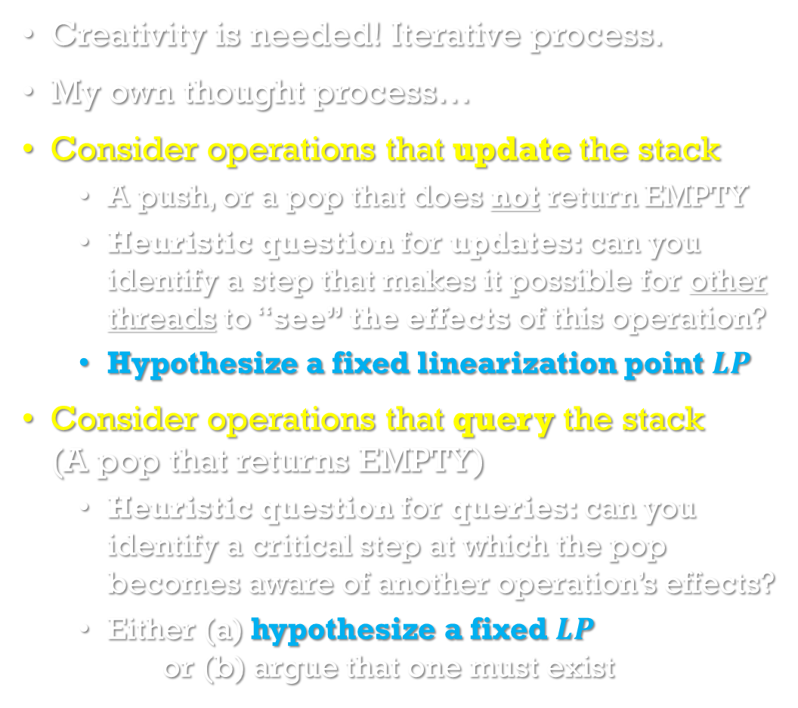
Choosing Linearization points for our Stack
Creativity is needed! Iterative process.
My own thought process…
Consider operations that update the stack
  A push, or a pop that does not return EMPTY
  Heuristic question for updates: can you identify a step that makes it possible for other threads to “see” the effects of this operation?
  Hypothesize a fixed linearization point $LP$
Consider operations that query the stack
(A pop that returns EMPTY)
  Heuristic question for queries: can you identify a critical step at which the pop becomes aware of another operation’s effects?
  Either (a) hypothesize a fixed $LP$
  or (b) argue that one must exist
void stack::push(int key)
node * n = new node(key);
while (true) {
node * curr = top;
n->next = curr;
if (CAS(&top, curr, n)) return;
}
int stack::pop()
while (true) {
node * curr = top;
if (curr == NULL) return EMPTY;
node * next = curr->next;
if (CAS(&top, curr, next)) {
return curr->key;
}
}

Slide 7
Sanity checking your hypothesized LPs
Brainstorm a 2-thread concurrent execution E
(you make it up, goal is to create opportunities to expose bugs)
Pick two concurrent operations O and O’, and
consider different possible thread schedules/interleavings of their steps
  Can you find an execution wherein either operation returns an incorrect value?
  (If there is any execution where it returns an incorrect value, then chosen LPs are wrong!)
creativity
thread p
Push(17)
Push(5)
Pop
Interactions between more than two threads / operations are also interesting. But this is a good start.
thread q
Pop
Pop
Time

Slide 8

Let’s try to see how sanity checks can catch an incorrect LP: the return statement in push
Creativity: brainstorm a sample execution E,
with concurrent operations O and O’
(one of which should be a push, to test our LP)
  It helps to pay special attention to LPs, and steps that change the return values of other operations.
What value should Pop() return in this execution,
to be consistent with the stack ADT?
Creativity: consider different thread schedules…
  Eventually, we might try scheduling the successful CAS of O before the start of O’
What will O’ actually return? (See code)
O’ will return 5 instead of EMPTY.
This disagrees with the ADT! So LP is wrong!
void stack::push(int key)
node * n = new node(key);
while (true) {
node * curr = top;
n->next = curr;
if (CAS(&top, curr, n)) return;
}
int stack::pop()
while (true) {
node * curr = top;
if (curr == NULL) return EMPTY;
node * next = curr->next;
if (CAS(&top, curr, next)) {
return curr->key;
} }
thread p
O’: Pop
E
thread q
O: Push(5)
Time
Successful CAS
$$LP$$

Slide 9

Let’s see another example of an incorrect LP:
the last read of top in push
Heuristic question:
can anyone else *see* our push yet?
Obtain sample execution via *creativity*
What value should Pop() return in this execution, to be consistent with the stack ADT?
  O’ must be linearized between its own start and end, so it must be after O. So, it must return 5!
After some *creativity* we try scheduling
the LP of O before O’
and the successful CAS of O after O’
What will O’ actually return?
O’ will return EMPTY instead of 5.
This disagrees with the ADT! So LP is wrong!
void stack::push(int key)
node * n = new node(key);
while (true) {
node * curr = top;
n->next = curr;
if (CAS(&top, curr, n)) return;
}
int stack::pop()
while (true) {
node * curr = top;
if (curr == NULL) return EMPTY;
node * next = curr->next;
if (CAS(&top, curr, next)) {
return curr->key;
} }
thread p
O’: Pop
E
thread q
O: Push(5)
Time
$$LP$$
Successful CAS

Slide 10


Correct LP: a successful CAS in push
Heuristic questions:
  can anyone else see our push before the CAS?
  how about after?
Creativity: try out various executions…
Execution E1:
  What value should Pop() return in this execution, to be consistent with the stack ADT?
  What will O’ actually return?
  O’ will return 5, as it should.
Execution E2:
  What should/will O’ return?
  EMPTY, as it should.
No amount of examples will
reveal a bug…
void stack::push(int key)
node * n = new node(key);
while (true) {
node * curr = top;
n->next = curr;
if (CAS(&top, curr, n)) return;
}
int stack::pop()
while (true) {
node * curr = top;
if (curr == NULL) return EMPTY;
node * next = curr->next;
if (CAS(&top, curr, next)) {
return curr->key;
} }
thread p
O’: Pop
E1
thread q
O: Push(5)
Time
$$LP$$
$$LP$$
thread p
O’: Pop
E2
IS a successful CAS
thread q
O: Push(5)
Time

Slide 11
Let’s choose an LP for pop
How about a successful CAS?
  Can only linearize there if there *is* one…
  If Pop returns EMPTY, there is no such CAS to linearize at!
  (Similarly if a pop crashes before performing such a CAS)
We linearize pop operations that
change the stack
differently from pop operations that only
query the stack
void stack::push(int key)
node * n = new node(key);
while (true) {
node * curr = top;
n->next = curr;
if (CAS(&top, curr, n)) return;
}
int stack::pop()
while (true) {
node * curr = top;
if (curr == NULL) return EMPTY;
node * next = curr->next;
if (CAS(&top, curr, next)) {
return curr->key;
} }

Slide 12
Case 1: pop performs a successful CAS
Heuristic question for updates:
Which step makes the effect of this pop visible to other threads?
Answer: the successful CAS
  Before the CAS, the value is not yet popped---other threads can still see it.
  After the CAS, they cannot.
So we linearize at the successful CAS
void stack::push(int key)
node * n = new node(key);
while (true) {
node * curr = top;
n->next = curr;
if (CAS(&top, curr, n)) return;
}
int stack::pop()
while (true) {
node * curr = top;
if (curr == NULL) return EMPTY;
node * next = curr->next;
if (CAS(&top, curr, next)) {
return curr->key;
} }

Slide 13
Case 2: pop returns EMPTY
Heuristic question for queries
  Can you identify a critical step S where the pop becomes aware of the effects of other update operations?
  Probing questions for identifying S
    Can we change the return value of the pop by scheduling a new update operation just before S?
    Are update operations after S essentially ignored by the pop?
Answer: the last read of top
  Suppose the stack is empty when we read top
  Then we will return EMPTY (ignoring any updates that occur after we read top).
  If an update operation changes top just before we read it, we will no longer return EMPTY
So, we linearize at the last read of top
void stack::push(int key)
node * n = new node(key);
while (true) {
node * curr = top;
n->next = curr;
if (CAS(&top, curr, n)) return;
}
int stack::pop()
while (true) {
node * curr = top;
if (curr == NULL) return EMPTY;
node * next = curr->next;
if (CAS(&top, curr, next)) {
return curr->key;
} }
Note: we have given linearization points for pop()s that perform a successful CAS, or return EMPTY.
What about pop()s that crash
(without performing a successful CAS)?
Exercise: show that it is wrong to choose the last read of top as the LP in Case 1.

Slide 14
Summarizing so far
Plausible linearization points
  Push: the successful CAS
  Pop:
    The successful CAS if there is one
    Otherwise, the last read of top
That argument was not a linearizability proof! It was a heuristic for choosing LPs.
Need to prove: with this choice of LPs,
every stack execution is linearizable.
How do we prove this?
void stack::push(int key)
node * n = new node(key);
while (true) {
node * curr = top;
n->next = curr;
if (CAS(&top, curr, n)) return;
}
int stack::pop()
while (true) {
node * curr = top;
if (curr == NULL) return EMPTY;
node * next = curr->next;
if (CAS(&top, curr, next)) {
return curr->key;
}
}

Slide 15


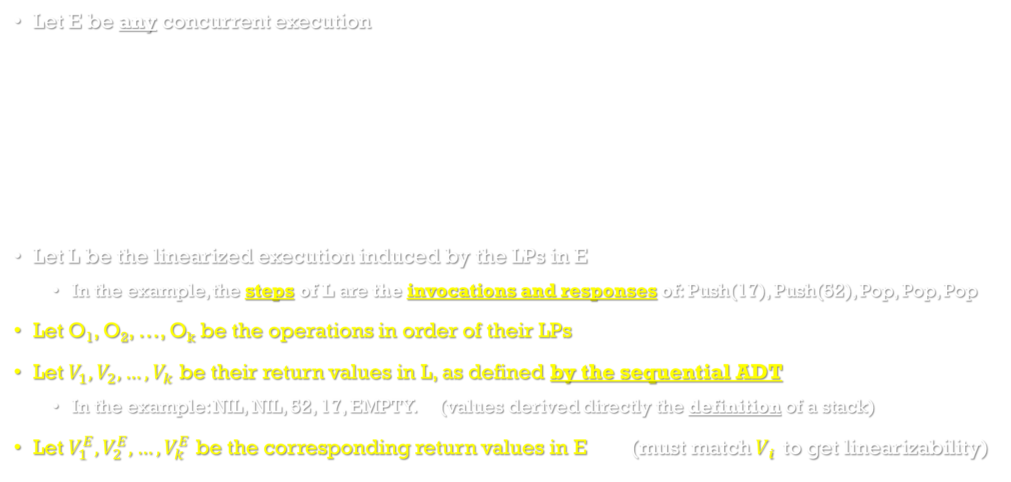



Proof Mechanics
LP: last CAS
LP: last CAS
LP: last CAS
Let E be any concurrent execution
Let L be the linearized execution induced by the LPs in E
  In the example, the steps of L are the invocations and responses of: Push(17), Push(52), Pop, Pop, Pop
Let O₁, O₂, …, O_{k} be the operations in order of their LPs
Let $V_{1},V_{2},…,V_{k}$ be their return values in L, as defined by the sequential ADT
  In the example: NIL, NIL, 52, 17, EMPTY. (values derived directly the definition of a stack)
Let $V_{1}^{E},V_{2}^{E},…,V_{k}^{E}$ be the corresponding return values in E (must match $Vi$ to get linearizability)
O₁
O₂
O₄
LP: last READ of top
For example, execution E might be something like this (but you,
as the theorem prover,
would not know what E looks like)
thread p
Push(17)
Push(52)
$$=V_{4}^{E}$$
Pop → 17
$${NIL=V}_{1}^{E}$$
$${NIL=V}_{2}^{E}$$
O₅
$${=V}_{3}^{E}$$
thread q
Pop → 52
Pop → EMPTY
$$=V_{5}^{E}$$
O₃
E represents every possible execution. This example just illustrates one.
LP: last CAS
Time

Slide 16
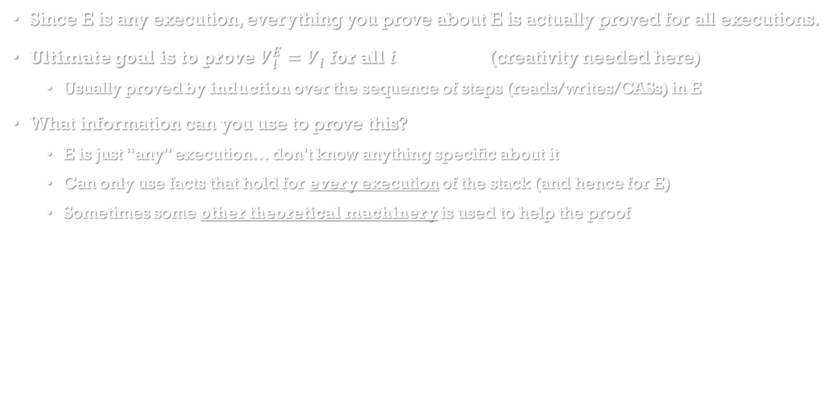
Proof Mechanics
Since E is any execution, everything you prove about E is actually proved for all executions.
Ultimate goal is to prove $V_{i}^{E}=V_{i}$ for all $i$ (creativity needed here)
  Usually proved by induction over the sequence of steps (reads/writes/CASs) in E
What information can you use to prove this?
  E is just “any” execution… don’t know anything specific about it
  Can only use facts that hold for every execution of the stack (and hence for E)
  Sometimes some other theoretical machinery is used to help the proof
More on this next…

Slide 17
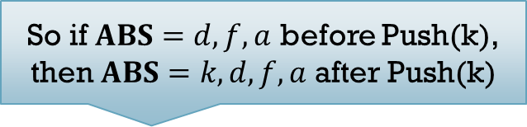
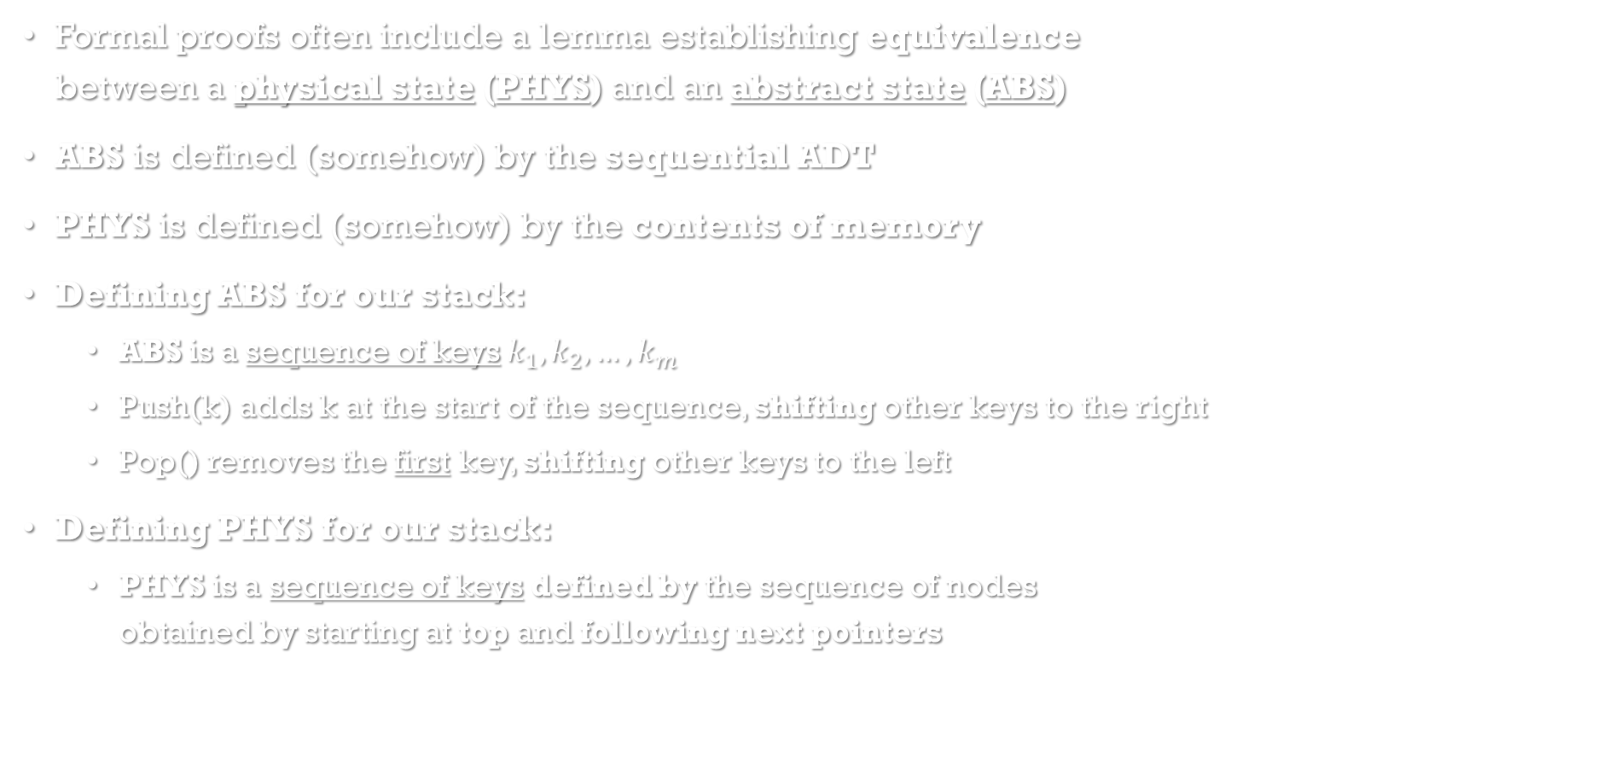
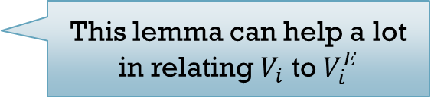

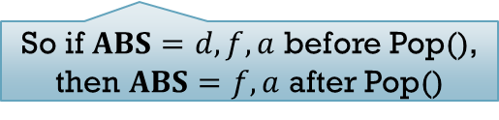
Useful theoretical machinery
This lemma can help a lot in relating $V_{i}$ to $V_{i}^{E}$
Formal proofs often include a lemma establishing equivalence
between a physical state (PHYS) and an abstract state (ABS)
ABS is defined (somehow) by the sequential ADT
PHYS is defined (somehow) by the contents of memory
Defining ABS for our stack:
  ABS is a sequence of keys $k_{1},k_{2},…,k_{m}$
  Push(k) adds k at the start of the sequence, shifting other keys to the right
  Pop() removes the first key, shifting other keys to the left
Defining PHYS for our stack:
  PHYS is a sequence of keys defined by the sequence of nodes
  obtained by starting at top and following next pointers
top
So if $ABS=d,f,a$ before Push(k),
then $ABS=k, d,f,a$ after Push(k)
d
next
f
So if $ABS=d,f,a$ before Pop(),
then $ABS=f,a$ after Pop()
next
Example: $PHYS=d,f,a$
a
next

Slide 18
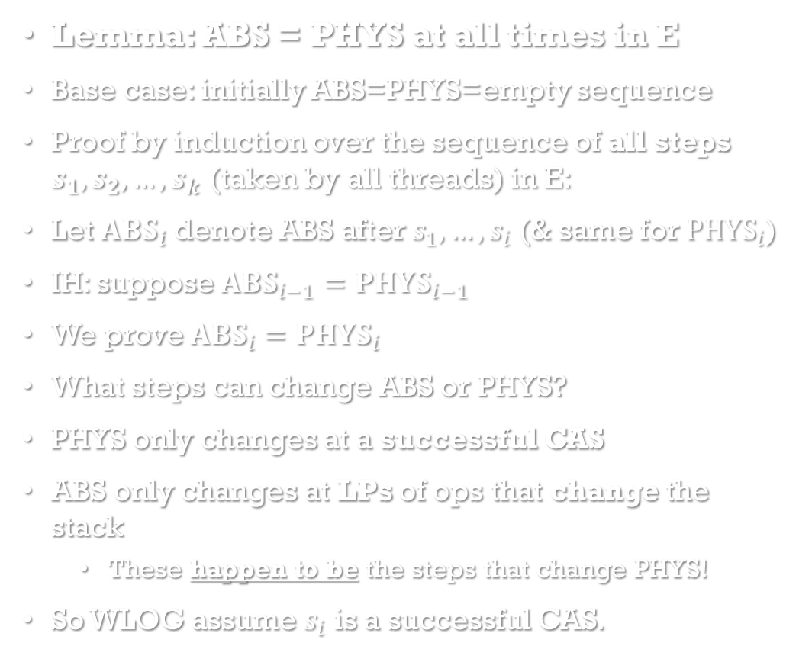
Stack Linearizability proof:
Starting with A powerful Invariant
Lemma: ABS = PHYS at all times in E
Base case: initially ABS=PHYS=empty sequence
Proof by induction over the sequence of all steps $s_{1}, s_{2}, …, s_{k}$ (taken by all threads) in E:
Let $ABS_{i}$ denote ABS after $s_{1}, …,s_{i}$ (& same for ${PHYS}_{i}$)
IH: suppose $ABS_{i−1}=PHYS_{i−1}$
We prove $ABS_{i}=PHYS_{i}$
What steps can change ABS or PHYS?
PHYS only changes at a successful CAS
ABS only changes at LPs of ops that change the stack
  These happen to be the steps that change PHYS!
So WLOG assume $s_{i}$ is a successful CAS.
void stack::push(int key)
node * n = new node(key);
while (true) {
node * curr = top;
n->next = curr;
if (CAS(&top, curr, n)) return;
}
int stack::pop()
while (true) {
node * curr = top;
if (curr == NULL) return EMPTY;
node * next = curr->next;
if (CAS(&top, curr, next)) {
return curr->key;
}
}
Two cases arise…

Slide 19

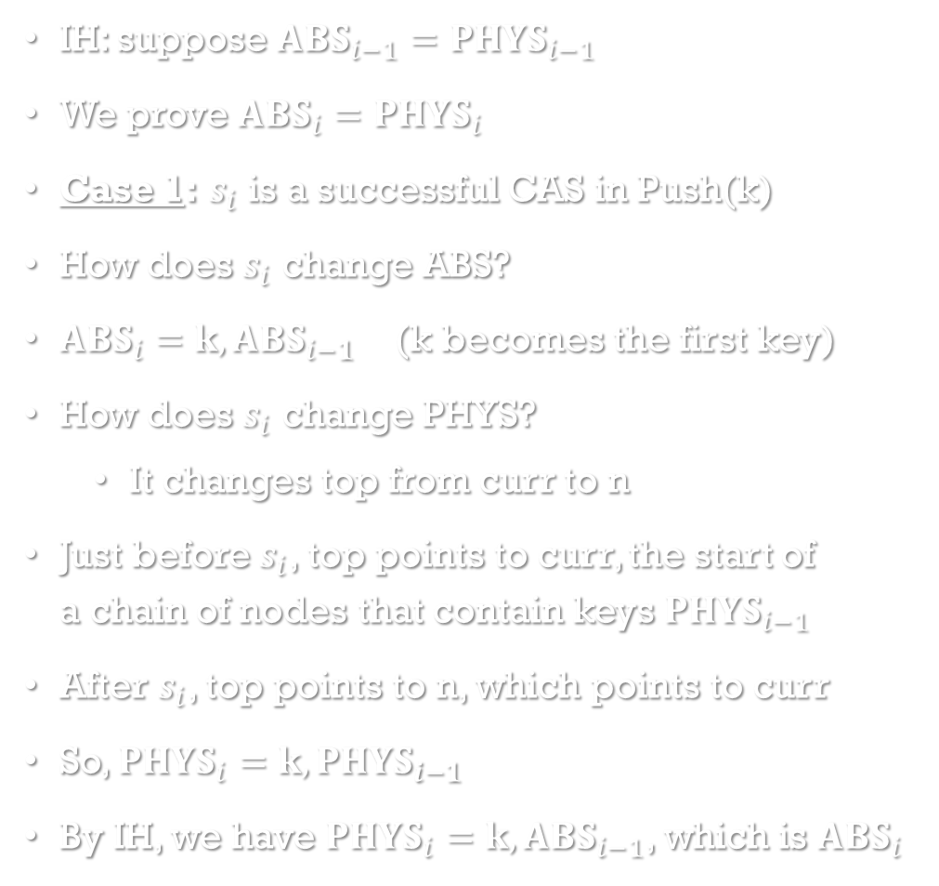

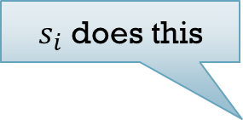

Proving the lemma: Case 1
IH: suppose $ABS_{i−1}=PHYS_{i−1}$
We prove $ABS_{i}=PHYS_{i}$
Case 1: $s_{i}$ is a successful CAS in Push(k)
How does $s_{i}$ change ABS?
$ABS_{i}=k,ABS_{i−1}$ (k becomes the first key)
How does $s_{i}$ change PHYS?
  It changes top from curr to n
Just before $s_{i}$, top points to curr, the start of
a chain of nodes that contain keys $PHYS_{i−1}$
After $s_{i}$, top points to n, which points to curr
So, $PHYS_{i}=k,PHYS_{i−1}$
By IH, we have $PHYS_{i}=k,ABS_{i−1}$, which is $ABS_{i}$
$s_{i}$ does this
n
Example
k
top
next
curr
d
next
$$PHYS_{i}=k,d,f,a$$
f
$$=k,PHYS_{i−1}$$
$$PHYS_{i−1}=d,f,a$$
next
a
next

Slide 20

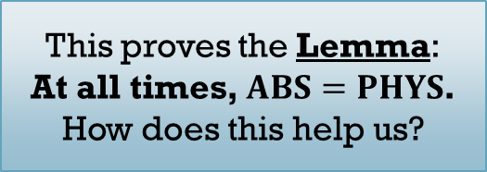
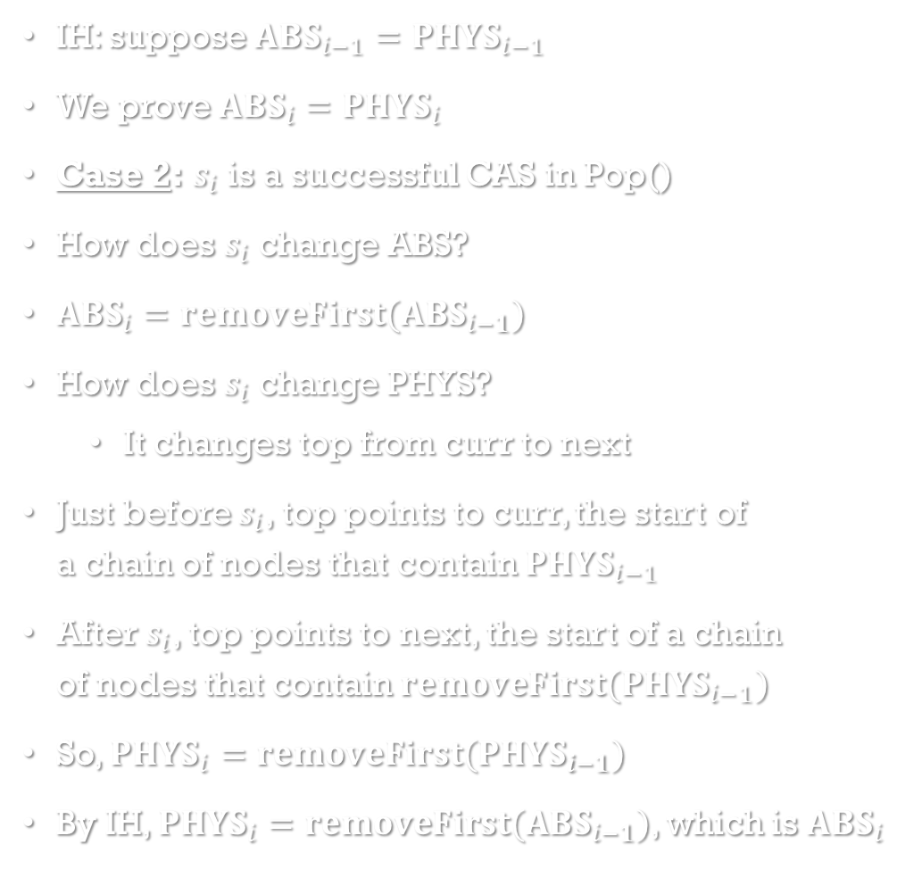


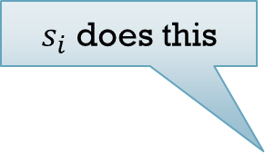
Proving the lemma: Case 2
IH: suppose $ABS_{i−1}=PHYS_{i−1}$
We prove $ABS_{i}=PHYS_{i}$
Case 2: $s_{i}$ is a successful CAS in Pop()
How does $s_{i}$ change ABS?
$ABS_{i}=removeFirst(ABS_{i−1})$
How does $s_{i}$ change PHYS?
  It changes top from curr to next
Just before $s_{i}$, top points to curr, the start of
a chain of nodes that contain $PHYS_{i−1}$
After $s_{i}$, top points to next, the start of a chain
of nodes that contain $removeFirst(PHYS_{i−1})$
So, $PHYS_{i}=removeFirst(PHYS_{i−1})$
By IH, $PHYS_{i}=removeFirst(ABS_{i−1})$, which is $ABS_{i}$
$s_{i}$ does this
Example
This proves the Lemma:
At all times, $ABS=PHYS$.
How does this help us?
top
curr
d
next
next
f
$$PHYS_{i−1}=d,f,a$$
next
$$PHYS_{i}=f,a$$
$$=removeFirst(PHYS_{i−1})$$
a
next

Slide 21
What exactly did we just prove?
We have proved ABS = PHYS at all times.
Intuition: this means the contents of memory (PHYS) contains the “correct” answer (ABS)
This does NOT mean our operations actually find and return the correct answer
  For example, if we changed the code for Pop to always return EMPTY,
  we could still prove ABS = PHYS at all times.
  But, whenever the stack is non-empty, our return values would be completely incorrect!
We are NOT done!
  We still need to prove that the return values of operations actually correspond to PHYS somehow!
  Then, our invariant PHYS = ABS will establish that our return values are correct.

Slide 22
Proving return values are correct
int stack::pop()
while (true) {
node * curr = top;
if (curr == NULL) return EMPTY;
node * next = curr->next;
if (CAS(&top, curr, next)) {
return curr->key;
} }
Lemma: every (non-crashed) Pop operation O returns
the first key that was in PHYS at the time O was linearized.
Case 1: Suppose O returns EMPTY.
  Then O is linearized at its last READ of top, which returned NULL, so PHYS was empty at O’s LP.
Case 2: Suppose O returns curr->key. Then O is linearized at its successful CAS.
  Since this CAS succeeds, top pointed to curr at O’s LP.
  Thus, when O was linearized, the first key of PHYS was precisely curr->key, which O returns.
Corollary: every Pop returns the first key that was in ABS when that Pop was linearized
Theorem: every operation in E returns the same value as it would in L.
  Push has no return value.
  By the Corollary, every Pop in E returns the first key in ABS, which is exactly what it returns in L.
  This proves the stack is linearizable.

