Slide 1
Multicore programming
Harnessing Disorder
Lecture 5
Trevor Brown

Slide 2
Last time
We proved that our lock-free stack is correct (linearizable)
This time:
Stack performance
Difficulties in using ordered data structures
Harnessing disorder

Slide 3
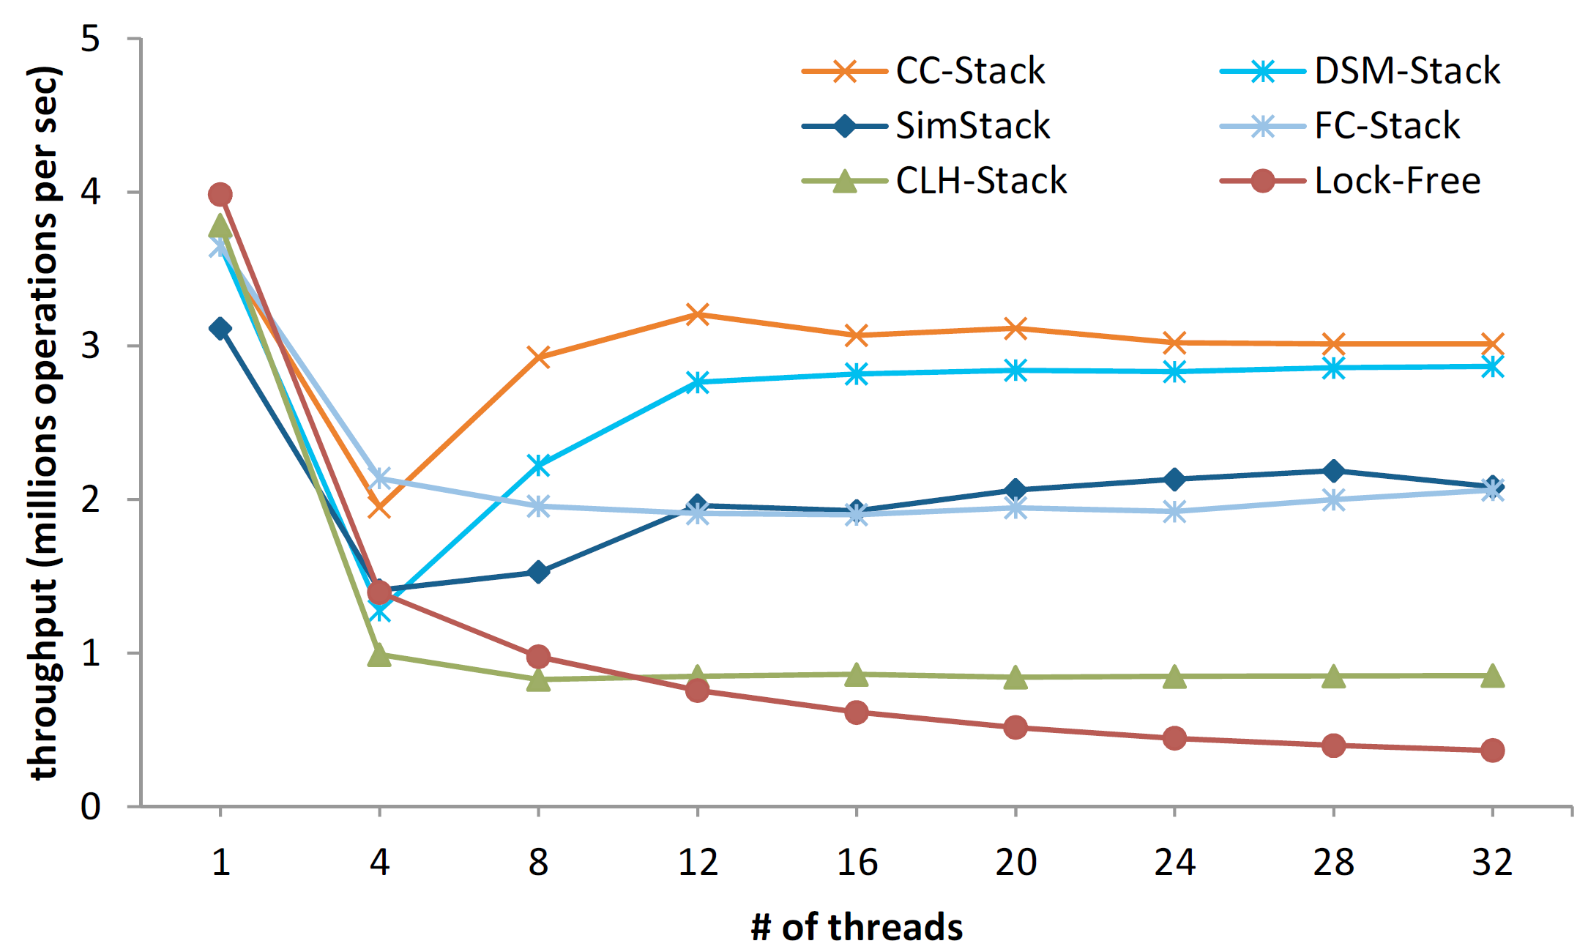
Performance
Are stacks really suitable for multicore programming? One thread is best…
Other stacks developed up to 2012
Treiber stack we just saw

Slide 4
Queues
Like stacks, but FIFO instead of LIFO
Logical next step
Concurrent modification of two pointers (head/tail) rather than just one (stack top)
Not covering in detail (no implementation / proofs)
They don’t scale
Are they really useful? Mainly just for handing data from one thread to another…

Slide 5
Why would we want concurrent stacks or queues?
Suppose we have a fast concurrent queue
Do we care?
Why use a queue over something with no ordering guarantees?
Less ordering would allow more concurrency (and better performance)
Must need the order!
Can we actually use the ordering a concurrent queue provides to do anything useful?

Slide 6
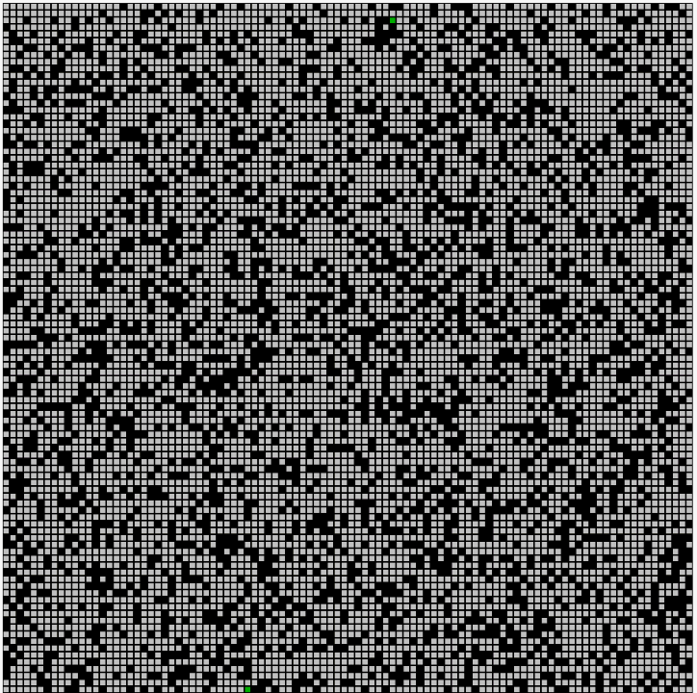
Example: breadth-first search (BFS)
Graph traversal algorithm that depends on FIFO ordered queue
BFS(startingNode, visitFunction)
q = new Queue
q.enqueue(startingNode)
while q is not empty
curr = q.dequeue()
visitFunction(curr)
for each neighbor n of curr
if n has not been visited and is not in q
q.enqueue(n)
ConcurrentQueue
Fun fact: replacing the queue with a stack yields depth-first search (DFS)
Refactor as operation: dequeueAndProcess.
Threads execute this concurrently
until q is empty.

Slide 7
Does queue ordering translate into traversal ordering?
In the sequential algorithm, u’s neighbours are enqueued first!
Dequeue node u
Enqueue u’s neighbours
thread p
Can get inversions in the enqueue order!
Not a BFS!
dequeueAndProcess
thread q
dequeueAndProcess
Sleeping here can lead to huge inversions!
Time
Even with strictly ordered data structures, the thread scheduler creates disorder!
What the queue gives us: u was enqueued before v
Dequeue node v
Enqueue v’s neighbours

Slide 8
Can we fix the BFS algorithm?
Consider a BFS starting from a used to compute distances from a
Thread p:
Dequeue a
Enqueue neighbor b @ dist 1
Sleep before enqueuing d @ dist 1
Thread q:
Dequeue b
Enqueue d @ dist 2
Must somehow fix d’s distance to get a correct result!
1
b
f
0
2
a
d
c
e

Slide 9
Algorithmic Idea
Allow out of order processing of queue elements
Instead of visiting each node once, visit repeatedly
On each visit, iteratively improve distance
Starting to sound sort of like Dijkstra’s algorithm…
If the distance to a node is not improved, don’t enqueue the node
(No need to update its neighbours, because it won’t change the distance to them)
With these changes, we can tolerate the inversions created by the thread scheduler that interfere with the FIFO processing of nodes

Slide 10
A tradeoff arises
Original BFS only visits each node once
Now, we may visit a node many times
However, we may also gain parallelism
The question: how much do we win vs lose?
Win: parallel node processing
Lose: wasted work revisiting nodes
For example: big win in trees
(1 path to each leaf = no need to fix bad distances)
a
b
c
d
e
…
f
g
h
i
…

Slide 11
Dijkstra’s algorithm is similar
Dijkstra’s algorithm already incrementally improves distances
Like BFS, but with a priority queue that sorts by distance
Instead of dequeue, it uses dequeueMin
Each node is only visited once
Because of the strict priority queue ordering
Without the strict priority ordering, nodes may need to be visited multiple times
Similar tradeoff → can win by relaxing the ordering

Slide 12
role of ordering
Strict FIFO queues do not make it easy to implement concurrent BFS
Concurrent BFS does not need to rely on FIFO (Dijkstra’s similar)
How much should we order our data?
Strict orders kill concurrency
Random orders may perform poorly
Data structures with relaxed ordering
Relaxed stacks, relaxed queues, relaxed priority queues
Typically provide bounds on how out-of-order things can get
Meta-point: concurrency is diametrically opposed to ordering.
Ordering → synchronization → waiting.

Slide 13
Harnessing disorder
Concurrent relaxed queues

Slide 14
Relaxed queue object
Operations:
Enqueue(e)
Adds element e to the back of the queue
Dequeue()
Removes some element from the queue and returns it
Meaningless without a quality guarantee
For example: “dequeue returns one of the k oldest keys in the queue”
(Otherwise it offers no ordering guarantees)

Slide 15
Multi-queue [ABKLN2018]: a concurrent relaxed queue
Pick your favourite sequential or concurrent priority queue implementation X
We will use X as an algorithmic building block
If X is sequential, we protect it with a lock
Idea:
Let N be the number of threads in the system
Assume threads have access to a consistent clock (wall time)
Create N separate priority queues of type X (called subqueues)
Threads will randomly pick subqueues to work on (in a particular way)
Prove dequeue operations return something “close” to the oldest key

Slide 16
Priority queue object
Stores keys and associated priorities
Operations:
Enqueue(e, pr)
Adds e to the priority queue with priority pr
DequeueMin()
Removes the highest priority element and returns it

Slide 17
Multi-queue
Enqueue(e)
Pick a uniform random subqueue q
t = Read(current wall time)
Enqueue e in q with priority t
DequeueMin()
Pick two uniform random subqueues qi and qj
Dequeue from whichever of qi and qj has the older top element
q₀
q₁
q₂
q_{N}
f,40
b,37
k,41
j,32
…

Slide 18
What does this guarantee?
Consider a multi-queue containing S elements
We say the oldest element has rank 1 (most desirable), and the newest element has rank S (least desirable)
Dequeue returns an element:
with rank O(N log N) with high probability, where N = #threads
Rank is tied to number of threads --- independent of queue size!
Very “close” to FIFO for large queues
More accurate as queue gets larger

Slide 19
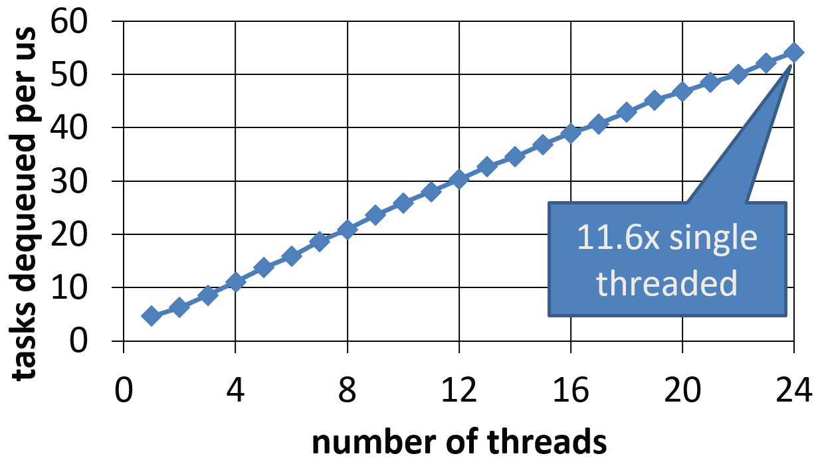
How does it perform?
Leading Strict FIFO queues (up to 2016)
No real scaling
MultiQueue
http://concurrencyfreaks.blogspot.com/2016/11/faaarrayqueue-mpmc-lock-free-queue-part.html

Slide 20
Recap
Challenges of actually using stacks/queues and other ordered data structures
Strictly ordered data structures such as queues
limited concurrency
algorithms such as BFS cannot easily harness this strict ordering
Relaxed data structures
somewhat ordered --- allow some inversions in the strict ordering (better scalability)
applications that can handle the inversions can benefit from this scalability
example of relaxed BFS / Dijkstra’s
tradeoff between greater scalability and repeated work (node adjustments)
Discussion of NUMA effects (L3 invalidations/misses when running on different sockets)
lscpu to see CPU topology ; taskset –c 0-7,16-23 and numactl –N 0 to pin threads

