Slide 1
Multicore programming
Hash Table Expansion, Linked Data Structures
Lecture 8
Trevor Brown

Slide 2
Last time
Probing vs chaining
Hash function quality
Started hash table expansion
This time:
Finishing hash table expansion
Starting linked data structures

Slide 3
Hash table expansion
Clarifying and finishing up after last time

Slide 4
Recall: Rough Implementation sketch
Atomic pointer to current table struct
Initial table struct:
old = NULL
oldCapacity = 0
chunksClaimed = 0
chunksDone = 0
struct hashmap
1 char padding0[64];
2 atomic<table *> currentTable;
3 char padding1[64];
/* code for operations ... */
Note total number of chunks in old is 0, so chunksDone = 0 means expansion is “done.”
struct table
old stays around so expansion can be done…
old stays around so expansion can be done…
1 char padding0[64];
2 atomic<int> * data;
3 atomic<int> * old;
4 int capacity;
5 int oldCapacity;
6 counter * approxSize;
7 atomic<int> chunksClaimed;
8 atomic<int> chunksDone;
9 char padding1[64];
Result of createNewTableStruct(t):
old = t->data
oldCapacity = t->capacity
chunksClaimed = 0
chunksDone = 0
Erratum: changed since last lecture!

Slide 5
Recall: Code from last time
Check if we need to expand, and start expansion as necessary, or help ongoing expansion. If we start or help expansion, retry our insert (in the new table)
int hashmap::insert(int key)
table * t = currentTable;
int h = hash(key);
for (int i=0; i < t->capacity; ++i) {
if (expandAsNeeded(t, i)) return insert(key);
int index = (h+i) % t->capacity;
int found = t->data[index];
if (found & MARKED_MASK) return insert(key);
else if (found == key) return false;
else if (found == NULL) {
if (CAS(&t->data[index], NULL, key)) return true;
else {
found = t->data[index];
if (found & MARKED_MASK) return insert(key);
else if (found == key) return false;
} } }
assert(false);
Found evidence of expansion… restart to help / get into the new table

Slide 6
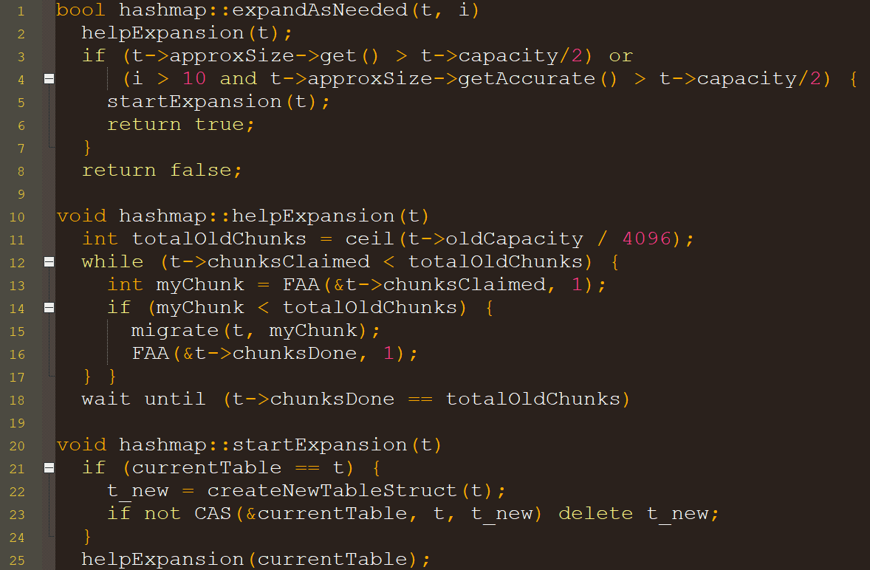
Clarifying the last lecture
Note: for initial table struct, this is a no-op
Important! Last time I made a mistake... Actually cannot let threads insert into the new table until after expansion is done!
What about this?
Wait until expansion is finished before returning!

Slide 7
Making migration more efficient
Typical index function to get a bucket index from a key:
index = hash(key) % capacity
If capacity doubles, indexes of keys are scrambled
Hash 23 in array of size 12: bucket 11 → in array of size 24: bucket 23
Hash 13 in array of size 12: bucket 1 → in array of size 24: bucket 13
Scaled index function
index = floor( hash(key) / largestHashPossible * capacity)
If capacity doubles, indexes of keys are doubled
In array of size 12: bucket 11 → in array of size 24: bucket 22
In array of size 12: bucket 1 → in array of size 24: bucket 2
With predictable indexes, can expand more efficiently!

Slide 8
idea
Old table
7
6
3
4
2
One thread can copy without synchronization
New table
7
6
3
4
2

Slide 9
More complex data structures

Slide 10
What else is worth understanding?
We’ve seen hash tables…
What about node based data structures?
(That aren’t just a single pointer like stacks, or two pointers like queues)
Singly-linked lists, doubly-linked lists, skip-lists, trees, tries, hash tries, …
New challenges:
Nodes get deleted when threads might be trying to work on them
Operations may require atomic changes to multiple nodes

Slide 11
Lock-based singly-Linked lists
Ordered set implemented with singly-linked list
Hand-over-hand locking discipline:
must lock a node before accessing it
Can only acquire a lock on a node:
if it is the list head, or if you already hold a lock on the previous node
Delete(15)
Insert(17)
Is this a good approach?
Locking causes many cache invalidations, even for searches!
Should avoid locking while searching/traversing the list!
head
7
8
11
15
20
23
head
7
8
11
15
20
23
17

