Slide 1
Faster Data Structures in Transactional Memory using Three Paths
Trevor Brown
University of Toronto

Slide 2
Problem
Handcrafted data structures are fast and important for libraries
Hardware transactional memory (HTM) can be used to make them even faster
How can we get the most benefit from HTM?
Notes:
And, hardware transactional memory can be used to make them even faster, since they often have significant synchronization overhead that can be eliminated using HTM.

Slide 3
Hardware transactional memory (HTM)
Can perform arbitrary blocks of code atomically
Each transaction either commits or aborts
HTM implementations are best effort
Transactions can abort for any reason
Need a non-transactional fallback path
Notes:
We’ve seen a lot of talks about hardware transactional memory, so I’ll just remind you that HTM implementations are best effort, which means that transactions can abort for any reason. For example, they can abort if they are too large. And, to guarantee progress, a programmer has to provide a non-transactional fallback path.

Slide 4
Transactional lock elision (TLE)
Parallelizes code protected by a global lock
Fast: Begin txn If lock is held, Abort txn Sequential code Commit txn On abort: Wait until lock is free Try again (up to K times) | Fallback: Acquire lock Sequential code Release lock
Notes:
One common use of HTM is to parallelize code protected by a global lock. This is called transactional lock elision. In TLE, the fallback path simply acquires a lock, performs sequential code, and releases the lock. On the fast path, we begin a transaction, check if the lock is held, and, if so, we abort to avoid interfering with a process on the fallback path. Otherwise, we perform the sequential code and commit. If we experience an abort, we wait until the lock is free, and then try our transaction again, up to K times, before moving to the fallback path.

Slide 5
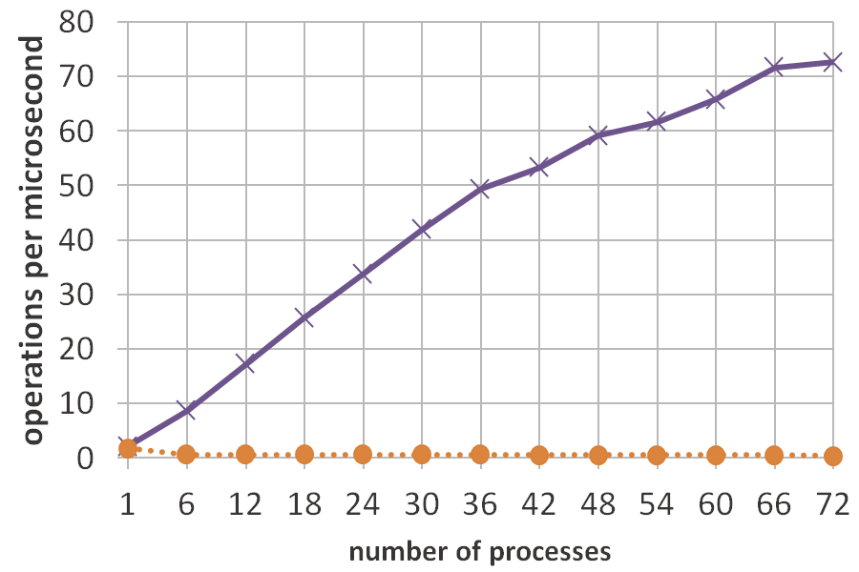
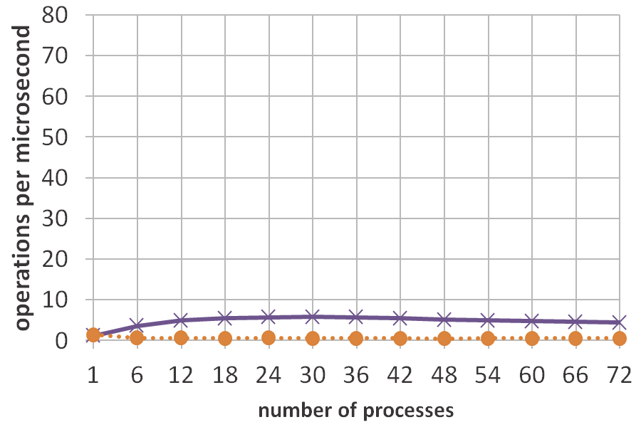
Performance results for a binary search tree
Problem: poor performance if operations frequently run on Fallback
100% updates, key range [0, 65536)
98% updates, 2% range queries
Notes:
Here are some results from a simple microbenchmark on a binary search tree from a new 72-thread Intel machine with HTM. Here, up is good, and with 50% insertions and 50% deletions in a tree containing approximately 32,000 keys, we can see that TLE performs well, and scales almost linearly. The problem with TLE is that is performs very poorly if operations frequently run on the fallback path. For example, if we take just 2% of the updates and replace them with range queries, which are large, and frequently have to run on the fallback path, the performance of TLE is crippled.

Slide 6
Concurrency between 2 paths
Fallback using fine-grained synchronization
Fast manipulates synchronization meta-data used by Fallback
Processes on Fast and Fallback can run concurrently
Problem: Fallback imposes overhead on Fast
Notes:
We can improve performance when operations frequently run on the fallback path by replacing the global lock-based fallback path with one that uses fine-grained synchronization, and modifying the fast path so that it manipulates the synchronization meta-data used by the fallback path. This allows processes on Fast and Fallback to run concurrently. The problem is that the fallback path imposes overhead on the fast path.

Slide 7
New approach: add a Middle path
Notes:
To eliminate this overhead, I propose adding an HTM-based middle path.

Slide 8
Paths and concurrency
Fast path: sequential code in a transaction
Fallback path: fine-grained synchronization
Middle path: transactions manipulate synchronization meta-data used by Fallback
Fallback does not impose overhead on Fast
Concurrency | Fast | Middle | Fallback
Fast | Y | Y | N
Middle | Y | Y | Y
Fallback | N | Y | Y
Notes:
More specifically, the fast path consists of sequential code run in a big transaction, the fallback path uses fine-grained synchronization, and, on the middle path, transactions manipulate the synchronization meta-data used by the fallback path. This allows the middle path to run concurrently with the fallback path, and it can also run concurrently with the fast path, since both use HTM. However, the fast path cannot run concurrently with the fallback path, and this is very important, and desirable, because this means that processes on the fast path do not need to coordinate with processes on the fallback path. Consequently, fallback does not impose any overhead on fast, irrespective of how it operates.

Slide 9
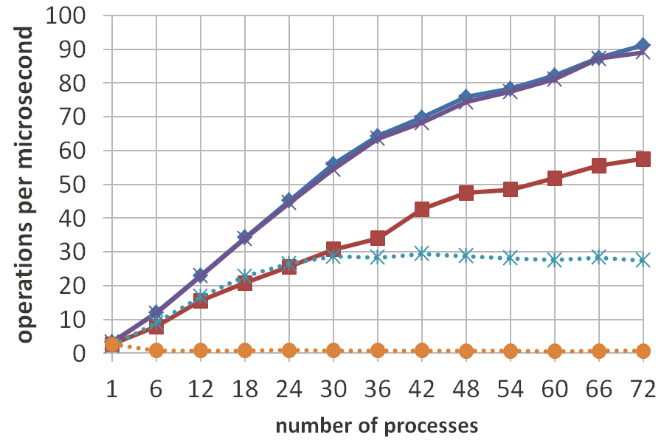
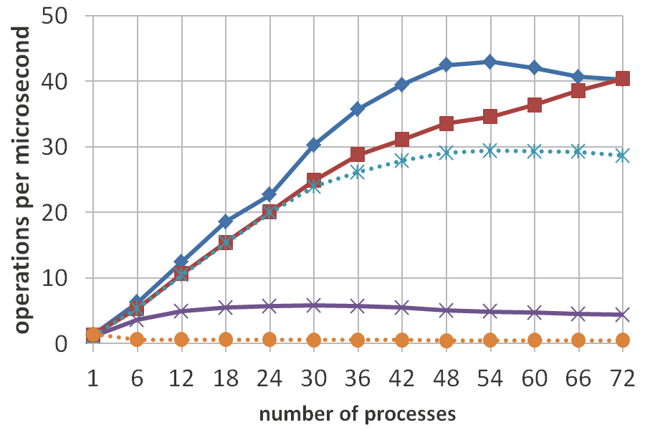
Performance results for a binary search tree
100% updates, key range [0, 8192)
98% updates, 2% RQ, key range [0, 65536)
Notes:
Let’s see how this idea performs. With 50% insertions and 50% deletions in a tree containing approximately 4,000 keys, TLE and my new 3 path algorithm perform the best, and almost perfectly overlap. For the 2 path algorithm whose fast and fallback paths can run concurrently, the overhead imposed on the fast path by the fallback path is quite visible. For reference, I also included the lock-free algorithm that is used as the fallback path, and the global lock. With 98% updates and 2% range queries in a tree containing approximately 32,000 keys, the performance of TLE plummets, but the 3 path algorithm remains at the top. The 3 path algorithm also outperforms the 2 path algorithm up to 66 threads, because some of its range queries complete on the fast path. At 72 threads and beyond, range queries stop succeeding in hardware due to contention, and the 3 path algorithm behaves identically to the 2 path algorithm. These graphs show that, when few operations run on the fallback path, the 3 path algorithm has extremely low overhead, and when many operations run on the fallback path, it obtains a large benefit from concurrency between the fallback path and the middle path. In other words, we get the best of both worlds.

Slide 10
Conclusion
We proposed adding a transactional middle path, which can run concurrently with the other two paths
Middle-Fallback concurrency provides high performance when many operations run on Fallback
Since there is no Fast-Fallback concurrency, Fallback does not impose any overhead on Fast

