Slide 1
Efficient Hardware primitives for immediate reclamation in Optimistic data structures
Ajay Singh, Trevor brown and Michael spear
Notes:
Hello Everyone my name is AJAY …….. SINGH.
And I work with Dr Trevor … Brown and Dr Michael Spear

Slide 2
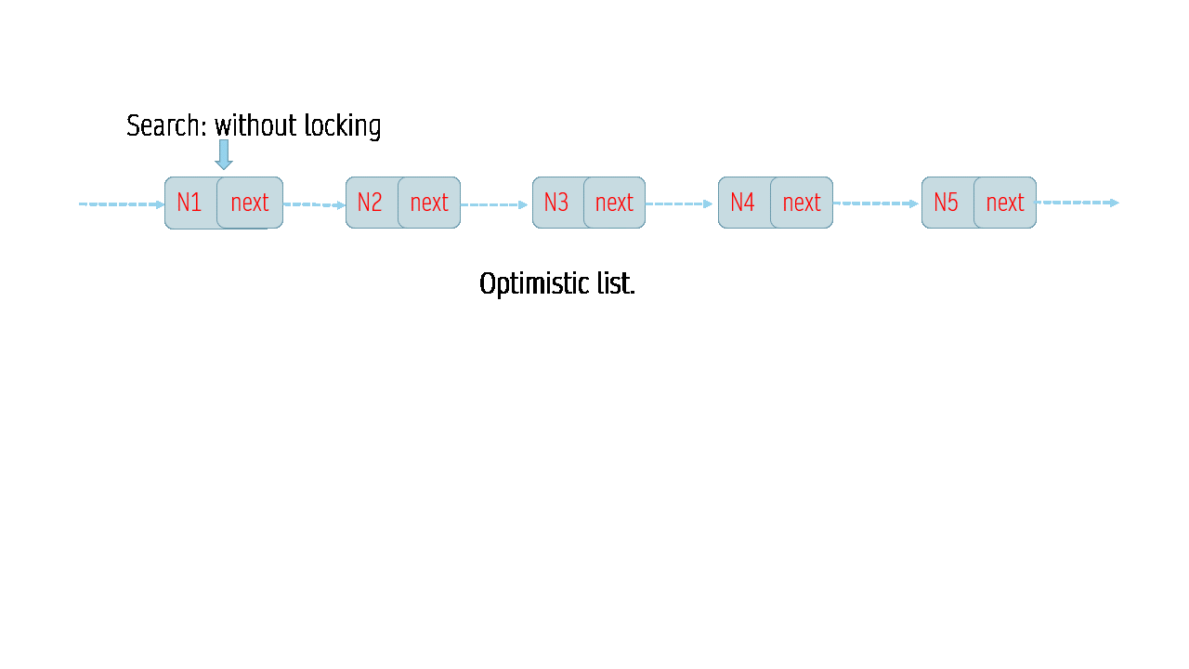
Optimistic Data Structures
No locks during searches.
Highly scalable.
Notes:
I want to take a look at this figure and guess what is happening?
This figure shows an Optimistic data structure, list in this case. These data structure have a nice property that searches donot acquiring any locks and locks are only acquired on a small region of the list when doing an update.
This makes such optimistic data structures highly scalable and it is not a surprise that these are increasingly getting popular.

Slide 3
Optimistic Data Structures Make reclamation difficult
Use-After-Free Error : searches are unaware of deletes.
N1
next
N2
next
N3
next
N2
next
!@#$
Search():
1: N2 = N1->next
4: N3 = N2->next
Optimistic list.
Delete (N2):
2: N1->next = N2->next
3: Free(N2)
Thread 1
Thread 2
Use-after-free error !!!
Notes:
But reclaiming memory in these data structure is a difficult problem..
Since searches do not take any locks ….
they are unaware of concurrent deletes …. therefore they may access a freed node …
This results in use-after free errors.
I will walk you through an example on how this could happen using the optimistic list.
Say, a thread T1 reaches node N1 by reading the next pointer of n1 and sleeps just before using n2.
Another thread T2 is concurrently deleting n2, so it unlinks n2 and then frees it.
Now if T1 wakes up and accesses n2 it will incur use after free error, often leading to segfaults.
<<<ODS have reclamaing challenge>>>

Slide 4
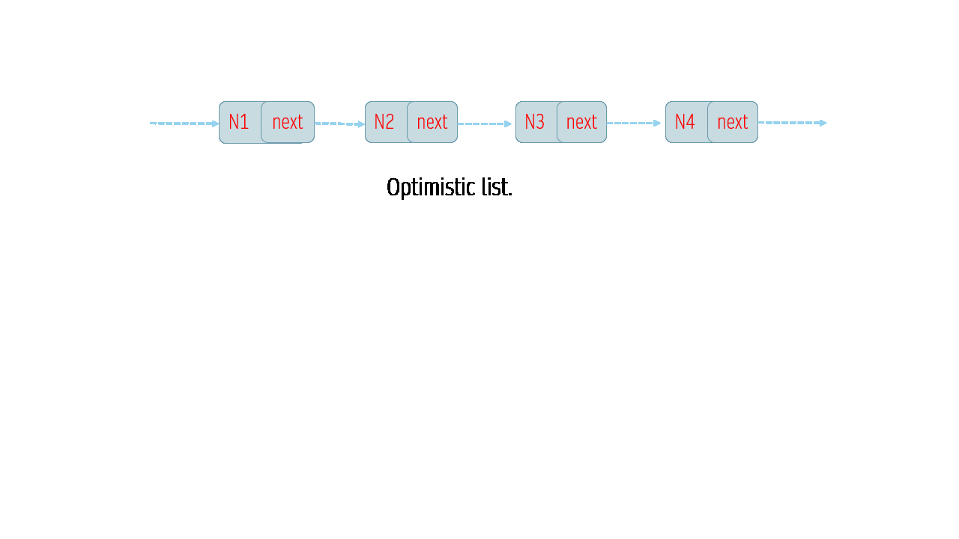
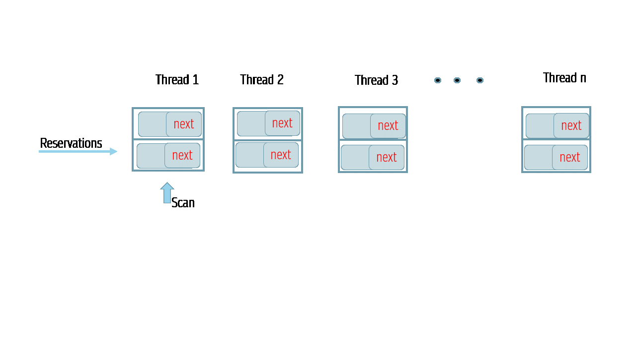
Prior Solution: Hazard Ptrs
Searching Threads: reserve nodes before access.
Freeing Threads: scan all thread’s reservations and free only unreserved ones.
Problem: High Overhead
Conventional Remedy: Batch nodes to be freed!
Notes:
TO solve this problem of uaf error in ODS many safe memory reclamation algorithms exist. Most studied of them all is hazard pointers.
The way it works, is that all searching threads are required to reserve nodes before access and on the other side, any thread trying to free a node is required to scan all these per thread reservations and only free the unreserved nodes.
The problem with this this synchronization incurs overhead not only for updates but also for searchers in data structures.
A most common approach all smrs algos follow is to batch objects to be freed ie delay reclamation to amortize this reclamation overhead.
Here it is done for performance reason but many other technique use batching safety of reclamation. Like EBR.
<<<there are solutions already solving this and their property>>>

Slide 5
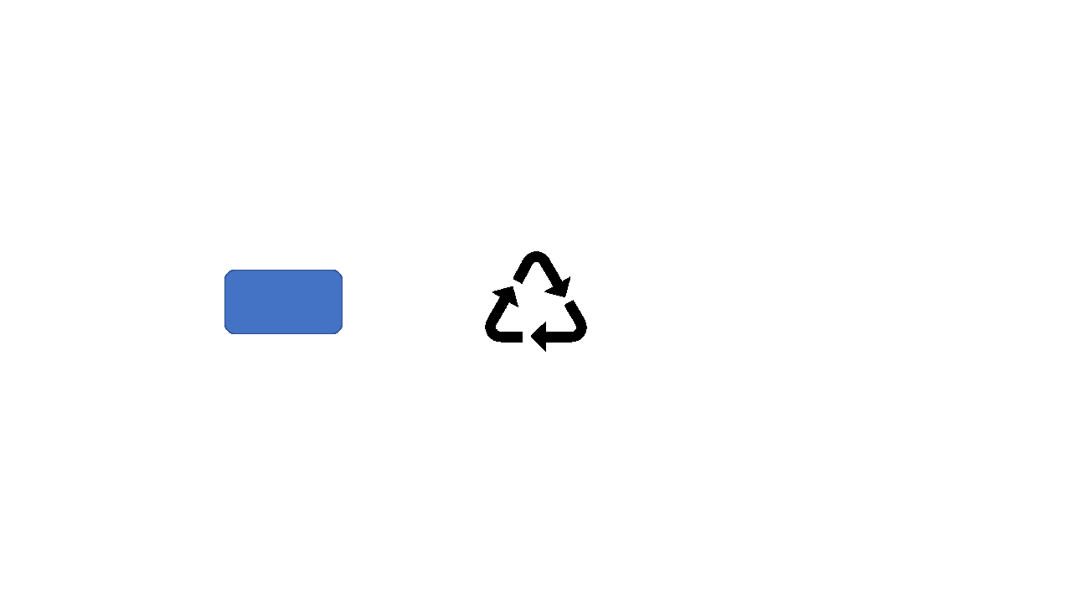
Complications With BatchING
Small Batches: low memory footprint but Slow.
VS
Large Batches: Fast but large memory footprint.
Figure: Freeing in batches
Increased attack surface for privacy attacks.
Impedes memory overcommitment in virtualized data centers.
Ideal Safe Memory Reclamation: Avoid Batching!
Be “Fast with small memory-footprint”
Notes:
Though Batching solves a problem it introduces other complications.
It leads to a tradeoff between speed and memory footprint. Programmers need to decide an optimal batch size.
where small batches though have low memory footprint, …. Make data structures very slow because reclamation happened frequently which causes rec overhead to be incurred more often.
On the other hand large batches make optimistic data structures faster but incur large memory footprint. This increases tail latency which hinders optimistic data structures from reaching full achievable performance.
Not only that, increased life time of nodes due to delay in freeing exposes them to side channel privacy attacks and hampers use of techniques like memory overcommitment in virtualized data centers.
Therefore an Ideal smr will avoid batching. and will be provide low memory footprint and yet be fast.
<<<issue with batching so ideal solution will let go batching>>>

Slide 6
Our Solution: Conditional Access
What ?
Fast and reclaims memory Immediately.
How ?
Observation: Use-After-Free errors are preceded by coherence events in hardware.
Intercept & Expose information to make searches aware of deletes.
New conditional memory access instructions.
Hardware-Software Codesign: “Reuse Synchronization Don’t Reinvent !”
Notes:
Targeting an ideal safe memory reclamation … we design conditional access which gets rid of batching, it has low memory footprint and it is fast.
Moreover it provides sequential data structure like immediate reclamation.
How do we achieve this ideal reclamation?
Well, we observe that every use after free error in data structures is preceded by coherence events at the cache level in hardware.
So Idea is simple, if somehow we can intercept these preceding coherence events and expose the information gained from these events to the data structure.. Then searches could be made aware of a concurrent delete.
To be able to do this we design new conditional memory access instructions. These instructions monitor cache coherence events and when used in programs allow data structures to skip/reading or writing on locations that it infers might be concurrently freed. Thus, it resolves avoid uaf errors.
This neat hw/sw codesign helps in reusing synchronization already happening at the cache level eliminating the need of reinventing the synchronization between searchers and freeing threads at the data structure level. As a result this technique is remarkably fast.

Slide 7
Cache EVENTs preceding DeletionS
N1
next
N2
next
N3
next
N2
next
DataStructure level
Thread 1: access N2
Thread 2: delete(N2)
Cache level
S
N1
S
N1
Read(N1->next)
Read(N1->next)
Invalidate
I
N1
M
N1
Write(N1->next)
Ack
Read freed N2
S
#$%@
Free(N2)
Notes:
I told you that key observation of optimistic data structures CA uses is that “use after free errors are preceded by some cache coherence events”
Lets take a look at these coherence events during user-after-free error in the same optimistic list where thread 1 is accessing node N2 and thread 2 is deleting it.
So, when thread 1 is currently reading the next field of N1 to reach N2; at the cache level it's cache will have cacheline with N1 in shared state.
And, when thread 2 reads N1 and N2 to delete N2. At the cache level it will have N1’s cacheline in shared state.
Now when thread 2 unlinks N2 by modifying N1's next field. At cache level this results in T2 invalidating the shared copy at T1's cache and getting the corresponding cache line in M state. After this T2 can modify and free N2.
Now if T1 wakes up, it will attempt using N2 which has been freed causing uaf error. It is worth repeating here that before deleting N2 thread 2 send invalidation to thread T1 which it acknowledged. And if Thread one instead of blindly accessing N2 leverages this information then it could avoid use after free error.
****

Slide 8
Intercepting & Exposing cache eventS
CREAD(addr, dest)
CWRITE(addr, val)
CLEARTAGSET()
Thread 1: access N2
Thread 2: delete(N2)
Cache level
Add N1 to tag set
S
N1
S
N1
Cread(N1->next)
Cread(N1->next)
Invalidate
I
N1
M
N1
Cwrite(N1->next)
Ack
Cread(N2)
#$%@
Free(N2)
S
Notes:
********
Conditional access exposes these preceding events to programmers using conditional memory access primitives cread and cwrite.
So instead of using a normal read /write data structure can utilize cread/cwrite. Upon first cread on a shared node it tags the cacheline of that node, conceptually tagging a cacheline is equivalent to adding it to a tag set. Tagging a cacheline signifies that a thread is interested in monitoring invalidation events to this cacheline.
….. and any subsequent creads or cwrites before reading or writing on that cachecline will verify whether the tagged location has been invalidated and return an appropriate status to program.
These locations can be removed from the tag set using a clear instruction.
So, for the simple optimistic list, when T1 reads N1 for the first time it adds it to its tag set.
And when T2 invalidates this address in the T1’s tag set. T1 records it.
And the subsequent cread by T1 will use the fact that the cache line has been invalidated and prevent use after free error in program.
------------------------------------------------------------------------------------------------------------------------------------------------------------
In the case of a simple optimistic list, when Thread 1 (T1) reads N1 for the first time, it adds N1 to its tag set. When Thread 2 (T2) invalidates this address in T1's tag set, T1 records this invalidation. Subsequent cread operations by T1 will detect that the cache line has been invalidated, preventing use after free errors in the program."

Slide 9
Results On Graphite SimuLator
L1 stalls (ns) 3K
16K
22-28K
Notes:
*********
We prototype CA on a multicore graphite simulator. The plots shown are for a lazylist with 100% updates and max size of 1000 nodes.
Left side plot shows throughput of the list with thread counts as X axis. As seen CA curve outperforms other reclamation techniques:
Because unlike other reclamation techniques it does not require extra sync between serchers and freeing threads and induces no extra cache traffic.
CA also outperforms no reclamation based list because of its conditional read and writes which unlike normal reads/writes do not incur cache miss penalties on contended nodes.
If we see L1D stalls in nanoseconds the performance difference become more clear. Here CA occurs least stalls in ns ie 3K..
Right side shows number of unreclaimed nodes vs different times in execution of an experiment for update only workloads. It represent memory consumption behaviour of the list.
As seen, CA has 0 unreclaimed nodes while other have high number of unreclaimed nodes.
L1 cache utilization + localization of misses penalties + backoff effect

Slide 10
Conclusion
Conditional Access: Fast Reclamation OR Immediate Reclamation? Take Both
Key Idea: Leverage hardware software codesign to harness existing cache events to prevent use-after-free errors.
In Paper:
Implementation.
Example data structures and reasoning about correctness.
Comprehensive Evaluation.

Slide 11
Results On Graphite SimuLator
L1 stalls (ns) 3K
UNRECLAIMED NODES
CA has ZERO unreclaimed nodes
16K
22-28K
Notes:
>>> Similarilty with LL/SC
HTM + ER
>>>> Tagging with other DS.

