Slide 1
A General Technique for Non-blocking Trees
Trevor Brown, University of Toronto
Faith Ellen, University of Toronto
Eric Ruppert, York University

Slide 2
The Problem
Non-blocking data structures are difficult to design and prove correct.
General techniques for non-blocking data structures are too inefficient.
Hand-crafted implementations are extremely complicated.
Proofs are extremely long, sketchy, or even skipped altogether.

Slide 3
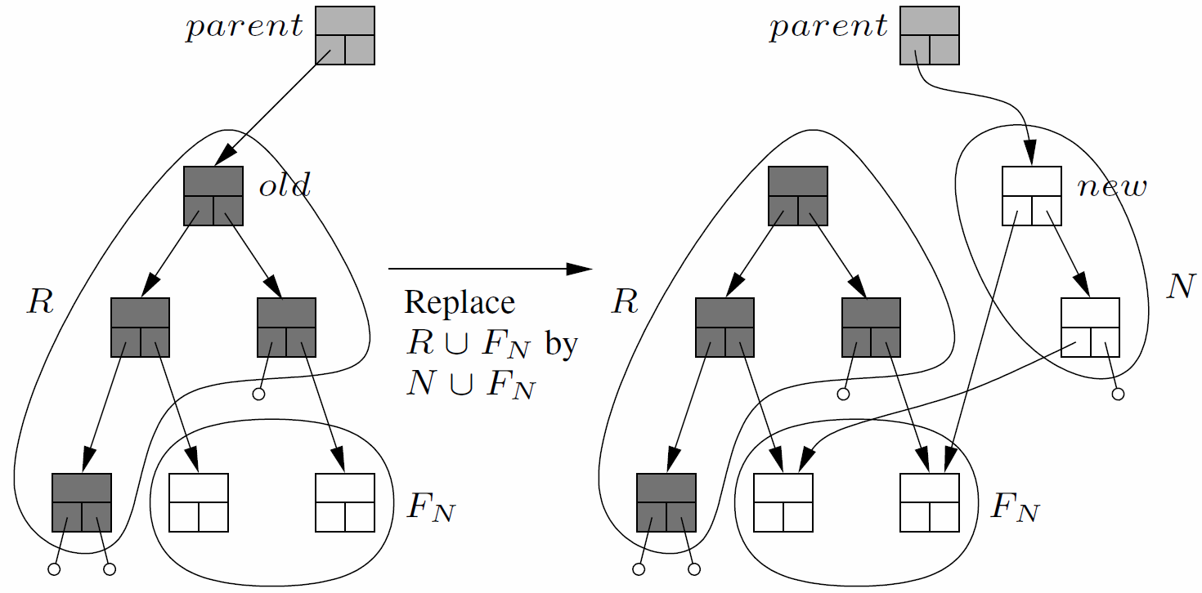
Tree Update Template
.
5
400
.
5
400

Slide 4
Tree Update Template
Uses the recent LLX, SCX and VLX primitives, which operate on multi-field records [PODC13]
Modular, and can be used to build many tree data structures.
Updates can be thought of as atomic actions.
Drastically simplifies proofs.
Data structures built using the template are automatically linearizable and non-blocking, and can be very efficient.

Slide 5
Non-blocking Balanced BST
We developed a Chromatic tree, which is a relaxed version of a red-black tree.
First provably correct, non-blocking balanced BST that uses fine-grained synchronization.
Height is guaranteed to be O(c + log n) where
n = number of keys in the tree
c = number of updates in progress
Complete correctness proof in five pages.

Slide 6
Other Non-blocking Balanced Trees
Relaxed balance data structures:
decouple rebalancing updates from other updates
allow updates to be interleaved arbitrarily
many relaxed balance versions of sequential data structures exist in the literature
are well suited for non-blocking implementation using the tree update template
Relaxed AVL tree: non-blocking implementation took a ﬁrst-year undergraduate student one week
Relaxed (a, b)-tree: in progress

Slide 7
Designing Queries
Sequential implementations of some queries give correct, linearizable answers, even though they completely ignore concurrency.
For instance, an ordinary BST search works.
We show how to design some more complex queries that interact properly with updates.
For example, predecessor and successor queries in our Chromatic tree.

Slide 8
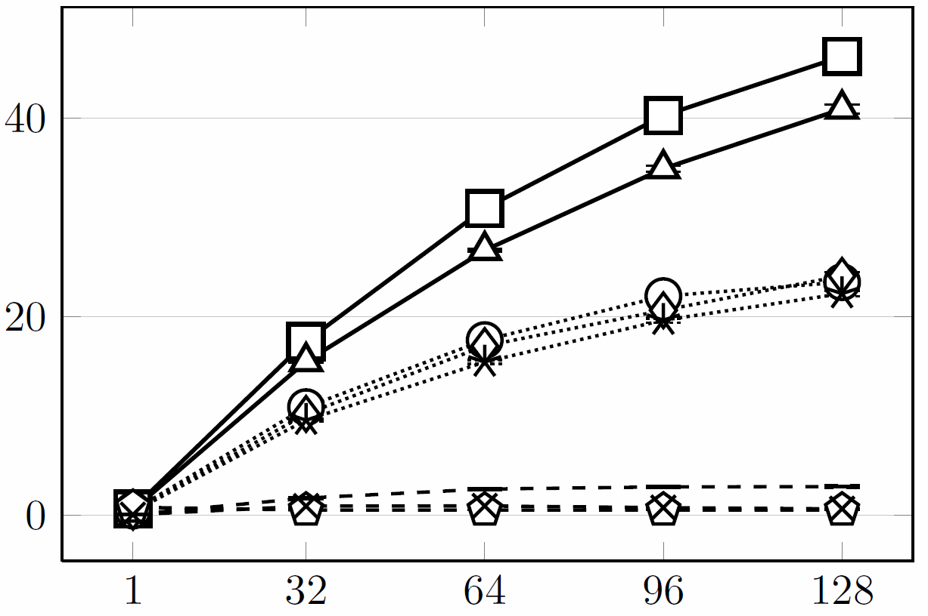
Performance Experiments 20% Ins, 10% Del, 70% Search, key range [0,10⁴)
throughput (millions/sec)
# threads
Notes:
9 graphs in the full paper, here is one example

