Slide 1
The Fence Complexity of Persistent Sets
Gaetano Coccimiglio | Trevor Brown | Srivatsan Ravi

Slide 2
Motivation
New non-volatile memory (NVRAM) – Intel Optane
We want to exploit NVRAM to create persistent data structures
Sets: Insert(key), Remove(key), Search(key)
Useful for key-value stores, database indexes etc
Designing correct persistent data structures is non-trivial
We need theoretical foundations
Which correctness condition?
Which progress condition?
Is the theory meaningful in practice?

Slide 3
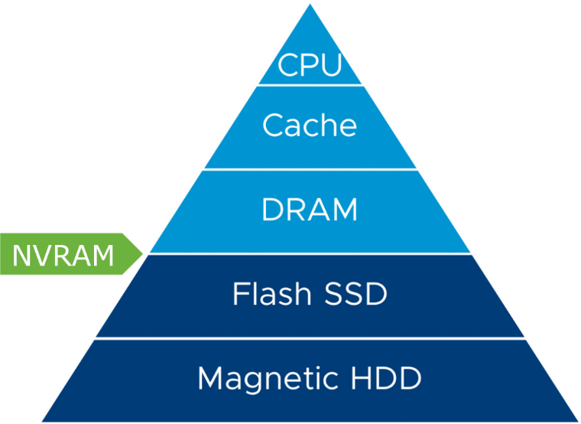
Motivation
Writes first take effect in volatile cache memory
Persisting a write requires a flush and persistence fence (pfence)
Psync is a flush followed by a pfence
Processor can flush data asynchronously at any time
System can crash at any time
recovery procedure restores data structure back to consistent state

Slide 4
Need for explicit persistence
address 0x8000
D
Contents of
volatile
memory:
…
A
B
E
address 0x8000
Contents of
persistent
memory:
…
A
B
E
Power failure
Must flush contents of D and fence before changing B’s next pointer!

Slide 5
Understanding Persistent Sets
How many flushes and pfences are required to implement persistent sets?
Are all required flushes and pfences useful?
How fast can we recover after a crash?
Do the answers differ based on the correctness condition?
Do the answers differ based on the progress condition?

Slide 6
Our Contribution
Strict Limited Effect (SLE) Linearizability: a new correctness condition specifically for persistent sets
Lower bound: SLE linearizable sets and persistence free searches
Lower bound: Durable linearizable sets and redundant flushes
New technique for implementing persistent sets
Empirical analysis of hand-crafted persistent sets

Slide 7
Background – Progress Conditions
Lock-freedom (non-blocking):
If at least one thread continues to take steps then some threads will make progress even if some threads stop taking steps forever
Dead-lock freedom (blocking):
If a thread stops taking steps forever then it might block other threads forever

Slide 8
Background – Correctness Conditions
Linearizability (volatile memory): each operation takes effect atomically at some time during the operation
Durable linearizability (persistent memory): after a power failure, must recover all data structure operations that terminated before the crash
Strict linearizability (adapted for persistent memory): Intuitively operations must take effect before the crash or not at all*

Slide 9
The Problem with the Strict Linearizability
The missile example:
Solider during wartime presses a button to launch a missile but the system fails
War ends after which the system recovers
Would be bad if we launch the missile now
Problem:
Strict linearizability does not preclude this type of scenario
Operations need to just appear to take effect before crash
Operations can be completed during or after recovery

Slide 10
Visualizing the Problem
Thread 1
Thread 2
Insert(D) → True
Insert(A)
Search(D) → True
Delete(A) →
True
time
crash

Slide 11
Strict Limited Effect (SLE) Linearizability for Sets
Our attempt at capturing intentions of strict linearizability for crash-recovery models
Not a general solution – definition is just for sets
Intuition: everything that is recovered already happened
Capturing limited effect:
Update operations take effect at the key write
Key write must occur before a crash event or not at all
Can be extended to other data types

Slide 12
Ordering Key Write and Crashes
Key write is before crash = OK
Thread 1
Thread 2
Insert(D) → True
Insert(A)
Search(D) → True
time
crash

Slide 13
Ordering Key Write and Crashes
Key write did not occur before crash = NOT OK
Thread 1
Thread 2
Insert(D) → True
Insert(A)
Search(D) → True
time
crash

Slide 14
 | Durable linearizability | SLE linearizability
Lock-freedom
Deadlock-freedom

Slide 15
SLE Linearizable Sets and Persistence Free Reads Impossibility
For a lock-free set that satisfies SLE linearizability
Searches must flush and pfence
Basic idea:
Key write must be followed by a psync
Psyncs have no visible effects in volatile memory
Cannot always distinguish between data that is persistent and data that is transient
Response of searches depends on whether or not the data has been persisted
Forces searches to flush/pfence
Searches can avoid flushing/pfencing by sacrificing SLE linearizability or lock-freedom
Allow blocking or lose ability to determine whether an operation took effect before a crash

Slide 16
 | Durable linearizability | SLE linearizability
Lock-freedom | Allows persistence free searches | Searches must flush/pfence
Deadlock-freedom | Allows persistence free searches

Slide 17
Durable Linearizable Sets and Redundant Psyncs
For a lock-free set that satisfies durable-linearizability
Operations might be forced to perform redundant flushes/pfences
Basic Idea:
Psyncs have no visible effects in volatile memory
Lock-freedom means processes can sleep after performing a flush/pfence
Operations by other processes that depend on data being persisted are forced to flush/pfence even if the data has already been persisted
Redundant flushes can be avoided by sacrificing lock-freedom
Allow blocking

Slide 18
 | Durable linearizability | SLE linearizability
Lock-freedom | Allows persistence free searches | Searches must flush/pfence
 | Cannot avoid redundant psyncs
Deadlock-freedom | Allows persistence free searches
 | Can avoid redundant psyncs
Are there practical implications of these results?

Slide 19
Extended Link and Persist
Link and persist (David et al 2018)
Persist data structure links (pointers)
Mark data to indicate whether it has been persisted
Cannot be used to implement persistence free searches
Extended link and persist
Double the size of data structure links to include an ‘old’ pointer
When updating data structure links save the old value
Easiest method is to use DWCAS (cmpxchg16b on Intel)
Searches can look at the old pointer and current value to correctly linearize without the need to flush/fence if next pointer is marked as not persisted

Slide 20
Extended Link-and-Persist Example
So far the insert thread has created C, persisted it and marked it as persistent
C
1
old
…
Volatile
memory
A
B
D
1
1
0
1
old
old
old
B.old is reverted to null when the persistence mark is set
A concurrent search can check B.old to determine that B’s persistence mark is 0 because of an Insert
Persistent
memory
…
A
B
D
C
Notes:
This is a quick example of how our extension works when we use a double wide CAS to update the next pointer and the old pointer atomically
Once again we have seen the start of this example many times so I have skipped ahead a few steps, so far the insert thread created C, persisted it and set its persistence bit. And you can see that nodes now have an old pointer attached to them, currently they are all null.
So the next step of the insert is to update B.next to point to C and B.old to point to D and this is done atomically with a double wide CAS
(play anim)
(play anim)
Now a concurrent search can use the contents of B’s old pointer to determine that B’s persistence bit is 0 because of an insert
(play anim)
So now we flush and pfence to persist B.next
(play anim)
Finally, when we set the persistence bit we again use a double wide CAS to set the persistence bit to 1 and revert the old field back to null

Slide 21
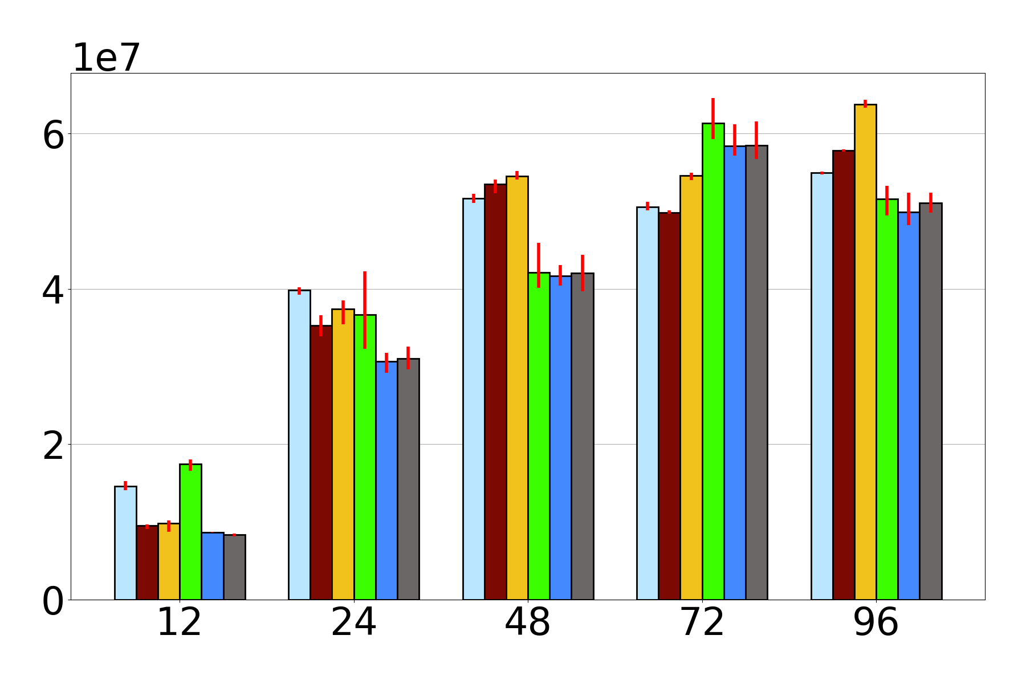
Experiments
Throughput (ops/sec)
Persists pointers
Does not persist pointers + PF Search
Persists pointers + PF Search
Does not persist pointers
Persists pointers
Does not persist pointers + searches flush/pfence
99% Search – 500 keys

Slide 22
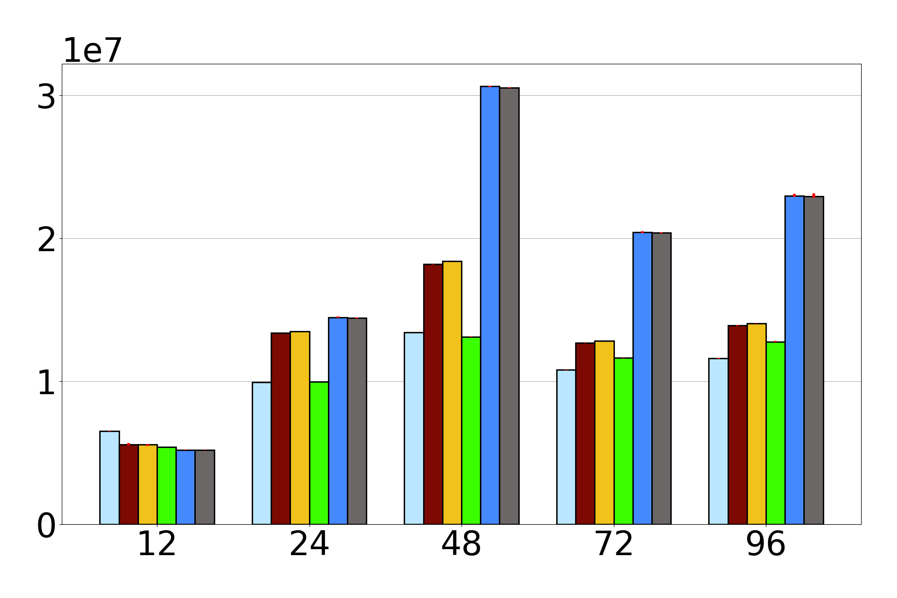
Experiments
Throughput (ops/sec)
Persists less structure = better throughput but need to traverse all of memory to recover
Performance of SLE sets are very close to durable sets with PF searches
50% Search – 500 keys

Slide 23
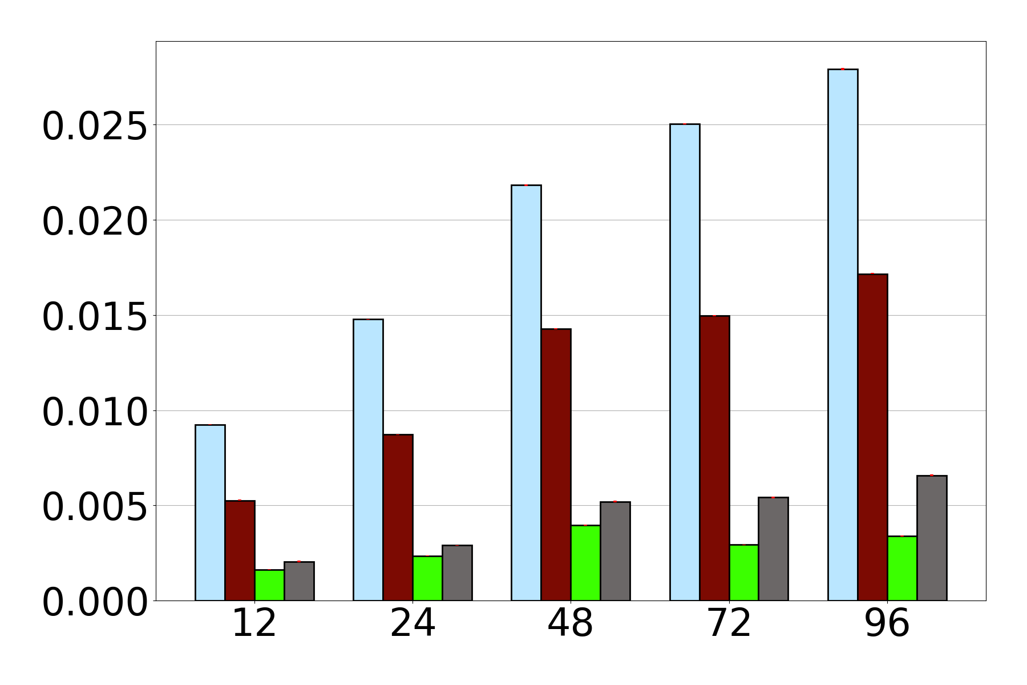
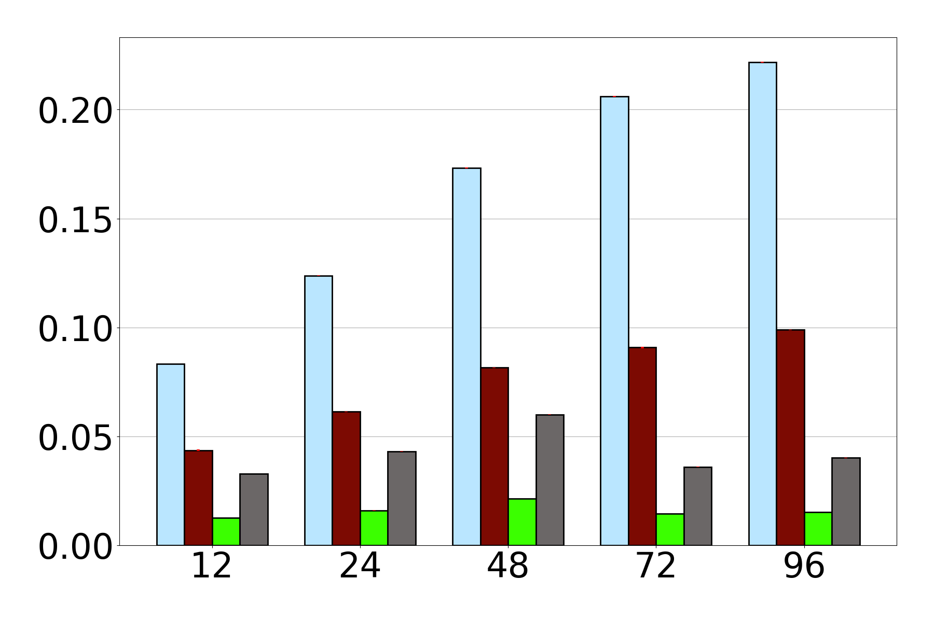
Experiments
Avg Psyncs Per Search
99% Search – 50 keys
50% Search – 50 keys

Slide 24
Conclusion
Defined SLE linearizability to realize the intentions of strict linearizability for persistent sets
Presented two lower bounds establishing a theoretical separation between
SLE linearizable lock-free sets and durable linearizable lock free sets
durable linearizable lock-free sets and durable linearizable deadlock-free sets
Extended link and persist technique for implementing persistent sets with persistence free searches
Experimental analysis of hand-crafted persistent sets

Slide 27
Extra slides

Slide 28
Background – Correctness conditions
Linearizability: each data structure operation takes effect atomically at some time during the operation
Satisfies linearizability
Thread 1
Thread 2
Insert(D) → True
Search(D) → False
Search(D) → True
time
Equivalent sequential execution:
Search(D)→ Insert(D)→ Search(D);

Slide 29
Background – Correctness conditions
Does NOT satisfy linearizability
Thread 1
Thread 2
Insert(D) → True
???
Search(D) → True
Search(D) → False
time
No equivalent sequential execution exists!

Slide 30
Background – correctness conditions
Insert(D) → True
Recovery option 1: undo the delete
Thread 1
Thread 2
Delete(D)
Search(D) → False
time
Equivalent sequential execution:
Search(D) → Insert(D);

Slide 31
Background – correctness conditions
Thread 1
Thread 2
Insert(D) → True
Delete(D) → True
Recovery option 2: finish the delete
Delete(D)
Search(D) → False
time
Equivalent sequential execution:
Search(D) → Insert(D) → Delete(D);

Slide 32
Background – correctness conditions
Sometimes you must finish an operation that is concurrent with a power failure!
Recall: must recover all data structure operations that terminated before the crash
Thread 1
Thread 2
Insert(D) → True
Delete(D)
Search(D) → False
time
For this to return false, Delete(D) must occur!

Slide 33
Background – correctness conditions
Strict linearizability: described as stronger than durable linearizability
Intuition: operations must take effect before the crash or not at all
No “rewriting history”
Intended to enforce limited effect
Operation must take effect within some limited amount of time after it is invoked

