Slide 1
Non-blocking Interpolation Search Trees with Doubly Logarithmic Running Time
Trevor Brown
University of Waterloo, Canada
Joint work with Aleksandar Prokopec, Dan Alistarh

Slide 2
Setting
Want fast non-blocking concurrent data structures so we can implement better database indexes, KV-stores, etc.
Target workload: large data sets, high search volumes, high concurrency
Ordered set data structures are especially desirable (insert, delete, search, range search)
Asynchronous shared memory model
Non-blocking: always, eventually, some thread makes progress
Threads can experience halting failures
Cannot use locks or we lose non-blocking progress

Slide 3
Existing solutions
Many concurrent ordered sets offer logarithmic time searches in the worst case
binary search trees, B-trees, (a,b)-trees, skip lists, skip trees, …
In the sequential setting, many techniques improve the average case
Very little work along these lines in the concurrent setting
Notable exception: Skip trie [OshmanShavit13]
Search in $log log |U|$ amortized expected time
Our work: Interpolation search tree
Search in $log log n$ expected time by exploiting a smoothness assumption on the key distribution

Slide 4
Interpolation Search?
Make some assumption about the data
Predict the location of a key and jump right there
Wrong prediction? Prune the search space & recurse.

Slide 5
Example: Interpolation Search for key 400
Looking for 400, which is 84.5% of the way from 17 to 490
Min = 17
Max = 490
(linear interpolation)
Array containing 10 keys
17 | 32 | 141 | 143 | 180 | 287 | 371 | 372 | 401 | 490
So jump to the ~84.5th percentile key
One more step to 401
Strategy works well for smooth key distributions (actually a large class)
Well studied in the sequential setting [see, e.g., MelhornTsakalidis93]

Slide 6
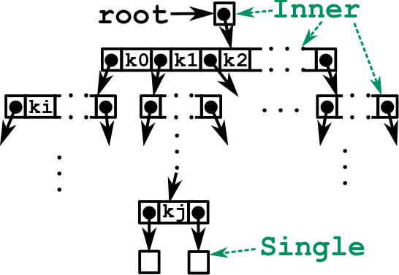
Interpolation Search Trees (ISTs)
Inner nodes have many keys; Single has 1; Empty has 0
External: all keys in the set are in Singles (“routing” keys in other nodes)
Search with interpolation at each node to find the next child pointer to follow
Insert and Delete at leaves
Rebuild entire subtrees periodically to maintain the desired tree shape

Slide 7
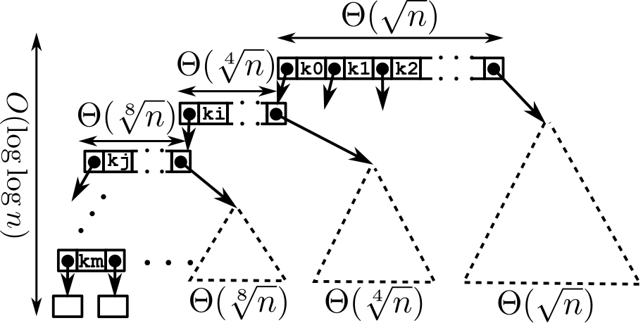
The Ideal Interpolation Search Tree Shape
When we rebuild, this is what we create

Slide 8
Challenges in Making This Concurrent
Concurrent inserts/deletes must synchronize correctly with rebuilding
Ideally want wait-free searches (worst case log n time)
Rebuilding should not compromise scalability
Should guarantee $\log{\log{n}}$ expected time even with concurrent updates (as long as the key distribution is smooth)

Slide 9
Inserting a Key
Let’s first pretend there is no rebuilding
35
67
141
143
180
287
371
372
401
490
550
591
670
715
771
779
…
<35
$≥$35
Insert(19)
Insert(13)
Target location
10
18
20
30
Replace Empty with new Single
Replace Single with new: Inner and two Singles
X
3
5
12
16
19
21
22
31
34
Using compare-and-swap (CAS)
X
(Using CAS)
2
3
7
9
15
15
17
20
21
22
30
31
34
15
Note: Empty and Single are never modified, only replaced
Target location
13
15

Slide 10
Deleting a Key
Let’s first pretend there is no rebuilding
35
67
141
143
180
287
371
372
401
490
550
591
670
715
771
779
…
<35
$≥$35
Delete(15)
10
18
20
30
Replace Single with new Empty
3
5
12
16
21
22
31
34
(Using CAS)
X
2
3
7
9
15
17
20
21
22
30
31
34
15
Insert and Delete are so simple! Nuance is in the rebuilding…
Target location

Slide 11
Partial Rebuilding
When and how should we rebuild?
When?
Consider a subtree that was rebuilt at time t, and contained n keys at that time
We rebuild it as soon as it has experienced n/4 inserts or deletes since time t
Lemma: Let $p$ be the number of concurrent threads modifying a C-IST containing $n$ keys. The worst case depth of this C-IST is $O(p+\log{n)}$
Lemma: Let $μ$ be a smooth probability density [MehlkornTsakalidis93]. Expected search time in a $μ$-random C-IST of size $n$ is $O(\log{\log{n}}+p)$
Lemma: Let $μ$ be a probability density with finite support. Expected total cost of a sequence of $n$ $μ$-random insertions and uniformly random deletions in an initially empty C-IST is $O(n\left(\log{\log{n}}+p\right)γ)$ where $γ$ is a bound on interval contention

Slide 12
Partial Rebuilding
When and how should we rebuild?
How?
Maintain exact counters at each node except the root
The root has an approximate counter (using [ABKLN18])
These counters track how many inserts & deletes happen in every subtree
Atomically replace any subtree over the n/4 update threshold (since last rebuild) with a new subtree of ideal shape
Let’s see this now

Slide 13
Atomic Subtree Rebuilding
Each Inner node has a status field containing [started, finished, count]
1. An insert/delete notices this subtree needs rebuilding
35
67
141
143
180
287
371
372
401
490
550
591
670
715
771
779
…
0
2. Create a special rebuilding node with a pass-through pointer
3. Traverse the old subtree, using CAS to mark all Inner nodes and count keys
X
10
18
20
30
X
X
This facilitates helping
Claim: old subtree will never be changed again
0
Insert it with CAS
8
CAS
3
5
X
X
12
16
X
X
19
21
22
X
X
31
34
X
X
0
0
1
2
0
0
2
2
2
5
8
15
X
X
23
32
X
X
0
1
0
2
15
31
32

Slide 14
Atomic Subtree Rebuilding
Claim: old subtree will never be changed again
35
67
141
143
180
287
371
372
401
490
550
591
670
715
771
779
4. Create new subtree with ideal shape
…
0
5. Replace rebuilding node with the new subtree using CAS
X
10
18
20
30
X
X
8
19
31
0
0
8
3
5
X
X
12
16
X
X
19
21
22
X
X
31
34
X
X
5
15
23
32
0
0
0
0
0
0
1
2
0
0
2
2
2
5
8
15
X
X
23
32
X
X
2
5
8
15
19
23
31
32
0
1
0
2
6. Garbage collect old subtree (must wait for concurrent operations in it to terminate)
15
31
32

Slide 15
Synchronizing Between Updates and Rebuilding
Idea: any modifications to nodes with started set should fail
We accomplish this with double-compare-single-swap (DCSS)
DCSS(addr1, addr2, exp1, exp2, new2) atomically: checks whether addr1 = exp1 and addr2 = exp2, and if so sets addr2 to new2
Can be implemented using CAS [Harris02, ArbelBrown18]
Replace our CAS steps in updates with DCSS steps
Consider a CAS that modifies a field of node
We use a DCSS that behaves the same as this CAS, but fails if started is set
In this case, the entire update operation restarts

Slide 16
Problem: rebuilding at the root
The previous algorithm essentially uses sequential helping
Threads compete to mark and count and to build the new subtree (individually)
Not a problem for rebuilding small subtrees, but the entire tree is rebuilt sometimes fairly often

Slide 17
Collaborative Rebuilding
The root of the new tree functions like a lock-free work queue
NIL pointers represent pending subtree-rebuilding jobs (~$\sqrt{n}$ of them)
Threads repeatedly “reserve” a job and perform it
Redundant helping starts after all jobs are reserved
Mark and count is also parallelized at each level of the tree
At each node, helpers optimistically reserve independent subtrees
Like above, they finish with a redundant helping pass over all subtrees
Needed for non-blocking progress
Old subtree garbage collection is also parallelized

Slide 18
Experimental setup
System: 4x 24 core / 48 thread Xeon Platinum 8160 3.7GHz, 384GB RAM
Setup: synthetic benchmarks, 30 second timed trials
n threads perform u% updates (half insert, half delete) and 100-u% searches
uniform random keys from a fixed key range $[1, 2⋅{10}^{k}]$ (also Zipfian keys in paper)
Algorithms compared: 10+ leading search trees (fastest 3 competitors shown)
C-IST: our new lock-free concurrent interpolation search tree
BCCO: partially external relaxed AVL tree with optimistic concurrency control
NM: leading lock-free external unbalanced binary search tree
ABTree: leading lock-free B-tree-like search tree

Slide 19
Performance Highlights
Ideal case for us. 100% searches on 1 billion keys
~150M searches/sec
Our new C-IST
Lock-free ABTree
BCCO optimistic AVL tree BST
NM lock-free BST

Slide 20
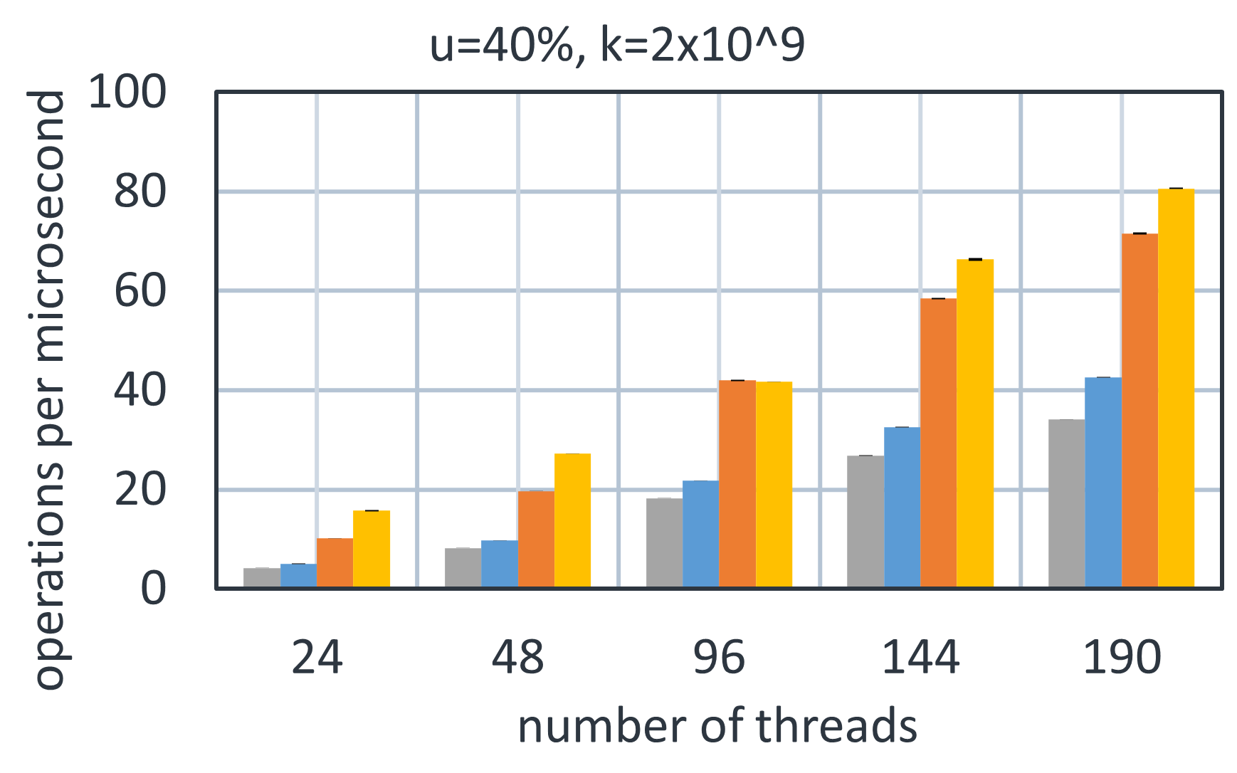
Performance Highlights
20% insert, 20% delete, 60% search
on 1 billion keys
Even with 40% updates, C-IST still performs well
Our new C-IST
Lock-free ABTree
BCCO optimistic AVL tree BST
NM lock-free BST

Slide 21
Conclusion
C-IST: a new concurrent doubly-logarithmic search tree, engineered for extremely fast searches
Collaborative rebuilding approach is likely applicable to other data structures with rigid balance constraints
Extensive experiments not shown here
Application benchmarks (noSQL database workloads)
Skewed key distributions, many key ranges and update rates
Analysis of cache misses, tree height / average key depth, memory footprint
Performance factor analysis (breaking down optimizations)

