Slide 1
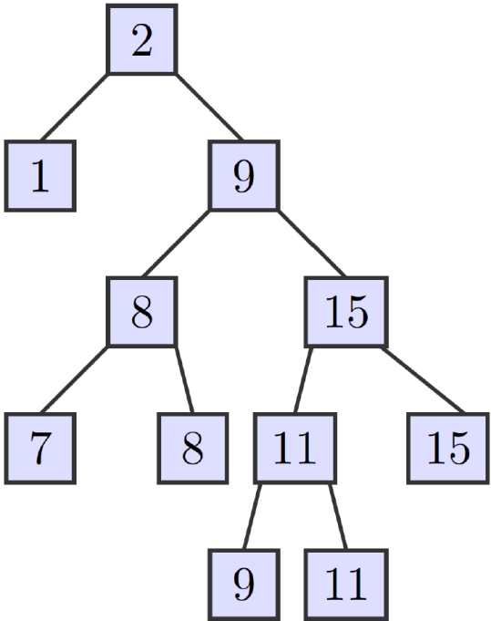
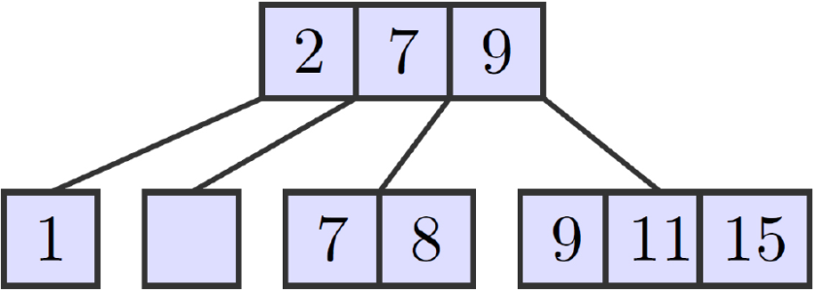
Non-blocking k-ary Search Trees
Trevor Brown – University of Toronto
Joanna Helga – York University
Ellen, Fatourou, Ruppert, and van Breugel. Non-blocking binary search trees.
In Proc. 29th ACM Symposium on Principles of Distributed Computing, July 2010.
Notes:
search trees are important
parallel algs. might want to use them
up until last year, concurrent trees used locks or h/w inst. like MCAS
can use univ. constructions, but overkill
first non-blocking bst at podc last year
it was not implemented
natural question: can we generalize to k-ary trees? yes.
stepping stone to b+trees, priority queues, etc.

Slide 2
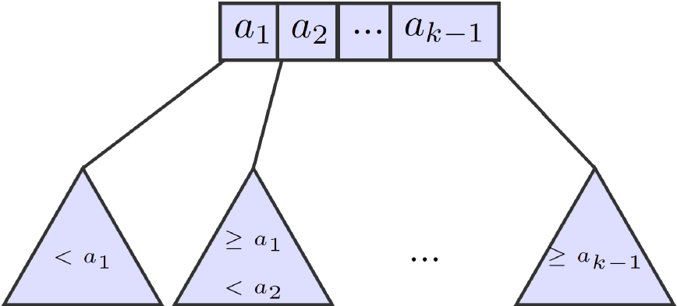
k-ST data structure
Operations: Insert, Delete, Search
Leaf-oriented tree
Nodes have k children and k-1 keys

Slide 3
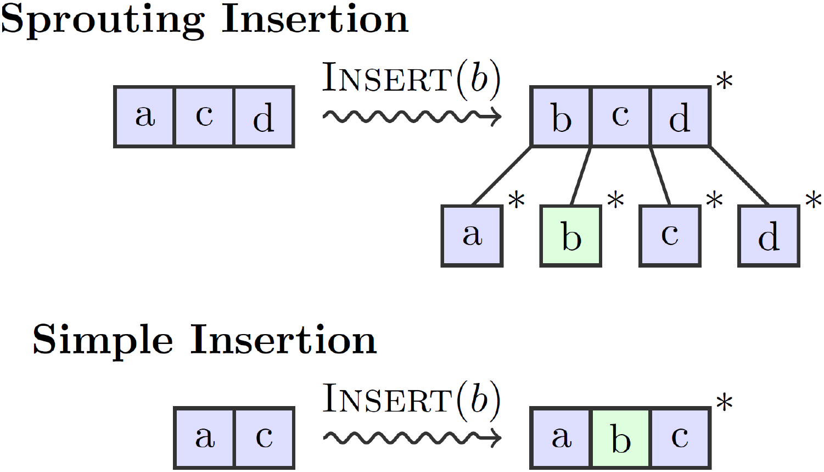
Updates to the structure
Two cases for Insert:

Slide 4
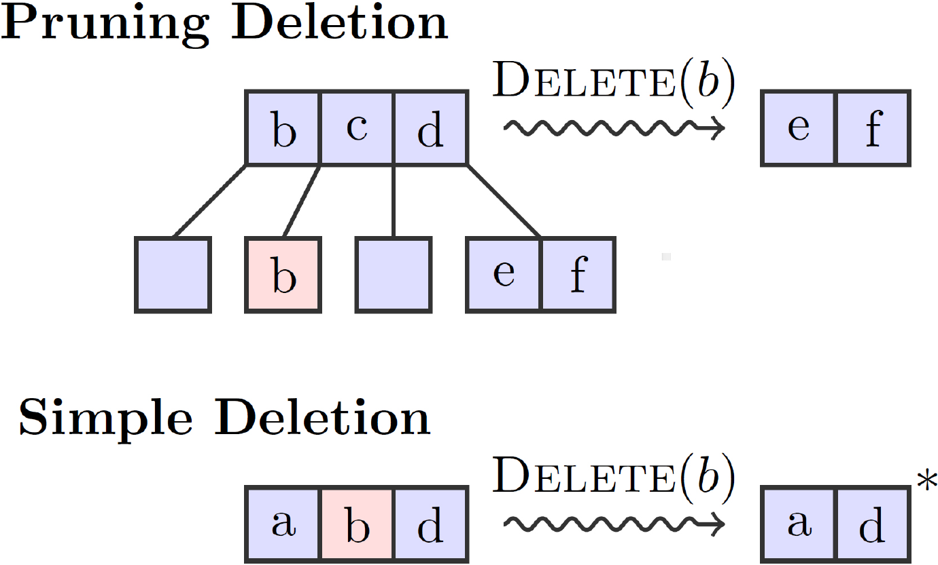
Updates to the structure
Two cases for Delete:

Slide 5
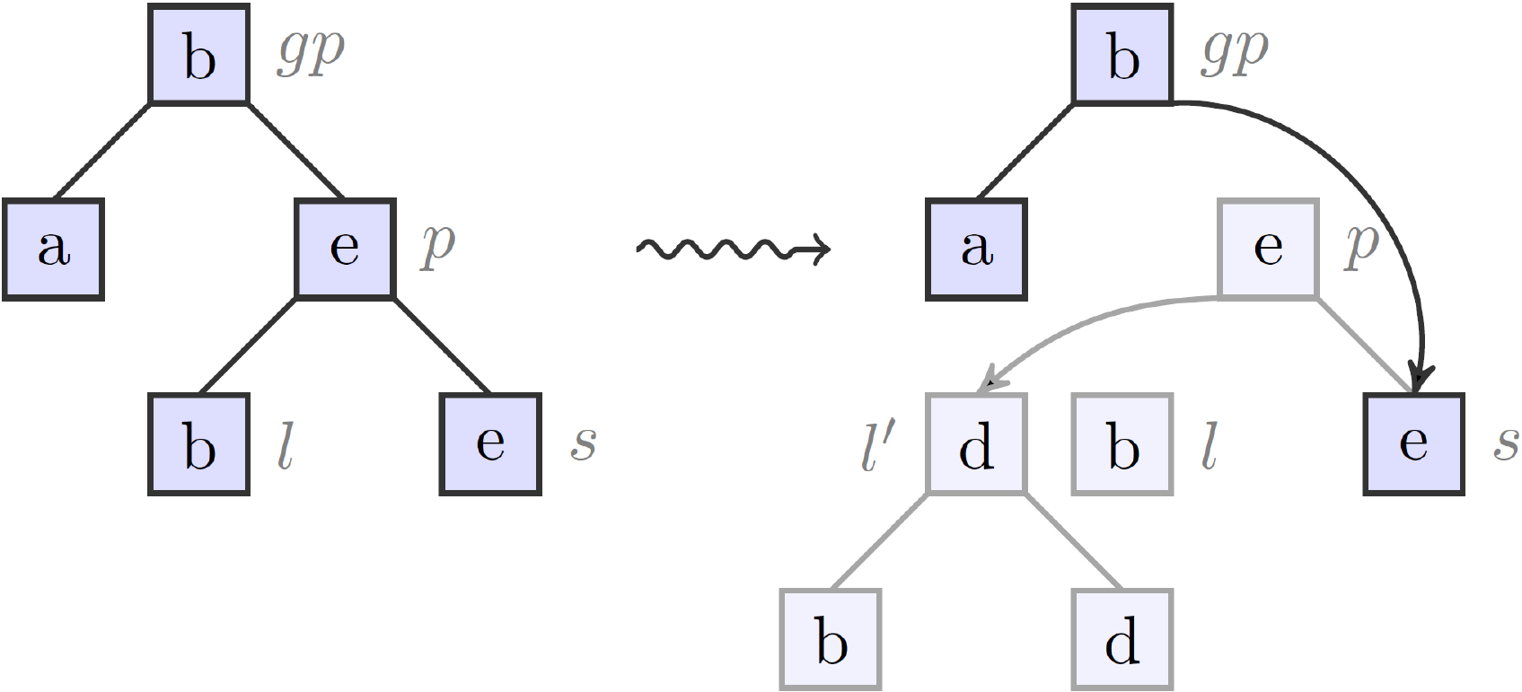
Danger of concurrent modifications
Concurrently: Delete(b), Insert(d)

Slide 6
Coordinating processes: flags and marks
Before a process can modify the tree:
If changing a child pointer of a node, it must flag the node (temporary)
If deleting a node, it must mark the node* (permanent)
Can only flag or mark a node that is unflagged and unmarked.

Slide 7
Coordinating processes: which nodes are flagged and marked

Slide 8
Coordinating processes: which nodes are flagged and marked

Slide 9
Coordinating processes: helping
What if we try to flag or mark a node x that is already flagged or marked?
Flags and marks contain extra information
Read this information and help complete the update that flagged or marked x
Then retry our own operation from scratch

Slide 10
Coordinating processes: implementing flags, marks and helping
Consider Delete(9) on the following tree
Flag: Pruning Delete(9)
Clean
Mark
Clean

Slide 11
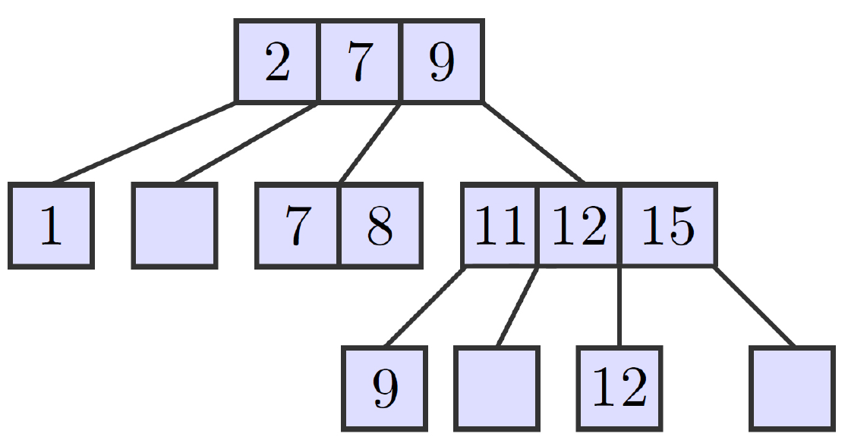
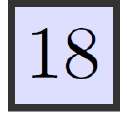
Coordinating processes: backtracking
Consider Delete(9) on the following tree
Insert(18) has already flagged a node
Flag: Pruning Delete(9)
Clean
Flag: Insert(18)
Clean
Notes:
Suppose we flag a node, but cannot mark its child (before we delete it)
Then some other update has flagged it
We first help the other update complete
Then we remove our flag and try again

Slide 12
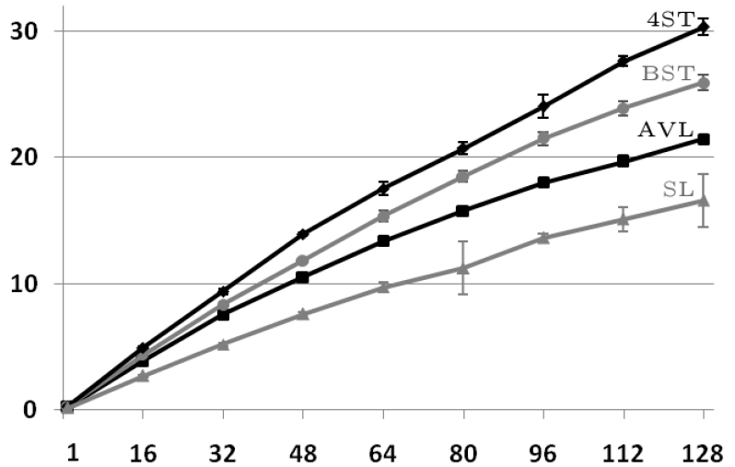
Performance data (1)
key range: [0, 10⁶); 100% Search

Slide 13
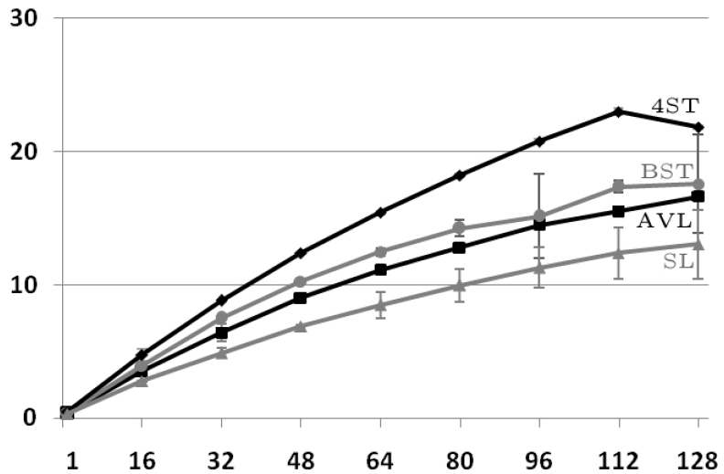
Performance data (2)
key range: [0, 10⁶); 8% Insert, 2% Delete

Slide 14
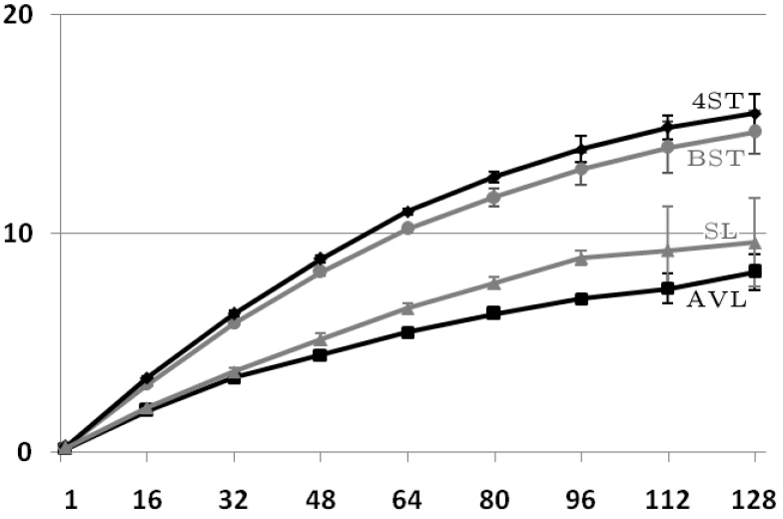
Performance data (3)
key range: [0, 10⁶); 50% Insert, 50% Delete

Slide 15
Performance vs. operation mix

Slide 16
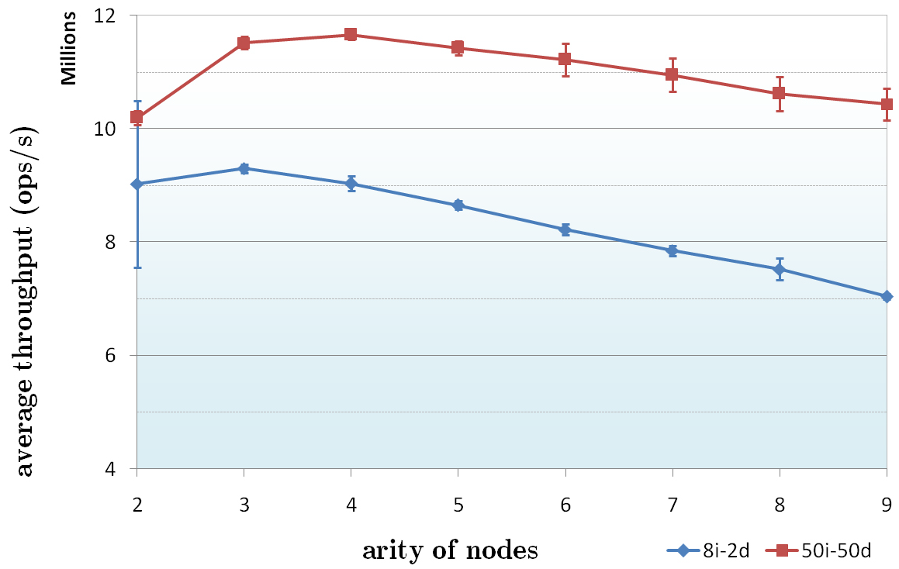
Performance vs. arity of nodes

Slide 17
How much helping actually occurs?
Approx. 100-200 helps per 1000 operations for 4ST key range [0, 10²),
and roughly half as much helping for BST.

Slide 18
Future directions
Add balancing
Generalize these techniques
Other non-blocking algorithms
e.g., B+trees, priority queues

