Slide 1




Multiverse: Transactional Memory with Dynamic Multiversioning
Gaetano Coccimiglio | Trevor Brown | Srivatsan Ravi

Slide 2
Problem
Multithreaded synchronization → difficult and error prone
Transactional memory (TM)
Block of code → transaction
Appears to execute atomically
TM handles locking for you
Conflict → one txn writes to an address that a concurrent txn has already read/written
Abort and retry to resolve
Focus on opaque TM → control behavior of committed and aborted txns

Slide 3
Multiversion Concurrency Control (MVCC)
TM typically cannot handle long running reads in the presence of frequent updates
Classic solution → MVCC
Single version
Multiversion
5
Write(17)
17
ver 2
17
ver 1
5
Reads use snapshots → read a consistent version from some point in the past
Drawbacks:
Expensive to maintain multiple versions
Slower than TM in common case
Increased memory consumption*

Slide 4
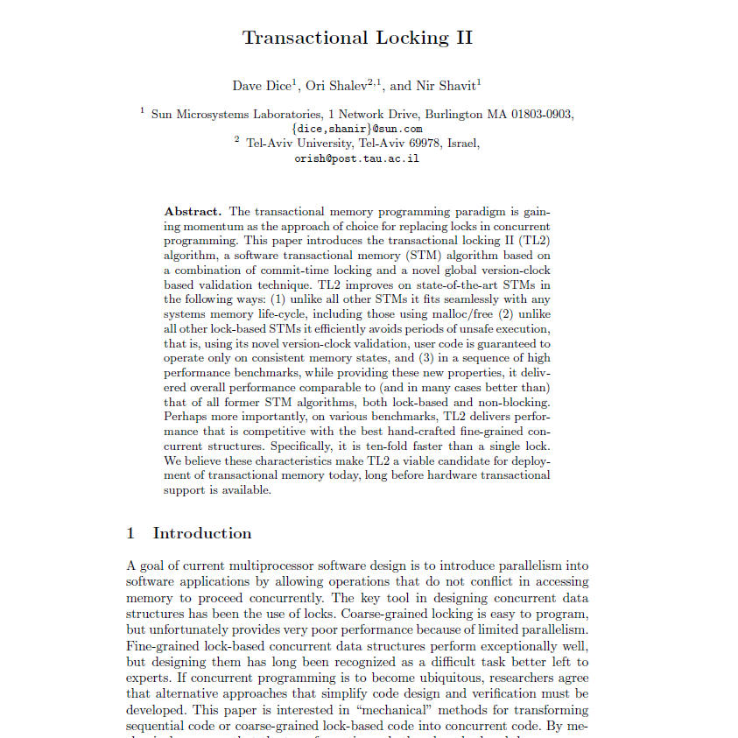
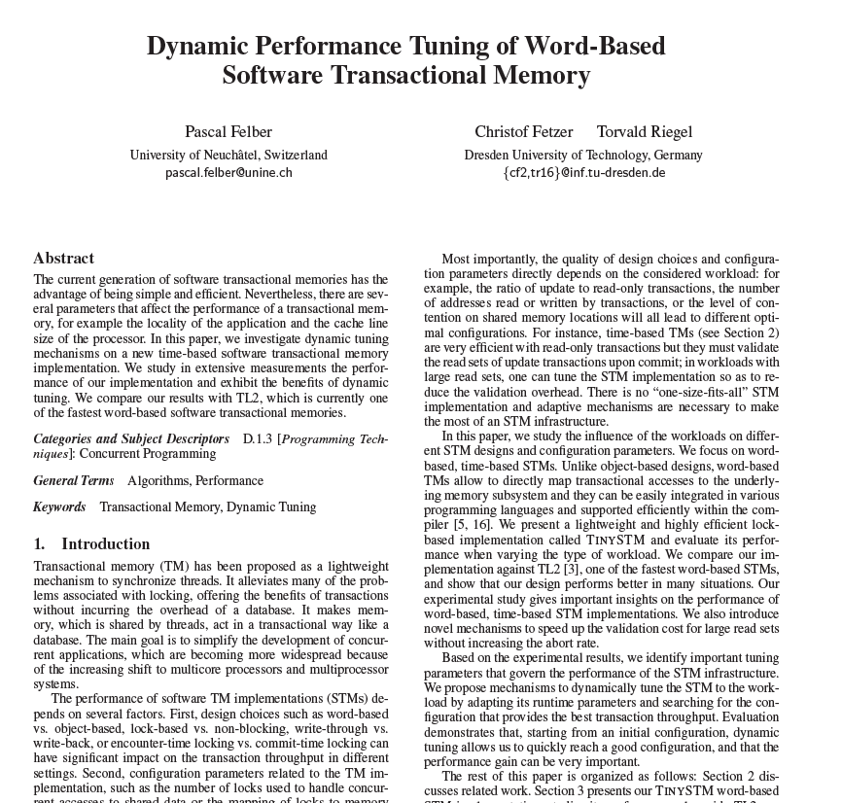
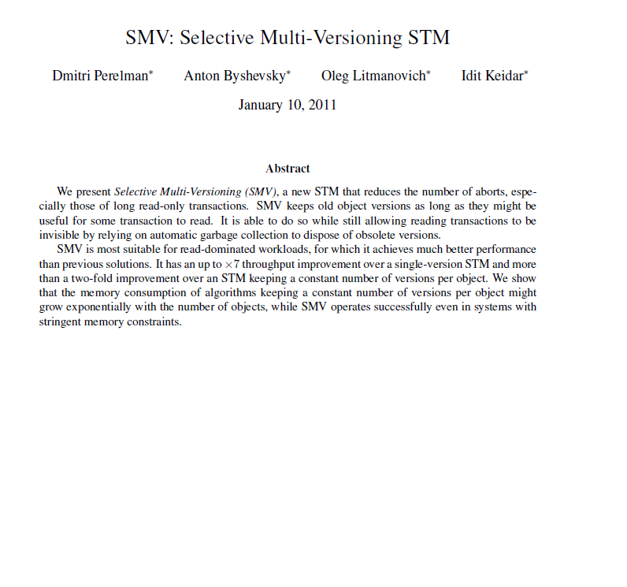
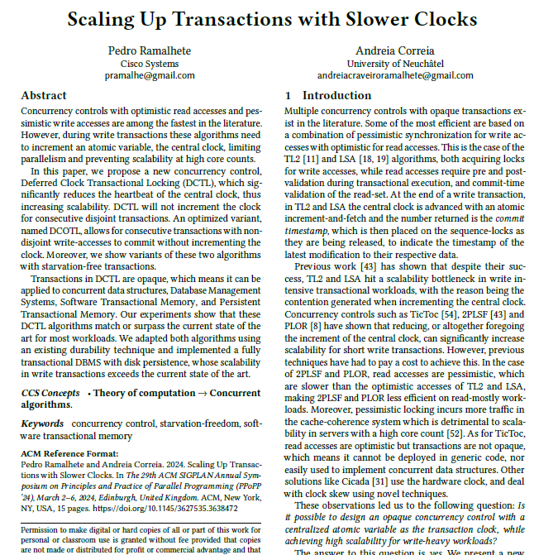
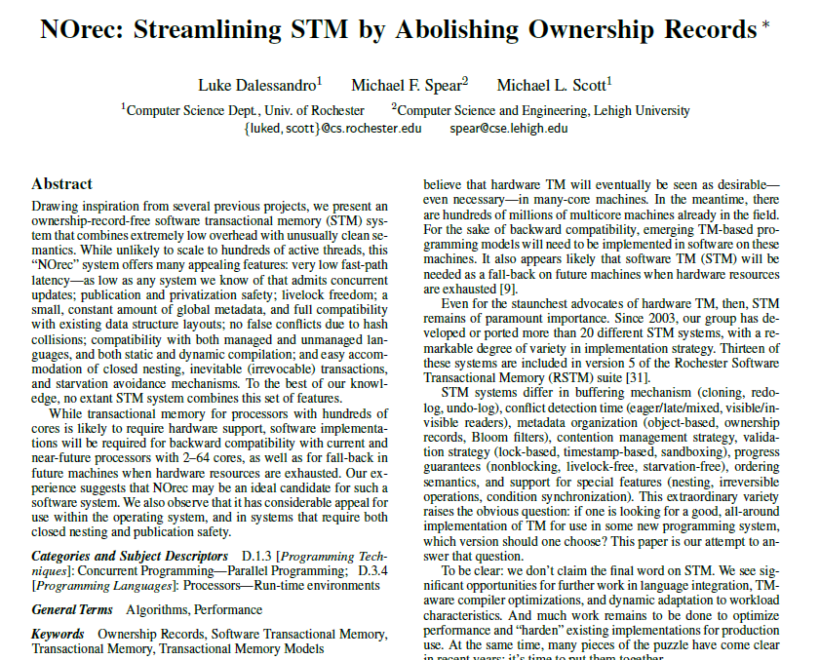
Prior Work
TL2 (2008)
SMV (2011)
DCTL (2024)
Our Contribution: Multiverse
A new opaque TM
matching state-of-the-art in single-version TM for typical workloads plus ability to handle long running reads
TinySTM (2008)
NORec (2010)
Classic Opaque Single-Version TMs
Opaque Multiversion TM
New SOA Opaque Single Version TM

Slide 5
Multiverse Transaction Design
Transactions are versioned or unversioned
Unversioned txns → behave like traditional STM
Versioned txns → behave like MVCC
Transactions start as unversioned
Txns that write remain unversioned
Read-only txns become versioned based on a heuristic
Design goal - prioritize unversioned transactions (common case):
Unversioned txns should be as fast as DCTL
Versioned txns should be as fast as possible without slowing down unversioned txns

Slide 6
Multiverse Data Structures
Lock
Table
Bloom Filter Table
Version List Table (VLT)
VLT bucket 1 Contents
TM Addresses
address a₁
address a₈
address a₂₀
versioned
lock 1
bloom
filter 1
VLT
bucket 1
versioned
lock 2
a₁
bloom
filter 2
VLT
bucket 2
version list head
version list head
version list head
a₂
version
list
version
list
version
list
a₃
versioned
lock k-1
bloom
filter k-1
VLT
bucket k-1
versioned
lock k
bloom
filter k
VLT
bucket k
versioned node
versioned node
timestamp
data
timestamp
data
Global Clock
Version list associated with address a₁
Notes:
TM addresses = addresses of the data we want to atomically access via the TM
Each address is protected by a versioned lock which is stored in a separate lock table - You could imagine storing locks alongside data but we dont want to change the memory layout of the user program
Also note that the lock table is a finite size and we map addresses to individual locks - this means multiple addresses can map to the same lock. In this example a1 and a2 both map to lock 1 but this isnt a problem - even if 2 txns want to separately access a1 and a2 they will content on the lock which at worst might cause one to abort
We also have a bloom filter table and a version list table. Before getting into what they are used for ill just note that all 3 tables are the same size and use the same mapping function meaning an address will map to the same index in all 3 tables
In multiverse addresses, like transactions, can be versioned or unversioned. When a address is versioned it needs a version lists associated with it but we dont want to store it alongside the in-place data for the same reason that we dont colocatethe locks
Instead we store the version lists in the VLT. Each bucket in the VLT is a linked list storing multiple version lists. Now this means that determining if an address is versioned would require traversing a VLT bucket. To sometimes avoid this we use bloom filters as a fast way to check if an address is definitely not versioned
A version list itself is a linked list where each node has a timestamp and some data. The timestamp like the lock versions comes from the global clock

Slide 7
TM Modes
4 possible modes → 2 stable modes + 2 transient
Mode Q → queries version: prioritizes unversioned txns
Mode U → updates version: prioritizes versioned txns
Start
Mode Q
Transient
QtoU
Mode U
Transient
UtoQ
Notes:
talking points over the slide
our TM has a few modes it can run in, two stable modes, and two transient ones
the goal of these modes is to prioritize either versioned transactions or unversioned transactions
in mode Q, long running queries are responsible for versioning addresses they are interested in, so they pay the cost of versioning
in mode U, updates pay this cost, with the end result that long running queries can run more efficiently, and with fewer aborts (since updaters preserve old values instead of replacing them)
long running queries that struggle to progress cause a switch to mode U, and a background thread switches the system back to mode Q based on some heuristics. the use of a background thread here makes sense because the switch back to mode Q is based on "non-events," because mode Q is appropriate when we are not running queries whose progress depends on updates versioning.

Slide 8
Unversioned Transactions
Begin Txn
current version = read global clock
TM-Read(A)
read *A
validate A’s lock
add A to read set
Abort
Unversioned read does not access the version list

Slide 9
Unversioned Transactions
Newly added versions are marked to-be-determined (TBD) until commit
TM-Write(A)
validate and acquire A’s lock
check if A is versioned
update version list
add A to versioned write set
Abort
update *A
add A to standard write set
Notes:
Versioned write set → versioned addresses written

Slide 10
Unversioned Transactions
TryCommit()
if read-only
validate read set
commit
clock = reread global clock
replace TBDs with commit clock
Done
Abort
release locks to commit clock
Abort
increment global clock
heuristic check to retry as versioned or different mode
Retry

Slide 11
Versioned Transactions
Only read-only transactions can be versioned
No need to validate lock when A is already versioned
Traversal blocked by TBD versions
TM-Read(A)
check if A is versioned
traverse version list to find suitable version
if suitable version found
acquire A’s lock without validating version
Abort
allocate new versioned node
version A
validate A’s lock
Abort
lock ver
*A
Notes:
mention if we were talking about Mode U then it is very likely that we find a suitable version (if a concurrent update changes an address you're interested in, it's non-destructive in mode U, so the old value you're interested in should generally still be available) (maybe hint at optimization regarding if the addr is unversioned without going into detail)

Slide 12
Evaluation
C++ compiled with GCC 10.3.0 using -O2
AMD EPYC 7662 processor (64C/128T)
20 second trial → average of 5 trials
Competing TMs
TL2
DCTL
TinySTM
NORec

Slide 13
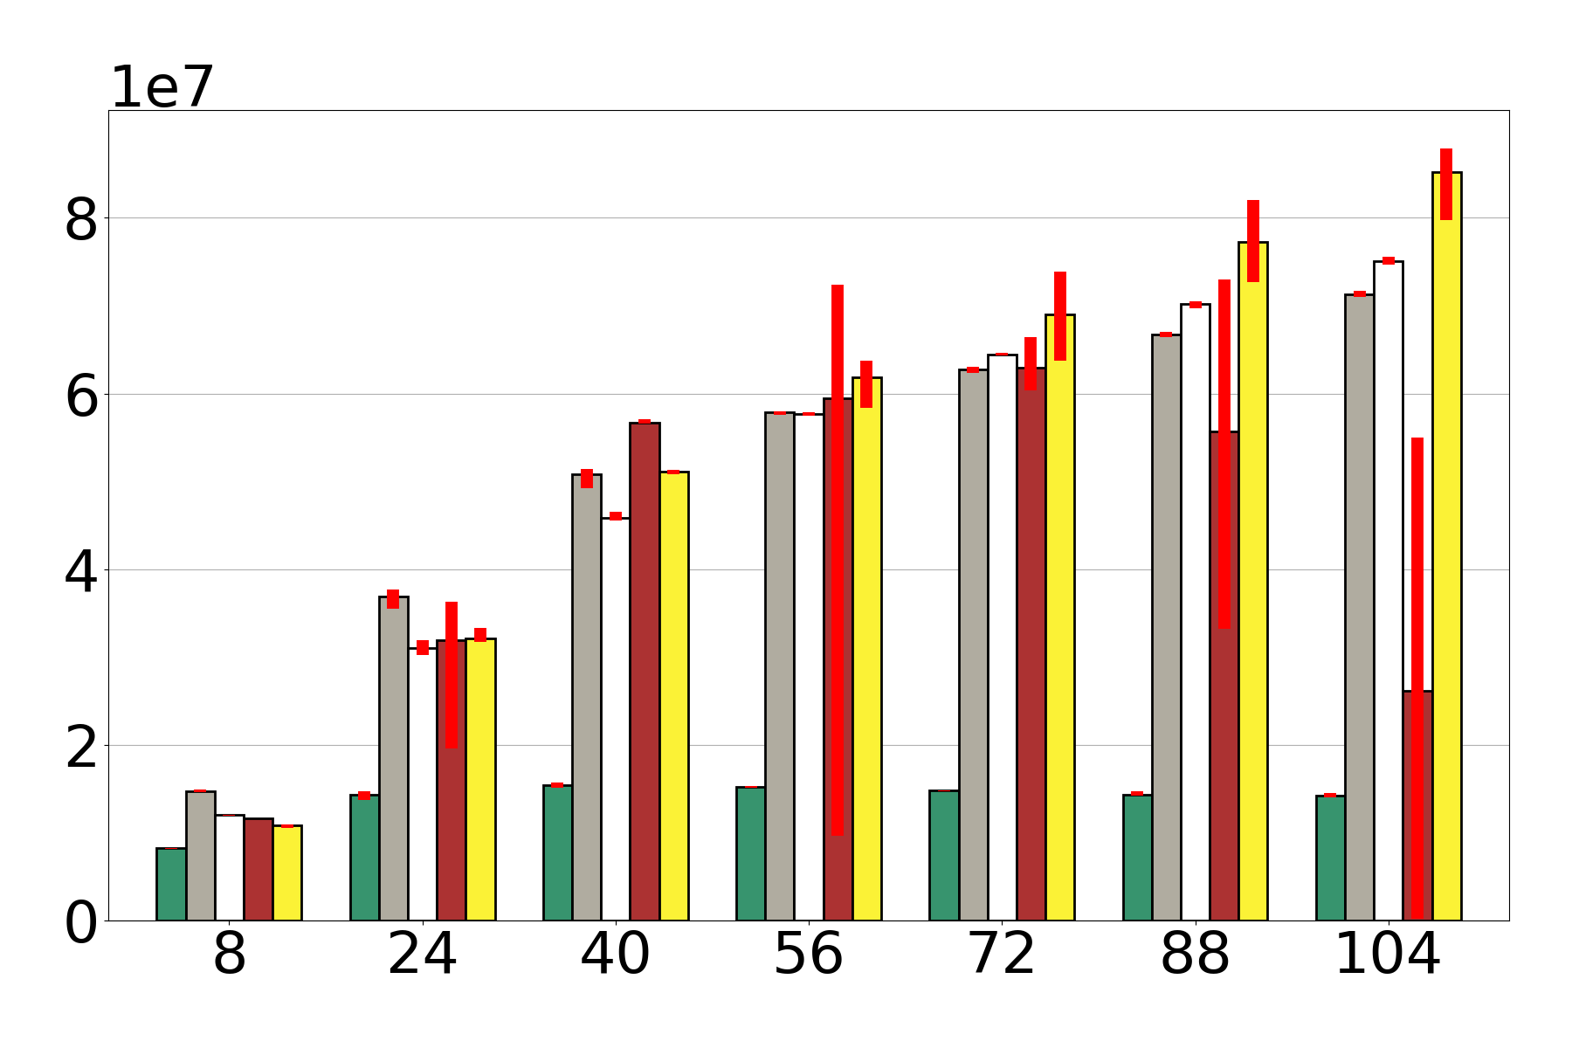
Throughput When Versioning is Not Needed
(a,b)-tree a=4, b=16. Uniform key access pattern.
90% Read-only (search), 5% insert, 5% delete
Multiverse
DCTL
ops/sec
TL2
NOrec
TinySTM
number of threads

Slide 14
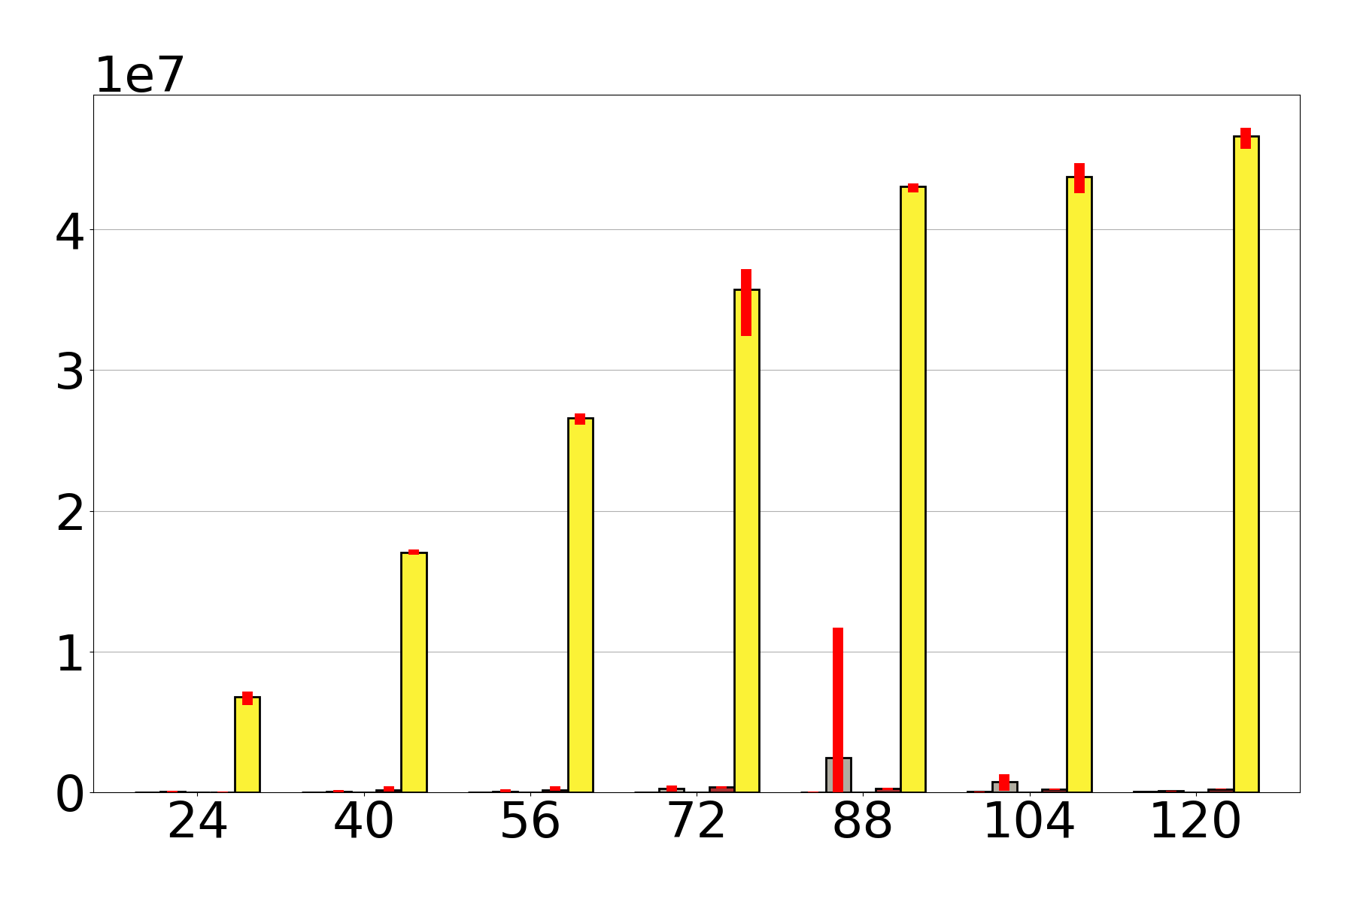

Handling long running queries under frequent updates
(a,b)-tree a=4, b=16. Uniform key access pattern.
89.99% search, 5% insert, 5% delete, 0.01% RQ (10k RQ size)
16 dedicated updater threads
Multiverse
ops / sec
TL2
DCTL
number of threads
NOrec
TinySTM

Slide 15
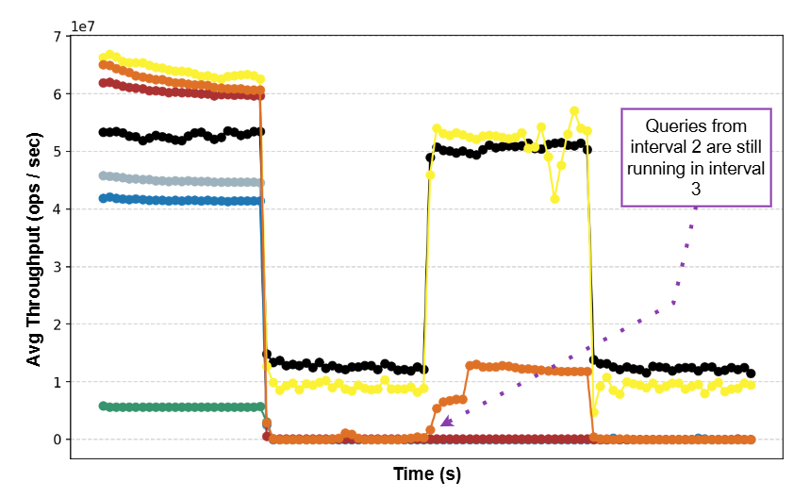
Time-Varying Workload
4 Interval, each 5 sec:
64 worker threads
10% insert
10% delete
Interval 1 and 3:
0 dedicated updaters
0 RQs
Interval 2 and 4:
4 dedicated updaters
0.01% RQ
100k RQ size
Multiverse-ModeQ-Only
Multiverse-ModeU-Only

Slide 16
Conclusion
Multiverse: a novel TM combining the best of unversioned TM and MVCC
Versioned and unversioned transactions
Dynamic versioning of individual addresses
Multiple TM modes
Opaque
Maintains performance of SOA single-version TM for typical workloads
Significantly outperforms single-version TM for workloads with long-running reads
Identified subtle memory management bug in several SOA TMs
Code: gitlab.com/Coccimiglio/mvcc_tm
gccoccim@uwaterloo.ca

Slide 19
Extra slides

Slide 20
Versioning Addresses
Bloom Filter Table
VLT
VLT bucket x Contents
Lock Table
TM Addresses
add address a₁ to bucket
a₁
a₂
allocate new
version list for a₃
a₃
versioned
lock x
bloom
filter x
VLT
bucket x
allocate new versioned node
0
1
0
0
timestamp
data
Insert a₃ into the bloom filter

Slide 21
Unversioning Addresses
Unversioning performed by a background thread
When to unversion
Heuristic: VLT buckets with very old version compared to global clock
What to unversion
Not individual addresses
Per address stats would be expensive to track
Unversioning address would mean removing from bloom filter
Entire buckets
Reset bloom filter → effectively unversions the whole bucket
Notes:
Non event driven

Slide 23
Evaluating Workloads with Long Running Queries
Hard to design good benchmarks with long running queries:
Easy to design workloads where algorithms that do not have proper RQ support can still appear to have good throughput
We want a workload with long running queries where only algorithms that have proper RQ support can achieve good throughput
Bad Workload Example: 10% chance to perform a RQ, 90% chance to perform an update
T1
Update
Range Query
Range Query
Range Query
7 ops later
T2
Update
Update
Range Query
Range Query
T3
Update
Update
Update
Range Query
Time

Slide 24
Useful Range Query Workloads
Avoiding the naive approach → add dedicated updater threads
Threads that will only perform update operations which are guaranteed to never commit as read-only
Regular insert/delete updates in expectation will be read-only 50% of the time
Long running queries are likely to experience conflicts
Workload can never be read-only

Slide 25
Evaluating Workloads with Long Running Queries
Difficult to select a representative workload for TM
Macro-benchmarks are lacking / outdated
YCSB-A → nearly read-only workload = boring
TPC-C → almost append-only workload = boring
STAMP → outdated, designed for first generation TM which had no practical support for large queries
Hard to design good benchmarks with long running queries

Slide 27
Mode Q – Queries version (Default mode)
Mode Q → prioritizes unversioned transactions
Only versioned txns add versions
Unversioned txns mostly oblivious to versioned txns
Mode Q ideal when versioned txns are unlikely to experience conflicts → versioned txns are infrequent or small

Slide 28
Mode Q – Queries version (Default mode)
Mode Q → prioritizes unversioned transactions
Only versioned txns add versions
Unversioned txns mostly oblivious to versioned txns
Mode Q ideal when versioned txns are unlikely to experience conflicts → versioned txns are infrequent or small
Read a₀ (ver 8 )
TBD blocks until write commits
Read a₀
Version a₀ (ver 7)
Tx ver 8
T1
read a₀ to a_{n}
abort
read a₀ to a_{n}
commit
Write a₀
Write a₀ (ver 8)
T2
Update a₀
Update a₀
Time
Notes:
one address that receives many updates (like a hot key) and its the only address that intersects the range were interested in so it suffices to have the RQ hit the address experience the conflict, version the addr and retry and succeed

Slide 29
Need for Other Modes
Mode Q not sufficient when versioned txns are likely to experience conflicts
→ larger versioned txns with frequent updates to difference addresses

Slide 30
Need for Other Modes
Mode Q not sufficient when versioned txns are likely to experience conflicts
→ larger versioned txns with frequent updates to difference addresses
Read a₁
Read a₀
Version a₀
Read a₀
Version a₁
T1 commits after n² accesses
T1
read a₀ to a_{n}
abort
read a₀ to a_{n}
abort
Write a₀
Write a₁
continue with same pattern
T2
Update a₀
Update a₁
Time

Slide 31
Mode U – Updates version
Mode U → prioritizes versioned transactions
Unversioned writes add new versions
Versioned txns operate as if every address is versioned
Unversioning is disabled
Essentially enables ‘global versioning’
VLT bucket x Contents
TM Addresses
VLT
add address a₁ to bucket
a₁
VLT
bucket x
allocate new
version list for a₃
a₂
a₃
allocate new versioned node
allocate new versioned node
The versioning update’s current version
ver 8
new data
ver 7*
old data

Slide 32
Mode U – Updates version
Mode U → prioritizes versioned transactions
Unversioned writes add new versions
Versioned txns operate as if every address is versioned
Unversioning is disabled
Essentially enables ‘global versioning’
Tx ver 7
Read a₀ (ver 7)
Read a₁ (ver 7)
T1 commits after n accesses
T1
read a₀ to a_{n}
Version a₀ (ver 7)
Write a₀ (ver 8)
Version a₁
(ver 7)
Write a₁
(ver 8)
continue with same pattern
T2
Update a₀
Update a₁
Time

Slide 33
TM Modes
TM mode implemented as monotonic counter
At the start of every txn the executing thread gets its local mode by reading the global mode counter
Consequence → Concurrent threads can operate in different modes
Cannot transition between Mode Q and Mode U

Slide 34
TM Modes
Any thread can CAS to transition mode from Q to QtoU
All other transitions = background thread
TM mode implemented as monotonic counter
At the start of every txn the executing thread gets its local mode by reading the global mode counter
Consequence → Concurrent threads can operate in different modes
Cannot transition between Mode Q and Mode U directly
Intermediate QtoU → transient mode to transition from Mode Q to Mode U
Waits for all Mode Q writers to commit or restart
Intermediate UtoQ → transient mode to transition from Mode U back to Mode Q
Waits for all Mode U readers to commit or restart

Slide 36
Example - Without Opacity
int x = 0; int y = 0; debug = 0;
txn {
0x0: x = x + 1;
0x1: y = y + 1;
0x2: if (!debug) // skip print
0x3: jmp( 5+2(x-y)² )
0x4: print("dbg…")
0x5: TryCommit();
}
TM::TryCommit() {
0x6: validate()
0x7: doCommit()
}
read
x = 0
write
x = 1
read
y = 0
write
y = 1
jmp
(5+0)
0x5
TryCommit()
T1
read
x = 1
write
x = 2
read
y = 0
write
y = 1
jmp
(5+2)
0x7: doCommit()
T2
Time
End result: We lost the invariant of x == y
T2 should have aborted but it incorrectly calculated the jmp addr to be the addr of doCommit

Slide 37
Example - With Opacity
int x = 0; int y = 0; debug = 0;
txn {
0x0: x = x + 1; // & validate reads
0x1: y = y + 1; // & validate reads
0x2: if (!debug) // skip print
0x3: jmp( 5+2(x-y)² )
0x4: print("dbg…")
0x5: TryCommit();
}
TM::TryCommit() {
0x6: validate()
0x7: doCommit()
}
T1
read
x = 0
write
x = 1
read
y = 0
write
y = 1
jmp
(5+0)
0x5
TryCommit()
T1 validates then commits
read
x = 1
Conflict = T2 aborts
T2 retries
T2
Time
End result: We maintain the single-threaded invariant of x == y

Slide 38
Memory Management
Read-only txns in TMs like TL2 and DCTL do not revalidate read sets → better performance for reads
Problem → permits a crucial memory reclamation race condition

Slide 39
Memory Management - Linked List Example
T1
Txn { Traverse A to D }
T1
T1
T1
A
B
C
D
T2
T2
T2
Txn { Remove back half of list }
Free(C)
Free(D)
T2 commits

Slide 40
Memory Management - Linked List Example
T1
T1 segfaults on C
Txn { Traverse A to D }
T1
A
B
C
D
T2
T2
T2 frees
C and D
Txn { Remove back half of list }
Free(C)
Free(D)

Slide 41
Safe TM Memory Management
Possible solutions:
Force read-only txns to revalidate
Use of TM to control internal state of memory allocator
Epoch based reclamation EBR
Multiverse uses EBR → Epochs directly tied to txn abort / commit
On abort:
Undo retires performed during the txn then
Retire objects allocated during the txn
On commit:
Finalize allocations
Attempt freeing retired objects → they might not be freed until a later txn by the same thread

Slide 43
Correctness in TM
Serializability: history of committed txns is equivalent to some sequential history
Opacity: history of all txns (including aborted ones) is equivalent to some sequential history
Requires all txns observe consistent state → every read returns the value of the latest committed write
Opacity matters - without opacity even single-threaded invariants cannot be maintained
Notes:
maybe don't need to diff serializability and opacity, and just mention at some point that this is an opaque tm, where opacity is the gold standard for correctness? [like maybe this can just be said out loud later?]

Slide 44
Problem with prior work
Existing single-version TMs cannot handle workloads with long running reads
Most existing multiversion TMs are not opaque
Only opaque multiversion TM, SMV has performance concerns
Updates always add new versions
Written specifically for Java → relies heavily on Java garbage collection
Goal: a new opaque TM
matching state-of-the-art in single-version TM for typical workloads plus ability to handle long running reads

Slide 45


Easier Synchronization - Transactional Memory
Transaction memory (TM) → scalable approach to using locks
Mark blocks of code as transactions → synchronization handled for you
TM

Slide 46
Transactions
TM interface: begin, commit, (voluntary) abort
Transaction → some code that we want to appear to execute atomically
Read set → all addresses read by a txn
Write set → all addresses written to by a txn
Conflicts → when the write set of one txn overlaps the read/write set of another concurrent txn
Conflicts = txn sees inconsistent state

Slide 47
TM Behaviour
Example banking transactions → read balance, withdraw funds, deposit funds
Initial balance = 10
Same conflict / resolutions for overlapping
write + write
Resolving the conflict:
Delaying a txn
Overlapping
reads
Non-overlapping
read + write
Overlapping
read + write
Read Balance = 10
Read Balance = 0
Most TMs use aborts
Withdraw
10
Withdraw
10
Read
Balance = 10
Read Balance = 20
Read Balance = ?
Read
Balance = 10
Deposit 10
Withdraw 10
Resolving the conflict:
Aborting one or both txns
✔ No conflict
✔ No conflict
X Conflict
Read Balance = ?
Abort Read Balance
Retry Read Balance = 0
Withdraw 10

