Slide 1
Neutralization Based Reclamation
Ajay Singh, Trevor Brown and Ali Mashtizadeh
(Multicore Lab, University of Waterloo)
Notes:
Welcome every one
This talk is about a neutralization based algorithm to solve the problem of safe memory reclamation in concurrent data structures.
This work is done in collaboration with Prof Trevor Brown and Prof Ali Mashtizadeh.

Slide 2
OUTLine
Safe memory reclamation (SMR)
Desirable properties of SMR
Existing SMRs
Our contribution
NBR
NBR+
Results
Conclusion
Notes:
We will briefly discuss what is Safe memory reclamation properties, then we will see categories existing SMRs fall into in regards with those properties and our motivation for the contribution of this work NBR.
Then we will see some results followed by conclusion of our work.

Slide 3
Safe MEMORY RECLAMATION
Addresses the issue of "use-after-free" in concurrent programs using dynamic memory.
Sleep
Awake!
Crash!
T1: Find (n3)
T2: delete(n2)
head
n1
n2
n3
Free(n2)
Notes:
Problem of Safe memory reclamation boils down to the issue of use-after-free types of conflicts in concurrent data structures where a thread might access a concurrently freed shard memory address.
For example, consider a simple linked list and two threads T1 and T2. Where T1 is executing find (n3) and T2 is deleting n2.
T2 enroute n3 sleeps after reading a poionter to n2. Simultaneously T2 unlinks and frees n2.
Now if T2 wakes up and tries to dereference the pointer to n2, it will crash.
Set of algorithms which solve this problem of concurrent memory reclamation are safe memory reclamation algorithms.

Slide 4
Desirable Properties In a SMR algorithm
Performance : low latency and high throughput.
Bounded Garbage : number of records not yet reclaimed should be bounded to ensure lock freedom.
Usable : minimum intrusive changes to code, data or build environment.
Consistent : relative performance should not drastically vary across workloadtypes, subscription rates, data structures types and data sizes.
Applicable : Applies to many data structure
Notes:
Now, These safe memory reclamation algorithms should have certain desirable properties. Namely
They should have high throughput (or should have less overhead for underlying ds), should bound garbage to maintain progress properties of underlying ds.
An smr algo could be widely adapted if it doesn't involve intrusive changes to code and build environemnet or special primitives or compiler support.
Their performance should not drastically wary across different workload types, subscription rates, ds types and their sizes.
Last but not least it is important that a SMR algo is widely applicable to as many ds as possible.

Slide 5
Existing Safe Memory Reclamation
Reference Counting Based:
Overhead on readers
Conditionally bounds garbage
Hazard Pointer Based:
Overhead on readers
Bounds garbage
EBR Based:
No overhead on readers
Unbounded garbage
Notes:
Current SMR algos could roughly be categorised into RCBRm HPBR and EBR.
RCBR involves incrementing and decrementing a per record counter to ensure use-after free conflicts are resol;ved. This incurrs overhead for read only operations as well. And it has conditionally bounded garbage as in case of cycles in garbage the amount of garbage may increase indefintely.
HPBR on the other hand bound the amount of unreclamed records and involves reservation/unreservation of accesses pointers to resolve uase-after-free conflicts. This mechanism of preotection of accessed records again incurs ovehead for read operations.
On the contrary EBR is faster as it doesn't have per read overhead as in the other two but it suffers the issue of unbounded garbage. Which makes it useless for lock free data structures.
Additionally, in regards with
CONSISTENCY: EBR is susceptible to delayed threads which could lead to accumulation of retired records which when freed together could bottleneck the underlying allocator. Leading to inconsistency in performance.
USABILITY: Though having bounded garbage HP are difficult to use: reasoning about when a node is definitely reachable from the root is difficult for many ds and requires significant programming effort.
Finally, HP is not applicable to many data structures where traveral of sequence of marked or logically deleted node is possible. As discussed in previous papers for example Brown's DEBRA.
A few notable examples include NM tree, brown interpolation search tree lazylist etc....

Slide 6
Data structures where Hazard Pointer based SMR does not apply
Steve Heller, Maurice Herlihy, Victor Luchangco, Mark Moir, William N Scherer, and Nir Shavit. 2005. A lazy concurrent list-based set algorithm. In International Conference On Principles Of Distributed Systems. Springer, 3–16.
Faith Ellen, Panagiota Fatourou, Eric Ruppert, and Franck van Breugel. 2010. Non-blocking binary search trees. In Proceedings of the 29th ACM SIGACT-SIGOPS symposium on Principles of distributed computing. 131–140.
Faith Ellen, Panagiota Fatourou, Joanna Helga, and Eric Ruppert. 2014. The amortized complexity of non-blocking binary search trees. In Proceedings of the 2014 ACM symposium on Principles of distributed computing. 332–340.
Aravind Natarajan and Neeraj Mittal. 2014. Fast concurrent lock-free binary search trees. In Proceedings of the 19th ACM SIGPLAN symposium on Principles and practice of parallel programming. 317–328.
Dana Drachsler, Martin Vechev, and Eran Yahav. 2014. Practical concurrent binary search trees via logical ordering. In Proceedings of the 19th ACM SIGPLAN symposium on Principles and practice of parallel programming. 343–356.
Notes:
HP does not apply to many ds like lazylist, external BST's of faith etal, natarajan and Mittal as its hard to argue about the reachability of nodes from root to reserve a pointer to a node thatis being read.

Slide 7
Data structures where Hazard Pointer based SMR does not apply CONTD ...
Shane V Howley and Jeremy Jones. 2012. A non-blocking internal binary search tree. In Proceedings of the twenty-fourth annual ACM symposium on Parallelism in algorithms and architectures. 161–171.
Arunmoezhi Ramachandran and Neeraj Mittal. 2015. A fast lock-free internal binary search tree. In Proceedings of the 2015 International Conference on Distributed Computing and Networking. 1–10.
Trevor Brown, Faith Ellen, and Eric Ruppert. 2014. A general technique for non-blocking trees. In Proceedings of the 19th ACM SIGPLAN symposium on Principles and practice of parallel programming. 329–342.
Trevor Brown, Aleksandar Prokopec, and Dan Alistarh. 2020. Non-blocking interpolation search trees with doubly-logarithmic running time. In Proceedings of the 25th ACM SIGPLAN Symposium on Principles and Practice of Parallel Programming. 276–291.
Niloufar Shafiei. 2013. Non-blocking Patricia tries with replace operations. In 2013 IEEE 33rd International Conference on Distributed
Computing Systems. IEEE, 216–225.

Slide 8
War CRy
" Fast SMR which bounds garbage, is usable and applies to many data structures "
https://www.thequint.com/voices/opinion/jhansis-lakshmibai-mutiny-heroine-or-a-reluctant-rebel
Notes:
So really our ambition is to design a SMR algorithm which bounds garbage and yet is as fast as any EBR algorithm. Additionally it should be easy to use and apply to as many data structures as possible. Thus our war cry is to design such a SMR algorithm.

Slide 9
Neutralization based reclamation (NBR)
Achieves Bounded garbage and matches (sometimes surpasses) EBR's throughput by enforcing QUIESCENCE through neutralization signals.
Every thread accumulates retired records in its private buffer.
After reaching a certain buffer size a thread T_{I} broadcasts a neutralizing signal (POSIX) to other threads.
Upon receiving a neutralization signal other thread T_{J}:
Either discard its private shared memory pointers.
If not, they should have reserved all of their shared memory pointers.
HOLY GRAIL: Quiescence is enforced across threads to mitigate use-after-free conflicts.
T_{J} will not use a record that could be freed concurrently.
T_{I} will not free a record that is being used by T_{J} .
Notes:
NBR alternatively achieves bounded garbage and is as fast as EBR. It does so without requiring synchronization at every shared memory read unlike HP and RCBR.
It does so by enforcing quiescence across threads.
Intuitively it does so by : explain second chart.

Slide 10
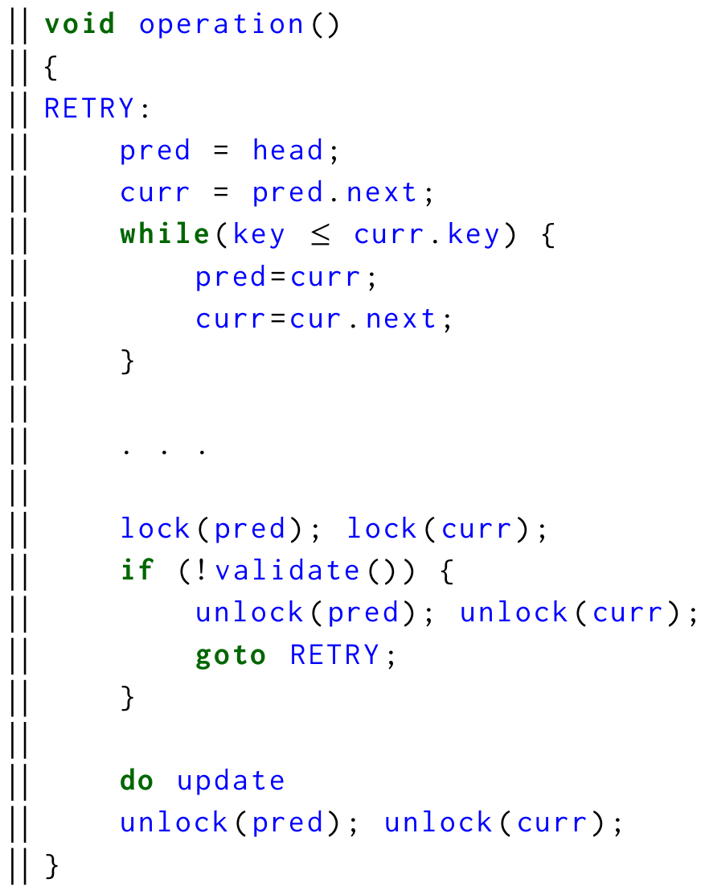
AssumptionS:
Operations consist of (or can be presented in) two phases:
Phase where threads only read the underlying data structure.
Optional phase where threads modify the underlying data structure.
Read-phase:
reservation-phase:
Set of records required in the write-phase are known beforehand.
write-phase
Notes:
This requires NBR to assume that DS operations consist of two broad phases:
first where a thread only reads the underlying shared records and thus could be safely restarted without impacting correctness.
And second optional phase where a thread could be modifying the underlying ds.
For example, in a lzylist a long search phase is followed by a updates at target nodes. NBR terms them as read-phase and write phase.
At read phase a thread could discard pointers to underlying data structure at any time and restart.
At write phase, a thread may not be able to discard its pointer as it might be in middle of a update. So, it reserves the records needed in write before entering the write phase at the coneptual reservation phase... This requires that set of records needed in write phase should be known beforehand. --- assumption2 animation.

Slide 11
Working of NBr
Enough garbage! I wanna recycle
T1: Read-phase
T2: Write-phase
T3: reclaimer
Discarding pointers
Reader-reclaimer handshake
writer-reclaimer handshake
Neutralize signal
Neutralize signal
reserved pointers
Free pointers that are not reserved
Notes:
After a thread accumulates enough number of records in its private buffer (depending on some threshold) it sends neutralization signal to other threads.
When a thread recieves a neutralization signal:
It could be in read phase of a data structure operation:
In that case since it hasnot done any changes to underlying ds yet, it could safely restart yielding all private references to underlyingds (list in this case)
In doing so T1 (reader) guarantees that it holds no pointers to retired records in it private buffer.
Thus achieving a reader-reclaimer handshake where reclaimer inform readers befoire reclamaing and readers discard private shared memory references.
Additionally, a thread cold be in write phase, where they would have alread reserved the records they would need to access in write phase. Thus threads in write phase could simply continue what they were doing upon recipt of a nz signal
Essentially, writers guarantee that they will reserve records they would need in write phase and reclaimers intyurn guarantee that they will not reclaim anyreserved record in their buffer.
So, after a reclaimer I sdone sending signals to all the threads it is assured that no thread holds a reference to a record in its buffer or if it does then that record is actually reserved. Therefore a reclaimer could actually free all unreserved records in its buffer.

Slide 12
NBR+: A sweet side effEct of enforced Quiescence in NBR
Signal broadcast by a thread is enough for all threads to reclaim their buffers.
Records retired before t1 are safe to free
All threads go quiescent eventually
ADVANTAGE:
Less number of signals
Lower amount of wasted work for readers.
t1: start signaling
t2: end signaling
Notes:
Observation in NBR:
It appears that the neutralization signal broadcast by a single thread is enough for all threads to reclaim their own buffer.
As shown in figure when a thread starts sending signals at t1 and by the time it finishes sending neutralization signal at t2. Every thread either looses pointers to records retired before t1 or must have reserved them.
Thus all threads could piggyback on the quiescence enforced by this thread to reclaim their own buffers.
Neutralization signal broadcast by one thread is enough for all other threads to reclaim their buffers.
Adv:
> less cost of signal delivery
> low number of times readers wil have to discard their work in restarting their search.
How?

Slide 13
Working of nbr+
All threads maintain two thresholds C1 & C2 in its buffer. (C1< C2)
At C2, a thread T_{J} enforces quiescence and reclaims its buffer as in NBR.
Additionally, maintains a SWMR timestamp which it increments once at t1 and at t2.
After reaching C1, a thread T_{I} passively monitors for some T_{J} that could be sending signals so that it could piggyback on signals sent by T_{J} to reclaim its own buffer.
All threads go quiescent eventually
Records retired before t1 are safe to free
T_{J}
t1: start signaling
t2: end signaling
Notes:
This lead us to design NBR+ which is an optimization over the top of vanilla NBR .
Each thread now maintains two thresholds lets say c1 and c2.
Whenever a thread reaches c2 in its buffer its broadcasts signals as in plain NBR, additionally it maintains a SWMR timestamp variable which it increments twice. Once before it starts sending signals and once after it finishes sending signals.
Other threads passively monitor these time stamps once they hit C1 and as soon as they realize that some thread has enforced quiescence they too piggyback and reclaim the records in its buffer retired before it started monitoring quiescence by other threads which is befopre t1.

Slide 14
Experiments
(A,B) Tree [Brown et al]
Harris Michael list (in paper*)
Binary search tree [DGT15, tudor et al]
Lazylist (in paper*)
Quad socket Intel Xeon
192 Hardware threads
Ubuntu 18.04, G++ 7.4, -O3 enabled.
5 second trials
DEBRA
HP
IBR
QSBR
RCU
Notes:
We validate NBR+ by integrating it with bst ll ab tree and HM list on 4 socket machine with 192 threads.

Slide 15
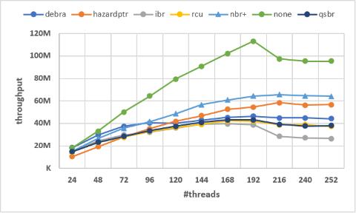
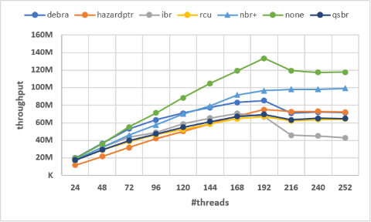
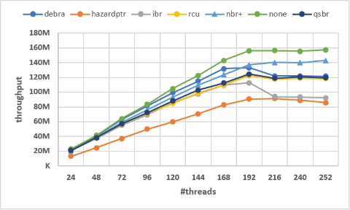
Crosses Debra
oversubscription
50% inserts – 50% deletes
25% inserts – 25% deletes
5% inserts – 5% deletes
Workload types
Data Structure:
External Binary search Tree (DGT15)
Size: 2M keys
Notes:
IN this ext bst NBR+ is faster than best know EBR algo DEBRA in update intensive workloads and matches debra in middle and read-intensive workloads. And Beats all other SMRs across all workload types.
Even under oversubscription NBR+ doesn't degrade much.
One interesting observation is the point at which NBR+ crosses DEBRA, we think this is because ebr based algorithms are susceptible to delayed thread which increases as more numa nodes come into play at higher threads. This combined with hyperthreading this leads to accumulation of large number of records in thread's buffers which leads to a reclamation burst that bottlenecks the allocator.
This phenomenon becomes severe with update intensive workloads leading to different cross over points at different workload types.

Slide 16
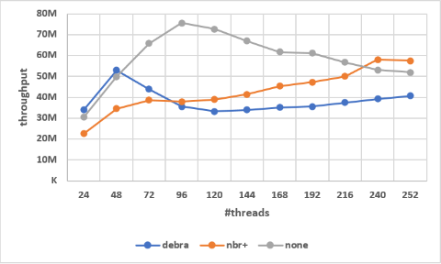
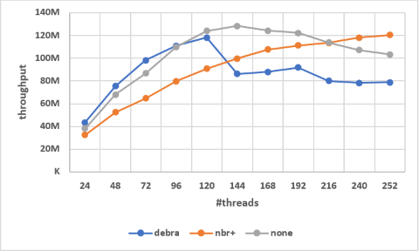
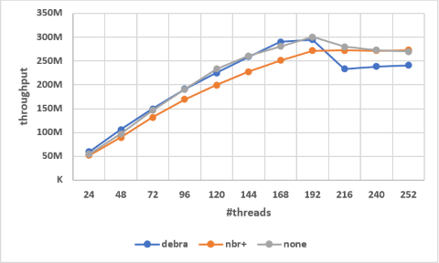
50% inserts – 50% deletes
25% inserts – 25% deletes
5% inserts – 5% deletes
Workload types
Data Structure:
Brown's (a,b)-Tree
Size: 2M keys

Slide 17
Conclusion
Fast :
As fast as fastest known EBR algorithm DEBRA.
Bounded Garbage :
Per reclamation event number of unreclaimed records are bounded. Linear in (#threads x max reservations)
Usable :
Doesn't require special primitives, compiler support or intrusive code/build environment changes.
Consistent :
Performance doesn't drastically vary across workload types, subscription rates, data structures types, data sizes.
Applicable :
Notes:
Say there some data structures where HP applies but NBR doesn't for example: Partially external AVL, Harris Michael list.
is as fast as fastest known EBR algorithm DEBRA.
performance doesn't drastically vary across workload types, subscription rates, data structures types, data sizes.

Slide 18
Conclusion: Applicability
Data structure | HP | EBR | NBR
Lazy list [Heller et al 2005]
Harris list [Harris 2001]
EFRB BST [Ellen et al 2010]
External (a,b) tree [Brown et al, 2017]
Howey-Joney internal BST [2017]
External chromatic tree [Brown et al, 2014]
External AVL tree [Brown et al, 2017]

Slide 19
references
DGT15:Tudor David, Rachid Guerraoui, and Vasileios Trigonakis. 2015. Asynchronized concurrency: The secret to scaling concurrent search data structures. ACM SIGARCH Computer Architecture News 43, 1 (2015), 631–644.
Brown's (a,b)-Tree: Trevor Brown. 2017. Techniques for Constructing Efficient Lock-free
Data Structures. arXiv preprint arXiv:1712.05406 (2017).
https://gitlab.com/aajayssingh/nbr_setbench

Slide 20
NBR: Execution Trace
root
n1
n2
n3
n5
n4
T2 restarts
in read-phase
T2del(n5)
T1 (reclaim)
reclaim non-reserved
T3 ins(n4)
reserve n3, n5
resume
in write-phase

