Slide 1
Investigating the Performance of Hardware Transactions on a Multi-socket Machine
Trevor Brown
University of Toronto
Joint work with:
Alex Kogan, Yossi Lev and Victor Luchangco
Oracle Labs

Slide 2
Problem
Large multi-socket machines with HTM are becoming more prevalent
The behaviour of HTM is significantly different on multi-socket machines than on single-socket machines
NUMA effects present challenges for scaling the performance of HTM algorithms
Notes:
As large multi-socket machines with HTM become more prevalent, it is important to understand the differences in how HTM behaves on large systems, in comparison to small systems. In this talk, I’m going to show some experiments that suggest these differences can be quite significant. Most HTM algorithms in the literature have been tuned for small systems, and they require different tuning to scale beyond a modest number of threads on large systems, both because of increased concurrency, and because of the effects of non-uniform memory architectures, which present new challenges for scaling the performance of HTM algorithms.

Slide 3
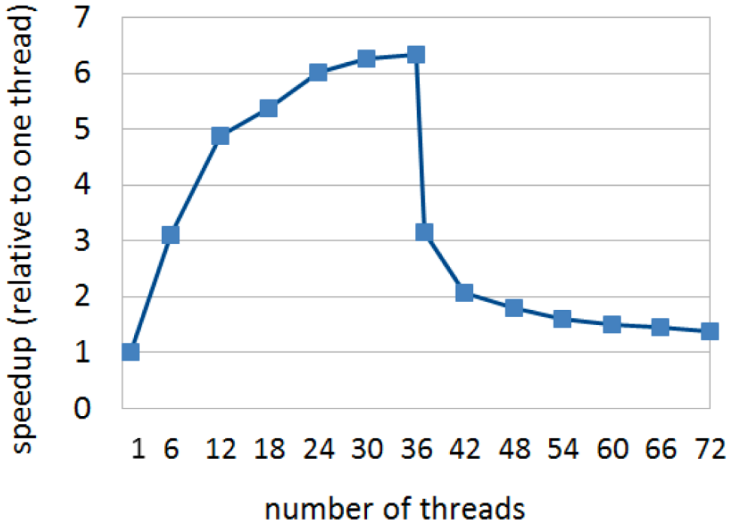
Teaser: severity of the problem AVL tree microbenchmark
speedup (relative to one thread)
2 socket machine, 36 threads per socket
ONE thread on the second socket
Is better
number of threads
Goal: identify challenges to achieving scalability on large HTM systems and address them
Notes:
To get an idea of how severe these performance issues can be, consider the following graph, which shows results from a simple microbenchmark on an Oracle X5-2 Intel-based machine with 2-sockets and 36 threads per socket. The y-axis shows speedup over a single thread, so up is good. The x-axis shows the number of threads. Here, threads are pinned so that the data points for 1 through 36 threads correspond to threads executing on a single socket, and the workload scales reasonably well. However, at 37 threads, when there is only a single thread running on the second socket, the performance is cut in half. At 72 threads, performance drops to almost the same as with a single thread. The goal of this work is to identify these kinds of challenges to achieving scalability on large HTM systems and find ways to address them.

Slide 4
Non-uniform memory architecture (NUMA)
Very different costs for a core to access:
Its own cache
The cache of a different core on the same socket
The cache of a core on a different socket or main memory

Slide 5
Transactional Lock Elision (TLE)
TLE is a drop-in replacement for locks
It attempts to elide lock acquisition by executing within a transaction
If the transaction aborts, it may be retried, or the critical section may be executed by acquiring the lock
Transactions begin by checking the lock to ensure they do not run concurrently with a critical section that holds the lock

Slide 6
Methodology
We use TLE as a vehicle to study the behaviour of HTM
Most of our experiments use TLE applied to an AVL tree (a balanced BST)
Threads repeatedly invoke Insert, Delete and Search operations on keys drawn uniformly from a fixed key range
Notes:
Mention avl tree is protected by a single global lock which is parallelized using tle

Slide 7
Thread pinning
The operating system (OS) assigns threads to cores where they will run
The OS is free to migrate threads between cores and across sockets
Thread pinning manually assigns threads to cores and prevents migration
Unless otherwise specified, we pin threads to socket 1, then socket 2

Slide 8
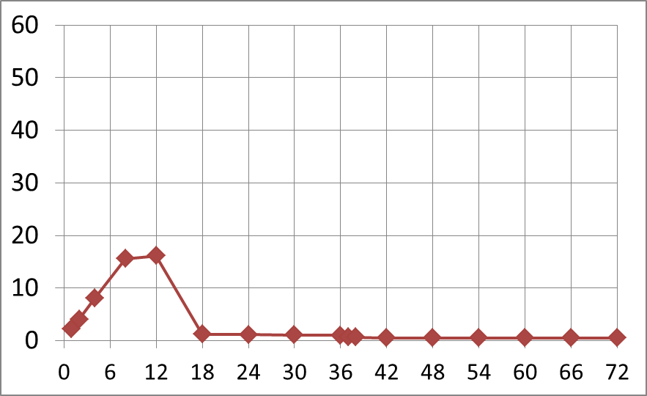
Going beyond 8-12 threads 100% updates, key range [0, 131072)
Testing different retry policies
← 1 socket 2 sockets →
operations per microsecond
Simple-5
Is better
number of threads
Notes:
If you take an HTM algorithm that was designed to be run on a small HTM system and execute it on a large HTM system, you may find that it stops scaling long before NUMA effects become a factor. In our experiments, we found that common policies for deciding whether a transaction should retry or fall back to take the lock can prevent an algorithm from scaling. This is because the conventional wisdom about what constitutes a good retry policy has arisen from experiments on small HTM machines.
The simplest retry policy one can imagine is to allow each transaction a fixed budget of k aborts before it must fall back to the lock. Here, we use a common budget of 5 attempts. As you can see, this policy fails to scale beyond 8-12 threads. On small HTM machines, the degree of concurrency was not high enough to expose its scalability issues. As a minor note, this algorithm does the standard anti-lemming optimization: after a transaction aborts, we wait for the lock to become free before retrying.

Slide 9
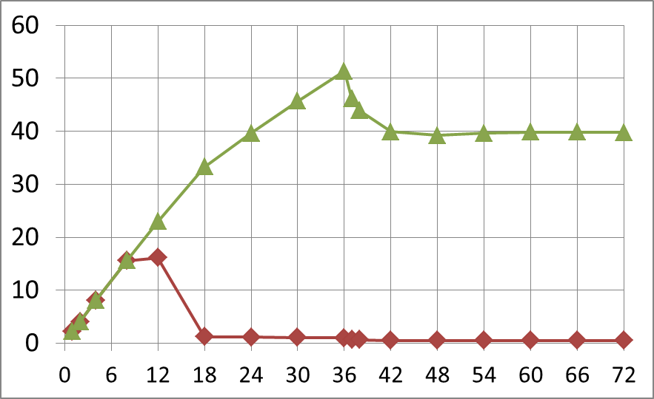
Going beyond 8-12 threads 100% updates, key range [0, 131072)
Testing different retry policies
← 1 socket 2 sockets →
operations per microsecond
Improved-5
Simple-5
Is better
number of threads
Notes:
We can improve this retry policy for large HTM systems by modifying it so that if a transaction aborts simply because the global lock was held, then that abort does not count toward the transaction’s budget. This greatly improves scaling up to 36 threads (at which point NUMA effects enter the picture). This is an improved anti-lemming optimization is not commonly used.

Slide 10
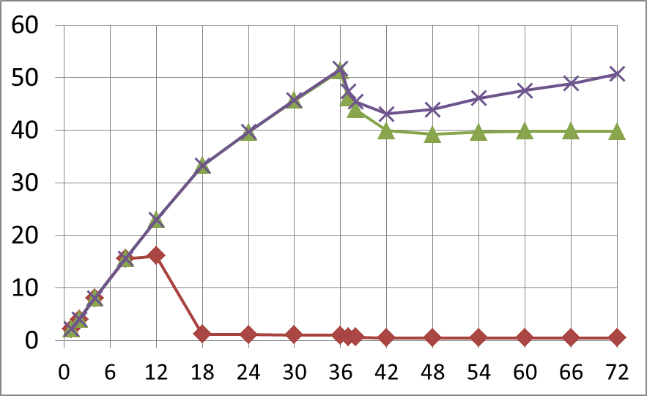
Going beyond 8-12 threads 100% updates, key range [0, 131072)
Testing different retry policies
← 1 socket 2 sockets →
operations per microsecond
Improved-20
Improved-5
Simple-5
Is better
number of threads
Notes:
The performance above 36 threads can be somewhat improved by increasing the budget for attempts, but even with very large budgets, NUMA effects negatively impact scaling above 36 threads. We tried much higher numbers of retries, but performance did not change substantially.

Slide 11
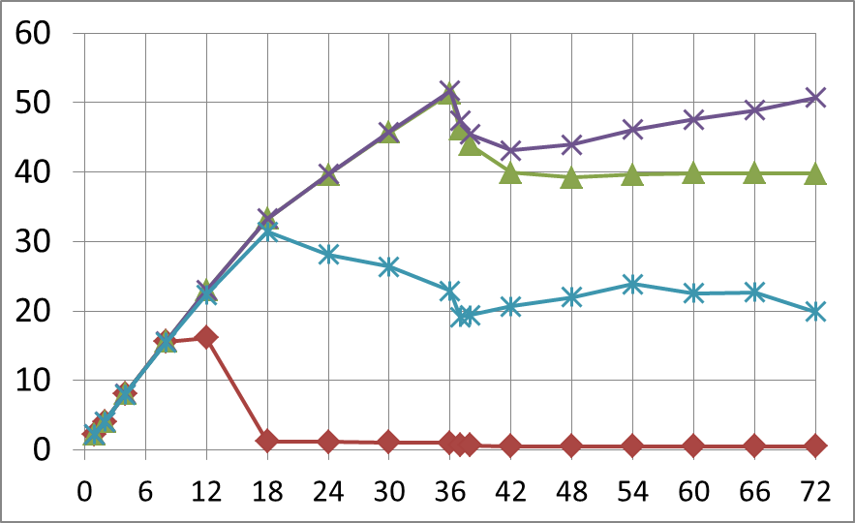
Going beyond 8-12 threads 100% updates, key range [0, 131072)
Testing different retry policies
← 1 socket 2 sockets →
operations per microsecond
Improved-20
Improved-5
Bad optimization-5
Simple-5
Is better
number of threads
Notes:
It’s interesting to note that a common optimization applied to retry policies on small HTM systems significantly damages performance on large HTM systems. In Intel’s HTM, when a transaction aborts, it returns a status code that includes a retry hint bit. This retry hint bit is set whenever the hardware suspects that the transaction might succeed if retried. Knowing this, if a transaction aborts and its retry hint bit is NOT set, then it is natural to think “why should I continue to retry this transaction if the hardware suspects it will abort again?” Eagerly falling back to the lock in this case improves performance for some algorithms on small HTM systems. However, on large HTM systems, the cost of acquiring the global lock is much higher, since it means blocking many more processes. As you can see in the graph, applying this optimization to Improved-5 is a bad idea on our large HTM system. The retry hint bit is also somewhat unreliable. In our experiments, we found that as much as 4% of our successful transactions committed after first failing with the retry hint bit not set.

Slide 12
Why NUMA effects hurt HTM
Hypothesis: Cross-socket cache invalidations lengthen the window of contention for transactions
Example: consider two transactions T1 and T2
T1 writes to x (invalidating any cached copies of x) and commits, then T2 reads x
T2 incurs a cache miss
If T1 and T2 are on the same socket (Non-NUMA), T2 can fetch x from the shared L3 cache – FAST
If T1 and T2 are on different sockets (NUMA), T2 must fetch x from the other socket – SLOW!!
While T2 waits for data to travel across sockets, data conflicts may occur → more likely to abort
Notes:
When a transaction writes to a memory address and causes a cache invalidation, and another transaction on the same socket subsequently reads it, the second transaction incurs a cache miss, and can serve that cache miss from its L3 cache, which is shared by all cores on a socket, on these Intel machines we studied. Accessing the shared L3 is fairly fast. However, if the second transaction is running on a different socket, then its cache miss must be served by going either to the L3 cache on a different socket, or to main memory. In either case, the data must travel over the bus, which is very expensive. Since these cross-socket cache invalidations cause cache misses take dramatically longer to serve, they effectively lengthen the window of contention for the second transaction, and, hence, make it significantly more likely to abort.

Slide 13
Our algorithm: NATLE (1/2)
An extension of TLE that is built on an experimental observation
In many TLE workloads, critical sections fit into two categories:
Category 1: Critical section performs best when run on ONE socket only
Category 2: Critical section performs best when run on ALL sockets
Notes:
Now I’m going to talk about our solution to this problem.

Slide 14
Our algorithm: NATLE (2/2)
We exploit this observation by periodically profiling TLE performance
Goal: determine, for each lock L, whether it is better:
to allow any thread to execute critical sections protected by L, or
to restrict concurrency so L can be acquired only by threads on one socket
If it is better to restrict concurrency, we cycle through the sockets, allocating some time for each socket

Slide 15
Implementation (1/2)
We assume a two-socket system for simplicity of presentation
Associate a mode with each lock
Mode 1: socket 1 only
Can be acquired only by threads on socket 1 (threads on other sockets will block)
Mode 2: socket 2 only
Can be acquired only by threads on socket 2
Mode 3: both sockets
Can be acquired by threads on either socket

Slide 16
Implementation (2/2)
Breaking down an execution
Cycle 1
Cycle 2
Cycle 3
…
time
(Profiling) Cycle 2
Profiling phase
Post profiling phase
Mode 1
Mode 2
Mode 3
Quantum 1
Quantum 2
…
(Determines which
mode is best for each lock)
Mode x
Mode y
Mode x
Mode y
Notes:
Mention this is a drop-in replacement for tle

Slide 17
Parameters for our experiments
Cycle 1
Cycle 2
Cycle 3
…
time
10% of total time allocated to profiling
300ms
(Profiling) Cycle 2
30ms
270ms
Profiling phase
Post profiling phase
10ms
10ms
10ms
30ms
30ms
Mode 1
Mode 2
Mode 3
Quantum 1
Quantum 2
…
(Determines that
mode x is best)
Mode x
Mode y
Mode x
Mode y

Slide 18
Microbenchmark: TLE AVL tree with 100% updates, key range [0, 2048)
operations per microsecond
operations per microsecond
number of threads
No thread pinning
number of threads
Is better

Slide 19
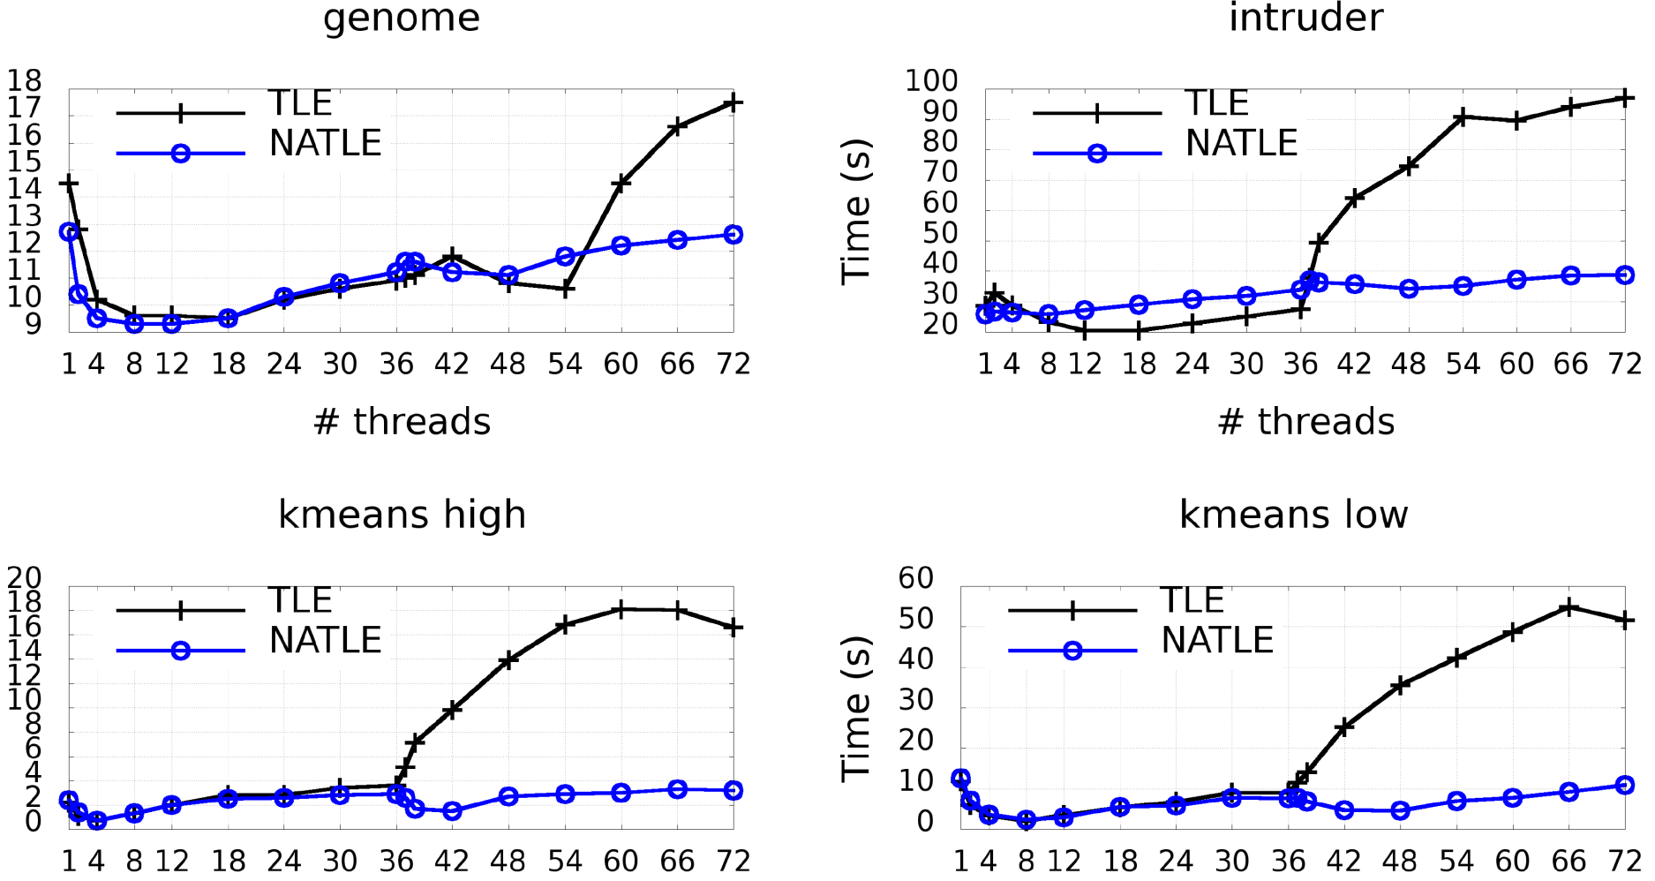
Application benchmark: STAMP
time (seconds)
Is better
number of threads

Slide 20
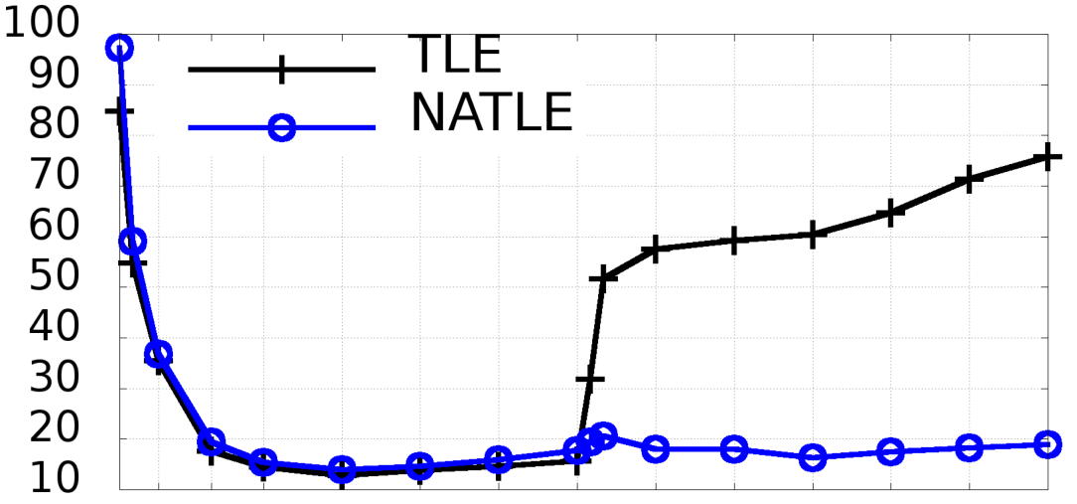
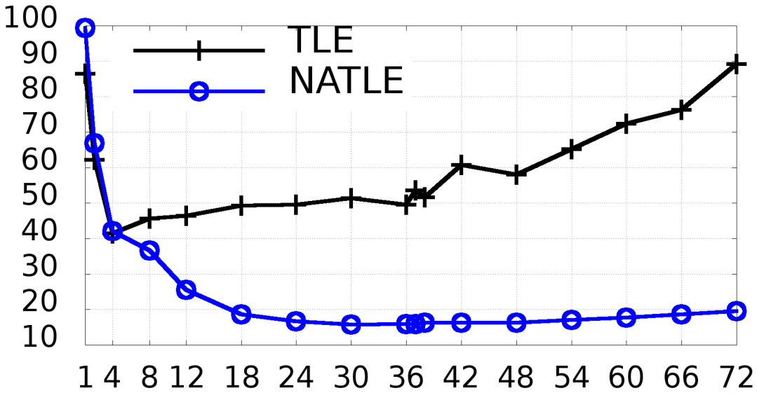
Application benchmark: ccTSA
time (seconds)
time (seconds)
number of threads
No thread pinning
Is better
number of threads

Slide 21
Machine with 4 sockets TLE AVL tree with 100% updates, key range [0, 2048)
operations per microsecond
number of threads
Is better
Notes:
A natural question to ask is whether the problem exists, and our solution applies, on a system with more than two sockets. Very recently, we got some time on a larger machine with 4-sockets and 144 total threads. Running a relatively straightforward extension of our algorithm for machines with more than two sockets, we can see that NATLE still performs quite well.

Slide 22
Conclusion
We found significant differences between small and large machines with HTM
Traditional retry policies for small machines yield poor performance on large machines
NUMA effects: cross-socket communication causes high abort rates
Presented NATLE, an extension of TLE for throttling sockets on a per-lock basis
Takes advantage of multiple sockets for workloads that scale on NUMA systems
Avoids performance degradation for workloads that do not

