Slide 1




Persistent HyTM via Fast Path Fine-Grained Locking
Gaetano Coccimiglio | Trevor Brown | Srivatsan Ravi

Slide 2
Problem
Concurrent data structures
For example, a set implemented with a search tree
E.g., serve as an in-memory database index
Accessible by many threads
Synchronization issues
Cache utilization issues
We want high performance
We have NVM → we want persistence
After a power failure / crash, recover a consistent state

Slide 3
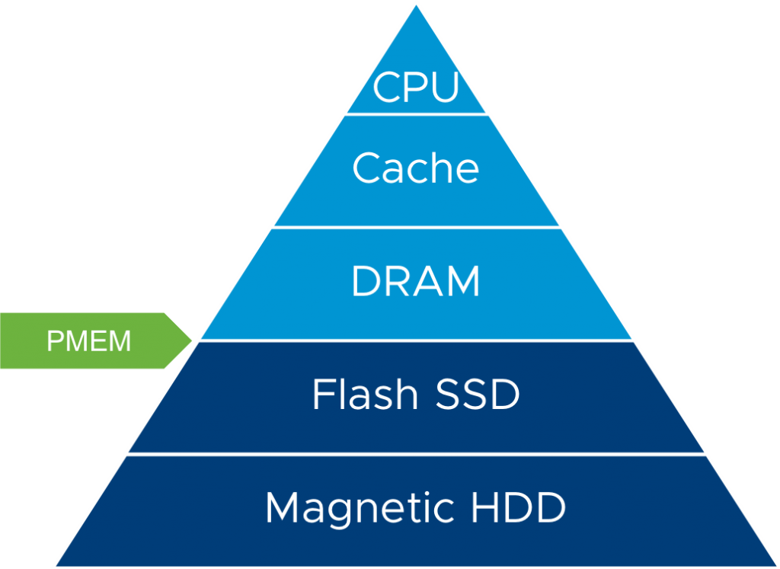
Setting
To ensure data is persisted we need to flush and fence to write back to NVM
Volatile
Caveat: processors with eADR have effectively persistent cache
NVRAM
Persistent

Slide 4



Easier Synchronization - Transactional Memory
A persistent TM also ensures effects of committed transactions are written to NVM
Mark blocks of code as transactions
Synchronization handled for you
TM
Software
Hardware
Hybrid

Slide 5
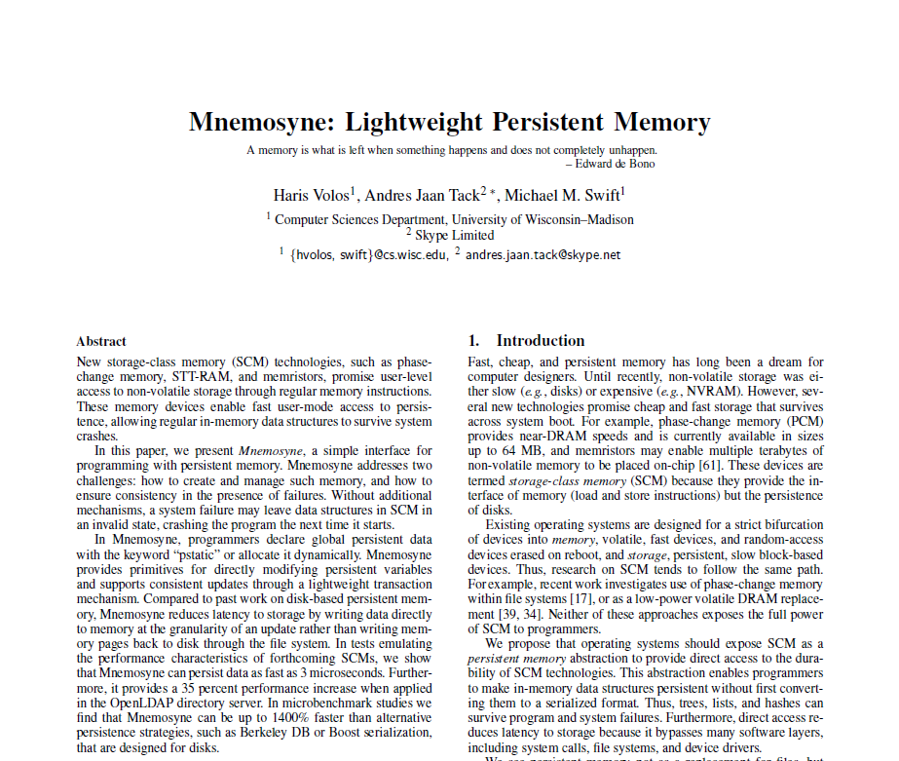
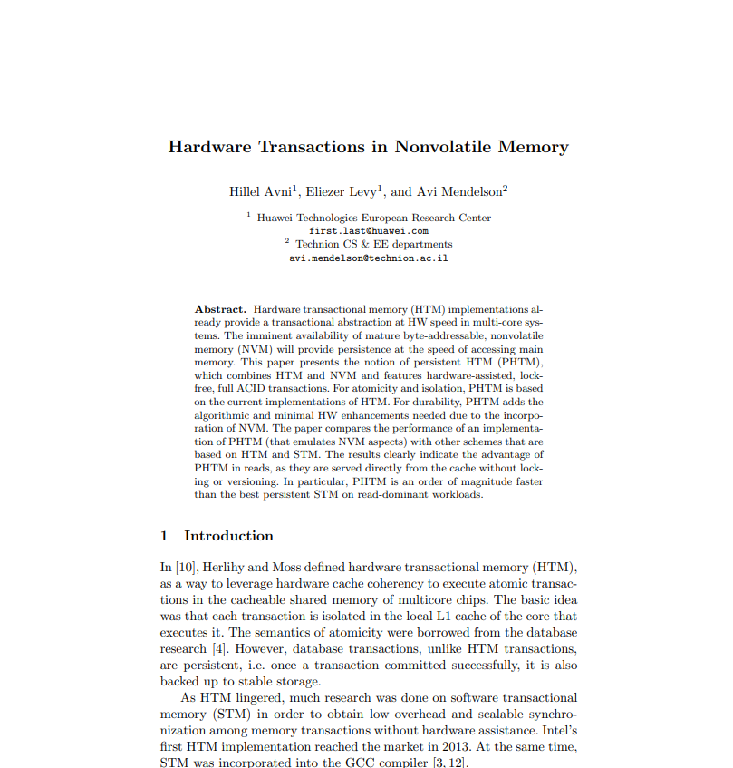
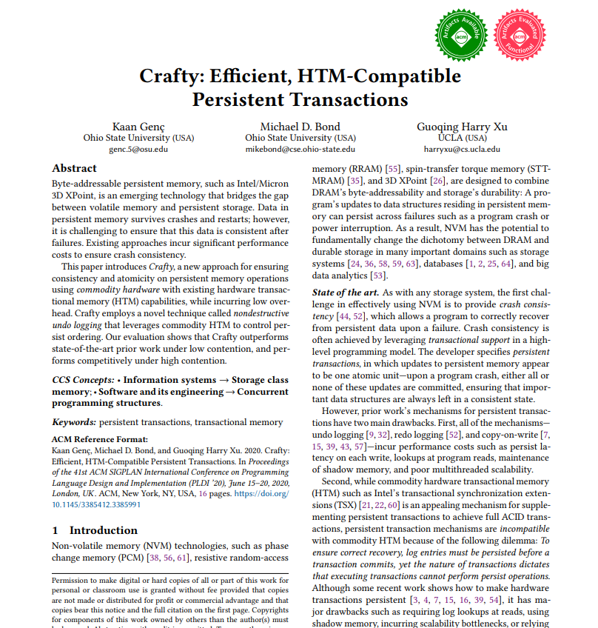
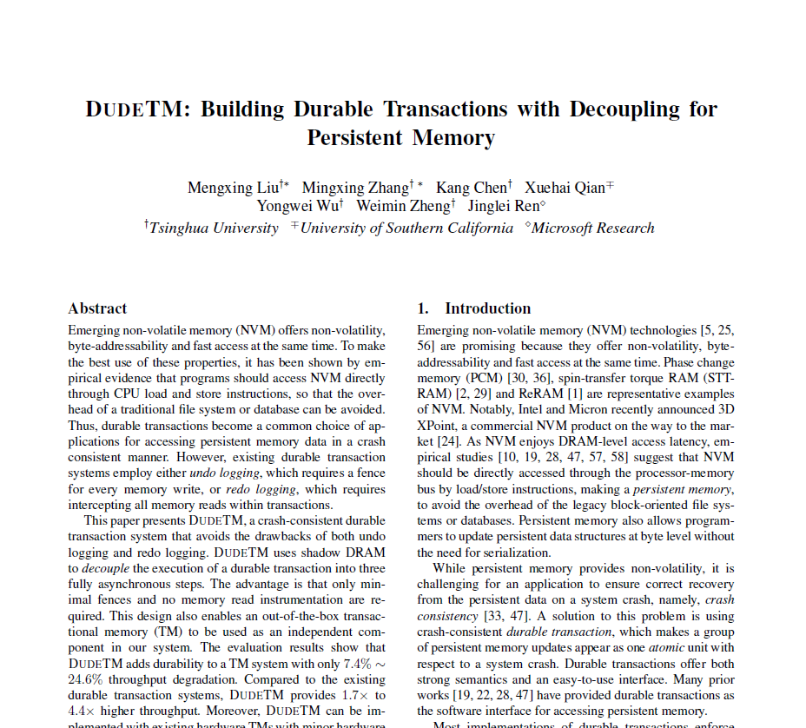
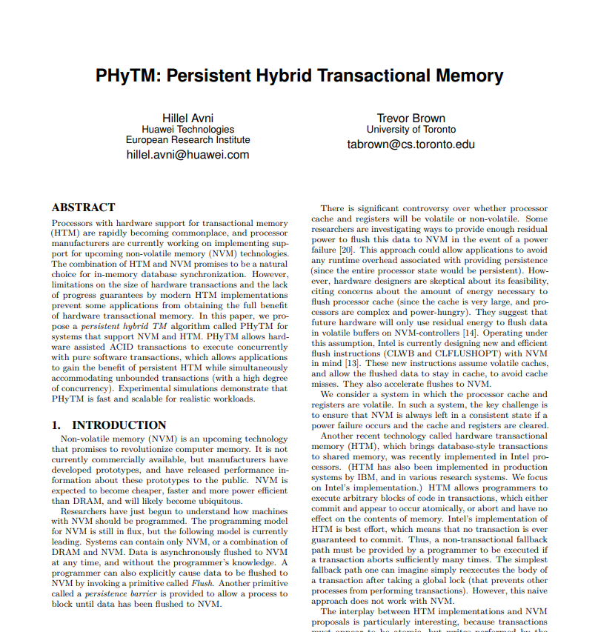
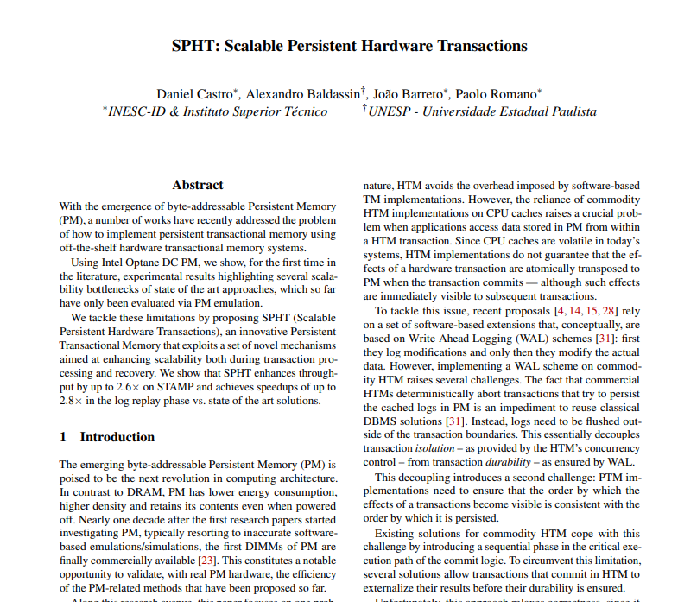
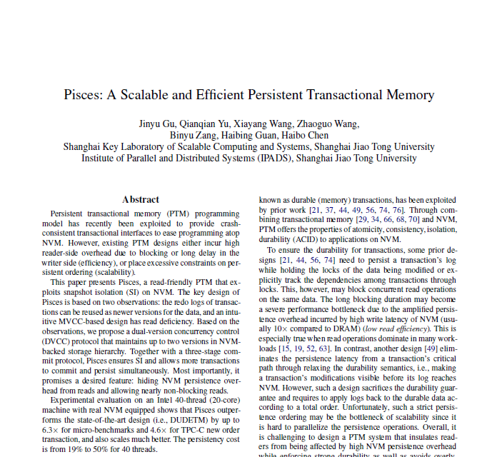
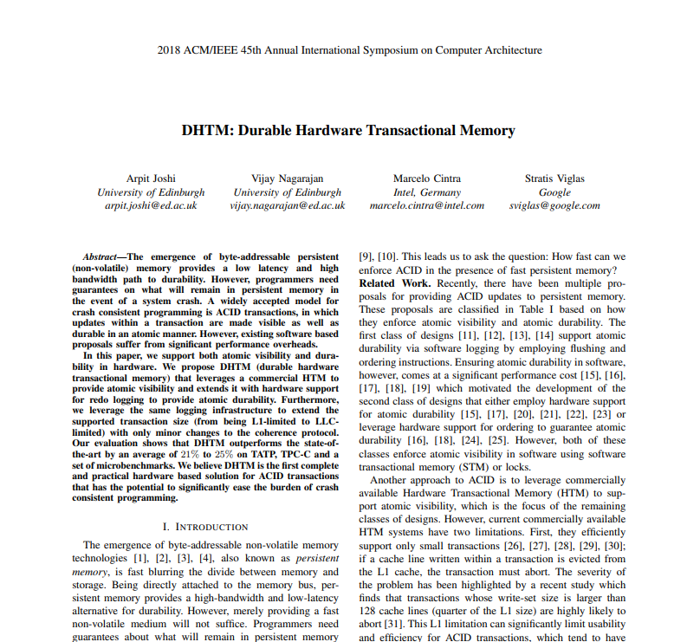
Prior persistent TMs
(2011)
(2015)
(2020)
(2017)
(2016)
(2021)
(2019)
(2018)
Many more…
Software only
Persistent HyTMs which DON’T work on current hardware
Persistent HyTMs that work on current hardware

Slide 6
Prior persistent HyTMs are Lacking
Existing state of the art has performance problems
Trivial global lock fallback
No concurrency between hardware and software transactions
Disjoint transactions can block each other
No memory reclamation
(2021)
Persistent HyTMs that work on current hardware
Goal: Practical Persistent HyTM with non-trivial software path + concurrency between hardware and software transactions

Slide 7
Our contribution
New approach to persisting hardware transactions
NV-HALT: Non-volatile Hardware Assisted Locking Transactions
Hardware transactions primarily used to acquire fine grained locks → counterintuitive but very effective
We provide different implementations of NV-HALT with different progress guarantees
We introduce new notion of progress for HyTMs

Slide 8
Background: Transactions
Interface: begin, commit, (voluntary) abort
Typically track read and write set
Conflicts cause aborts
Hardware TM:
Intel RTM: xbegin(), xend(), xabort()
Read and write set tracked via cache coherence protocol
Spurious aborts
No progress without software fallback
Cannot flush inside hardware transaction

Slide 9
Background: Correctness and Progress
Opacity:
set of all transactions (including aborted ones) is equivalent to a sequential execution where every read returns value of latest committed write
Weak progress:
txn aborts → exists concurrent conflicting txn
n conflicting txns → possibly all aborted
Strong progress:
n conflicting txns → at least one commits

Slide 10
C-Abortable Progress
HyTM progress guaranteed by slow path → HTM can spuriously abort
Including fast path = cannot have strong progress
We want progress definition that excludes fast path
Typically fast path is optimistic → bounded aborts before fallback
We introduce C-abortable progress
HyTM is allowed to spuriously abort for any reason at most C times after which it must follow weak or strong progress
If C is a constant we say the TM is O(1)-abortable progressive

Slide 11
NV-HALT
Two path persistent HyTM
Hardware fast path + software fallback path
Guarantees opacity + O(1)-abortable progress
Hardware transactions acquire fine grain locks
Logging based persistence inspired by state-of-the-art PSTM

Slide 12
NV-HALT: Data Structures
Software path:
read set + write set → dynamically sized tables
strong progressive only → global clock
Hardware path:
per thread logs → fixed size
Versioned locks → lock table
weak progressive: general lock bit
strong progressive: general lock bit + hardware lock bit

Slide 13
NV-HALT: Software Path Strong Progressive
Begin Txn
Read global clock

Slide 14
NV-HALT: Software Path Strong Progressive
TM-Store(A)
check if A is locked
Add A to write set
Abort
TM-Load(A)
check if A is locked
Add A to read set

Slide 15
NV-HALT: Software Path Strong Progressive
Validate read set
Try Commit
If read-only
sort write set
Try acquire write set locks
CAS to inc global clock
Abort
perform writes
persist writes
Done
Abort
Validate read set only checking for concurrent h/w txns
release locks
Strong progressive implementation changes how/when we validate read set
Done

Slide 16
NV-HALT: Hardware Path Strong Progressive
Begin Txn
xbegin()

Slide 17
NV-HALT: Hardware Path Strong Progressive
Sets h/w lock bit + general lock bit
lock A
TM-Store(A)
read A’s lock
perform write
log write
Abort
Locked at encounter time → different from software path
Locking at end of h/w txn would mean more work + more metadata
TM-Load(A)
read A’s lock

Slide 18
NV-HALT: Hardware Path Strong Progressive
Try Commit
xend()
If write log empty
persist writes
release locks
Done
Done

Slide 19
NV-HALT: Software Path Weak Progressive
Validate read set
Try Commit
If read-only
sort write set
Try acquire write set locks
CAS to inc global clock
Abort
perform writes
persist writes
Done
Abort
Validate read set only checking for concurrent h/w txns
release locks
Done

Slide 20
NV-HALT: Hardware Path Weak Progressive
Sets h/w lock bit
lock A
Sets h/w lock bit
TM-Store(A)
read A’s lock
log write
Sets general lock bit
Abort
TM-Load(A)
read A’s lock

Slide 21
Situational Optimizations
Lock table vs. inlining locks
If we can change memory layout of user data → inlining can benefit performance
Lock table
Inlined locks
Lock
user data
Lock
Lock
user data
Lock
user data
user data
Lock
user data
user data
Lock
Lock
Lock

Slide 22
Why Lock in Hardware?
Opaque volatile HyTMs must read shared metadata on the hardware path (Brown & Ravi 2017)
What about the persistent setting?

Slide 23
Why Lock in Hardware?
if only SOME of a txns' writes are persisted, they are ignored
No locking!
System Crashes
Observes A and B are unlocked
Write
A=1; B=1;
T1 Txn {
A=1;
B=1;
}
commit
hardware txn
Persist
A=1;
T1 sleeps
Log
A=1; B=1;
Logs not shared
T2 Wakes up, observes B and C unlocked and B == 1
Write
C=1;
commit
hardware txn
Persist C=1;
T2 Txn {
if (B==1)
C=1;
}
T2 sleeps
Log
C=1;
Commit
What we recover:
Recovered state is inconsistent and violates opacity
Conclusion: h/w txns must write to shared metadata in persistent setting
A=0
B=0
C=1
T1 did not complete so we do not recover its writes
Inconsistent: cannot have C=1 when B=0
Notes:
Initial state A=B=C=0

Slide 24
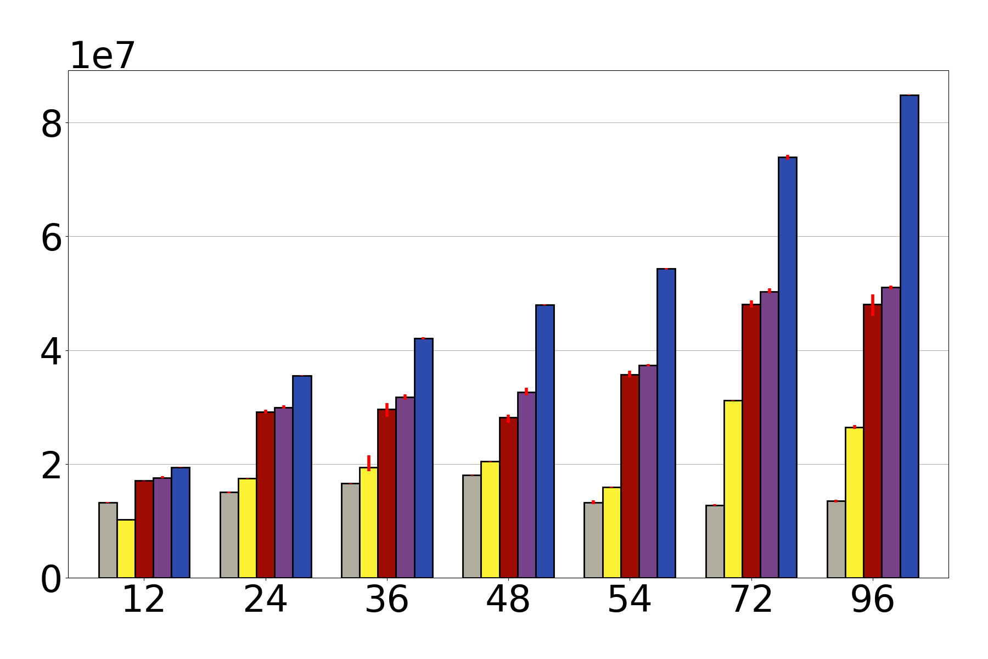
Performance versus State of the Art
(a,b)-tree with max 1 million keys, a=4, b=16. Uniform key access pattern.
90% Read-only (search), 5% insert, 5% delete
SPHT does not free!
NV-HALT has non-trivial memory reclamation cost
Previous State of the art Persistent HyTM SPHT
ops/sec
NV-HALT (inline locks)
NV-HALT (lock table)
State of the art PSTM: Trinity with concurrency via TL2
NV-HALT strong progressive
number of threads

Slide 25
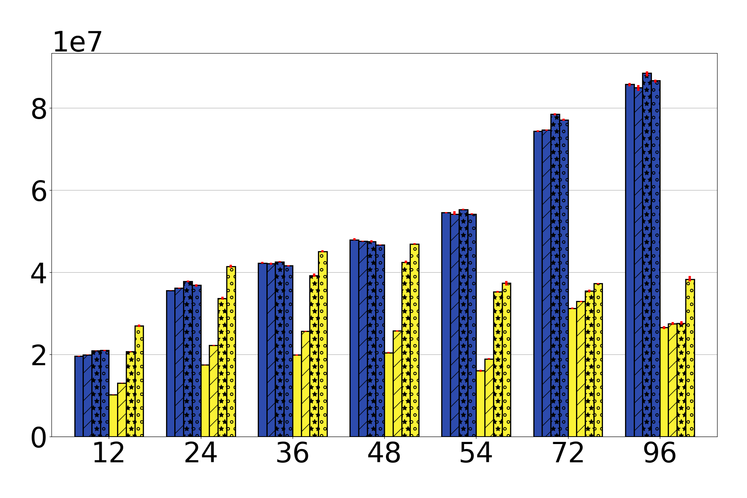
Ablation Study versus Previous State of the Art Persistent HyTM (same (a,b)-tree)
90% Read-only (search), 5% insert, 5% delete
data in DRAM (instead of NVM)
no sync for persisting h/w txns
flushes and fences become no-ops
SPHT (same breakdown)
NV-HALT
(inline locks)
ops/sec
number of threads

Slide 26
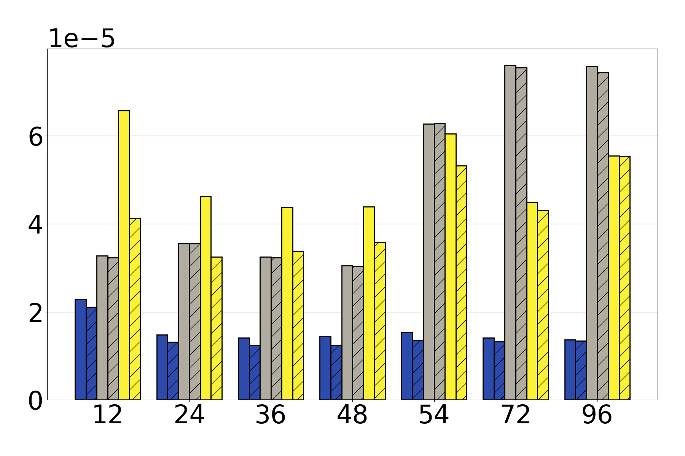
Energy consumption of CPU package
via perf
Same (a,b)-tree
50% Read-only (search), 25% insert, 25% delete
y-axis: average joules per commit
Measurement is always entire CPU
Mostly interested in max thread count case
NV-HALT consumes significantly less energy per commit
SPHT
Trinity
NV-HALT (inline locks)
flushes and fences become no-ops
number of threads

Slide 27
Conclusion
Introduced NV-HALT
Practical Persistent HyTM with:
non-trivial software fallback path
concurrency between hardware and software transactions
both weak and strong progressive implementations
Significant performance improvement over existing state of the art PSTM and previous state of the art persistent HyTM
Many more details in the paper
Additional experiments → other workloads, STAMP benchmark
gccoccim@uwaterloo.ca

Slide 29
Bonus slides

Slide 30
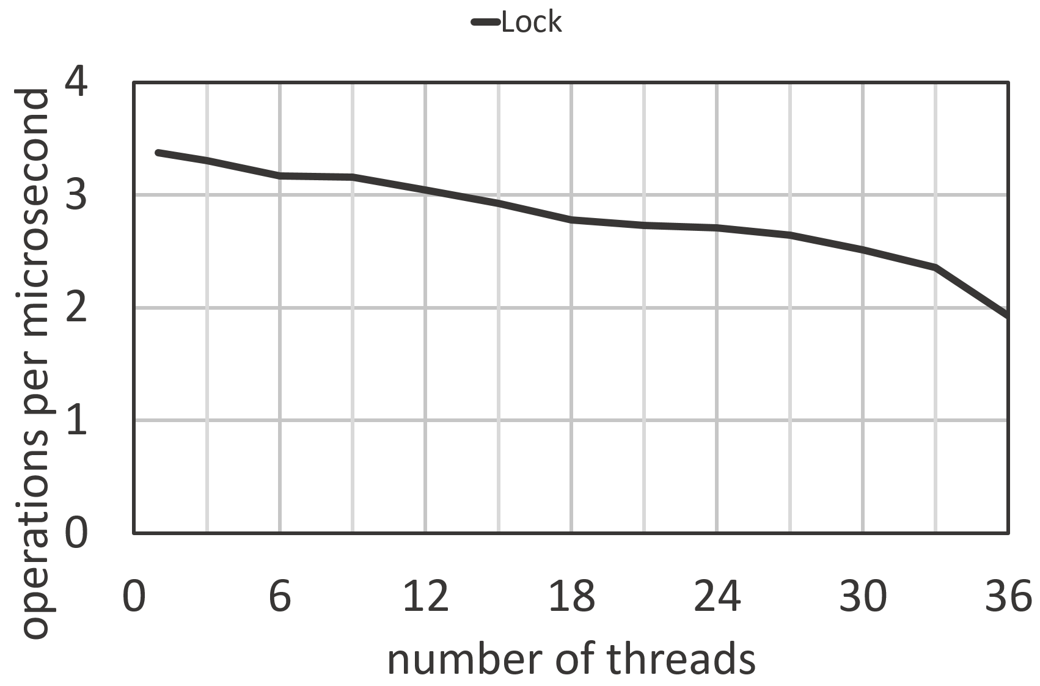
Concurrency is hard
Handcrafted data structures are complex – not always appropriate
Simple solutions tend to be slow
Example: simple kv-store
Binary search tree
Thread safety via global lock
Simple experiment: n threads perform searches for k seconds
Better alternative to global lock with similar effort?

Slide 31
NV-HALT: Software Path
Addresses protected by versioned locks
Strong progressive implementation uses global clock
Loads validate lock version
Stores buffered until commit time
Commit time:
lock write set
Strong progressive: CAS to increment global clock
If failed then validate read set normally
If success then validate to check for concurrent hardware transactions
Weak progressive: validate read set normally
perform writes + persist

Slide 32
NV-HALT: Hardware Path
Stores:
acquire lock
Strong progressive: locks have 2 flag bits to indicate locked and locked by hardware transaction
log writes in thread-local storage
Loads:
read lock state
Locks claimed during hardware transaction but not released
After returning to software:
persist write set
release locks

Slide 33
Ablation Study versus Previous State of the Art Persistent HyTM
Same (a,b)-tree
90% Read-only (search), 5% insert, 5% delete
ops/sec
Bar 4: No synchronization for persisting hardware transactions
SPHT
Bar 3: All data stored in DRAM (instead of NVM)
Bar 2: Flushes and fences replaced with no-ops
NV-HALT
(inline locks)
number of threads

Slide 34
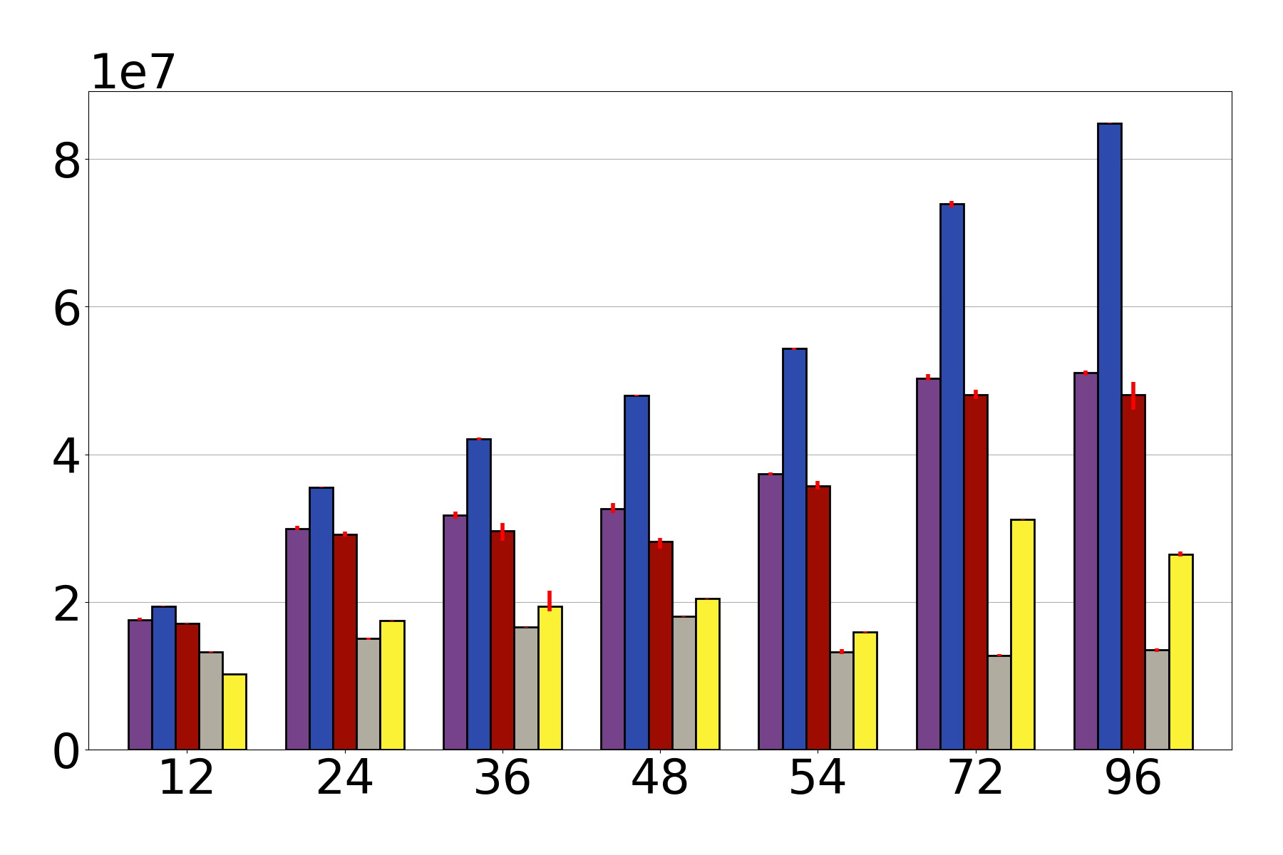
Performance versus State of the Art
(a,b)-tree with max 1 million keys, a=4, b=16. Uniform key access pattern.
90% Read-only (search), 5% insert, 5% delete
SPHT does not free!
NV-HALT has non-trivial memory reclamation cost
Previous State of the art Persistent HyTM SPHT
ops/sec
NV-HALT (lock table)
NV-HALT (inline locks)
State of the art PSTM: Trinity with concurrency via TL2
NV-HALT strong progressive
number of threads

Slide 35
Energy consumption of CPU package
via perf
Same (a,b)-tree
50% Read-only (search), 25% insert, 25% delete
Measurement is always entire CPU
Mostly interested in max thread count case
NV-HALT consumes significantly less energy per commit
y-axis: average joules per commit
flushes and fences become no-ops
number of threads

