Slide 1
PathCAS
An efficient middle ground for concurrent search data structures
Trevor Brown, William Sigouin, Dan Alistarh

Slide 2
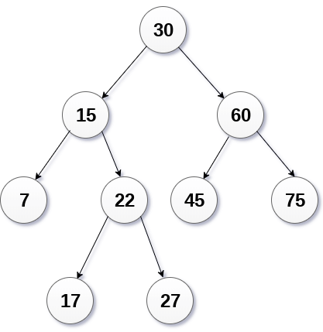
Problem
Designing fast data structures for large multicore systems
Notes:
Suppose you want to design a fast data structure for large multi-core systems

Slide 3
Input: sequential data structure
Output: concurrent version
Universal construction
Transactional memory
Handcrafted
Locks, CAS, FAA, etc. Usually fastest, but very difficult
Typically very slow…
harder
start_txn() sequentialCode(key)
commit()
In hardware:
+ Can be fast
- Not on AMD
- Security risk
In software:
+ Fairly easy
+ Portable
- Usually slow
Notes:
There is a diverse spectrum of well understood techniques that you can use for this task. You could start with an "easy" general technique like a universal construction, but those tend to be slow.
You could use transactional memory to achieve higher performance while keeping the implementation relatively simple, but hardware transactional memory is increasingly being disabled due to security concerns on modern architectures, and it's not available, for example, on AMD.
You could use software transactional memory, but such implementations tend to be very slow compared to handcrafted data structures.
At the most difficult end of this spectrum you have handcrafted data structures, which encompass both fine-grained locking data structures and lock-free ones.

Slide 4
Fine-grained locks
binary search tree 10⁵ keys
Better
Many cache misses (locking -> eviction)
tree operations
(millions per second)
Search without locking? >100x faster.
number of threads
Notes:
Lock-free programming is so hard that maybe you don’t want to take that approach. To make your job slightly easier, you might try using locks. If you've never used locks before, you might think (like I did years ago) that a straightforward hand over hand locking implementation of a data structure would give you at least tolerable performance. In fact, if we compare hand over hand locking with a single global lock that protects the entire data structure and kills all concurrency, the difference is almost negligible. So, how are you supposed to get high performance using locks? The problem here is that any locking discipline that acquires locks while traversing a data structure effectively turns reads into writes, and this creates a huge number of cache misses because locking a node causes cache invalidations and evictions.

Slide 5
Making locks fast
Don’t (or rarely) lock during searches
See optimistic concurrency control
Searches become lock-free (or mostly lock-free)
This can make correctness arguments very hard!
b
e
h
Notes:
So, you better not lock during searches. And you can get some highly efficient data structures by combining locking updates with lock free searches. But designing such data structures is difficult--maybe even as difficult as designing some full blown lock free data structures.
For example, suppose we want to design a lock based doubly linked list, but we want to have lock-free searches. To delete e in this list, we might lock b, e and h, and then change b and h to point to each other, instead of pointing to e. At a quick glance, you might think that locking all of these nodes before we change their pointers is enough to make our update atomic. However, if we want to have lock-free searches to get high performance, then our searches should be able to ignore these locks and “flow through” the locked nodes, continuing on their way to their destination in the list. If searches ignore the locks, then the locks do NOT make updates appear to be atomic from the perspective of searches. Rather, searches will be able to see the individual steps of updates.

Slide 6
Bugs happen
9
“Logical ordering” tree of Drachsler, Vechev and Yahav [PPoPP’14]
Tree nodes are also in a doubly linked list!
Searches ignore locks
Can end at wrong node
Use linked list pointers to correct
Bug: inconsistent reads -> non-linearizable searches
Easy fix: swap two lines of code
3
15
2
5
12
16
4
7
Notes:
This sort of reasoning mistake is easier to make than you might think, and it has led to subtle bugs in published algorithms. That was one of the motivations for this work in the first place. My student William Sigouin who coauthored this paper with me discovered a bug in a lock based tree whose nodes are also stored in a doubly linked list. Lock free searches were allowed to flow "through" the data structure regardless of whether locks were held. The idea was that even if a search ended up at the wrong place in the tree because it read inconsistent state as a result of ignoring locks, it could then use next/prev pointers to find its way to the correct node at the end. I won't go into the details here, but William showed it was possible to return non linearizable search results if several threads perform operations that are interleaved in a specific way. Incidentally, the same bug was independently discovered by another group from the Technion, andthe fix to the data structure is very easy, you just flip two lines of code.

Slide 7
Universal construction
Transactional memory
?
Handcrafted
harder
Notes:
So even locks are difficult to use if we want achieve high performance. To make this task more reasonable, perhaps we should be using some abstractions that are higher level than atomic instructions or locks, but lower level than transactional memory, so that we can really fine tune the balance between expressiveness and performance.

Slide 8
Universal construction
Transactional memory
Multi-word sync. primitives
Handcrafted
harder
Notes:
To this end, there’s a long line of research introducing multi-word synchronization primitives that can be implemented from atomic instructions and then used as a black box.

Slide 9
LLX and SCX Brown et al. [PODC’13]
Load-link extended (LLX) and Store-conditional extended (SCX)
Can atomically change one pointer and mark a set of nodes
Only if a set of nodes have not changed since you read them
Can’t change multiple pointers atomically!
Notes:
For example, back in 2013 I introduced llx and scx, which are node based generalizations of load-link store conditional. Intuitively, you can use LLX to load a sequence of data structure nodes, and then use SCX to atomically change one pointer and mark a subset of the nodes as deleted, and SCX will succeed only if none of the nodes have changed since we read them. Now you can implement some cool data structures this way, of course the obvious drawback of SCX is that you can't change multiple pointers atomically.

Slide 10
k-word compare and swap Harris et al. [DISC’02]
KCAS(a₁..a_{k}, e₁..e_{k}, n₁..n_{k})
Atomically:
If all addresses contain their expected values, sets all addresses to their new values and return true else return false
KCASRead(addr) return the last value stored in addr by a KCAS (or the initial value if addr has not been changed yet)
Notes:
If you want to do that you have to use something like multi-word compare and swap. (It does this...)
At first glance, kcas looks like a panacea---a perfect solution. It can change multiple pointers atomically, and at the same time it can verify that multiple addresses contain specific values. So it should be easy to perform any sort of update you want atomically right?

Slide 11
Internal binary search tree (BST)
Typical BST algorithm taught in undergrad
Insert: easy
Delete leaf: easy
Delete node with one child: easy
Delete node with two children: harder
Find predecessor p
Steal p’s key and delete p
5
6
Insert 7
4
8
Delete 9
Delete 8
2
5
7
9
Delete 6
Predecessor of 6
Notes:
Well, suppose we want to implement an internal binary search tree. As a refresher, this is just the typical …

Slide 12
Atomic modifications are not enough
Delete 40
Insert 37
40
delete node with 2 children → replace key with predecessor
23
53
then delete predecessor node
17
27
Not found!
But 37 was already inserted!
21
33
31
34
37
37
Notes:
Such a tree is surprisingly difficult to implement in a concurrent setting, even with KCAS. To see why, suppose insert(37) starts... Gets to a node, key is atomically moved up...

Slide 13
Problem with KCAS
KCAS only
helps here!
Update operation
Search
Modification
time
How to do this?
Notes:
The problem is, in data structures where you first search for a location, and then perform a modification, kcas only helps you after you've completed your search. In other words Kcas makes the modification phase of an update atomic, but it doesn't make the search phase atomic. And the atomicity of your modification doesn’t help you if a search takes you to the wrong place in the data structure. In the end, you’re still on your own to solve the problem of performing correct lock free searches.

Slide 14
Solving this problem using KCAS
Delete 40
Insert 37
40
23
53
Perform KCAS including every address we read. KCAS fails because root.key changed since we read it
17
27
21
33
31
34
37
37
Notes:
We can actually fix this problem with a “brute force” application of kcas, by including all of the addresses read during the search in the KCAS that is performed at the end. We don’t actually change these addresses with the KCAS. We just specify the values we read from them as both expected and new values. With this “brute force” approach, the KCAS will only succeed if no address has changed since we read it. However, because of the way that kcas is usually implemented (essentially using a sort of lock free variant of 2 phased locking), doing this would effectively turn all of the reads done in a search into writes, introducing huge overhead, and contention near the root.

Slide 15
Multi-compare multi-swap (MCMS) Timnat and Petrank [EuroPar’15]
Variant of KCAS in which some addresses are only compared and not modified
Implemented using hardware transactional memory
Without hardware support, same as KCAS
Notes:
This brute force usage of KCAS would be much faster if KCAS allowed you to only compare some addresses rather than attempting to update every address.

Slide 16
PathCAS
Interface
start()
add(a, exp, new) an address to be changed
visit(node) a node to be validated
validate() verify no visited nodes have changed
exec() KCAS the added addresses
vexec() atomically: if validate() then exec()
There is also a read function for addresses modified by PathCAS, but those calls are automated in C++ with operator overloading
Notes:
To address this problem we introduce pathcas. Pathcas is inspired by the literature on multi word synchronization primitives and transactional memory. We designed PathCAS primarily for node based data structures (although we can play fast and loose with what constitutes a node). PathCAS is somewhat similar to MCMS in the sense that we want to allow some addresses to be compared only (or in our terminology, validated). The interface is syntactically a bit closer to transactional memory than it is to KCAS or MCMS. Instead of supplying all of your arguments to a single monolithic KCAS call, you incrementally build up your arguments through multiple calls. At the start of a data structure operation, you invoke start(). You can think of this as preparing a hidden object that will store the arguments you are incrementally building up. Add() should be called on any addresses that you would like to change from a specific expected value to a new value. Visit() should be called on any nodes that you would like to be validated. What does that mean? Well, validate() can be called to verify that no visited node has been changed since it was visited. Exec() is essentially just KCAS. It doesn’t do any validation, and ignores the visited nodes. It just performs a KCAS using the added addresses. It’s basically included in the interface for backwards compatibility---if you just want to do a KCAS, you can. The special sauce is really in vexec(), which atomically does a KCAS only if validation succeeds.

Slide 17
KCAS algorithm of Harris, Fraser, Pratt [DISC’02]
pred
succ
after
Delete(17)
15
17
20
X
KCAS descriptor
status = Undecided
n = 5
&pred.next | succ | after
&after.prev | succ | pred
&pred.mark | false | false
&succ.mark | false | true
&after.mark | false | false
Succeeded
Notes:
14:30
So let’s talk about how PathCAS is implemented. Our implementation builds on the lock-free KCAS algorithm of Harris, Fraser and Pratt. I’m going to briefly sketch that algorithm so I can highlight a few of the key changes in PathCAS.
[using dcss…]

Slide 18
Sketch of changes for PathCAS
pred
succ
after
15
17
20
X
Delete(17)
v3
v5
v2
v4
v6
v3
Re-read versions of visited nodes
KCAS descriptor
status = Undecided
visited |  | n = 8
&pred.next | succ |  | after
&after.prev | succ |  | pred
&pred.mark | false |  | false
&succ.mark | false |  | true
&after.mark | false |  | false
Visited nodes
n = 12
&head | v17
…
&pred | v3
&succ | v5
&after | v2
Succeeded
&pred.ver | v3 | v4
&succ.ver | v5 | v6
&after.ver | v2 | v3
Notes:
To efficiently track changes to visited nodes, we give each node a version number. Whenever PathCAS modify a node, it also increments the version number of that node. As an aside, we decided to made the programmer responsible for calling add() for each version number increment. We could have possibly made it automatic, but it would be less efficient, and we’d be baking in a hard requirement that PathCAS only be used to modify nodes (whereas we still want to allow you to change arbitrary addresses with PathCAS). In any case, the end result is that version number increments also appear in the KCAS descriptor.
I’m glossing over some details here, so if you’re interested in getting a deeper understanding, I welcome you to take a look at the paper.

Slide 19
How to use PathCAS
By example
Using PathCAS to design an internal BST based set
Operations
Contains(key) if key exists, return true (else false)
Insert(key) if key does not exist, insert and return true (else false)
Delete(key) if key exists, delete and return true (else false)
Notes:
So that’s the implementation of PathCAS. Let’s see an example of using PathCAS, to design an internal binary search tree based set that offers operations to check whether the set contains a key, insert a key if it’s not already in the set, and delete a key from the set.

Slide 20
PathCAS based BST algorithm
Each node has a version number
And a marked bit that is set when the node is deleted
Checked by validate
Contains, Insert and Delete all call a search helper function
search is just a typical BST search, except:
It calls start() at the beginning
It calls visit on each node
It returns pointers to the final node it finds (target), and its parent,
and their versions (which are returned by visit)
Notes:
Now that we understand what we’re implementing, let’s see how we implement it. We give each tree node a version number, and a marked bit. I omitted this detail earlier, but since marking is so common in concurrent data structures, our PathCAS implementation actually reserves the least significant bit of the version number to serve as the marked bit. That way, validate can efficiently check whether any nodes are marked as the same time as it checks that their versions have not changed. The result is that a marked node will cause validation to fail, which is exactly what we’d like marking to accomplish, since a marked node is a deleted node.

Slide 21
Inserting a new key
Insert(7)
search(7)
n = new leaf containing 7
add(target.left, null, n)
add(target.ver, v2, v3)
if vexec() return true
Succeeds only if entire search path is unchanged
else retry from scratch
parent, v3
6
v3
4
8
target, v2
v5
v2
v3
2
5
7
v2
v7
v1
Notes:
Let’s see exactly how insert and delete work by breaking down a few cases. First, let’s insert a key 7 that’s not already in the set.

Slide 22
What if the key exists already?
Insert(8)
search(8)
if target.key == 8 and validate() return true
Succeeds only if entire search is atomic
parent, v3
6
v3
4
8
target, v2
v5
v2
2
5
v2
v7

Slide 23
Deleting a node with two children?
parent, v4
9
Delete(6)
search(6)
if target.key == 6 and target has 2 children
findPredecessor(6)
add(target.key, 6, 5)
add(target.ver, v3, v4)
add(predParent.right, pred, null)
add(predParent.ver, v2, v3)
add(pred.marked, false, true)
if vexec() return true
else restart
v4
6
5
target, v3
v3
v4
2
8
v5
v2
1
3
v7
7
v2
v1
4
v2
predParent, v2
pred, v3
5
v3

Slide 24
Performance
Systems
256 thread AMD (2 sockets)
Does not support hardware TM
192 thread Intel (4 sockets)
Supports hardware TM
Experiment
Compare PathCAS AVL tree to state of the art balanced BSTs
Threads access the same tree, uniform random keys, 10 second trials
Notes:
Validating the entire search path is pretty naïve… How fast can this approach be?
In the paper, we actually implemented an AVL tree, which is balanced, but I didn’t have time in the talk to explain balancing. Fundamentally it’s no different from what we do in the unbalanced case. That is, PathCAS is used in exactly the same way.

Slide 25
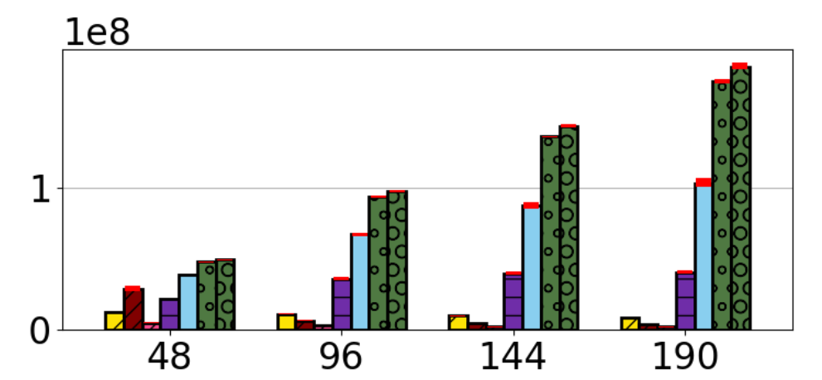
versus transactional memory AVL trees (Intel) 90% search, 5% insert, 5% delete, 1 million keys
PathCAS AVL
txn lock elision
RHNOrec
PathCAS AVL + hardware TM
Hybrid NOrec
operations per second (in hundred millions)
TL2
NOrec
concurrent threads

Slide 26
versus handcrafted balanced trees (AMD) 90% search, 5% insert, 5% delete, 10 million keys
PathCAS AVL
OCC AVL (Bronson et al.)
LLX/SCX Chromatic
operations per second (in hundred millions)
TL2 AVL
Norec AVL
concurrent threads
OCC is the state of the art BST in search-heavy workloads!

Slide 27
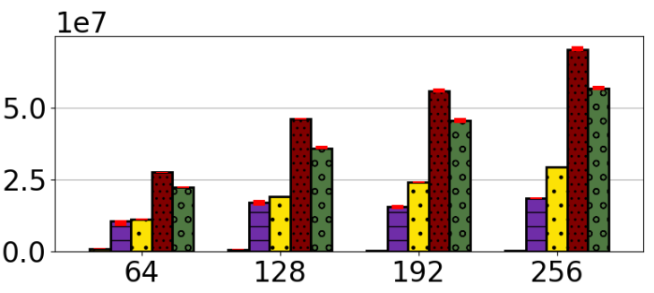
our worst workload (AMD) 50% insert, 50% delete, 10 million keys
OCC AVL (Bronson et al.)
PathCAS AVL
LLX/SCX Chromatic
operations per second (in tens of millions)
TL2 AVL
concurrent threads
Norec AVL

Slide 28
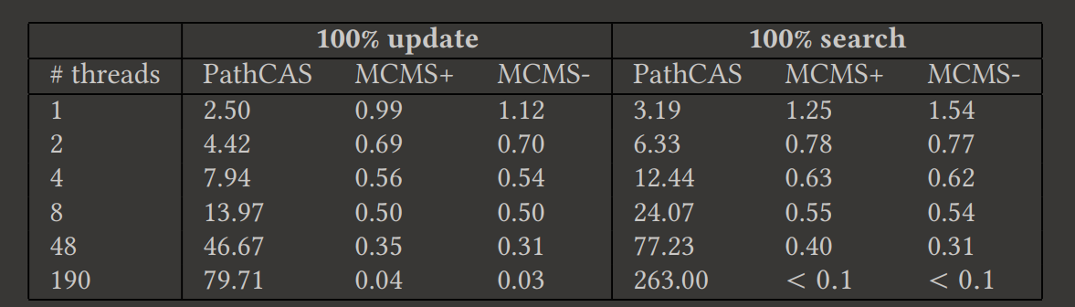
versus MCMS
100,000 key unbalanced BST

Slide 29
Conclusion
PathCAS adds efficient validation to KCAS
Simple approach of validating the entire search path is surprisingly effective
We have also implemented PathCAS (a,b)-trees, lists, hash tables, hash-lists, stacks, queues, skip-lists and dynamic graph connectivity
More subtle usages are possible…
See paper for
Rebalancing
Correctness and progress
Memory reclamation
Detailed analysis of why we outperform competitors (incl. MCMS)
More experiments, etc…

