Slide 1
PHyTM: Persistent hybrid transactional memory
Hillel Avni
Trevor Brown

Slide 2
Non-volatile memory (NVM)
Upcoming technology that promises to eliminate the disk/memory duality
Byte addressable memory that does not lose its contents after a power failure
Expected to replace (or at least coexist with) DRAM in the near future
Current hardware proposals suggest faster read speeds than DRAM, but slower writes

Slide 3
Model: memory
Memory hierarchy with (partially) non-volatile main memory
Volatile data asynchronously “trickles” to NVM, but can be manually flushed to NVM with FLUSH(addr)
Registers
L1 cache
Volatile
L2 cache
L3 cache
Main memory
NVM
DRAM

Slide 4
Model: failures
Power failures:
All volatile memory is set to zero
Recovery
A recovery process runs alone after a power failure
Repairs the current state (in NVM) before other processes are restarted
Runs alone, so it can perform many actions that would normally be dangerous
E.g., releasing locks held by other processes

Slide 5
Model: hardware transactional memory (HTM)
Intel’s implementation of HTM
Best effort
Built on top of cache coherence protocol
Operates only on data in processor cache
Data flushed to main memory by the cache coherence protocol after commit

Slide 6
Challenges using NVM with HTM
Example program
Overview of steps taken by the hardware
xbegin
Read x
Read y
Write x = x+1
Write y = y-1
xend
xbegin
Load cache line containing x
Load cache line containing y
Write x in cache
Write y in cache
xend
Flush cache line containing x to main memory (or NVM)
Flush cache line containing y
What if a power failure occurs here?
Inconsistent state!

Slide 7
Background: Persistent HTM (PHTM)
Introduced by Hillel Avni et al. at DISC 2015
Suggests an extension to Intel’s transactional instructions to promote compatibility with NVM
Key ideas
New commit instruction xend_log that atomically:
commits the transaction in the processor cache, and
writes and flushes a single bit to NVM
Add redo-logging for transactions so that data is not lost between commit and when any committed writes are flushed to NVM

Slide 8
Limited logging (1/2)
Traditional transaction logs store many transactions
Allows recovery if a process has performed many transactions without flushing results to NVM/disk
To limit the size of logs in PHTM, each process flushes its changes after each transaction
So PHTM only needs to be able to recover the last transaction for each process

Slide 9
Limited logging (2/2)
Traditional transaction logs store information about the order in which transactions committed
Needed when, e.g., two transactions set x=2 and x=3
To avoid storing ordering information in PHTM, writes in a transaction acquire locks
A lock is acquired on x before a process logs its write to x, and until x is removed from the log
Ensures that write(x) appears at most once over all process log entries

Slide 10
Data structure for PHTM
One log entry for each process
Locks
Process p’s log entry
Addresses[] to write
Values[] to write
Logged bit
Program data

Slide 11
How PHTM avoids inconsistency
Example program
Simplified view of how PHTM executes it
xbegin
Read x
Read y
Write x = x+1
Write y = y-1
xend
xbegin
Read x
Read y
Lock x, log write to x, write x
Lock y, log write to y, write y
Flush log to NVM
xend_log(addr of logged bit)
Crucial property: a transaction is logged (meaning it will be replayed in the event of a power failure) if and only if it was committed

Slide 12
Problem: the fallback path
If a hardware transaction fails sufficiently many times, it falls back to a single-threaded persistent software transactional memory called PSTM
PSTM acquires a global lock that eliminates all concurrency

Slide 13
Our algorithm: PHyTM
Eliminates the concurrency bottleneck of PHTM on the fallback path
Has multiple execution paths and offers a high degree of concurrency
Notes:
Builds on the logging mechanism of PHTM
Is inspired by hybrid transactional memory algorithms

Slide 14
Execution paths
Fast HTM: instrumented writes
Slow HTM: instrumented reads and writes
STM: locks its read- and write-sets, and buffers all writes until its write-back phase (which happens at commit time)
STM-Lock: same as STM, but transactions acquire a global lock that excludes only other STM transactions

Slide 15
STM path
Read(addr):
Read-lock addr and then read it
Write(addr):
Write-lock addr
Log the write in the process log entry e
Commit:
Flush e to NVM
Set logged bit in e and flush it to NVM
Perform all writes in e and flush them to NVM)
Reset e (so it can be reused) and release all locks
Commits precisely when the logged bit is flushed to NVM
Write-back phase

Slide 16
Slow HTM path
Read(addr):
If addr is write-locked then abort else read addr
Write(addr):
Write-lock addr
Log the write in the process log entry e
Perform the write
Commit:
Flush e to NVM
Atomically: commit, and set and flush e.logged in e
Flush all writes in e to NVM
Reset e (so it can be reused) and release all locks
Commits precisely when the logged bit is flushed to NVM

Slide 17
Fast HTM path
Identical to Slow HTM path except: Read(addr) is just an uninstrumented read
Notes:
Read(addr): simply reads addr
Write(addr): same as the Slow HTM path
Commit: same as the Slow HTM path

Slide 18
Concurrency between paths
Conflicts are resolved by the HTM hardware
Since Fast HTM has uninstrumented reads, it may see partial effects of STM transactions
Slow HTM and STM both acquire locks for reads and writes
Fine-grained locking lets STM transactions run concurrently except when the global lock is held
Notes:
Fast HTM and Slow HTM can run concurrently (because
both use HTM, so conflicts are resolved by the hardware).
However, since Fast HTM has
uninstrumented reads, it cannot run concurrently with STM
without an additional mechanism to determine whether STM
has left memory in an inconsistent state. Thus, each transaction
T on Fast HTM subscribes to a counter that contains
the number of transactions on the STM path that are in their
write-back phases. If the counter is ever non-zero during
T, then T may have seen inconsistent state, so it aborts.
If T aborts sufficiently many times on Fast HTM because
the counter is non-zero, then it moves to Slow HTM, where
it can run concurrently with STM transactions (because they both acquire locks for reads and writes). If T aborts
sufficiently many times for any other reasons, it moves to
the STM path to guarantee progress.
Transactions on the STM path, can run concurrently with other STM transactions, unless an STM transaction holds the global lock.
Note that the global lock excludes STM transactions, but allows HTM transactions to continue.

Slide 19
Correctness (without recovery)
Progress: deadlock- and livelock-freedom
Linearizability
Committed transactions are linearized when they commit (which is also when they are logged)
Each invocation of Read(addr) on each path returns the value written to addr by the last committed transaction with addr in its write-set

Slide 20
Recovery
After power failure, the recovery process:
Releases locks taken by all processes
Replays each log entry that has logged = 1
This consists of performing the transaction’s writes and flushing them to NVM

Slide 21
Correctness of recovery
Lemma 1: Each transaction that commits before a power failure terminates before the failure or is logged
Lemma 2(a): The set of log entries where logged = 1 always contains at most one instance of each address
Lemma 2(b): Each transaction with logged = 1 after a power failure had its write-set locked when the failure occurred

Slide 22
Experiments
System
4-core (8-thread) Intel i7-4770
Hardware support for HTM
No support for NVM
Simulating NVM
Based on the simulation scheme used by PHTM
Slower writes
Notes:
Atomic assignment and flush of the logged bit [[[talk to hillel… we don’t simulate power failures, do we???]]]

Slide 23
Experiments
Workload
Yahoo! Cloud Serving Benchmark
Database table with 20 million records
We study four types of transactions
Short reading transaction: read 16 records
Short writing transaction: write 16 records
Long reading transaction: read 256 records
Long writing transaction: write 256 records

Slide 24
Experiments
Algorithms
PHyTM
PHTM
Two-phase locking (2PL)
Uses fine-grained locking on the rows of the table
Was recently shown to be scalable on simulated systems with more than 1,000 processors

Slide 25
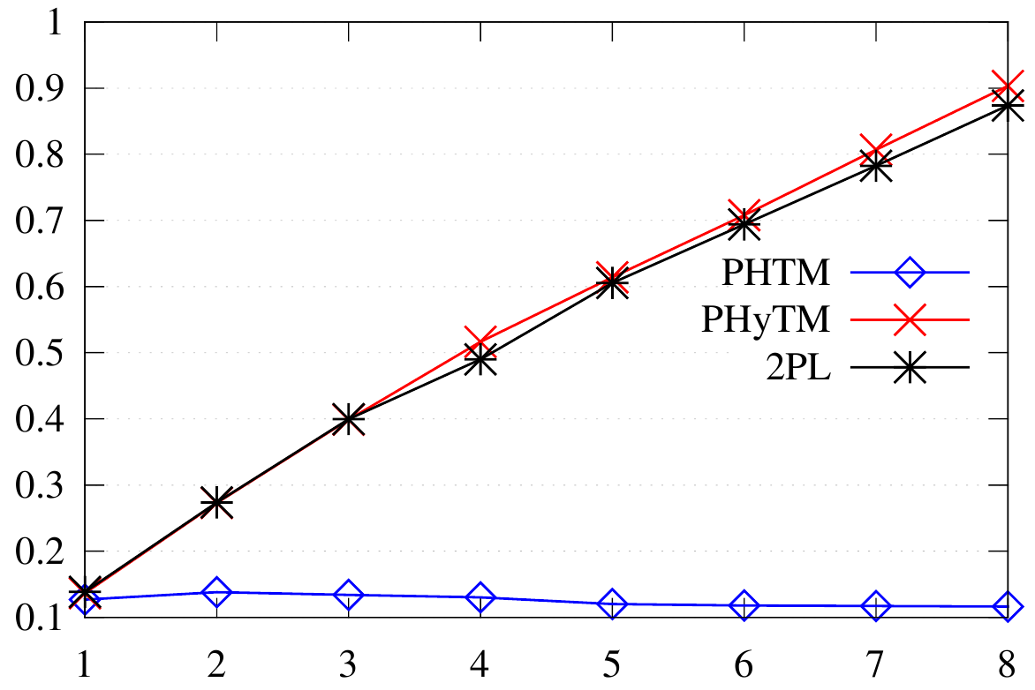
Transactions write 256 records
Operations per microsecond
Concurrent threads

Slide 26
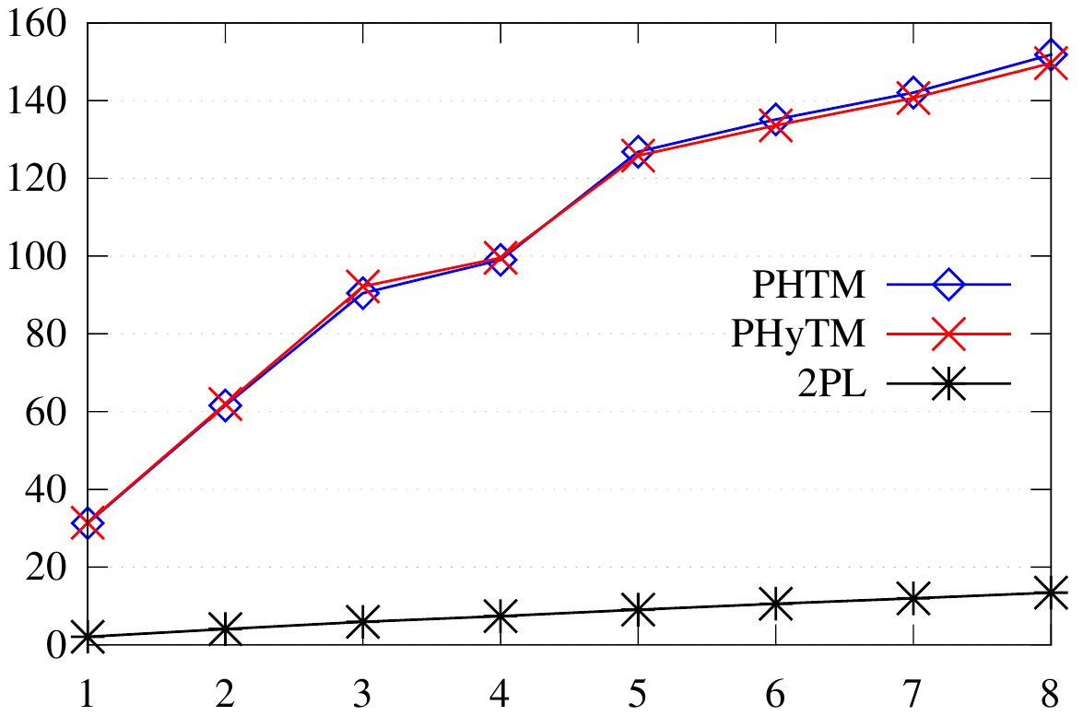
Transactions read 16 records
Operations per microsecond
Concurrent threads

Slide 27
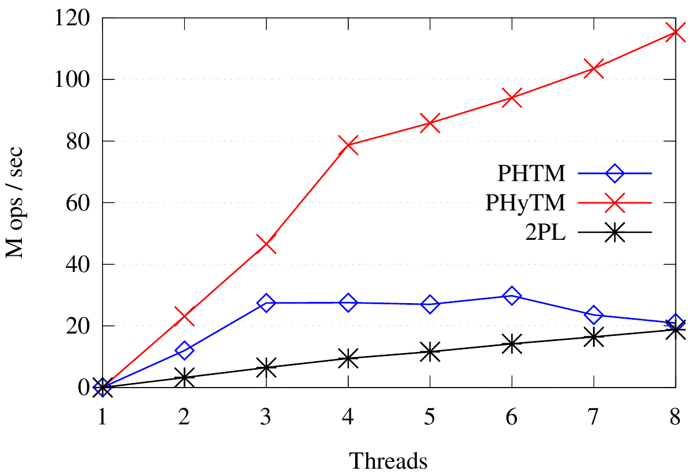
Thread 1: transactions read 256 records Other threads: short transactions
Operations per microsecond
Concurrent threads

Slide 28
Conclusion
We introduced PHyTM, the first hybrid TM for systems with NVM
PHyTM provides linearizable transactions and offers a high degree of concurrency
The biggest downside of PHyTM, the overhead of write instrumentation, is less significant with NVM because of the high cost of writes

