Slide 1
PHyTM: Persistent Hybrid Transactional Memory
Hillel Avni
Huawei
Trevor Brown
University of Toronto

Slide 2
Contents
HTM
Persistent HTM (PHTM)
Hybrid TM (HyTM)
Persistent HyTM (PHyTM)

Slide 3
Hardware Transactional Memory
Exploit native cache coherence
invalidation
consistency checking
rollback

Slide 4
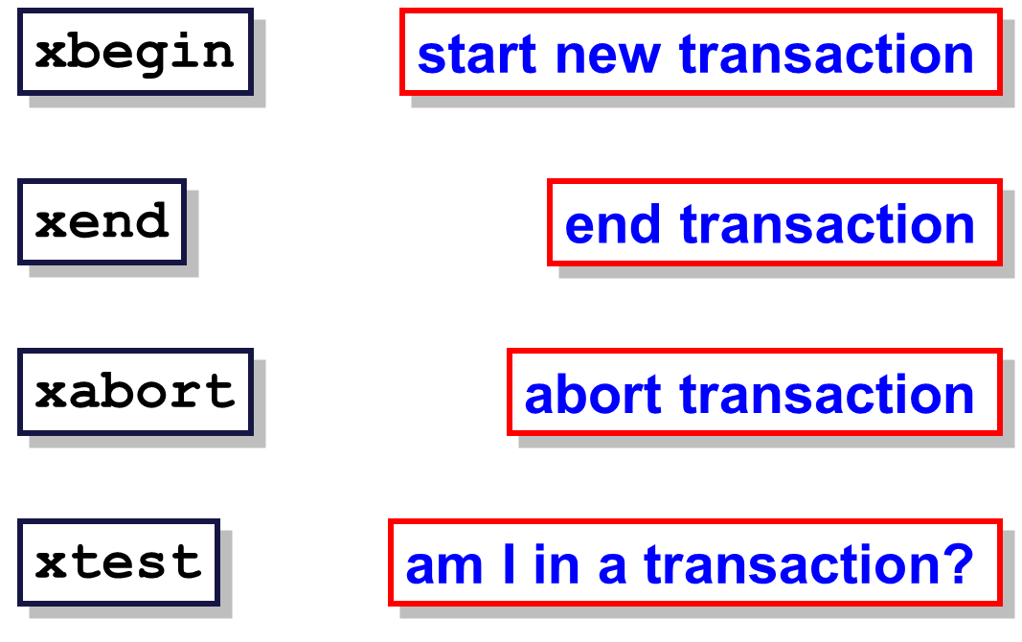
HTM in Intel x86 architecture

Slide 5
Contents
HTM
Persistent HTM (PHTM)
Hybrid TM (HyTM)
Persistent HyTM (PHyTM)

Slide 6
Persistent HTM (PHTM) in NVM
Nonvolatile memory (NVM) future:
Fast as DRAM
Size of a disk
Goal: ACID HTM transactions in NVM

Slide 7
Persistent HTM (PHTM) in NVM
Problem:
NVM will replace DDR but not L1 cache
HTM must work in L1 cache to be efficient
Solution:
Persistent HTM commit (DISC’15)

Slide 8
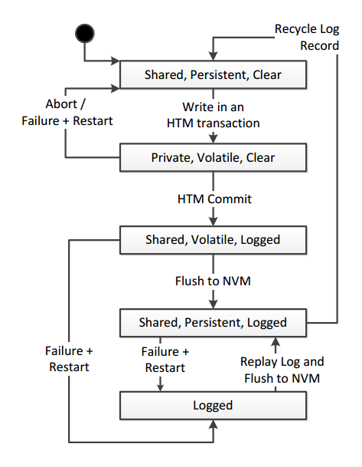
Commit and Log Simultaneously
Writing X in PHTM
No Live Transaction
T wrote X
X is committed and logged
HTM commits in volatile cache but log bit is set in NVM. Implies the new ISA - xend_log

Slide 9
Contents
HTM
Persistent HTM (PHTM)
Hybrid TM (HyTM)
Persistent HyTM (PHyTM)

Slide 10
HTM has a Problem
Good: Hardware Transactional Memory (HTM)
Bad: The HTM is “best-effort”
HTM may always fail due to (partial list):
L1 cache capacity
Interrupt
Unsupported instruction
To ensure progress, we need a software fallback

Slide 11
First Solution: Global Lock Fallback
Thread 1
Thread 2
1. HTM Start
1. HTM Start
2. Read lock and
check it is free
2. Read lock and
check it is free
3. ... code …
3. ... code …
4. HTM Commit
4. HTM Commit
No conflict –
HTMs commit concurrently

Slide 12
First Solution: Global Lock Fallback
Thread 1
Thread 2
Thread 3
1. HTM Start
Wait for Lock
1. HTM Start
Wait for Lock
1. HTM Start
1. Acquire Lock
2. Read lock and
check it is free
2. Read lock and
check it is free
2. Read lock and
check it is free
2. ... code …
4. ... CONFLICT …
HTM Restart
4. ... CONFLICT …
HTM Restart
3. ... code …
3. ... code …
3. ... code …
3. ... FAIL …
HTM Restart
3. Release Lock
No concurrency between hardware and software

Slide 13
First Solution: Global Lock Fallback
Good
Simple: No need to instrument reads and writes
Bad:
Serial fallback: A software fallback grabs the global lock and aborts all hardware transactions

Slide 14
Another Approach is: Hybrid TM
Thread 1
Thread 2
Thread 3
1. HTM Start
1. HTM Start
1. HTM Start
1. STM Start
2. Read lock and
check it is free
2. Read lock and
check it is free
2. Read lock and
check it is free
2. ... code …
3. ... code …
3. ... code …
3. ... code …
3. ... FAIL …
HTM Restart
3. … more code …
4. ... more code
4. ... more code …
STM and HTM execute concurrently

Slide 15
Another Approach is: Hybrid TM
Good
Hardware-Software Concurrency
Bad:
Complex:
Hard to coordinate hardware and software
Hard to apply to code due to instrumentation
Our focus
GCC C/C++ TM can help here

Slide 16
Contents
HTM
Persistent HTM (PHTM)
Hybrid TM (HyTM)
Persistent HyTM (PHyTM)

Slide 17
Persistent Software TM (PSTM)
Read: Lock and read
Write: Lock and buffer the write in NVM
Commit time:
Write back and flush (WB) the write-set
Release the locks

Slide 18
PHyTM Execution paths
Code can execute in three modes:
Fast PHTM: Only writes check the locks
Slow PHTM: Check locks for reads and writes
PSTM
Paths that can run concurrently:
Fast PHTM & PSTM (except WB)
Slow PHTM & PSTM (including WB)

Slide 19
PHyTM
Slow-PHTM
Fast-PHTM
Slow-Path Software: PSTM
Check WB existence
Lock X
Read y (pure)
Write X (Buffered)
Increment WB Count
ABORT
write back / Flush
Check y Lock
Unlock x
Read y
Check x Lock
Write x
xend_log
decrement WB Count

Slide 20
Experiments
Algorithms
PHyTM
PHTM
2PL from Yu et al. VLDB’14, with persistance
Workloads
YCSB
Long transactions that abort HTM
Short transactions that fit in L1

Slide 21
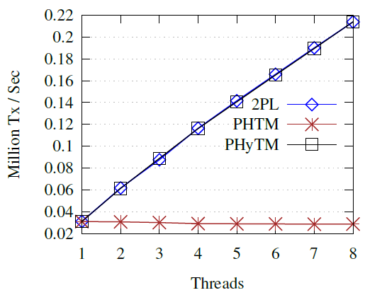
Long Transactions (256 reads)
PHyTM and
2PL are fast
PHTM is slow

Slide 22
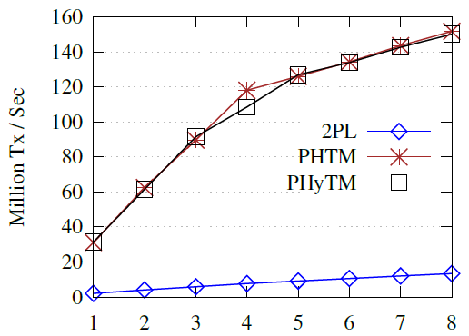
Short Transactions (16 reads)
PHyTM and
PHTM are fast
2PL is slow

Slide 23
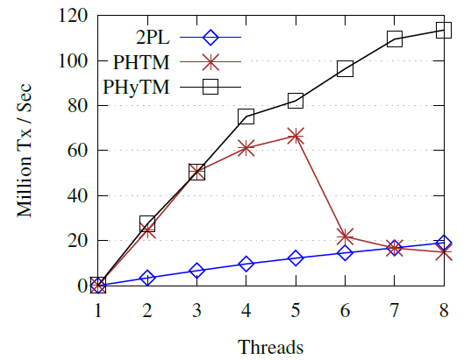
One Core Runs Long Transactions
PHyTM is fast
2PL and PHTM
are slow

Slide 24
Conclusion
PHyTM provides transactions with a high degree of concurrency and low overhead
When small transactions are common, PHyTM can improve the performance of synchronization and persistence

