Slide 1
PREP-UC: A practical Replicated Persistent Universal Construction
Gaetano Coccimiglio | Trevor Brown | Srivatsan Ravi

Slide 2
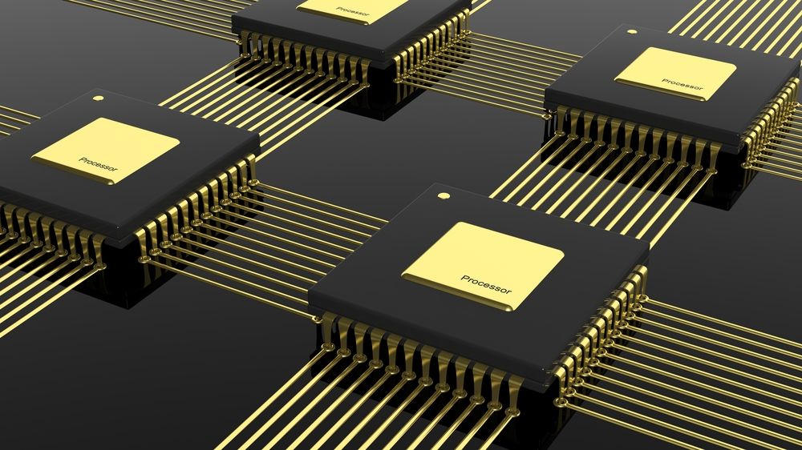
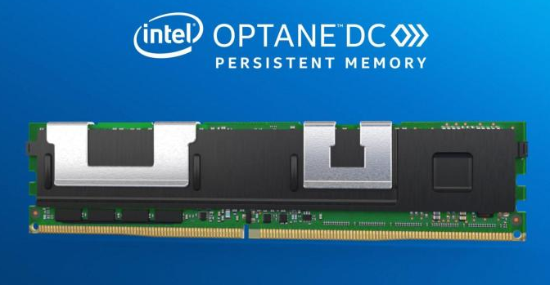
Problem
Concurrent data structures
For example, a set implemented with a search tree
E.g., serve as an in-memory database index
Or a priority queue
E.g., for work scheduling in graph algorithms
Accessible by many threads
Synchronization issues
NUMA effects
We want high performance
Also want persistence
After a power failure / crash, recover a consistent state
Notes:
pictures

Slide 3
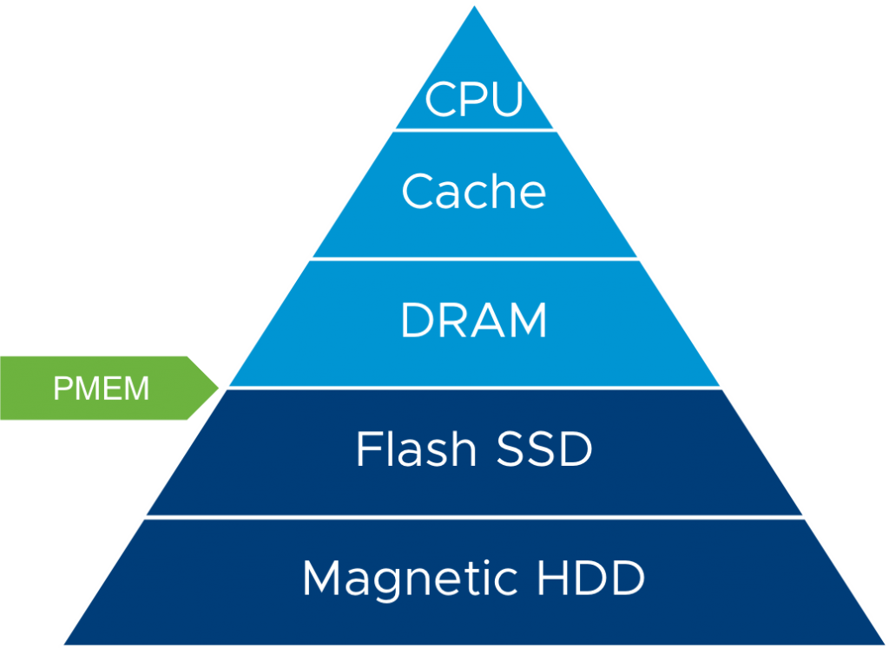
Setting
Volatile
Caveat: caches trending towards non-volatile…
NVRAM
Persistent

Slide 4
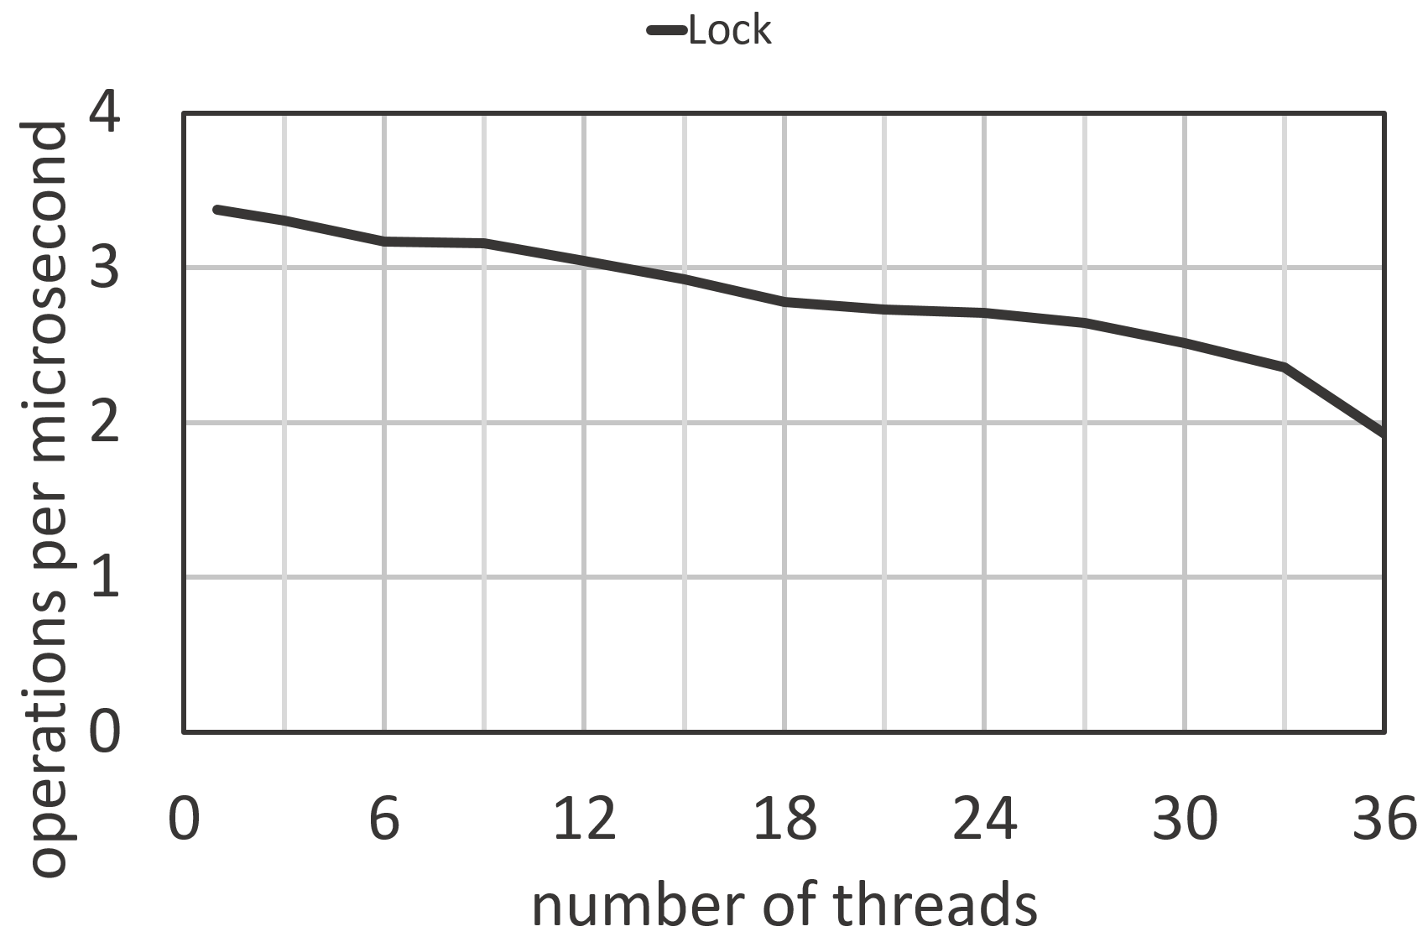
Concurrency is hard
Handcrafted data structures are complex – not always appropriate
Simple solutions tend to be slow
Example: simple kv-store
Binary search tree
Thread safety via global lock
Simple experiment: n threads perform searches for k seconds
Better alternative to global lock with similar effort?

Slide 5
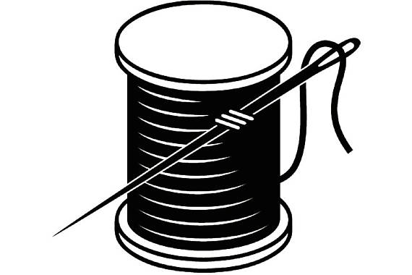
Automatic concurrency
Sequential object
Concurrent object
uc.execute(f(x))
f(x)
Universal Construction
uc.execute(f(x))
…
40
40
23
53
23
53
17
27
17
27
Notes:
Operation f(x)
Execute - function

Slide 6
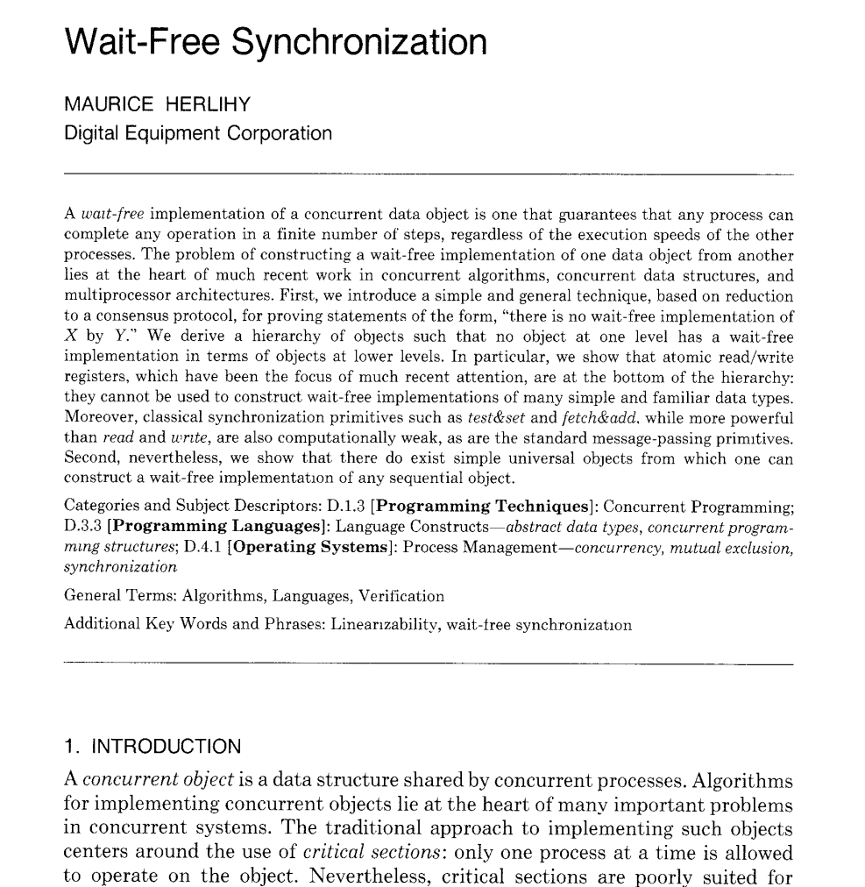
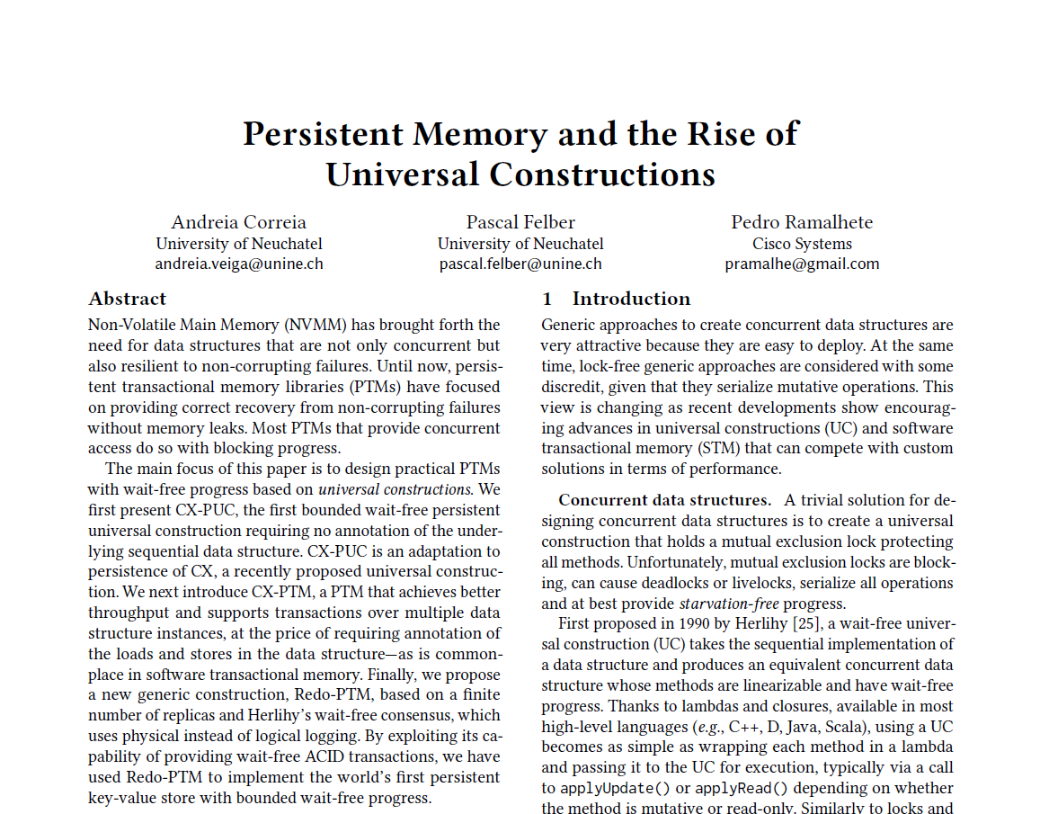
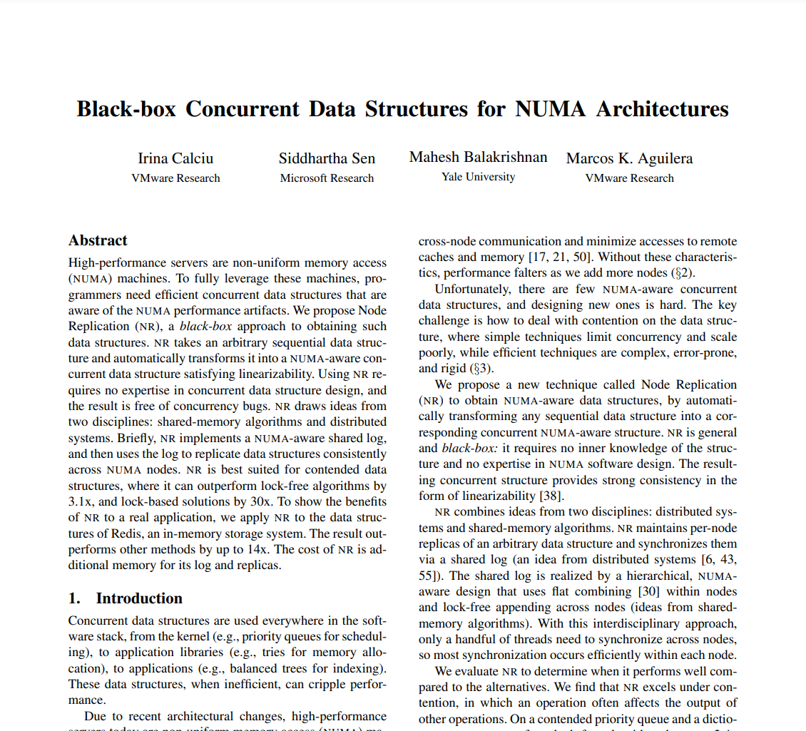
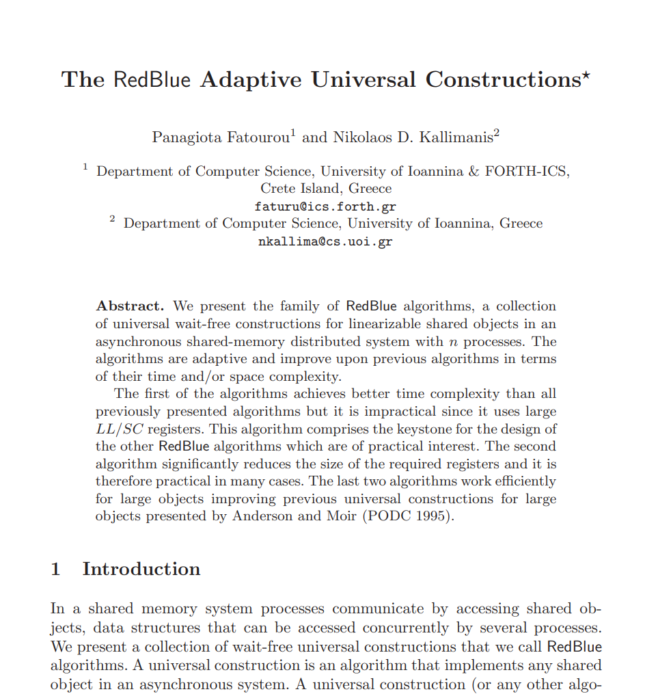
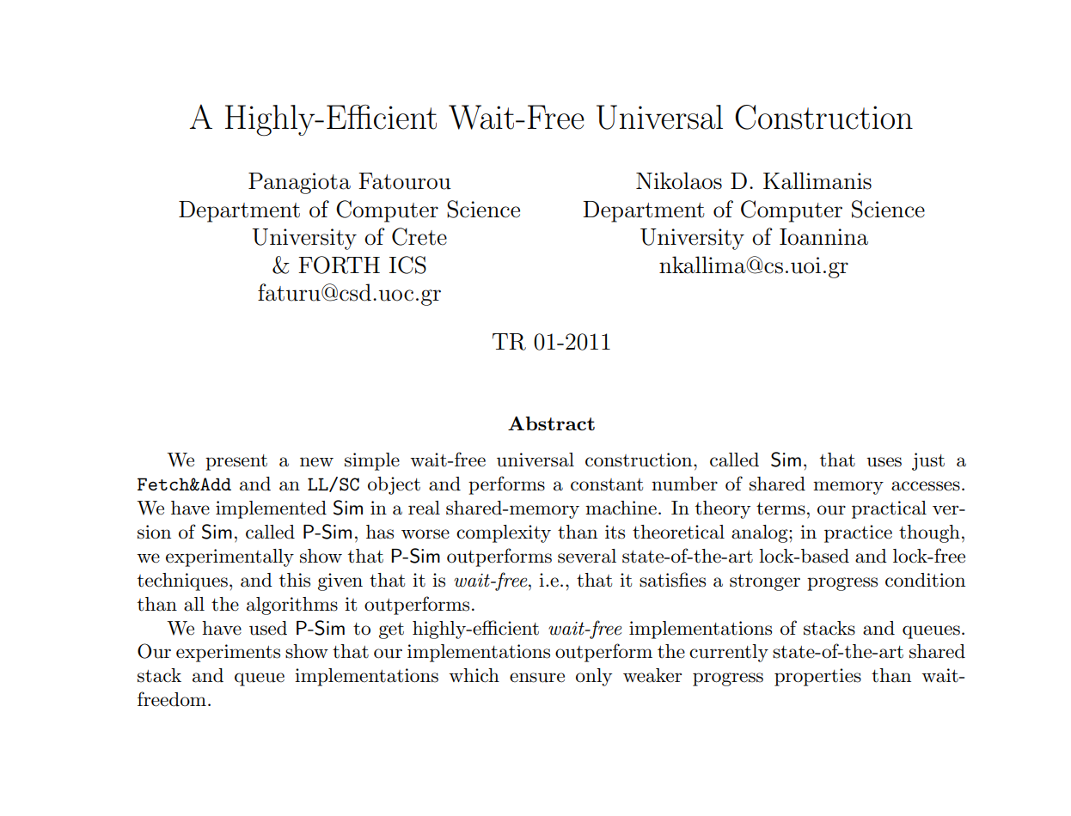
Prior universal constructions (UCs)
Non-persistent (1991)
Non-persistent (2017)
Persistent (2020)
Non-persistent (2001)
Non-persistent (2011)
“Node Replication (NR)”
UC of interest to the
systems community! (ASPLOS)
And many more… predominantly theory papers
“CX-PUC” is persistent!
But not as practical as NR…
Sequential object → UC → concurrent object
Sequential object → NR → NUMA aware concurrent object
Sequential object → CX-PUC → Persistent concurrent object
Goal: Sequential object → PUC → Persistent, NUMA-aware concurrent object
Notes:
Reinforce what persistent means

Slide 7
Our contribution
We developed two new solutions to this problem
Durable PREP-UC
Buffered PREP-UC
Both take a sequential object and produce a persistent, NUMA-aware, concurrent object
They differ only in their correctness guarantees
Both solutions are inspired by NR-UC

Slide 8
Background: Overview of NR
Replicas for each NUMA node and a global log
Write operations are logged then applied to the local replica
Other replicas apply these operations before their next operation
Local replica must be brought up to date before we modify it
Read operations bring the local replica up to date, then read it
Underlying object is not thread safe, so bringing the replica up to date is single-threaded
Optimize: log and apply a batch of operations at once
Insert(60)
Node A
Insert(40)
Node B
Insert(23)
40
Insert(53)
40
Insert(17)
Insert(27)
23
53
Insert(60)
23
53
Empty
Empty
17
27
60
...
Indicates how stale the replica is
Local Tail
Empty
Local Tail
Ops before this are logically completed
Completed Tail
Log Tail
Past this, log is empty

Slide 9
Update operations (Zooming in on node B)
While replica is W-locked
1. update replica
2. apply batch to replica
3. update local & completed tails
Global log
Operation
Retval
Node B batch (1 slot per thread)
Insert(40)
true
Node B replica
Insert(23)
true
Insert(53)
true
Slot 1
Local Tail
Insert(25)
40
Insert(17)
true
Insert(27)
true
Slot 2
Log Tail
Insert(60)
true
Completed Tail
Insert(50)
23
53
Empty
Insert(25)
true
Insert(50)
Empty
true
Slot 3
Delete(30)
17
27
50
60
Delete(30)
Empty
false
...
...
…
Empty
Threads can now get retvals
25
Slot n
WRITE-lock
Notes:
Before we apply the batch we bring the replica update to date
We can see the replica is stale, the local tail is behind the completed tail

Slide 10
Durable PREP-UC
Satisfies durable linearizability
When a crash / power failure occurs, can lose a subset of the operations that are in progress
Contents of NVRAM
Op is persisted here
Crash
5
Thread 1
Insert(5) → True
Insert(3) → True
In progress operation could be lost
3
10
Thread 2
Insert(10) → True
Insert(9)
Time
Notes:
In this example the insert of 9 of lost but its also possible that the insert of 9 was persisted before the crash

Slide 11
Buffered PREP-UC
Satisfies bounded buffered durable linearizability
When a crash / power failure occurs, can lose a bounded suffix of the history of operations
I.e., can lose the operations in some buffer (performed since the last checkpoint)
Contents of NVRAM
Buffer of previous ops is persisted
Crash
5
Thread 1
Insert(5) → True
Insert(3) → True
Insert(11) → True
3
10
Thread 2
Insert(10) → True
Insert(15) → True
Ops completed but are never persisted
Notes:
There is no buffer or checkpoint in the definition we just want to give some intuition

Slide 12
Overview of Buffered PREP-UC
Volatile replicas for each NUMA node, and a global log (as in NR)
Plus two persistent replicas
Essentially alternating checkpoints: one stable, one active
Periodically bring the active checkpoint up to date, then swap stable & active
Volatile data
Persistent data
Node A
Insert(40)
Node B
Insert(23)
Persistent replica 1
Persistent replica 2
40
Insert(53)
40
Insert(17)
Insert(27)
40
40
23
53
Insert(60)
23
53
Empty
Empty
23
53
23
53
17
27
60
...
Local Tail
Empty
Local Tail
Local Tail
Local Tail
Completed Tail
Log Tail

Slide 13
Why two persistent replicas?
We have no control over the underlying single threaded code!
Maybe it inserts into a list by doing:
Persistent replica
12
15
24
30
12
15
19
Local Tail
12
15
24
30
pred
19
curr
What if a crash occurs at this step while the persistent replica is being brought up to date?
Insert(19)
n
Temporarily unreachable!
Notes:
Recall the setting slide and asynchronous flushes

Slide 14
Updating & flushing persistent replicas
Updating: background thread continually updates the active replica
Flushing: whenever epsilon operations have been logged since the last checkpoint

Slide 15
Updating & flushing persistent replicas
Updating: background thread continually updates the active replica
Flushing: whenever epsilon operations have been logged since the last checkpoint
Insert(40)
Completed Tail
Contents of NVRAM
Stable Persistent Replica
Checkpoint Threshold
Insert(23)
Some volatile replica
Active Persistent Replica
Empty
Empty
Insert(53)
40
Empty
40
40
...
WBINVD
23
53
23
53
23
53
Empty
Completed Tail passed the threshold
Local Tail
Local Tail
Advance the checkpoint threshold
Active replica becomes stable
Time to checkpoint
Notes:
Introduce checkpoint threshold
Checkpoint threshold – says we have done epsilon operations since our last checkpoint
Motivate WBIND - don’t know what addresses are changed during updates in sequential object and therefore not clear what addresses to flush
But all addresses are in cache – special instruction WBINVD will flush the cache
Other ways to do this which we discuss in the paper but this is one reasonably efficient approach

Slide 16
Performance versus volatile UCs red-black tree, epsilon = 10k (1% of log)
90% Read-only (search), 5% insert, 5% delete
y-axis:
operations per second
Cost of persistence
Cost of persistence
Volatile PREP-UC (essentially our implementation of NR)
Naïve UC protecting a sequential object with a global lock
Much better than global lock
PREP-Durable
number of threads
PREP-Buffered
Notes:
Up is good

Slide 17
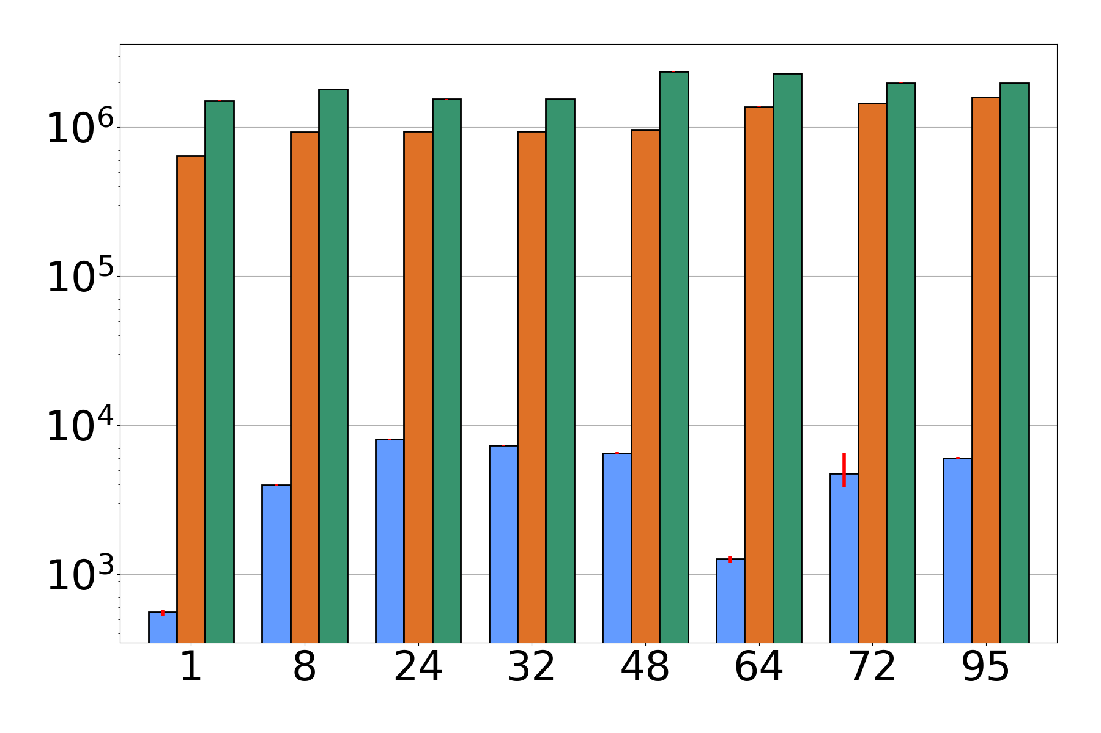
Performance vs persistent UCs red-black tree, epsilon = 10k (1% log size)
90% Read-only
CX-PUC
operations / sec
PREP-Buffered
PREP-Durable
number of threads

Slide 18
Performance vs handcrafted hashmap, epsilon = 10k (1% of log size)
90% Read-only
SOFT-10kB
SOFT-1kB
operations / sec
PREP-Buffered
PREP-Durable
number of threads
Notes:
We expect hand crafted algorithms to perform much better
8 threads would be a realistic thread count for common hardware

Slide 19
Conclusion
Introduced PREP-UC
Slower than handcrafted algorithms, but easy to use
Future work
Persistent software transactional memory
sequential object → PREP-UC → Persistent, NUMA-aware, concurrent object

Slide 20
Bonus slides

Slide 21
Read-only operations (Zooming in on node B)
Global log
Operation
Retval
Insert(40)
true
Threads on node B
Node B replica
Insert(23)
true
Insert(53)
true
40
Local Tail
Insert(17)
true
Search(27)
Insert(27)
true
53
Insert(60)
true
23
Empty
Insert(25)
true
Insert(50)
Empty
true
Search(30)
17
27
50
60
Completed Tail
Delete(30)
Empty
false
...
...
Empty
Local Tail == Completed Tail already!
25
Can search in parallel!
READ-lock

Slide 22
Buffered PREP-UC interface
std::function must accept a pointer to the sequential data structure since we need to apply the op to multiple replicas
std::function
wrapper
Sequential
method
User specifies if the op is read-only
Entry point to PREP-UC

Slide 23
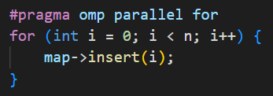
Trivial usage example
Sequential Inserts
(Broken) OpenMP parallel for
Mostly-automatic persistence and parallelism!
Guarantee: a bounded suffix of insertions can be lost (buffer size chosen by you)

Slide 24
Durable PREP-UC
Key difference: persist the log in addition to the persistent replicas
All logged operations are recovered after a crash / power failure
Persisting the log necessitates additional flushing and fencing
Also requires slight interface change (since std::function is not serializable)
Volatile data
Persistent data
Volatile data
Persistent data
Node A
Insert(40)
Node B
Persistent replica 1
Persistent replica 2
Insert(23)
40
Insert(53)
40
Insert(17)
23
53
Insert(27)
23
53
40
40
Insert(60)
Empty
Empty
23
53
23
53
17
27
60
...
Local Tail
Empty
Local Tail
Local Tail
Local Tail
Completed Tail

Slide 25
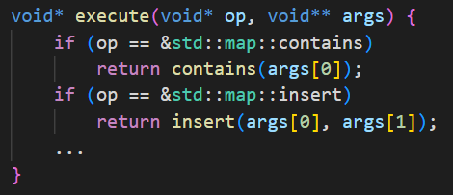
Durable PREP-UC interface
Cannot persist std::function (non-serializable) so we use function pointers
User must create Execute method to map function pointers to calls
We persist offset of function from the main function
This means no dynamic loaded functions

Slide 26
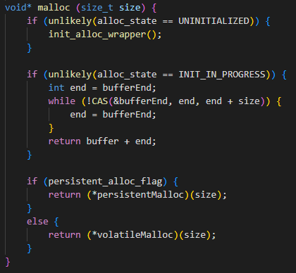
Memory Allocation
Need two allocators: persistent malloc and volatile malloc
Idea: hook malloc
call appropriate allocator based on whether we are currently executing on a volatile or persistent replica
malloc hook
Need a simple allocator to use while initializing (dlsym allocates)
NVRAM allocation
DRAM allocation

Slide 27
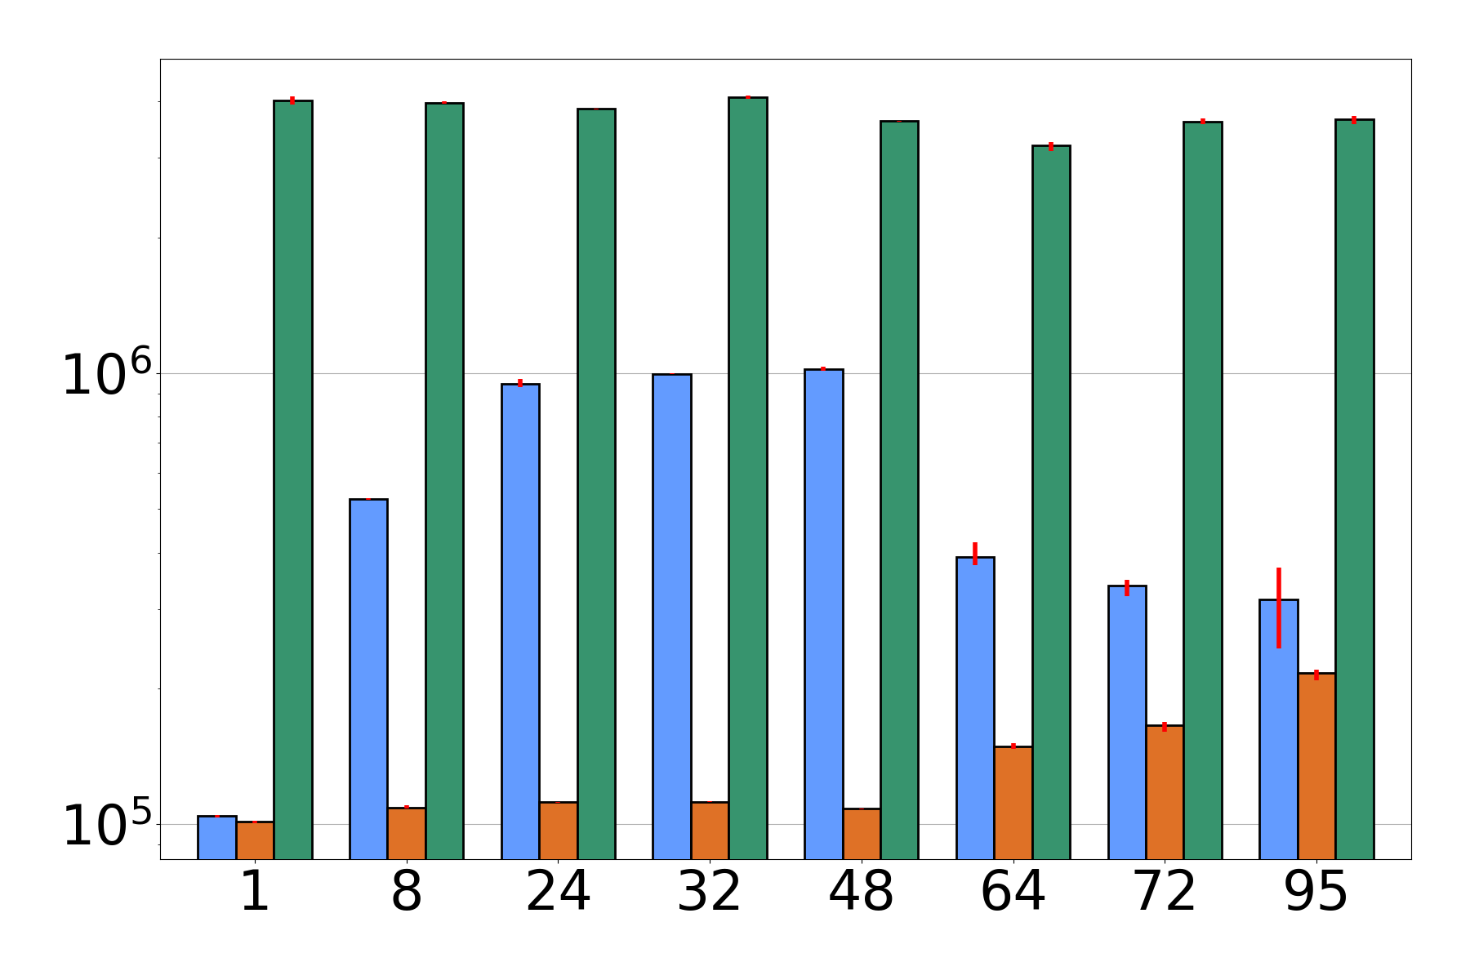
Performance vs persistent UCs stack, epsilon = 10k (1% of log size)
100% updates where workers perform pairs of push and pop operations
CX-PUC
operations / sec
PREP-Buffered
number of threads
PREP-Durable
number of threads
Average 500 items
Average 500,000 items

Slide 28
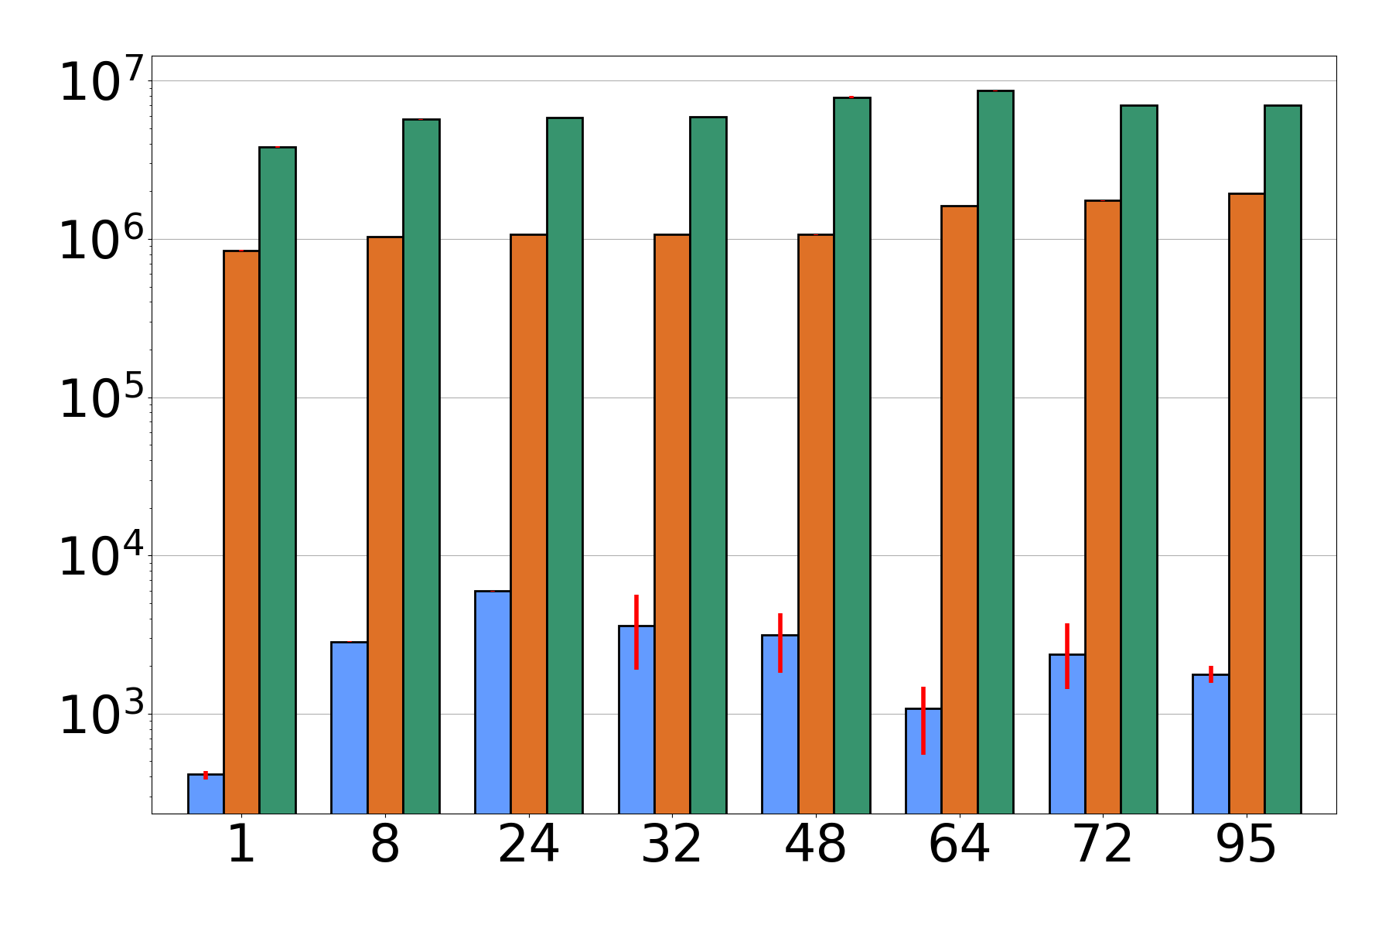
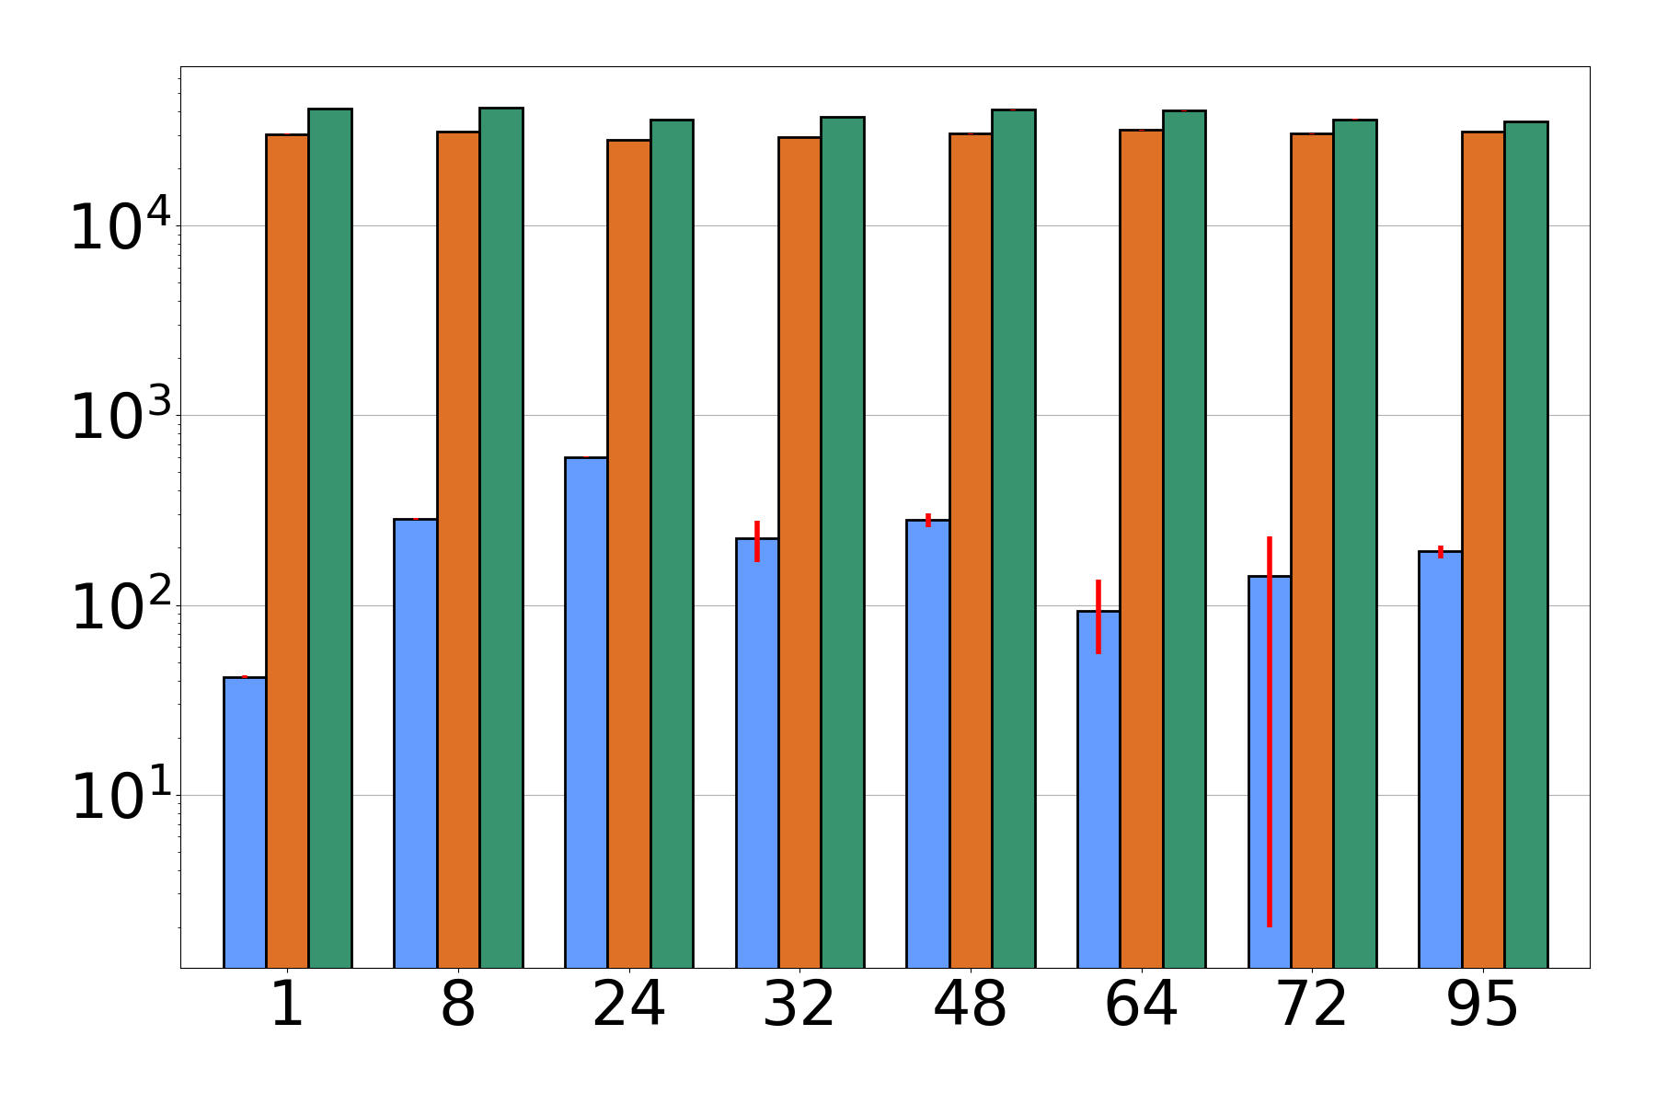
Performance vs persistent UCs hashmap, epsilon = 100 (0.01% log size)
90% Read-only
1% Read-only
CX-PUC
PREP-Buffered
operations / sec
PREP-Durable
number of threads
number of threads

Slide 29
Prior universal constructions (UCs)
Non-persistent (1991)
Non-persistent (2009)
“CX-PUC” is persistent! (2020)
But not as practical as NR…
Non-persistent (2011)
Non-persistent (2017)
And many more… predominantly theory papers
Sequential object → CX-PUC → Persistent concurrent object
largely ignoring systems concerns like NUMA effects
“Node Replication (NR)”
A universal construction of interest to the systems community! (ASPLOS)
Sequential object → UC → concurrent object
Sequential object → NR → NUMA aware concurrent object
Goal: Sequential object → PUC → Persistent, NUMA-aware concurrent object
Notes:
Related topic: transactional memory

