Slide 1
Memory Tagging
Minimalist Synchronization for Scalable Concurrent Data Structures
Dan Alistarh
IST Austria
Trevor Brown
University of Waterloo
Nandini Singhal
IST Austria

Slide 2
Motivation
What is the minimal amount of synchronization needed for correct and efficient search data structures?
Several answers from the literature
Fine-grained locking
Fine-grained lock-free data structures (e.g. Harris-Michael marking, Natarajan-Mittal BST, Balanced BSTs)
HTM, HyTM
Here: we revisit this question from a hybrid software-hardware perspective.

Slide 3
Basic Example: A Linked List
The Harris-Michael lock-free list design
Challenge: prevent insertion after removed nodes
Solution: marking of logically deleted nodes
Mark C as logically deleted.
Swing pointer.
P: delete(C)
A
B
C
E
Marking is an elegant solution to two problems: a marked node is logically deleted, and no further nodes can be inserted after it.
D
Insertion after logically deleted node will fail.
Q: insert(D)
But is marking “synchronization-optimal”?

Slide 4
Basic Example: The Failed Insert
Q reads C.next, bringing the cache line in L1
P modifies C.next, invalidating Q’s copy
Q unsuccessfully attempts to update C.next
This still causes cache traffic!
P: delete(C)
Mark C.next via CAS
This extra cache traffic by Q is unnecessary: Q’s cache “knows” that the line is invalid, and the operation could fail immediately.
A
B
C
E
D
Q: insert(D)
What if we could leverage this information?
Read C.next
CAS( C.next, E, D ) ← Fails!

Slide 5
Memory Tags
“Mark” memory locations during a data structure traversal, and to check later whether that they’ve been invalidated
AddTag( & node, size ) and RemoveTag( & node )
Validate&Swap(): validates all tags; if successful, atomically changes the value of a single location
Invalidate&Swap():
Validates all the thread’s local tags
If successful, it invalidates tags at given locations all other cores
Finally, it may update the value of a single tagged location
Tags can be implemented on top of L1 cache.
Why useful?
Simple answer: Tagging can implement efficient marking.
Interesting answer: A new hand-over-hand tagging technique.

Slide 6
Why Useful?
“Easy” answer: Tagging can replace marking
Interesting answer: Hand-over-hand tagging
Readers take tags on nodes they traverse, and drop old ones
Writers invalidate all tags on nodes they update
P: delete(C)
A
B
C
E
HoH Tagging notes:
Remote invalidation is critical for correctness
Readers do not write, and can overtake eachother
Failing is done locally
D
Q: insert(D)
Read C.next
CAS( C.next, E, D )
Can we generalize this pattern?

Slide 7
Application: tagged (a,b)-tree
Goal: use MemTags to accelerate a state-of-the-art search tree
(a,b)-tree as an example
Generalization of a B+tree
When there are no ongoing updates
Non-root nodes contain between a and b keys
All leaves at same depth
(These invariants can be violated during updates)

Slide 8
Reference implementation we build upon
We transform an LLX/SCX-based implementation to use MemTags as a fast path (LLX/SCX slow path)
What are LLX and SCX?
LLX(node) returns a snapshot of node
SCX (atomically):
changes one pointer,
finalizes a set of nodes (preventing further changes, similar to marking)
only if no node has changed since its LLX

Slide 9
LLX/SCX-based (a,b)-tree insertion
2. LLX(p)
Insert(c)
i
r
p
3. LLX(n)
b
b
d
d
e
e
f
f
g
g
h
1. Find node n to modify and its parent p
h
n
i
j
k
l
m
n
o
p
s
t
v
x
y
z
b
c
d
e
f
g
h
4. If either p or x is deleted (finalized), retry from step #1
5. use data read by LLXs to create a new leaf containing old keys + {c}
6. SCX to finalize n and replace it
Deletion is very similar

Slide 10
LLX/SCX-based (a,b)-tree insertion
What if the node is already full?
Leaves at different depths! Rebalance to fix this.
Insert(q)
LLX(p)
LLX(n)
p
i
r
SCX
i
j
k
l
m
n
o
p
n
n
i
j
k
l
m
n
o
p
s
t
v
x
y
z
i
j
k
l
m
n
o
p
q
create two new leaves and a singleton parent

Slide 11
Rebalancing is similar
Rebalancing example: Absorb-Sibling operation
Basic design pattern:
change one pointer and replace one or more nodes
…
gp
i
r
s
i
r
p
b
d
i
j
k
b
d
i
j
k
s
t
v
x
y
z
n
b
d
sib
i
j
k
Applies when: a node and its sibling could be combined

Slide 12
Replacing LLX/SCX with MemTags
LLX returns a snapshot of a node
Easily replicated by tagging a node before reading it
SCX changes one pointer and finalizes nodes
Replicating the capability to finalize nodes is subtle
Existing implementation of SCX uses marking to implement finalizing, and atomically sets marks
If we use marking, must VAS/IAS to set each mark – inefficient!!
If we do not, how can we tell whether a node is deleted?

Slide 13
Tagged (a,b)-tree: insertion
Naïve approach: tag all nodes on a path, and replace SCX with VAS
…
ROOT
If VAS succeeds, then no deletion has occurred on this path!
…
Thread P: Insert(c)
…
Full path tagging makes marking unnecessary!
VAS
i
r
…
p
…
b
d
e
f
g
h
n
i
j
k
l
m
n
o
p
s
t
v
x
y
z
b
c
d
e
f
g
h
Problems: susceptible to contention on entire path

Slide 14
Hand-over-hand tagging with VAS
Could we untag some nodes before our final VAS?
An (a,b)-tree operation that modifies a node might delete its children or grandchildren
But, no (a,b)-tree operation deletes a great grandchild
So when a node is deleted, its parent or grandparent must change
Idea: detect node deletion by tagging these nodes
maintain tags on the last three nodes traversed
validate() each time we tag() a new node
Does this work?

Slide 15
Hand-over-hand tagging with VAS
Counter-example: Suppose thread P does Insert(a)
Q: Absorb-Sibling does VAS
… replacing these nodes (without modifying them)
P: validate
…
ROOT
P: validate
…
…
…
P: validate
…
…
real
gp
…
gp
P: validate
n has a new grandparent…
Which is not tagged!
P sleeps just before its VAS on this pointer
i
r
…
p
…
P’s tagging can now miss changes to the real gp. So, it can no longer detect the deletion of n, p or gp!
P: validate
b
d
e
n
i
j
s
t
v
x
y
z
a
b
d
e

Slide 16
Hand-over-hand tagging with VAS
Counter-example: Suppose thread P does Insert(a)
Now, suppose Q does another Absorb-Sibling, and changes this pointer with VAS
…
ROOT
…
…
…
…
…
real
gp
…
gp
P’s VAS will succeed!
Insertion into a deleted part of the tree!
P sleeps just before its VAS on this pointer
i
r
…
p
…
…
b
b
d
d
e
e
…
n
i
j
s
t
v
x
y
z
a
b
d
e

Slide 17
Invalidate-and-swap to the rescue
Replacing VAS with IAS solves this problem
Q: Absorb-Sibling does IAS
… invalidating these nodes!
…
ROOT
…
…
…
…
gp
P’s IAS is now doomed to fail
P sleeps just before its IAS on this pointer
i
r
…
p
…
b
d
e
n
i
j
s
t
v
x
y
z

Slide 18
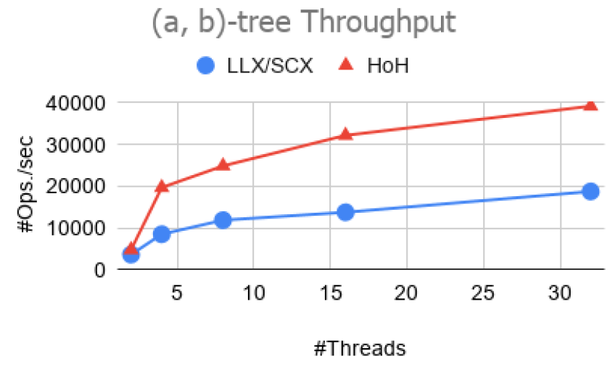
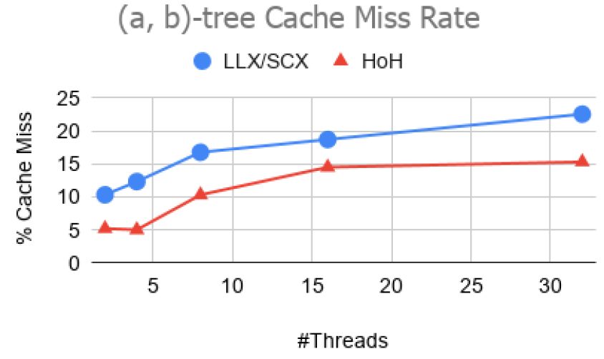
Experimental results
Graphite multi-core simulator
32 cores, each w/32KB L1, shared L2, MESI
MemTags implemented in L1 cache
35% Insert, 35% Delete, 30% Search

Slide 19
Conclusion
MemTags: a hardware proposal for better concurrent data structure designs
Hand-over-hand tagging can replace marking / finalizing
Tagging can improve performance: +30% for the NOrec software transactional memory +100% for the (a,b)-tree +20% for linked list
Tagging can also support simpler designs (e.g., with a global locking slow path, like lock elision)

